Slide 1
WELCOME to UMBC ASME
American Society of Mechanical Engineers
GBM #1 (Fall 2019)

Slide 2
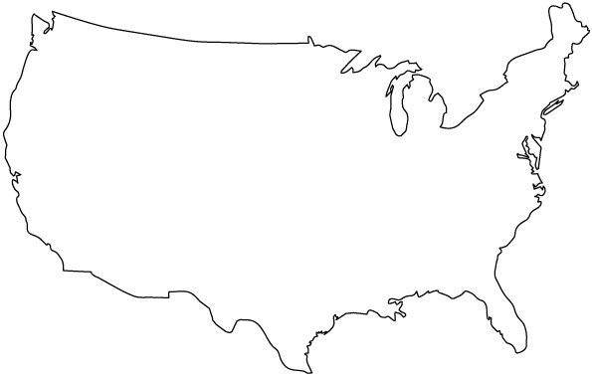
What is ASME?
ASME Baltimore
UMBC ASME
Founded in 1880
National Not-for-profit Organization
Mission Statement:
“To serve diverse global communities by advancing, disseminating and applying engineering knowledge for improving the quality of life; and communicating the excitement of engineering”
140,000+ Members in 158 Countries
Dedicated to outreach, education, training, advocacy, philanthropy
Official student membership is 25$
NOT REQUIRED

Slide 3
What Do We Do?
Outreach
Let’s Get Techy
Public Schools
Professional Develop.
Workshops
Speakers
Project
Remote Controlled Hovercraft
Socials
Mentoring
Design Challenges
Fundraising
Bake Sales
Food food food food food food food

Slide 4
Who is UMBC ASME?
Officer Introductions!

Slide 5
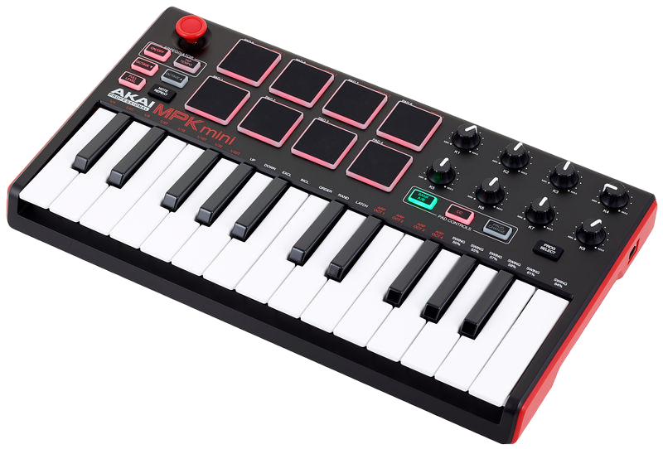
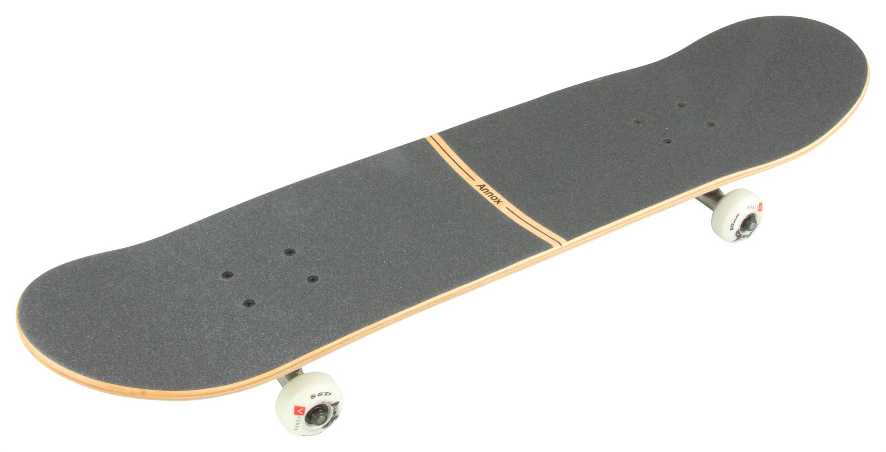
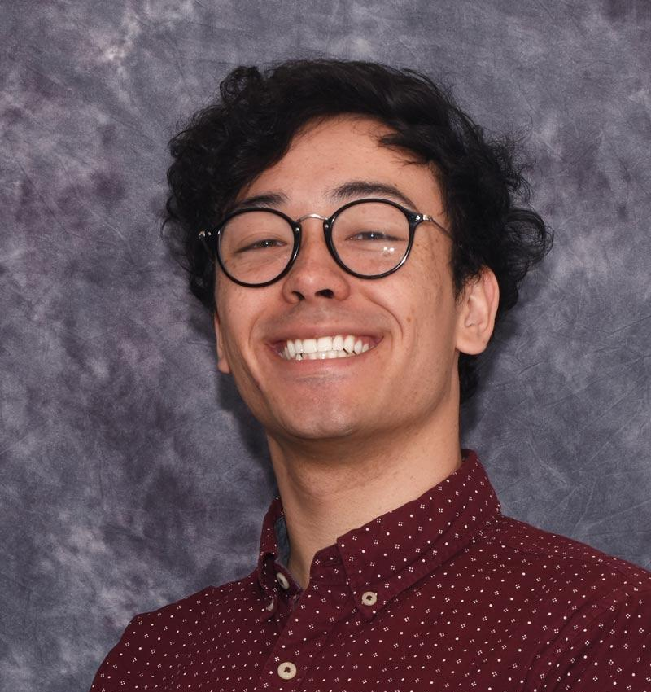
President
From Pasadena, MD
MechE major, (Comp Sci and Entrepreneurship minors)
Senior
Currently:
Taking CompE Capstone
Working in Dr. Soobum Lee’s Lab
Applying to Grad Schools
Playing Minecraft...

Slide 6
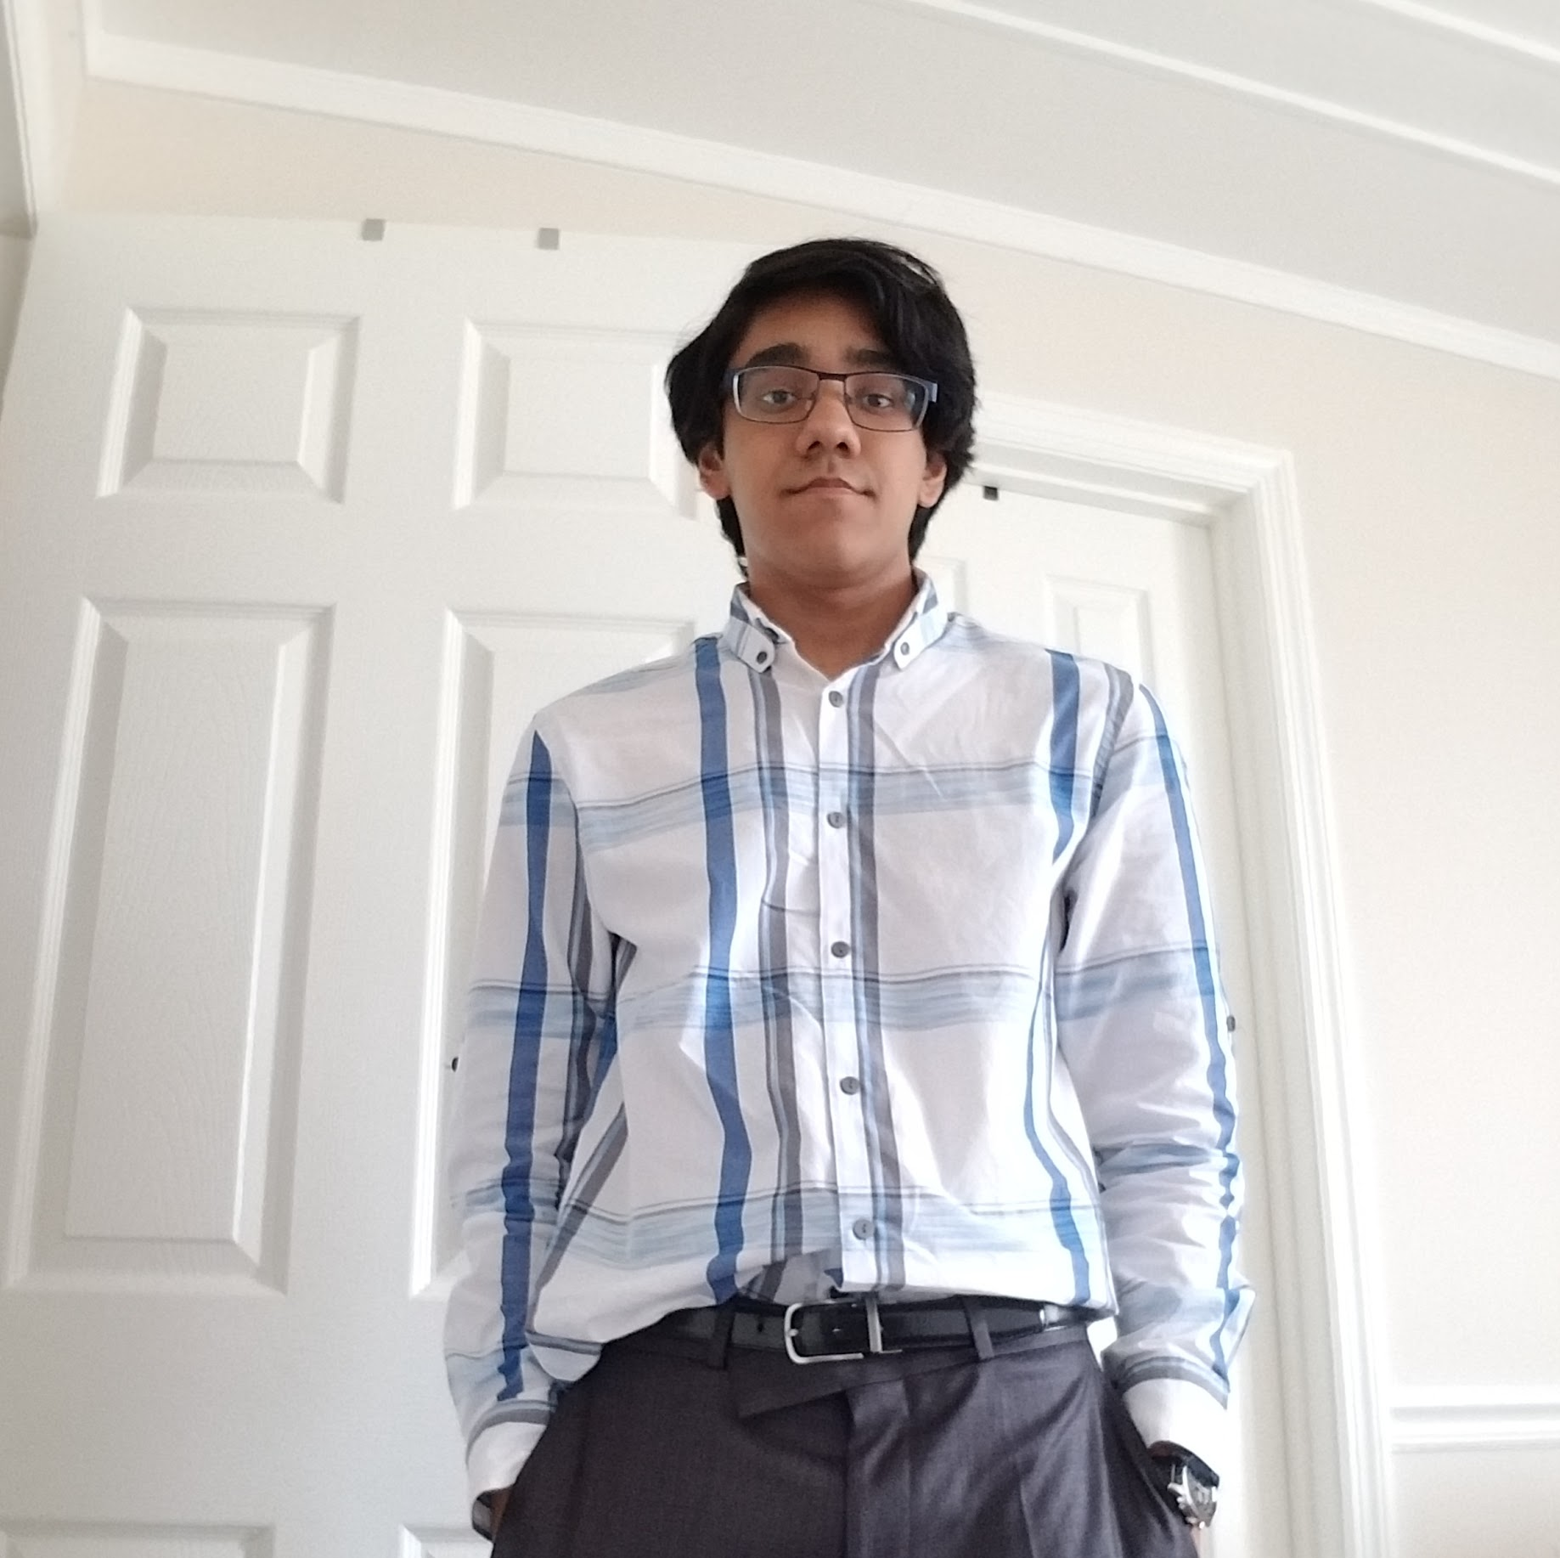
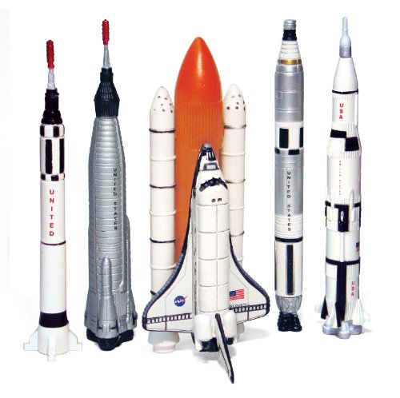
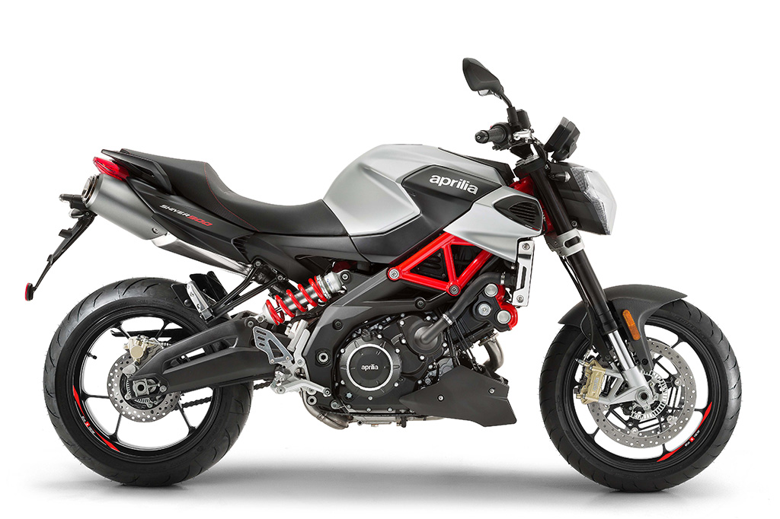
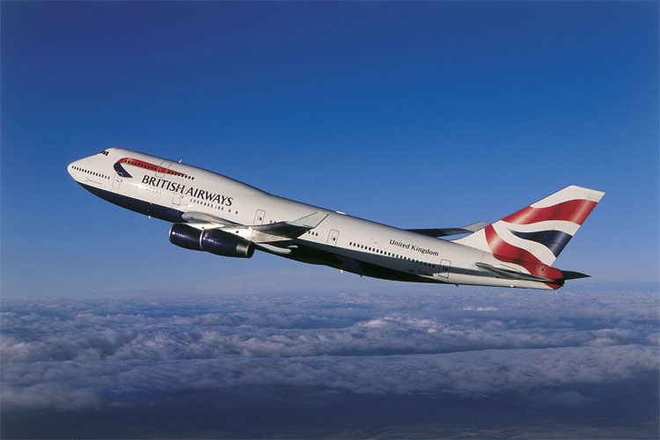
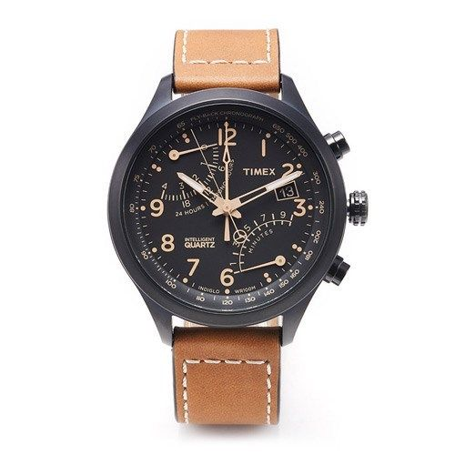
Vice President
Sal Aslam
From Baltimore, MD
MECHE, Math (minor)
Senior
Interned at The Aerospace Corp.
I like Chipotle…. alot

Slide 7
Secretary
(SENIOR)

Slide 8
Treasurer
Sanjay Mysore
From Clarksville, MD
Junior in Mechanical Engineering
Sanjay Mysore
From Columbia, MD
Senior Mechanical Engineering Major

Slide 9
ME Mentoring

Slide 10
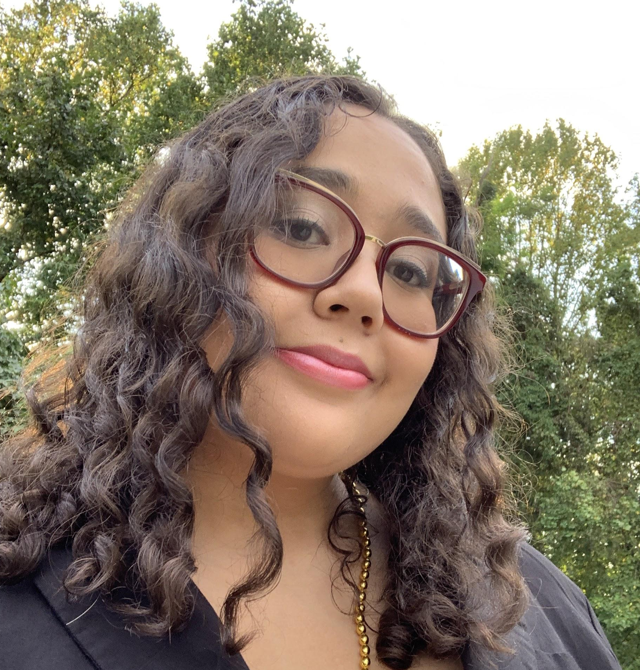
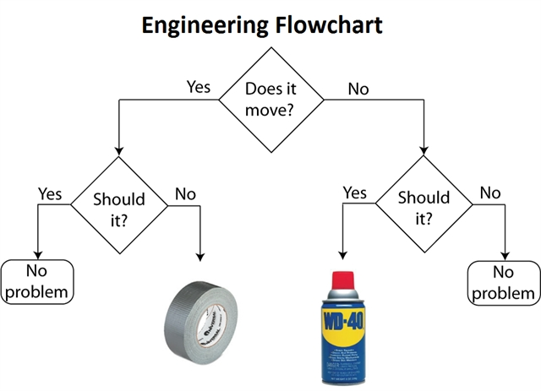
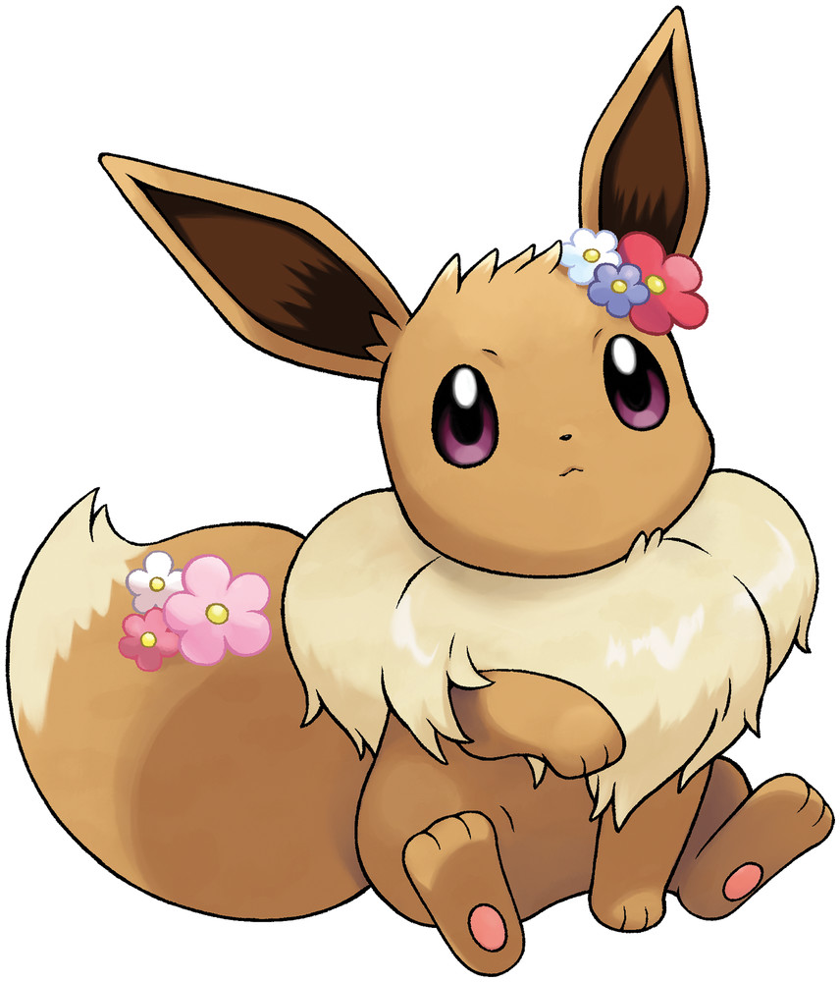
Social Chair
Jasmyn Frazier
From Capitol Heights, MD (Near DC)
MechE Major
Junior
Grand Challenges Scholar
CWIT Peer Mentor Co-Lead
I love memes & puzzles

Slide 11
Project Manager
Nathan Hartley
From Frederick, MD
Junior Mechanical Engineering
Intern at Performance Controls
Hovercraft lead

Slide 12
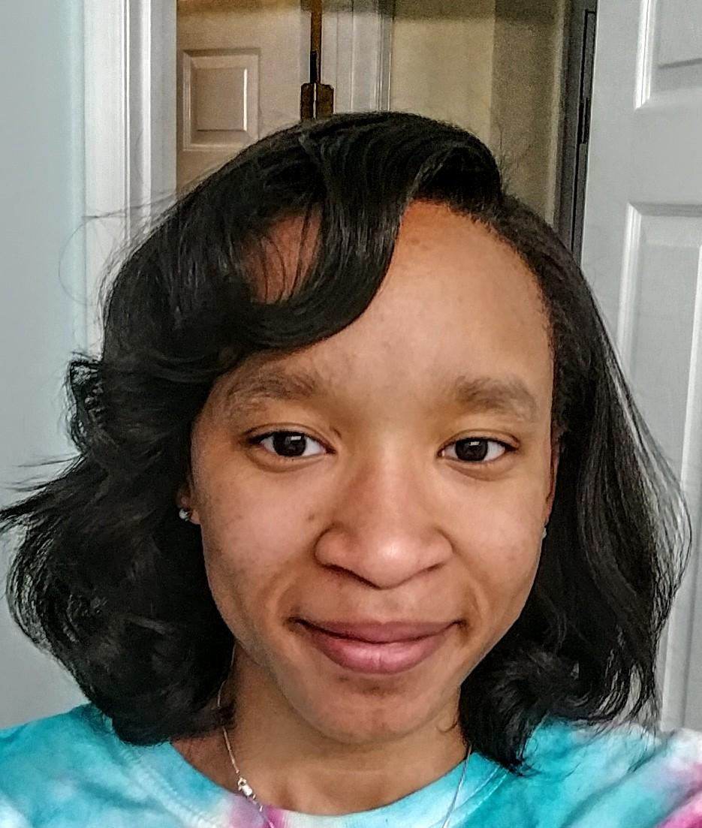
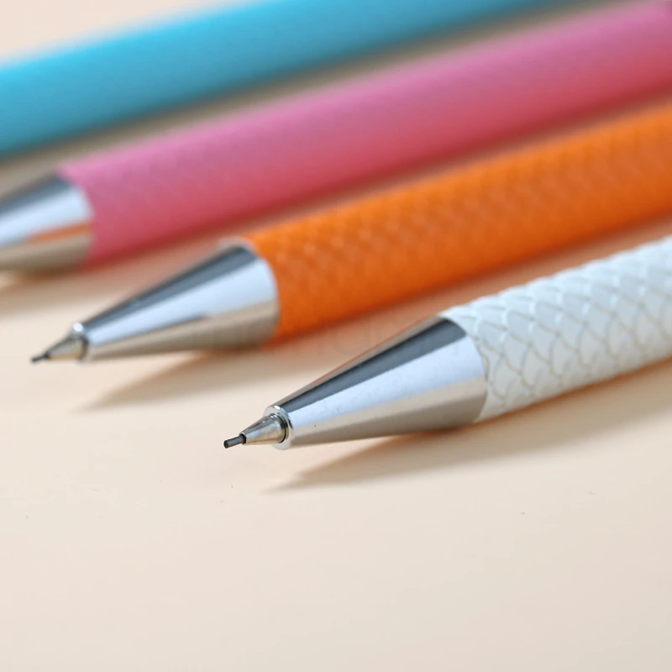
Historian
Jocelyn Wilkins
Senior,MechE major
From Upper Marlboro, MD
I love office supplies (especially mechanical pencils)
Over the summer I had a co-op at NASA Goddard

Slide 13
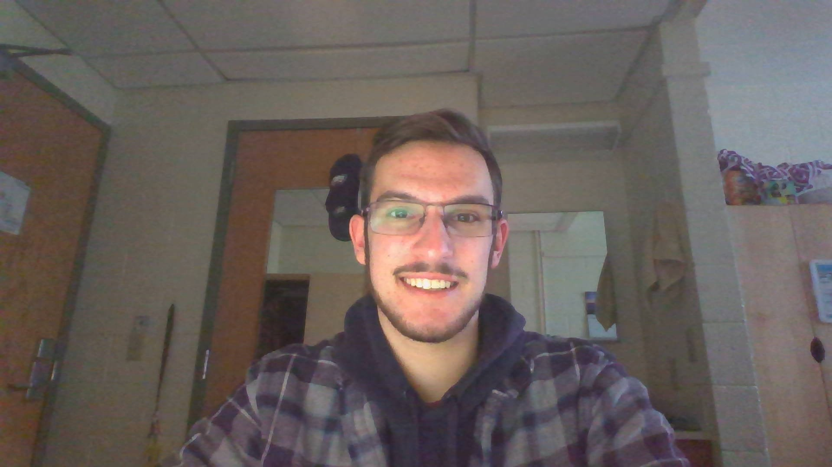
Sophomore Chair
Joe Fleming
Sophomore (obviously?)
MechE Major
Economics Minor
From North East, MD
Cecil County
Worked as a grocery store stocker for around 2 years
Looking for an internship
I love anything cars
I have underglow on my soccer mom SUV
Raised an Eagles fan
Became addicted to minecraft over the summer with my girlfriend

Slide 14
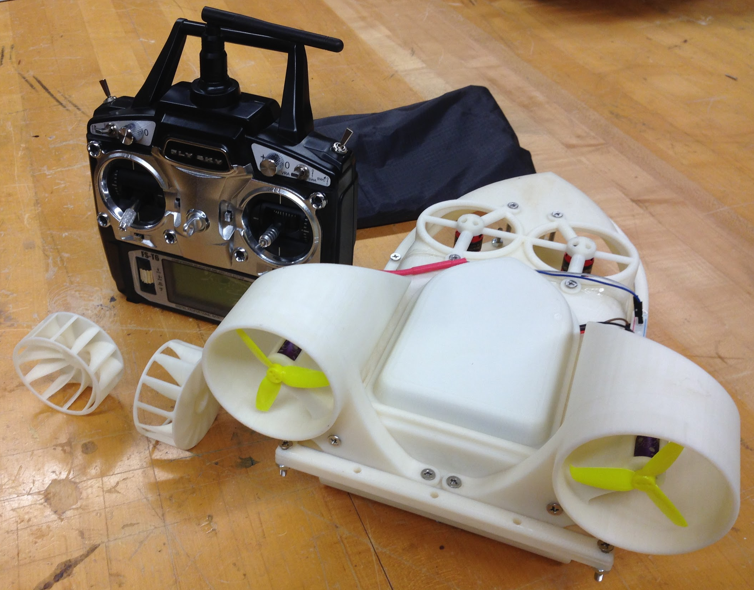
RC Hovercraft

Slide 15
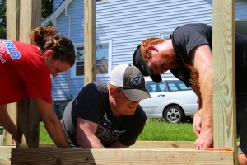
ME Mentoring Program
Are you a mechanical engineering undergraduate freshman/sophomore student looking for some guidance on courses, extracurricular activities, or campus life in general?
We need mentees!
ASME will be hosting a MODEL ME mentoring social soon.
Notes:
The M.O.D.E.L ME Mentoring Program is starting back up which means we are looking for Mechanical Engineering students interested in either being a Mentor or a Mentee. More information about this program can be found on the UMBC Mechanical Engineering page.
Below are the two applications for being either a Mentor or a Mentee.
Any grade level is eligible to be a Mentee. Freshman and Sophomore level is common.
To apply to be a mentee please fill out the Mentee Application
If you are a Junior, Senior, or Super Senior you are eligible to be a Mentor.
To apply to be a mentor please fill out the Mentor Application

Slide 16
Membership System

Slide 17
Non-Member
Requirements
Benefits
None
Can come to GBMs
Can come to volunteer opportunities
Can participate in events/socials
Can be Model ME Mentor/Mentee
Can attend project meetings

Slide 18
Standard Member
Requirements
Benefits
Must come to 1 GBM a month
Must perform 2 hours of involvement
All benefits of non-members
Able to Put “ASME Member (UMBC Student Branch)” on their resume
Receive Discount on Shirts

Slide 19
Official ASME Student Member
Requirements
Benefits
Purchase membership
Actual ASME benefits including networking with ASME Baltimore, Subscription to monthly magazine “Mechanical Engineering”, … stickers

Slide 20
Project Team Member
Requirements
Benefits
Must come to 1 GBM a month
Must perform 1 hour of involvement
Must attend > half of project meetings
Same benefits as Standard Member
Can put “ASME [insert project name here] Team Member” on resume

Slide 21
Graduating Senior
Requirements
Benefits
Same req as Standard Member
Must do 4 involvement hours that academic year
All benefits of Standard Member
Receive Cord Upon Graduation

Slide 22
Eboard Member
Requirements
Benefits
Must attend weekly eboard meetings
Must plan at least 1 GBM
Must fulfill duties specific to their role
All benefits of Graduating Senior (if graduating)
Receive Stole upon graduation
Can put their eboard position on their resume

Slide 23
GBM Dates
9/18
10/2
10/16
10/30
11/13
12/4
Professional
Design Challenge
Professional
Design Challenge
Professional
Design Challenge
Career Fest Prep
Cup Stacking Claw
Schedule Classes
Candy Catapult
Python Coding
Ornament Drop

Slide 24
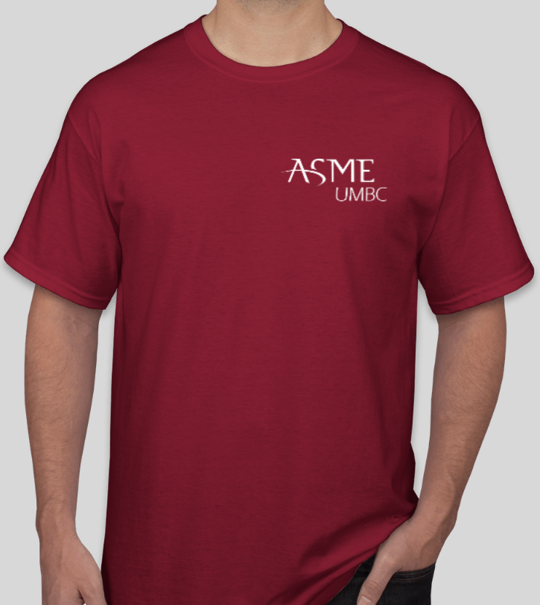
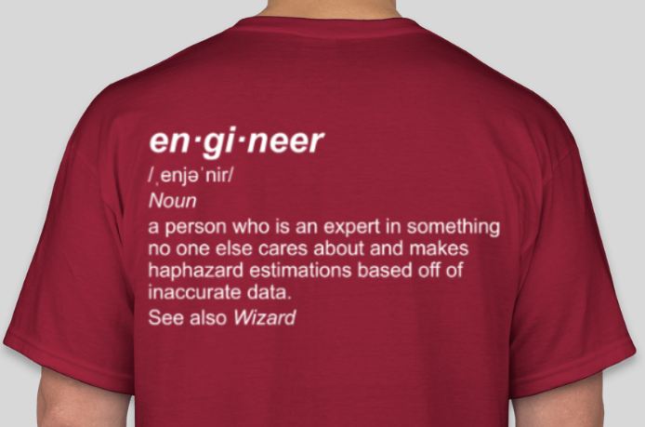
Shirts! $7, cash or Venmo @ASME-UMBC

