Slide 1
Career Fest Tips

Slide 2
What is Career Fair? (Wed. 25th, Noon to 3pm)
An event where employers come to network with students and try to recuit interns
BIG names!
NSA
Northrup Grumann
Lockheed
Boeing
Big Huge Games
Etc!
Notes:
What are some good Career Fest Tips and Tricks? How can we make this GBM fun or engaging?
Resume rescue
Can go to career fest
Have something to talk
Esubmit resume before hand
Have resume on phone
Work on elevator pitch
Sophomore/freshman
Research place before
UMBC Works Daily / once a week
Be able to sell class projects as an underclassman and highschool work

Slide 3
How Can You Stand Out?
Research the employers you know you want to visit ahead of time
Prepare engaging questions about their company
Work on your elevator speech
Name
Major
Year
Professional Interests

Slide 4
Underclassmen
Upperclassmen
Broad professional interests
Be able to sell high school experiences
Specific professional interests
Discuss relevant coursework
Fave subject?

Slide 5
Resume
E-submit your resume beforehand
Keep a copy on your phone
Keep physical copies in your backpack to hand out
Submit Resume to asme.umbc@gmail.com for review!!!

Slide 6
GBM Dates
9/18
10/2
10/16
10/30
11/13
12/4
Professional
Design Challenge
Professional
Design Challenge
Professional
Design Challenge
Career Fest Prep
Cup Stacking Claw
Schedule Classes
Candy Catapult
Python Coding
Ornament Drop

Slide 7
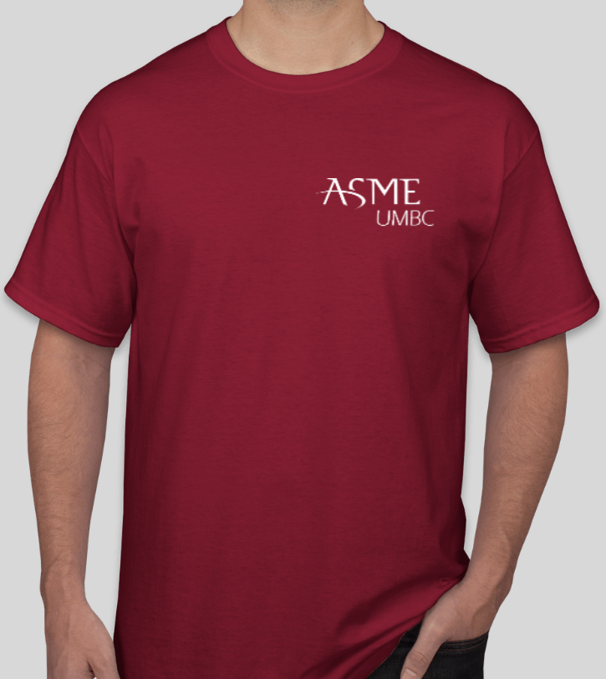
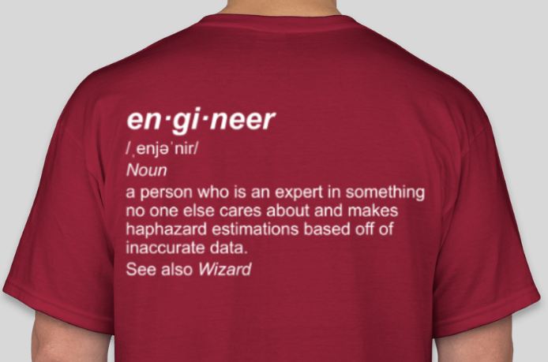
Shirts! $7, cash or Venmo @ASME-UMBC

