Slide 1
Meet Our Staff!
Bartleby: UMBC’s Creative Arts Journal

Slide 2
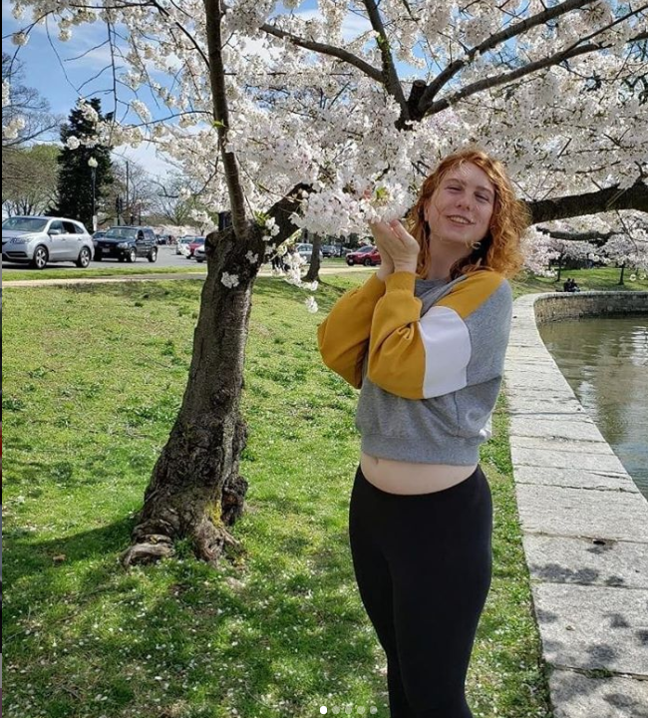
Angelica
Mansfield
Senior Managing Editor
(she/her/hers)
Majors: English Literature; Media and Communications Studies
Fun facts about me:
I’ve been vegetarian for (almost) 5 years
I play the trumpet
I wasn’t born in Maryland, but it’s still my favorite state

Slide 3
Ryan
Saladino
Junior Managing Editor
(he/him/his)
I’ve been writing fiction since 2nd grade
Used to be a Comp Sci major, then switched to English
I’ve watched more than 150 movies so far since the start of 2020 (thanks quarantine)

Slide 4
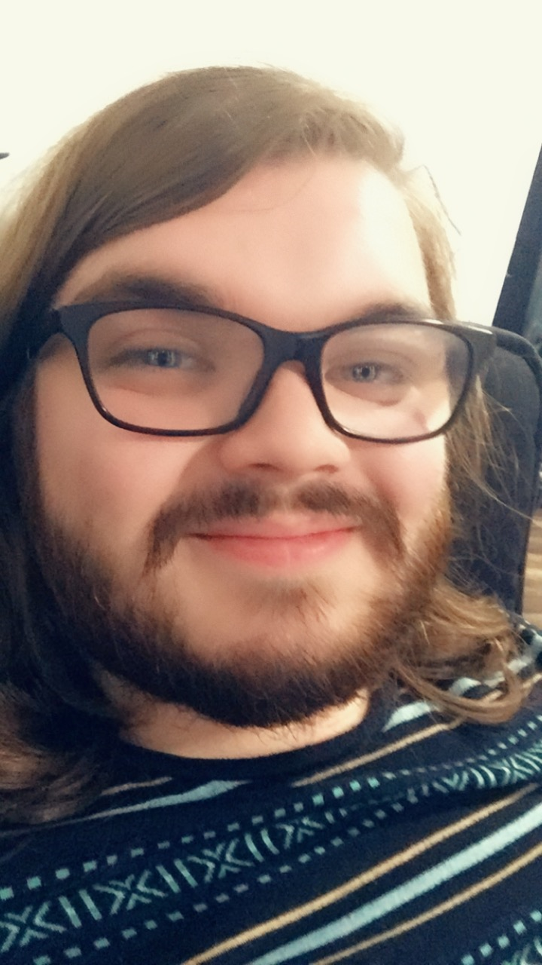
Ivan “Blue”
Perez
Lead Copy Editor (he/him/his)
Major: English Literature Major,
Minors: Writing; Ancient Studies
Fun facts about me:
I love Fantasy, namely the Elder Scrolls and the Lord of the Rings
I don’t eat fish or eggs
I have a sword collection

Slide 5
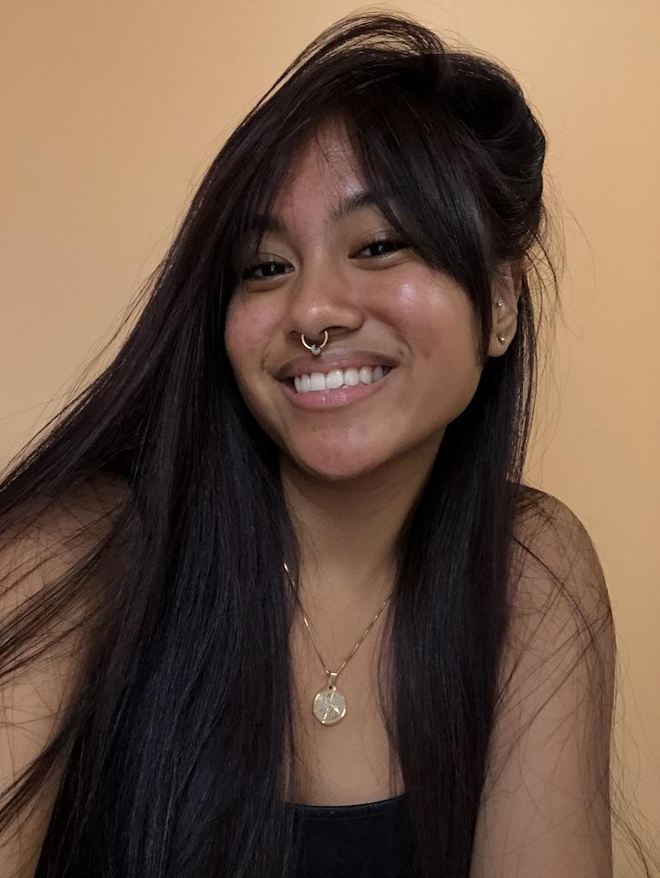
Chantal Anicoche
Creative Nonfiction Editor
(she/her/hers)
Major: Psychology
Fun facts about me:
I collect black graphic tees
I hate the taste of celery
I write poetry

Slide 6
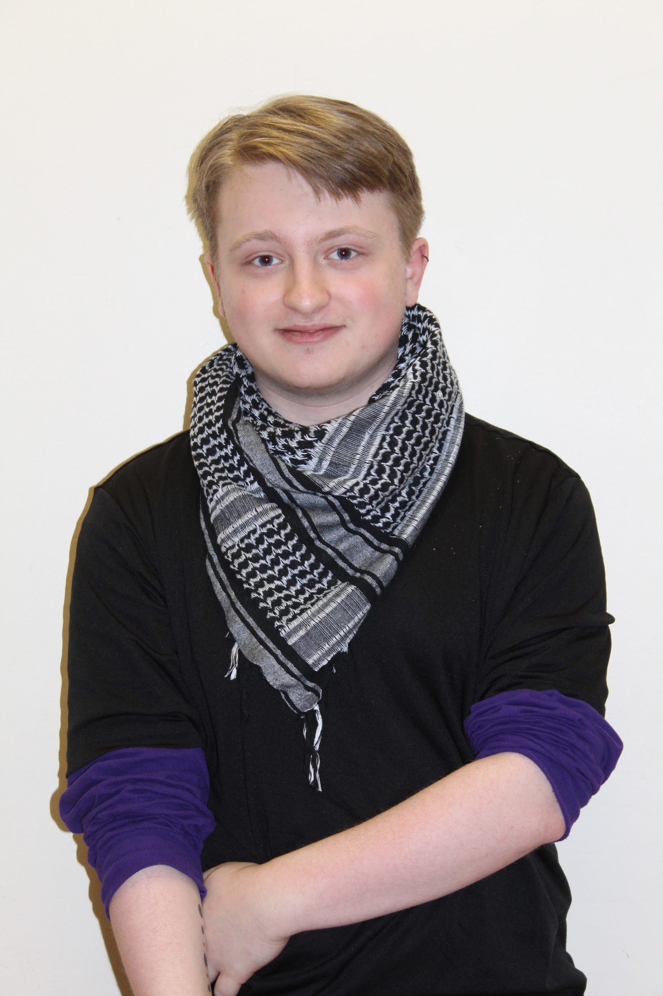
Joey
Odenwald
Art Section Editor
(they/them/theirs)
Mathematics Major, Computer Science & Applied Linguistics Minor, Secondary Education Certification
Fun facts about me:
I was featured in the 1st Lady of Maryland’s student art showcase in my senior year of HS
I am type-1 diabetic.
I have spreadsheets for everything!

Slide 7
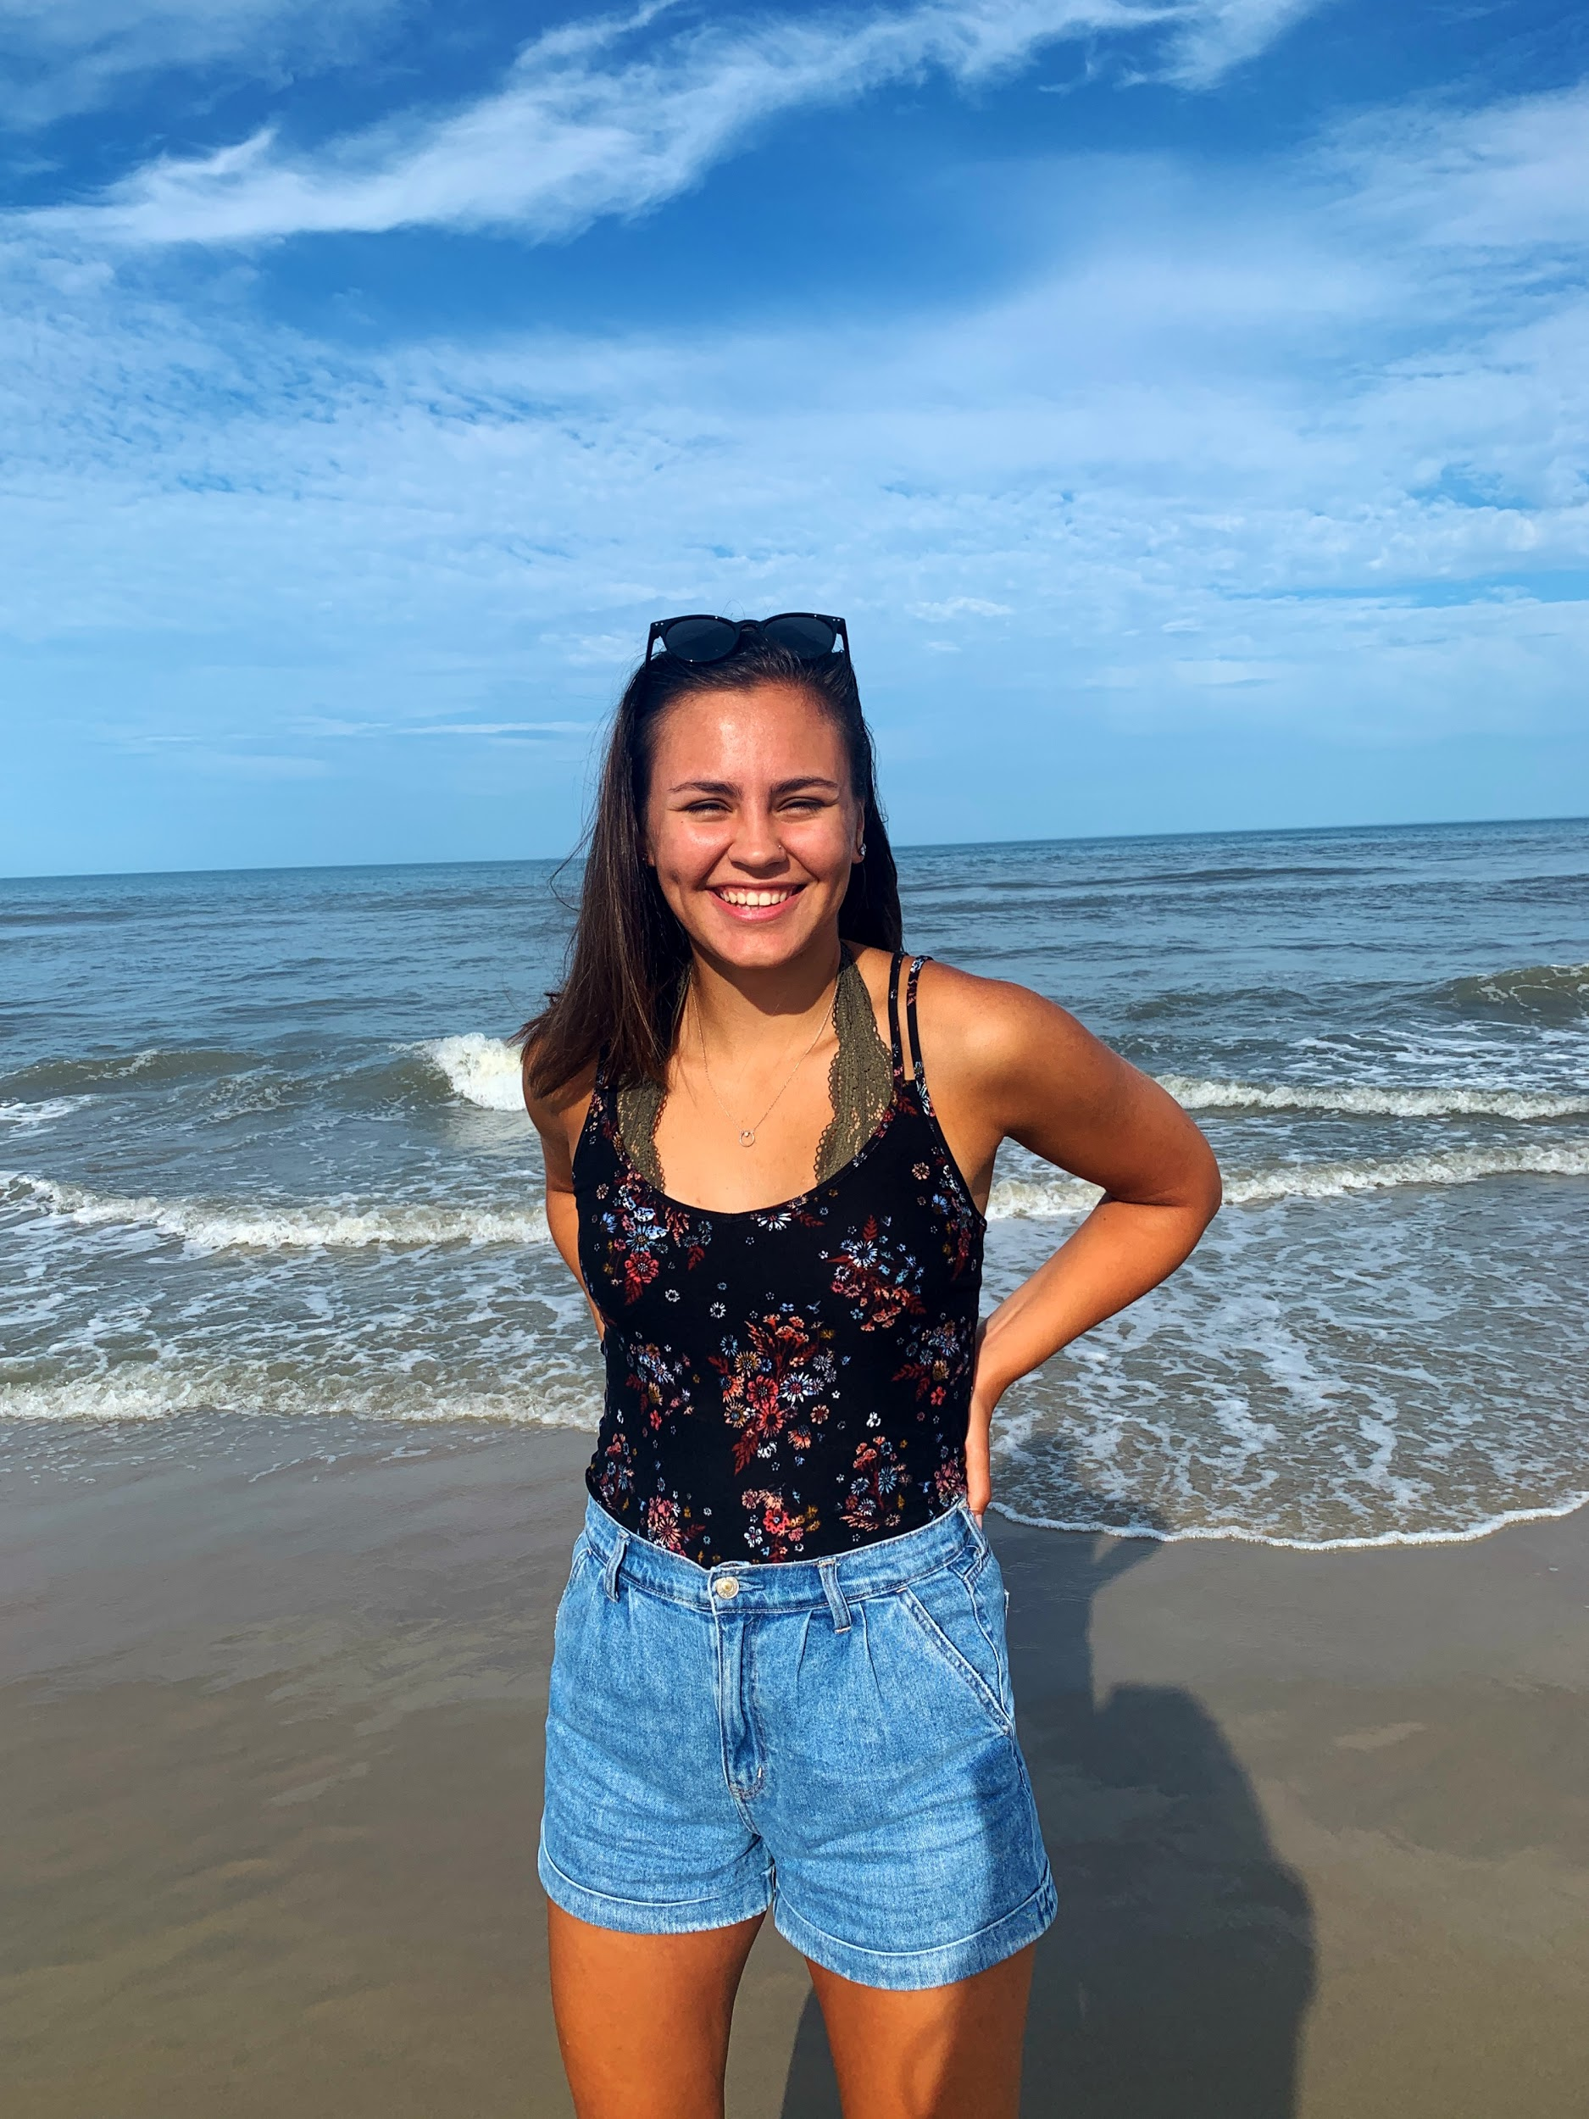
Julianna
Bumgardner
Social Media Coordinator
(she/her/hers)
Majors: English Literature; Media and Communications Studies
Fun facts about me:
I write and read fiction; right now, I'm reading Lord of the Rings for the first time!
I have two tattoos, one on each arm, neither of which you can see in this picture
I live right outside of Downtown Frederick!

Slide 8
Open Leadership
Positions
Poetry Editor
The Poetry Editor should have a background in writing/reading poetry, as this person will be responsible for running the poetry selection meetings in December
Fiction Editor
The Fiction Editor should know what quality creative writing looks like and will be responsible for running the fiction selection meetings in December

Slide 9
Other
Open Positions
Social Media Managers
Managers will work with the Social Media Coordinator to create content for Instagram, Twitter, Facebook, and the Bartleby Website
Graphic Designers
Designers will work with the one of our advisors and the social media team to create online flyers and will assist in the creation of the journal
Editorial Members
Members are essentially the backbone of our journal because they read and select which pieces will be included in our journal

