Slide 1
BioCOm General Body Meeting
10/21/19

Slide 2
BioEthics Debate
November 12th 7 to 9pm
Location: Skylight in Commons
Topic: Antibiotic Resistance
Two to three speakers
Pizza!
Open to everyone, including those who do not go to UMBC

Slide 3
Lab Tour
Sign ups are full, but future tours to come
For those who have signed up, the tour is Monday, October 28th, 12-1pm.
See Jon Sikora for details or questions
Bring questions!

Slide 4
Next Meeting… Graduate Student Talks!
November 4th 12-1pm
Several biology graduate students from UMBC
They will talk about their experiences as a graduate student (including applying)
Bring questions!

Slide 5
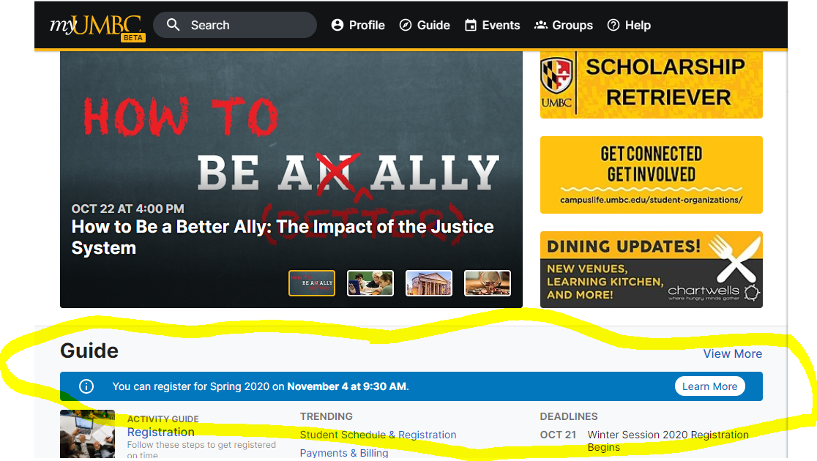
Registering for Classes
Notes:
If there is no blue bar at the bottom, you will need to add up how many credits you have earned from Summer 2019 and before.

Slide 6
YOUR ADVISING AND REGISTRATION CHECKLIST:
Know who your advisor is. This information is listed above, but is also available outside the Biological Sciences Office (BS 480) for BIOL, BINF, and BIOC majors, and at the Chemistry & Biochemistry Office (MEYR 100) for CHED, CHEM, and BIOC majors.
Know your Major, General Education, University, and any other academic requirements. Ultimately, you hold sole responsibility for making sure that these requirements are fulfilled. A helpful tracking tool for this information is available through Degree Audit (myUMBC>>Guide>>Advising& Student Support >> Degree Audit). For more assistance you can use this comprehensive HELP link.
Figure out when you will become eligible to register. Because you cannot view your exact Registration Eligibility Date until after you have been granted advisement clearance, the Registrar’s Office publishes a Registration Timeline as well as the Schedule of Classes information, so that students can estimate their earliest date of registration. Some students will be able to begin registration as early as Tuesday, October 29th.
Make an advising appointment. Ideally, this should occur before your earliest registration date. Please be aware that every advisor sets up their appointments differently. If you do not receive a communication from your advisor, then it is your responsibility to reach out to your advisor within the advanced registration period.

Slide 7
YOUR ADVISING AND REGISTRATION CHECKLIST CONTINUED:
Prepare for your advising appointment. At minimum, create a tentative course list or schedule. Some advisors will ask you to bring additional materials to your meeting.
Attend your advising appointment – on time! Missing your appointment may delay your registration time and could result in a notation on your advising record.
**Advising clearance operates separately from other holds on your account.** Although it is in your best interest to take care of any holds (financial/health/judicial/Consent & Respect) ASAP, these items can be taken care of AFTER you meet with your advisor. Check your myUMBC alerts for more information regarding these holds and be aware that ALL holds must be taken care of before you can register for classes.
Register for your courses in a timely manner.

Slide 8
Biology Major/Minors Requirements
https://biology.umbc.edu/undergrad/forms-links/

Slide 9
Example of How to Make Your Own Four Year Plan (Courtesy of Abigail)
Notes:
Most of the class schedules stay the same from spring semester to the next spring semester, and fall to next fall, etc, so you can plan pretty far out in advance.

Slide 10
Biology Degree Requirements
Questions?
B.A. in Biological Sciences
https://biology.umbc.edu/files/2019/04/Requirements_BIOL-BA-updated-Apr-19.pdf
B.S. in Biological Sciences
https://biology.umbc.edu/files/2019/04/Requirements_BIOL-BS-update-Aug-2018.pdf
B.S. in Biochemistry and Molecular Biology
https://biology.umbc.edu/files/2018/11/BIOC-BS-updated-Nov-2018.pdf
B.S. in Bioinformatics and Computational Biology
https://biology.umbc.edu/files/2019/04/Requirements_BINF-BS_Sept-2018.pdf
B.A. Biology Education
https://biology.umbc.edu/files/2019/04/Requirements_BIOE-BA-Aug-2018.pdf
Other Helpful Forms:
https://biology.umbc.edu/undergrad/forms-links/

