Slide 1
Biology Council of Majors (BioCOM)
February 24th
2020
General Body Meeting

Slide 2
Announcements
BioEthics Panel Topic
Graduation Cords
Susan Hindle

Slide 3
Reading Scientific Papers
What are the most important elements to a scientific paper?
The hypothesis/main question
What brought about this question/background
What is the basic experiment?
What were the results?
What do these results mean?

Slide 4
Abstract
While the abstract is helpful in determining what the researchers accomplished, this is not the meat of the paper.
You really want to skim the entire paper (specifically the introduction, results, and discussion section) as best you can to see how relevant the paper is to your argument.
This section summarizes the entire paper into one paragraph. This and the introduction help determine if the paper has what you need in it.
Notes:
Does your teacher ever ask you to find five sources about your topic first and you just choose five of the best looking ones for your topic from the top of the list? You really want to try and skim a little more. It is tedious in the moment, but you will be thanking yourself later when you are actually writing or analyzing the paper.

Slide 5
Introduction
Gives background and a statement of purpose. Usually contains the hypothesis/thesis statement.
The introduction usually begins with broad background and narrows down into the subject of the paper.
The big question of the entire paper is usually contained in this section.
The background information in this section is usually very pertinent to the paper as a whole, so make sure you have a solid understanding of the introduction before you move on to the rest of the paper.

Slide 6
Materials and Methods
The majority of the time, teachers will not ask you about specific methods the authors used, so just be sure you have a general understanding of what the experiment entailed.
One of the most detailed and unimportant sections of the paper for use in a science class.

Slide 7
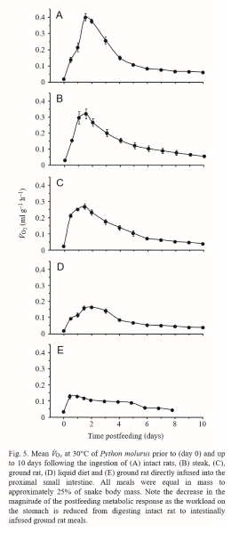
Figures/Tables of the Paper
One of the most important aspects of any research paper, whether you are analyzing one or you are writing one.

Slide 8
Results and Discussion
This gives you a clear idea if the authors of the paper achieved the goal they stated at the beginning of the paper.
This section is where the majority of the figures/tables come in.
You must be able to determine if the authors proved or disproved/drew inconclusive results about their initial hypothesis.
This is the most important section if you are writing a paper about the subject the authors were researching.

Slide 9
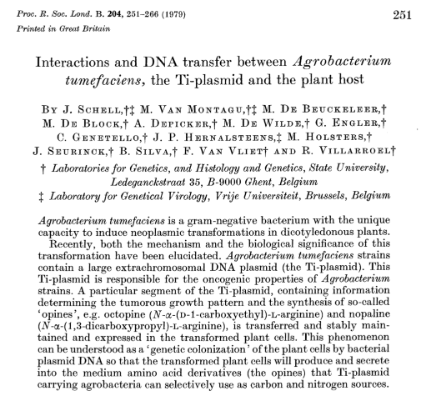
Paper to Analyze Next Meeting

Slide 10
THANK YOU!
Please see Abigail to be added to the GroupMe
I will post a copy of the paper on myUMBC
Sources: https://abacus.bates.edu/~ganderso/biology/resources/writing/HTWsections.html#introduction
https://www.huffpost.com/entry/how-to-read-and-understand-a-scientific-paper_b_5501628

