Slide 1

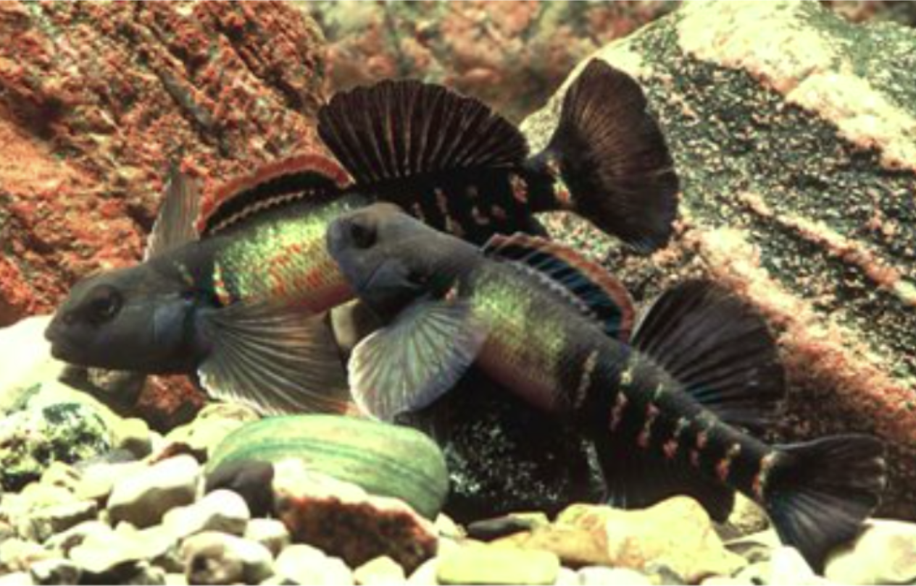


UMBC
Department of Biological Sciences
Visitor Seminar
Yseult Hejja-Brichard, Ph.D.
UMBC Biological Sciences
“Computational approaches to
understanding the evolution of sexual signal design”
Wednesday, October 4, 2023
12:00pm -1:00pm
Biological Sciences
Room 004
Host: Tamra Mendelson, Ph.D.
Visitors Welcome
For information call: 410-455-2261

