Slide 1

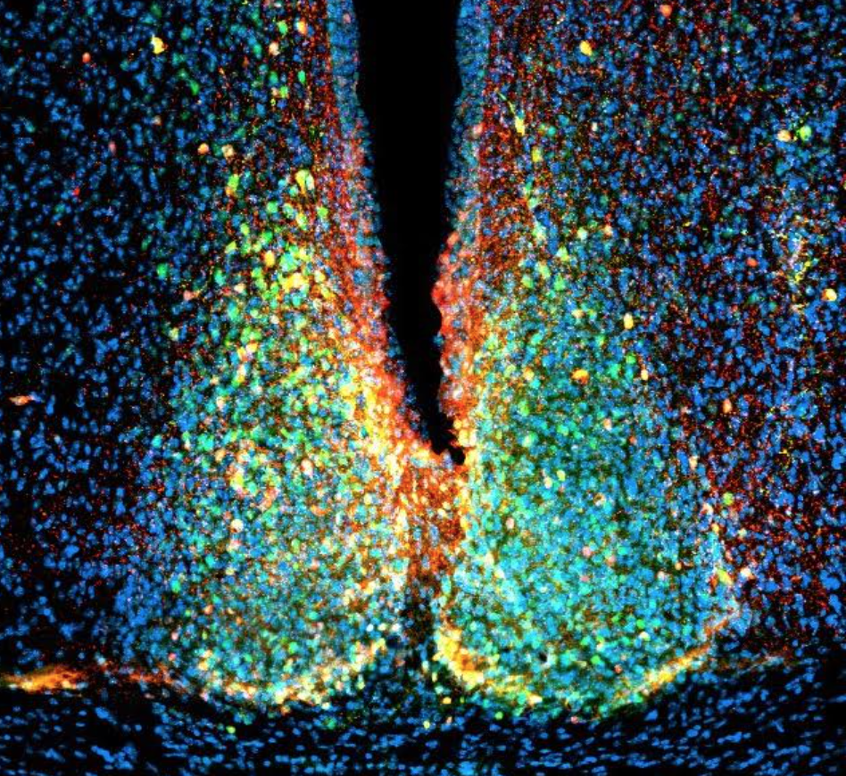


UMBC
Department of Biological Sciences
Visitor Seminar
Maria Yurgel, Ph.D.
NIH/NIMH
“Neural circuits underlying the interaction
between aversive experiences and
the central circadian clock”
Wednesday, March 13, 2024
12:00pm-1:00pm
BS 004
Host: Phyllis Robinson, Ph.D.
Visitors Welcome!
For information call: 410-455-2261

