Slide 1
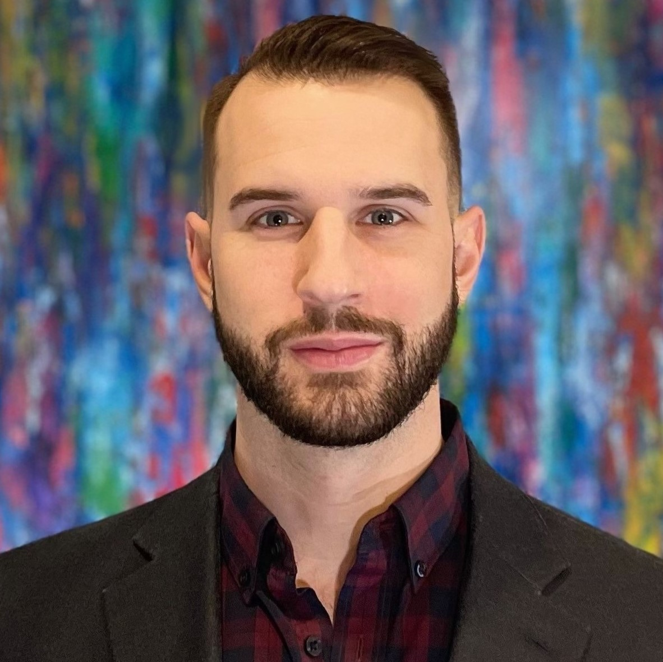
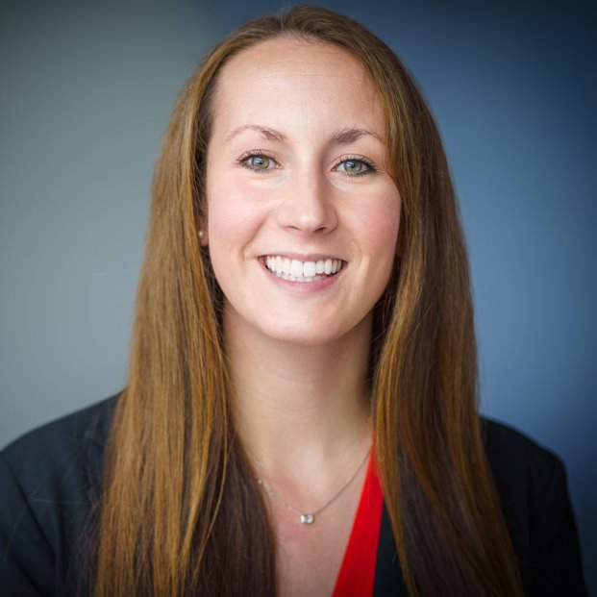
AstraZeneca Panelists
Mark Benesch
Global Engineering
Senior Director,
Capital Portfolio – Americas
UMBC B.S. ’08 Chemical Engineering
Asmaa Hasan
BioPharmaceutical Development
Associate Specialist,
Clinical Biologics
UMBC B.S. '22
Chemical Engineering
Emily Irwin
Global Operations
Associate Director,
Manufacturing Cell Therapy
UMBC M.S. ‘22
Mechanical Engineering, Certification Biochemical-Regulatory Engineering

