Slide 1

How To Prepare for the Virtual Career Expo
Benefits to Participation in the Expo: https://youtu.be/CEZQ6VYTWFY

Slide 2
What are your goals?
Network to build contacts/practice
Gather information to explore careers
Identify employers with jobs/internships in your field
Not sure

Slide 3
Preparation Before The Virtual Expo
Look on:
https://www.careereco.com/details/gcc to review the list of employers participating in the fair and the times for chatting.
Research employers by visiting company websites.
Use your research to rank the organizations in order of your interest to determine which organizations to chat with. This will help you make the best use of your time.
Prepare a list of questions to ask employers.
  Gain confidence by practicing your questions out loud.

Slide 4
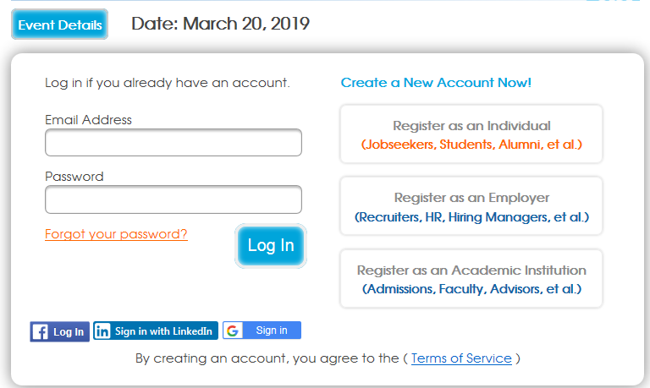
Registering for the Virtual Career Expo
Registration/Account Setup Tutorial Video
https://www.careereco.com/Fair/RenderPage?fairPageId=90b7bbc5-f39b-4524-b3c8-a832014ff36b
Review the FAQ Page
https://www.careereco.com/Fair/RenderPage?fairPageId=86a78064-038e-4a61-b0ae-a98f00e61632
Notes:
After showing the video, show students the FAQS page which can help answer questions they may have

Slide 5

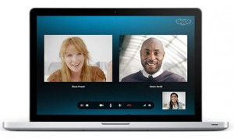
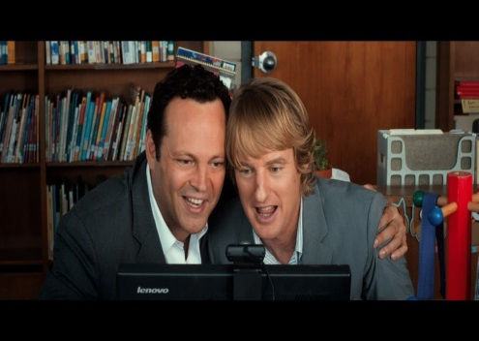

Virtual Expo Logistics
Use of Technology Time & Type Environment Look the Part
Questions to ask yourself:
Do I have access to a webcam and microphone if used?
What time zone will the virtual expo take place in?
Do I have a quiet and well lit space to participate in the virtual expo?
Do I look professionally presentable?
Notes:
According to NACE 2014 Recruiting Benchmarks Survey, over a third of employers use video interviewing. This means that virtual interviews are becoming more popular and it is important to prepare for it before you are scheduled for one. There are similarities to preparing for and in person and virtual interview, but here are the differences. (http://www.naceweb.org/surveys/current-benchmarks.aspx)
Use of technology
Anticipate any technical disruptions (battery charger plugged in, hard line usage, headphones to block out surrounding sound if needed)
Make sure you know the type of technology that will be used and install it ahead of time into your computer (Some examples are Skype, FaceTime, Google Hangout) Load or login time may take longer for some than others so login prior to the interview
Practice using the technology to ensure the quality of your video and audio capabilities
Time & Type
Be mindful of the times zones that the employer and virtual fair is scheduled to take place in
Confirm with the employer connection instructions. Are they inviting you to a private chat? Will they be using webcam and microphone? What information do you need to have in order to receive the connection?
Plan 10 to 15 minutes prior to the scheduled chat rooms to set up your computer, video and audio capability and materials
Prepare your Environment
Position your camera in front of you so that there is a blank or modest wall behind you (avoid having a window behind you as you never know what might pop up).
Find a quiet space that has good lighting so your image on the screen represents you well.
Make sure there is no clutter or areas in your screens view that can be distracting to the interviewer
Have your documents in front of you, i.e. notepad, resume, job description
Look the part
Treat the fair as if it was an in person experience wearing a professional outfit. If you are unsure of what to wear, it is ok to check with the HR department.
Be Mindful of Non-verbal Cues by conveying the message that you are engaged through maintaining eye contact with the webcam and not with your image or theirs on the screen (Are you sitting up straight? Is the chair the best height for the table or desk at which you’re sitting? How is your head tilted? You should look professional, but relaxed)
Position the camera so that it is eye level for a more engaging experience
http://www.salary.com/8-tips-for-acing-virtual-interviews/slide/9/
http://www.fastcompany.com/3041541/hit-the-ground-running/how-to-make-a-good-impression-in-a-video-interview

Slide 6
Expo Breakdown
Register, upload your resume, and RSVP at:
https://www.careereco.com/events/gcc?ref=ceh
Look for Jobs and Apply
Chat Rooms and Private Chats
Technology: Internet Access and Current Version of a Major Browser

Slide 7

How to Use the Virtual Expo Tool
http://player.vimeo.com/video/106122434
Notes:
Click on the picture to access the video tutorial.

Slide 8
Communication Skills
Non-verbal communication
Making good eye contact
Hand Gestures
Good posture
Smiling and being enthusiastic
Notes:
These core components can really help engage an employer when you are not physically there in person.

Slide 9
30 Second Pitch Example
Hello, my name is Frank. I’m currently working towards a master’s degree in Public History at X University. I saw on your website that [name of organization] has a graduate student internship program. I became interested in public history while interning as a curator at a local museum and was wondering if you could tell me more about the qualifications and skills you are seeking for the internship program.

Slide 10
Let’s Practice
Get out a sheet of paper and prepare your 30 second pitch
Introduce yourself to your neighbor and give your “30 second pitch”…
Give feedback to your partner
Now switch
Notes:
Give about 20 minutes total for this activity

Slide 11
Navigating the Expo
People on the Other End
Recruiters participating in the event are typically NOT hiring managers, they usually work in Personnel/Human Resources.
Everything you type in a chat room is a reflection of you.
Your appearance and attitude will also help the recruiter determine if you will fit in with the team/company.

Slide 12
Navigating the Expo
Personality Matching Technique
You mirror the personality of the person to whom you are speaking.
Match the voice (tempo and pitch).
Match the physical characteristics (facial expressions and posture).
The recruiters are the faces and personalities of the company and are looking for candidates like themselves to represent the company mission, values, etc.

Slide 13
Navigating the Expo
Negotiate
If you see a company that you really want to work for, but they are not hiring for your field or area of interest….what can you do?
  Approach the recruiter and ask: “Who should I contact in your company for a position in my field (ie. Computer programming)?
  You MUST get their name and phone number to follow up if they forward your resume to another department in the company.
  Your main objective is to get the name and title of the primary contact within the company who hires in your field.

Slide 14
Private Chat
Logistics
May join three chatrooms at one time
Some employers may prefer to engage in the main chatroom instead of private chats
You can initiate a private chat with company representatives on the User List
Video Chat is an option that employers may or may not use so be prepared

Slide 15
Private Chat
Network
This is a mini-interview
In advance, prepare a 30-60 second pitch about yourself.
Know your resume!
Review the previous messages posted to the Chat Rooms to read answers to prior questions
Be patient
Convince them you are a good fit with the company’s needs (this is why you do research prior to the expo).
Ask for contact information after the interview.
Ask about next steps in the hiring process and take notes about recruiter comment and/or instructions.

Slide 16
After the Expo
Follow Up Soon After the Expo
Send a thank you note or e-mail to each recruiter with whom you met.
Express your appreciation for the time and advice offered, let the recruiter know that you have completed anything he or she has asked you to do and reiterate your interest in the company.
Undertake next steps and apply online

Slide 17
Good Luck!!!
ANY QUESTIONS?

Slide 18
Virtual Career Expo 3/20/19
Register at: www.careereco.com/events/gradtalent

