Slide 1
Create your own success story

Slide 2
College Graduation…
How people expect you to feel:
How you actually might feel:

Slide 3
How We Hope You Feel!

Slide 4
Shifting From Student to Professional
Get Started Now!
Ready Means “Career Ready”
It’s All About Professionalism
Take Advantage of the Career Center!

Slide 5
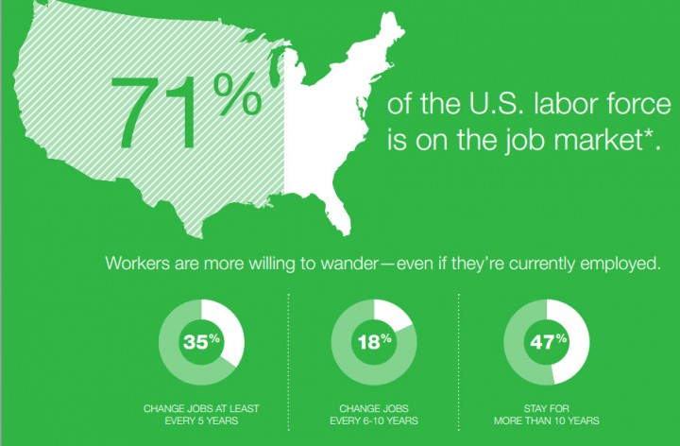
1. Get Started Now
There’s no such thing as too early
Fall = Recruitment Season
The job search is work.
Notes:
-- never too early to start → wherever you are in the process, begin your planning now → make a commitment today to start working on your career
-- it can take awhile to find a job!
-- Class of 2016 according to NACE, 46% of college graduates had job offers before graduation → sounds like a stat that you’d like to be a part of
-- biggest mistake that you can make at this point is not starting → take risks, go to events, explore options

Slide 6
2. Ready Means “Career Ready”
What are employers looking for?
According to the National Association of Colleges and Employers (NACE):
Critical Thinking/Problem-Solving
Oral/Written Communications
Teamwork/Collaboration
Digital Technology
Leadership
Professionalism/Work Ethic
Career Management
Global/Intercultural Fluency

Slide 7
How do I show that I’m “career ready”?
Know & Articulate Your Goals
Organization Leads to Better Preparation
Demonstrate Professionalism
Communicate Confidence in Your Personal Brand

Slide 9
Organizing a Job Search: Know What You Are Looking For!
Identify the industry/position type that you’re looking for:
Job Title
Major Sheets
Vault
Industry
Private, Public, Nonprofit Sectors
Specific Employers
UMBC Career Center events
UMBCworks
Informational Interviews
Friends, Family, Alumni, Peers
Notes:
It’s awfully hard to find something if you’re not sure what you’re looking for – difficult to do a word search without a list of words available

Slide 10
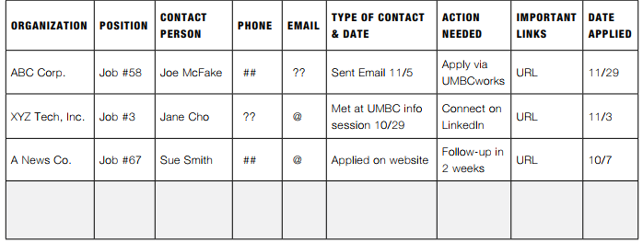
Organizing a Job Search: Organize Yourself
Set a schedule for job search (treat it like a class)
Time & place
Set small weekly goals that support your long-term goal
Identify potential employers
Revise/submit resumes
Attend networking events
Practice interviewing
Keep track of your activities

Slide 11
Organizing a Job Search: Be Strategic
Sample Strategy:
Identify 20 companies of interest
Each day, review two websites → if you find an interesting job, apply!
Add and delete companies
Sample Strategy:
Create a list of all upcoming career development events
Identify two per week to attend
At each event, generate one new networking contact to connect with on LinkedIn

Slide 12
Organizing a Job Search: UMBCworks

Slide 13
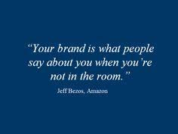
3. It’s All About Professionalism
Professional Documents (Resume, Cover Letter)
Networking Opportunities
Digital Image (LinkedIn, Social Media, website/portfolio)
Interviewing Skills
Evaluating Offers & Salary Negotiation

Slide 14
Building Your Professional Image
Appearance
Demeanor
Reliable/Punctual
Competence
Ethical
Communication

Slide 15
Communication: Verbal, Written, Digital
Verbal
Networking
Phone calls
Interviewing
Written
Resume
Cover letters
Professional statements
Emails
LinkedIn messages
Digital
Social media platforms
Content (original or shared)

Slide 16
Resume Ready?
Get your resume reviewed at the Career Center
Tailor your resume to specific positions → what is important for this employer to know?
Resume real estate → most valuable information at the top!
Descriptive bullet points with powerful verbs

Slide 17
“The difference between the almost right word and the right word is really a large matter – ‘tis the difference between the lightning-bug and the lightning.” – Mark Twain

Slide 18
Professional Email Correspondence
Do…
Avoid…
Send from your UMBC email
Include a brief, descriptive subject line
Use a greeting & name of recipient
Write concise, clearly organized body paragraphs
Choose an appropriate closing
PROOFREAD BEFORE SENDING!
Using multiple email addresses to correspond with employers
Writing with slang or casual language
Contacting employers too frequently
Asking questions that you can find the answers to!
Stressing – correspondence takes time!

Slide 19
Professional Email Correspondence: Before You Press “Send”…
Did you check your spelling and grammar?
Did you ask a question that you could find an answer for independently?
Did you communicate your message clearly?
What If I Don’t Hear Back?
Consider a follow-up call if appropriate
Follow up with an email if you’re expecting a reply
Include all previous e-mail threads → help track the conversation

Slide 20
LinkedIn Job Search Tips
Upgrade to Premium
Make yourself “Open to Recruiters”
Upload a professional headshot (Career Fair!)
Create an exciting headline with keywords
Be active!
Endorse skills
Follow companies & industries of interest
Request recommendations
Network with alumni

Slide 21
Marketing 101 Start With Why by Simon Sinek

Slide 22
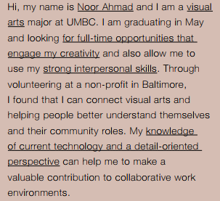
30 Second Commercial
Identify who you are
Highlight a few strengths and accomplishments
Show how you can bring added value to an organization
Bonus: Add your WHY!

Slide 23
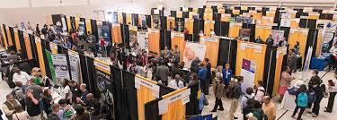
4. Take Advantage of Career Center Resources
Individual Appointments
Online & Print Resources
UMBC Connects
On-Campus Interviews
On The Road: Exploring Outside the Loop
Fall Career and Internship Fair!

Slide 24
Who We Are
Career Specialists |Internship & Employment Team | Employer Relations & Recruitment Programs

Slide 25
Appointments to Help
Career Specialists (60 minutes)
Career Decision Making
Interview Preparation & Evaluating Offers
Mock Interviews (must call to schedule)
LinkedIn Advanced Strategies
Internship & Employment team (30 minutes)
Job Search Process
Interview Preparation & Evaluating Offers
Industry-Specific Resume Reviews

Slide 26
Our Resources
UMBCworks database – check often, update resume, consider cover letter
Career Guide
Online & print (available next week!)
Newly redesigned!
Careers.umbc.edu
Sample industry resumes
What Can I Do With My Major? Sheets
Vault → explore industry guides to learn about jobs, read company reviews, read up-to-date advising from industry professionals
“For Students” tab

Slide 27
Get Connected to the Career Center

