Slide 1
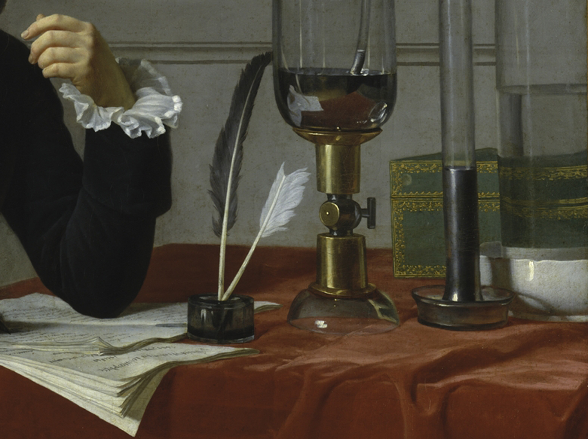
THE ART AND SCIENCE OF COLOR:
FOUR THOUSAND YEARS OF EXPERIMENTATION AND DISCOVERY
THROUGH THE COLLECTIONS OF THE METROPOLITAN MUSEUM OF ART

