Slide 1
The center for women in technology
Contributions to Research & Creative Achievement at the University of Maryland, Baltimore County
A presentation to the UMBC Research and Creative Achievement Council
September 8, 2017

Slide 2
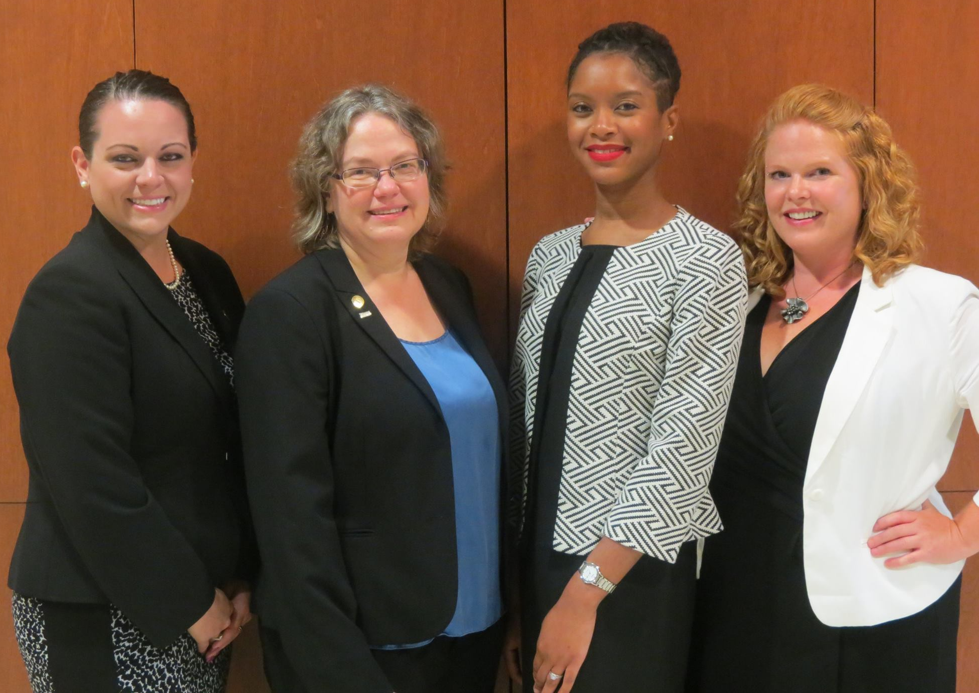
Our team
Penny Rheingans, Ph.D. – Director
Professor of Computer Science & Electrical Engineering
rheingan@umbc.edu
Danyelle Ireland, Ph.D. – Associate Director
Grant Projects, COEIT Climate Initiatives, Assessment, Industry Relations
direland@umbc.edu
Erica D’Eramo, M.A. – Assistant Director
CWIT Scholars, CWIT Living Learning Community
deramo@umbc.edu
Cindy Greenwood, M.Ed. – Assistant Director
Cyber Scholars, CWIT Affiliates
cindyg@umbc.edu
L-R: Erica D’Eramo, Penny Rheingans, Danyelle Ireland,
Cindy Greenwood

Slide 3
Four CWIT Priorities
The Center for Women in Technology (CWIT) is dedicated to increasing the representation of women in the creation of technology and in computing and engineering fields. We have identified four goals key to this aspiration:
Sustain and strengthen vital Scholar programs committed to increasing the representation of women and other underrepresented groups in technology fields.
Foster a supportive community for all women and allies in technology at UMBC.
Broaden the pipeline of talented women interested in technology with K-12 outreach programs.
Improve gender climate in the College of Engineering & Information Technology (COEIT).
We collaborate with faculty and staff within COEIT and other UMBC offices:
Chemical, Biochemical, and Environmental Engineering; Computer Science and Electrical Engineering; Information Systems; Mechanical Engineering; COEIT Undergraduate Student Services; UMBC Office of Undergraduate Education; and the UMBC Women’s Center

Slide 4
research & creative Achievement
Broadening Participation in Technology
Programs to facilitate professional, academic, and leadership development of underrepresented students in computing and engineering (CWIT Scholars, T-SITE Scholars)
K-12 outreach (Bits & Bytes, Cyber 101)
Undergraduate Education in Computing & Engineering
Developing and assessing models to support success of freshman, transfer, and continuing students; focus on underrepresented groups (COMP101, Post-Transfer Pathways)
Diversity and Inclusion in Technology
Investigating the diversity climate of the COEIT and issues that impede inclusion
Promoting inclusive excellence within COEIT community, building capacity among students to be effective advocates and allies for themselves and one another (IMPACT workshops, Allies in CWIT)

Slide 5
State-funded projects
“Center for Women in Technology (CWIT) Scholars” (2002 – Present)
Highlights
Scholarship program for academically talented undergraduates in computing and engineering majors (incoming freshmen); focus is on increasing the representation of women in technology
One hundred seventy-four Scholars served to date; 91.7% COEIT retention rate and 81.67 UMBC graduation rate
CWIT Scholars have a higher rate of retention in COEIT major and graduation from UMBC in four years than matched peers
CWIT model has been adapted to serve high achieving transfer students from MD community colleges at UMBC
Components of the CWIT model have been implemented within the broader population of women (and their supporters) in COEIT through the Affiliates program
Publications (under submission)
Penny Rheingans, Erica D’Eramo, Crystal Diaz-Espinoza, and Danyelle Ireland. 2018. CWIT Scholars: A Model for Increasing Gender Diversity in Technology . In Proceedings of ACM SIGCSE conference, Baltimore, MD USA, March 2018 (SIGCSE ’18), 8 pages.

Slide 6
Grant-funded projects
“Transfer Scholars in Information Technology & Engineering (T-SITE)” (2012-2017; 2015-2020)
NSF S-STEM; DUE 1154300 and DUE 1458343
Project Team: P. Rheingans (PI), T. Bayles, L. Blaney, M. desJardins, D. Ireland, E.F.C. LaBerge, S. Martin, C. Seaman, G. Slaughter, & A. Spence
Highlights
Scholarship program for academically talented transfer students in computing and engineering majors from MD community colleges; emphasis on serving women, underrepresented minorities, and students with financial need
Successful adaptation of CWIT Scholars model for transfer student population
Thirty-two Scholars served to date; 100% retained in computing and engineering majors
Insights from T-SITE inform CWIT’s broader initiatives to support transfer students in COEIT
Publications
Ireland, D. T., & Rheingans, P., & Blaney, L., & desJardins, M., & LaBerge, E. F. C., & Martin, S., & Seaman, C., & Slaughter, G., & Spence, A. M. (2017, June), Board # 61 : T-SITE: A UMBC Community of Transfer Scholars in Computing, Information Technology, and Engineering Paper presented at 2017 ASEE Annual Conference & Exposition, Columbus, Ohio. https://peer.asee.org/27891

Slide 7
research & creative Achievement
Broadening Participation in Technology
Programs to facilitate professional, academic, and leadership development of underrepresented students in computing and engineering (CWIT Scholars, T-SITE Scholars)
K-12 outreach (Bits & Bytes, Cyber 101)
Undergraduate Education in Computing & Engineering
Developing and assessing models to support success of freshman, transfer, and continuing students; focus on underrepresented groups (COMP101, Post-Transfer Pathways)
Diversity and Inclusion in Technology
Investigating the diversity climate of the COEIT and issues that impede inclusion
Promoting inclusive excellence within COEIT community, building capacity among students to be effective advocates and allies for themselves and one another (IMPACT workshops, Allies in CWIT)

Slide 8
Grant-funded projects
“Transforming the Freshman Experience of Computing Majors” (2012 – 2015)
NSF TUES; DUE 1140589
Project Team: P. Rheingans (PI), M. desJardins, S. Martin, and C. Seaman
Highlights
Developed, delivered and evaluated a new first-year seminar for computing majors designed to increase retention, completion, and success among students, especially women and those from underrepresented groups
Provides an overview of the discipline, builds foundational technical skills, includes a group design experience, and strengthens academic success and professional skills
COMP101 participants had higher rates of retention in major and COEIT than control group (though not statistically significant)
COMP101 is currently institutionalized at UMBC

Slide 9
Grant-funded projects
“Post-Transfer Pathways Program for Computing and Engineering Majors” (2016-2020)
NSF IUSE; DUE 1626413
Project Team: P. Rheingans (PI), D. Ireland, C. Seaman, L. Blaney, A. Spence, L. Shishineh, C. Bielawski
Highlights
An innovative model of pre- and post-transfer academic coaching for transfer students in computing and engineering
A discipline specific one-credit first year experience course designed for transfer students in computing and engineering majors at UMBC
An active, data-driven, collaborative learning community comprised of computing and engineering faculty, advisors, and administrators from six partners community colleges and from four academic departments at UMBC
Pre-/post-transfer survey to assess the backgrounds of transfer students from community colleges who intend to pursue computing and engineering majors at UMBC

Slide 10
research & creative Achievement
Broadening Participation in Technology
Programs to facilitate professional, academic, and leadership development of underrepresented students in computing and engineering (CWIT Scholars, T-SITE Scholars)
K-12 outreach (Bits & Bytes, Cyber 101)
Undergraduate Education in Computing & Engineering
Developing and assessing models to support success of freshman, transfer, and continuing students; focus on underrepresented groups (COMP101, Post-Transfer Pathways)
Diversity and Inclusion in Technology
Assessing the diversity climate of the COEIT and addressing issues that impede inclusion
Promoting inclusive excellence within COEIT community, building capacity among students to be effective advocates and allies for themselves and one another (IMPACT workshops, Allies in CWIT)

Slide 11
COEIT Climate initiatives
Highlights
Multi-year research collaboration with the COEIT Dean’s Office
Investigating factors that affect the social climate and academic experiences within the college (e.g. advising, faculty-student interactions, student peer interactions)
COEIT Climate Survey 2009, 2012, and 2016
COEIT Climate Focus Groups 2016 and 2017
Results used to inform policy and practice within the COEIT and guide CWIT programming direction
Results prepared for dissemination via COEIT Town Hall and publication outlets
Publications
Penny Rheingans, Anne Brodsky, Jill Scheibler, and Anne Spence (2011). The Role of Majority Groups in Diversity Programs, ACM Transactions on Computing Education. vol. 11, no. 2, July 2011.

Slide 12
Future directions
Areas of Interest:
Developing a model for diversity education in computing and engineering majors
Integrating concepts of social equity and self-awareness with technical content
Building capacity among students to promote inclusion and positive engagement in their classrooms and peer settings
Understanding the mechanics of mentoring for undergraduate computing and engineering majors (focus on women and URM)
Investigating three dimensions: industry, faculty, and peer mentoring
Adapting CWIT mentoring program model to other institutions and testing scalability

