Slide 2
I think good design is an object or a service that exceeds the user’s expectation.

Slide 3
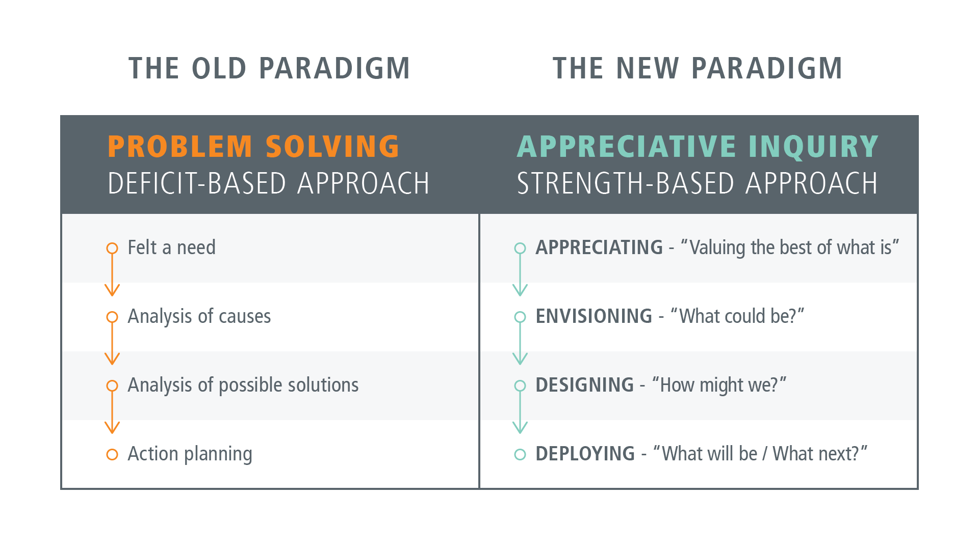

Slide 4
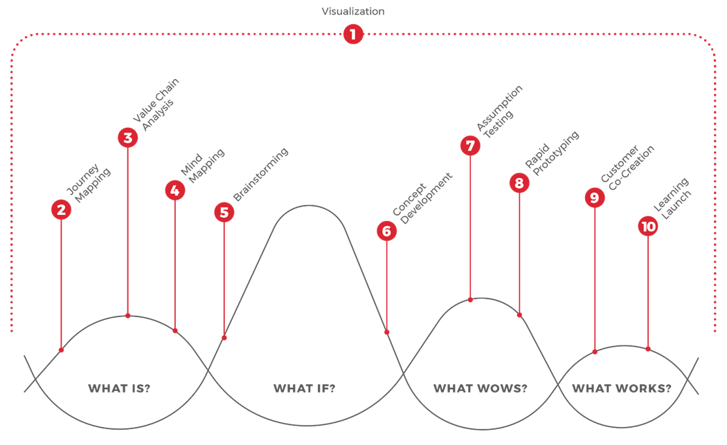
Design Thinking Model

Slide 5
Design Thinking

Slide 6

What Is?
1. Visualization: Using imagery to envision possibilities and bring them to life
2. Journey Mapping: Assessing the existing experience through the customer’s eyes
3. Value Chain Analysis: Assessing the current value chain that supports the customer’s journey
4. Mind Mapping: Generating insights from exploration activities and using those to create design criteria

Slide 7
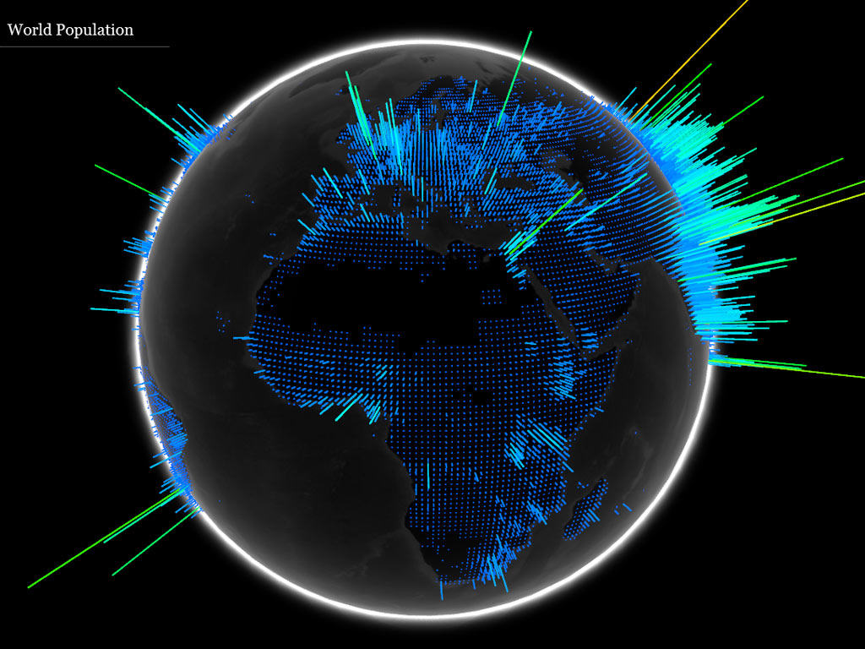
Visualization
Visualization: Using imagery to envision possibilities and bring them to life

Slide 8
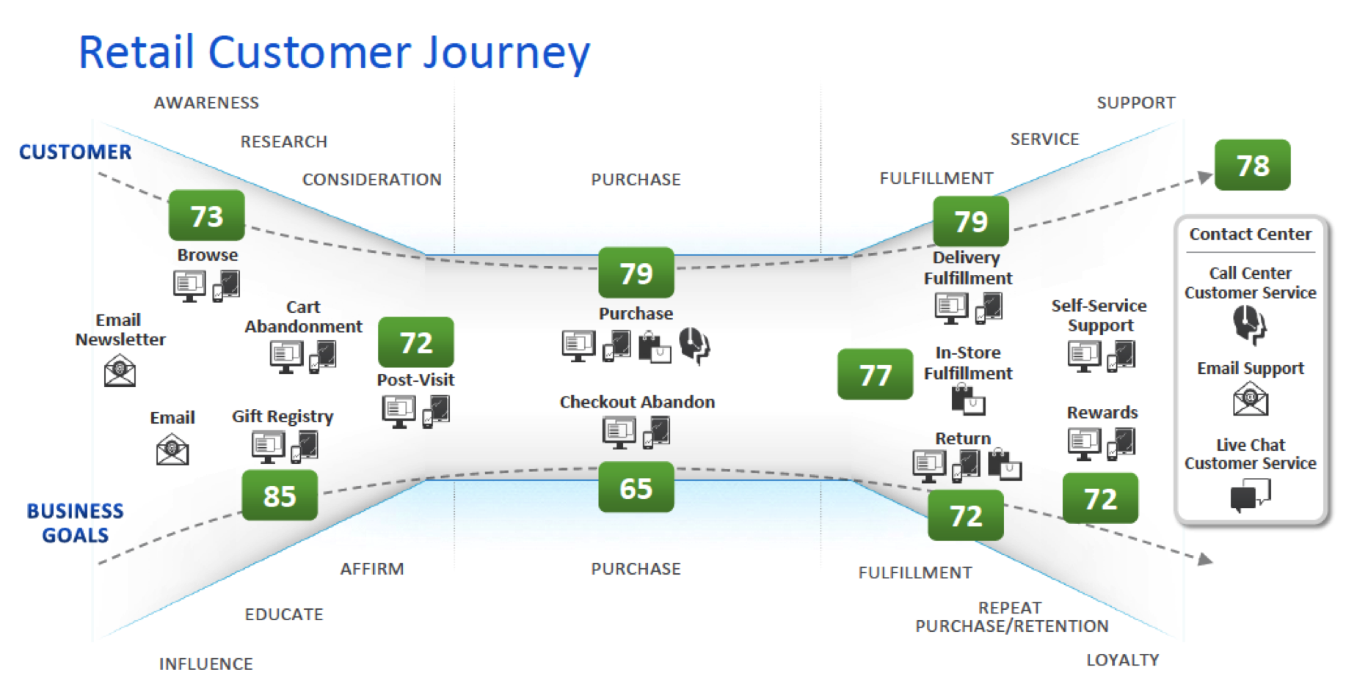
Journey Mapping
Journey Mapping: Assessing the existing experience through the customer’s eyes

Slide 9
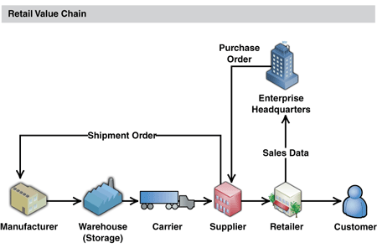
Value Chain Analysis
Value Chain Analysis: Assessing the current value chain that supports the customer’s journey

Slide 10
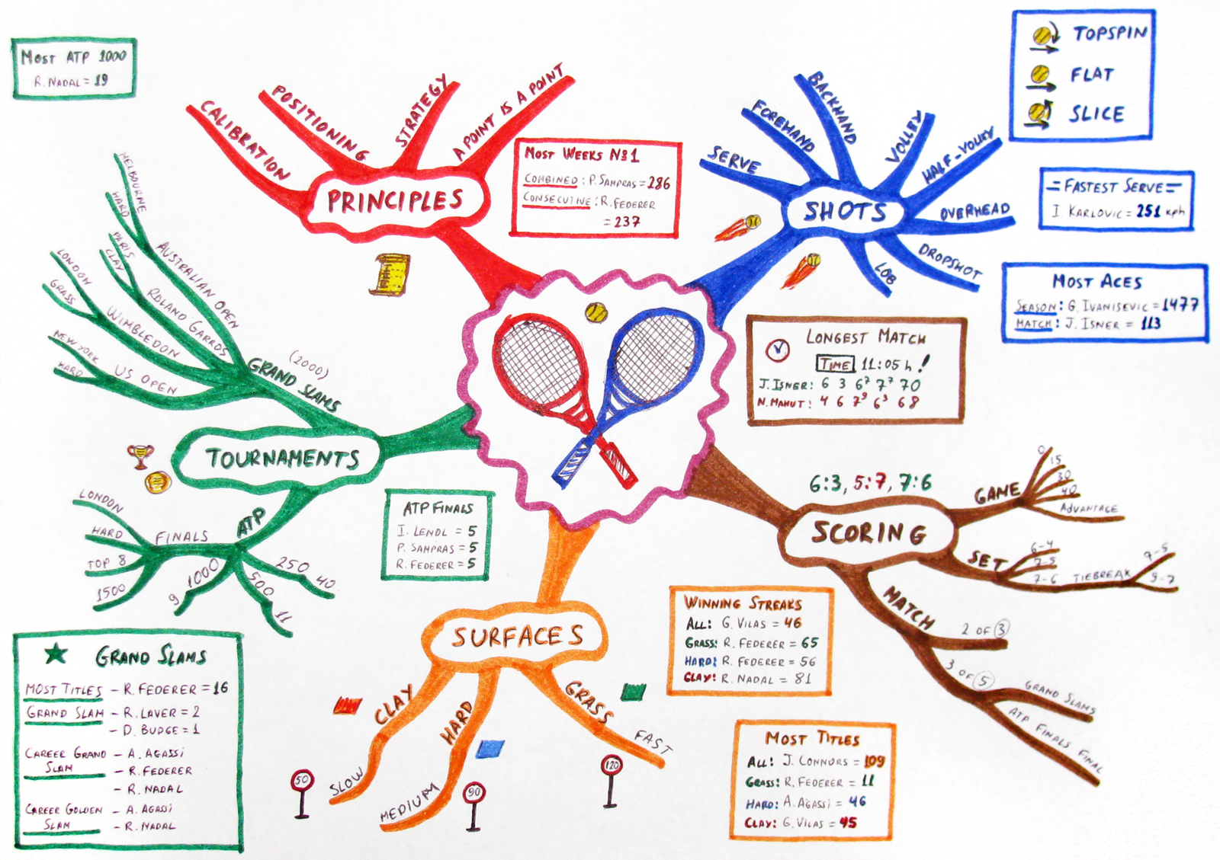
Mind Mapping
Mind Mapping: Generating insights from exploration activities and using those to create design criteria

Slide 11
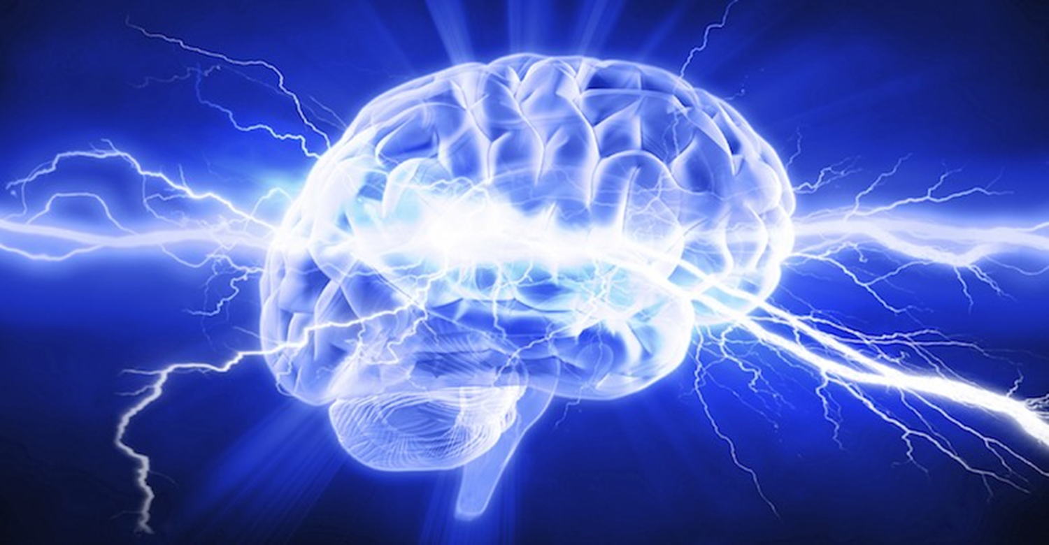
What If?
5. Brainstorming: Generating new possibilities and new alternative business models
6. Concept Development: Assembling innovative elements into a coherent alternative solution that can be explored and evaluated

Slide 12

What Wows?
7. Assumption Testing: Isolating and testing the key assumptions that will drive the success or failure of a concept
8. Rapid Prototyping: Expressing a new
concept in a tangible form for exploration,
testing, and refinement

Slide 13
Rapid Prototyping

Slide 14
Rapid Prototyping

Slide 15

What Works?
9. Customer Co-Creation: Enrolling
customers to participate in creating the
solution that best meets their needs
10. Learning Launch: Creating an affordable experiment that lets customers experience the new solution over an extended period of time, to test key assumptions with market data

Slide 16
Customer Co-Creation

Slide 17
Customer Co-Creation

Slide 18
Learning Launch

Slide 19
Learning Launch
?

Slide 20
