Slide 1
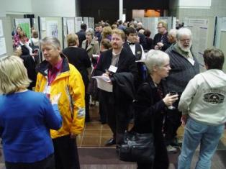
The Scholarship of
Teaching and Learning
The ISSOTL 2008 Poster Session Edmonton, Alberta, Canada

Slide 2
SoTL builds on existing traditions
Reflective Practice
Student Learning Assessment
Education Research
SoTL
Action Research

Slide 3
Ways to describe SoTL include:
Teaching as a form of scholarship, as community property, with a focus on student learning and evidence of student learning.*
Systematic study of teaching and/or learning and the public sharing and review of such work through presentations or publications.**
*D. Bruff, http://cft.vanderbilt.edu/teaching-guides/reflecting/sotl/
**K. McKinney, http://sotl.illinoisstate.edu/downloads/pdf/definesotl.pdf

Slide 4

SoTL has two faces:
Teaching as reflective practice
Teaching as research

Slide 5
SoTL may be seen as reflective practice when it
Involves close examination of student learning
Draws on the work of others
Examines alternate approaches to issues
Includes reflection on results as evidence
Includes sharing and discussion of results with others

Slide 6
SoTL may be seen as teaching as research when it
Asks an explicit question about teaching/learning
Builds on the work of others
Is explicitly designed
Requires credible data as evidence
Involves reflecting and taking action
Is cyclical and ongoing
Generates results that are shared and critiqued
D. Bruff, http://cft.vanderbilt.edu/teaching-guides/reflecting/sotl/

Slide 7
In SoTL we ask questions such as:
What is?
What works?
What if?
R. Gale (2009) International Journal for the Scholarship of Teaching and Learning, Vol. 3, No. 2, (July)

Slide 8
Various disciplinary methods of inquiry are appropriate in SoTL
Qualitative examples
  Think alouds
  Focus groups
  Analysis of student writing or performance
Quantitative examples
  Pre- and post test scores
  Exam performance
  Inventories or surveys

Slide 9
Ways of going public with SoTL
Web venues, e.g., Peer Review of Teaching Project
Conferences
Journals, disciplinary or SoTL-based

Slide 10
Examples of SoTl projects may be found at:
Visible Knowledge Project at Georgetown University
https://blogs.commons.georgetown.edu/vkp/
Gallery of Teaching and Learning at the Carnegie Foundation for the Advancement of Teaching
http://gallery.carnegiefoundation.org/gallery_of_tl/castl_he.html
Journals focused on teaching and/or SoTL

Slide 11
Questions, Discussion and Next Steps

