Slide 1

PeopleSoft Financials 9.2 upgrade
Kick-Off Meeting

Slide 2
AGENDA
Current Environment
Why Upgrade
New Environment
Samples Of 9.2 Advancements
Project Scope
Project Phases
Roles and Responsibilities
Project Timeline
Key milestones
Success factors
Risk factors
Communication
Next Steps (Fit/Gap Preparation)
FS 9.2 Kick-Off Meeting

Slide 3
Current environment
Application
Tools
Version 8.9
Released: Summer 2005
UMBC 8.9 Upgrade: 2/2006
Last Bundle Released: 9/2011
End of Oracle Support: 8/2013
Version 8.53.27
8.53 Released: 2/2013
UMBC Upgrade: 12/2013
End of Oracle Support: 7/2016

Slide 4
New FEATURES!
Why Upgrade?
Migrate to an Oracle supported application & tools release
Increased efficiency through performance enhancements improved usability, and streamlined processes.
Ease of maintenance post 9.2 using PUM (PeopleSoft Update Manager).
Adopt latest regulatory compliance features
Fully utilize features delivered in latest PeopleTools version.
Retire customizations for a lower cost of maintenance.
Leverage new set of development tools
Build a solid foundation to implement future UMBC Financials projects in PT pipeline
Ability to stay in compliance for patches and security & vulnerability updates as it relates to server software and operating system – Audit Risk
Improved Analytics
(Reporting , Query, Pivot Grids, Composite Query, Drilling URLs, Charts , BI Publisher, etc.)
New Workflow Technology
Mobile Applications/Framework
People Tools Health Center (Performance Monitoring, Health of System, Review log files, etc.)
Cumulative Features by Module
Search Interface
Work Centers
Activity Guides
Dashboards
Fluid Pages
And many more………

Slide 5
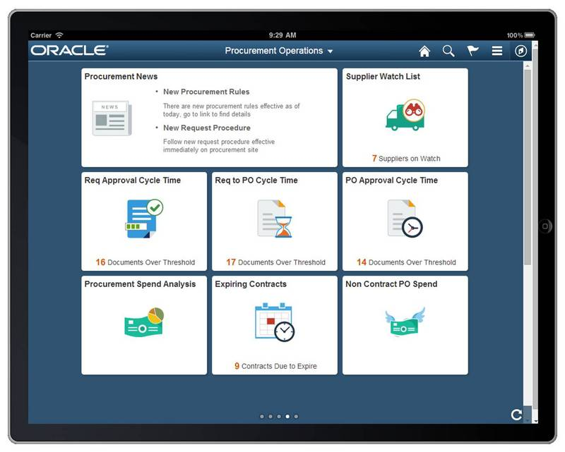

NEW environment
Application
Version 9.2
Tools
Version 8.55

Slide 6
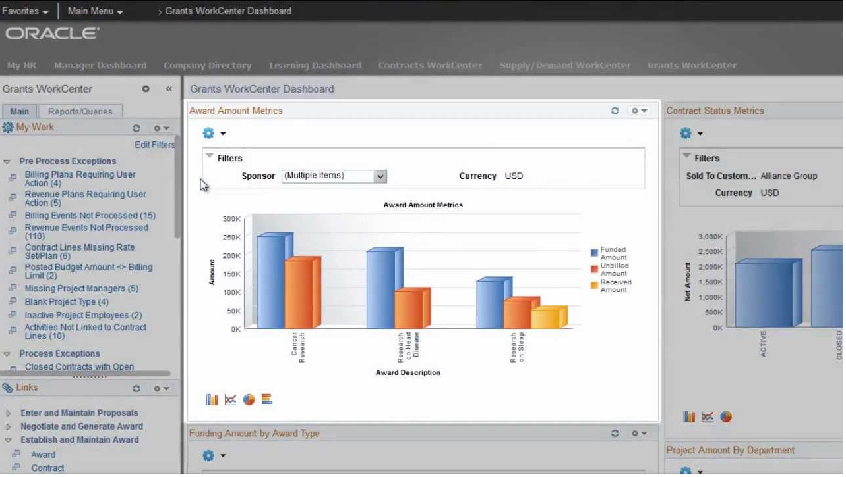
GRANTS WORKCENTER

Slide 7
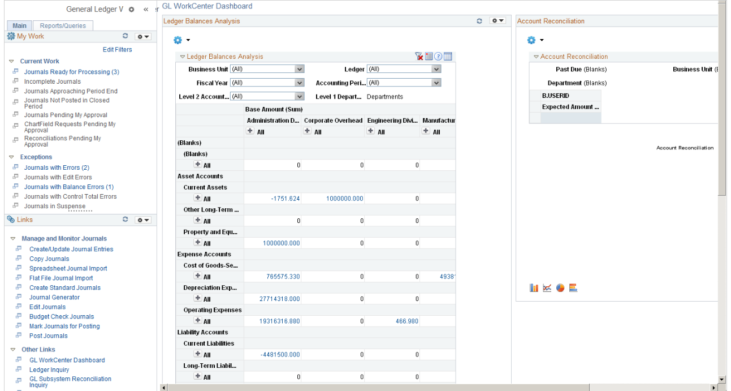
GL WORKCENTER & Dashboard

Slide 8
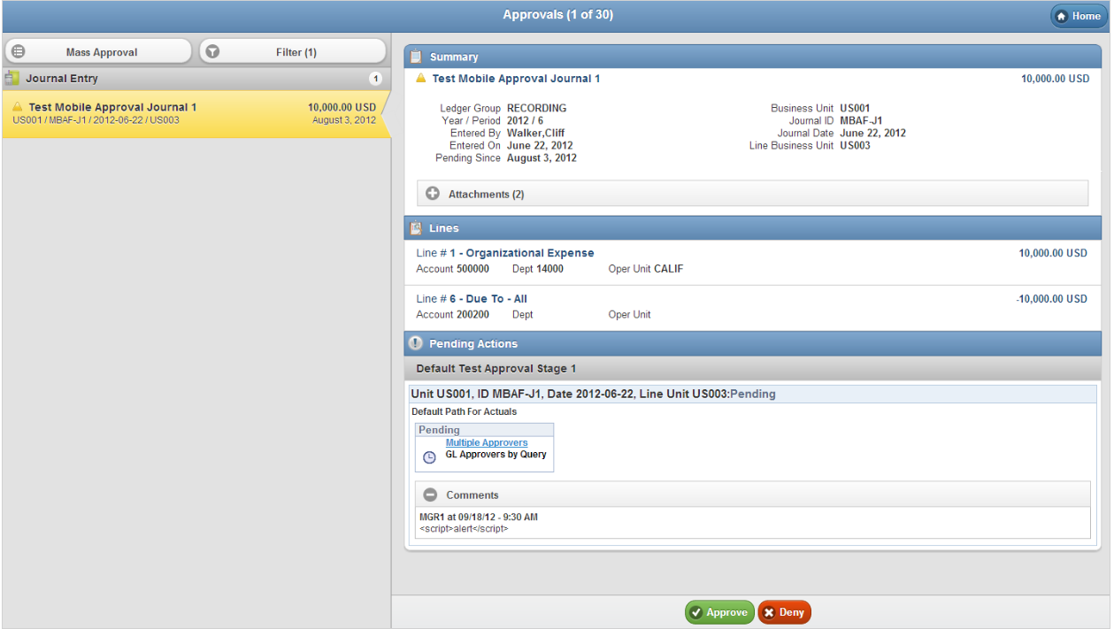
Journal ENTRY FLUID MOBILE APPROVAL

Slide 9
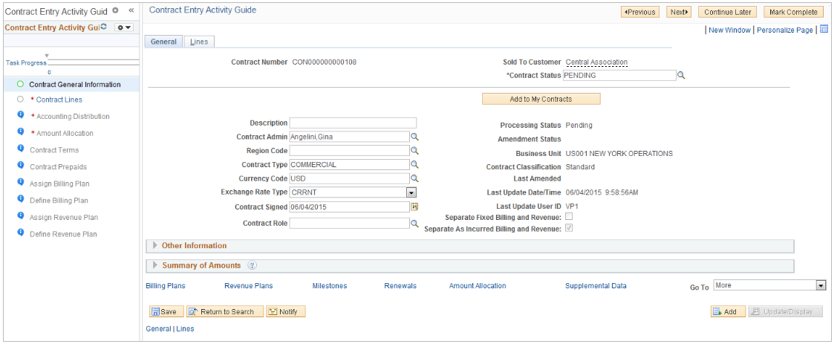
ACTIVITY GUIDE - Contracts

Slide 10
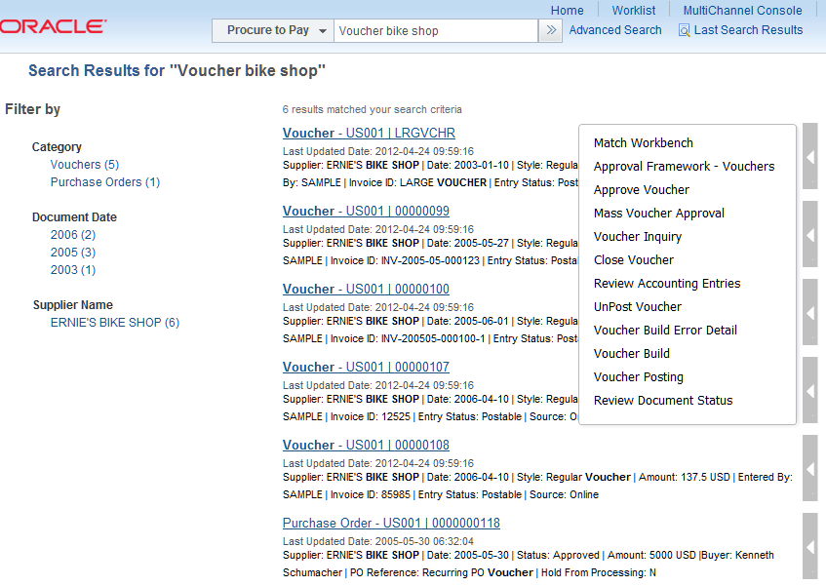
New Search framework

Slide 11
PRIMARY Project scope
Upgrade PeopleSoft Modules 8.9 to 9.2 with minimal operational disruption
Leverage delivered functionality by retiring customizations as feasible within project timeline
Eliminate dormant UMBC modified reports/processes/functionality
Retrofit approved customizations
General Ledger | Contracts
Asset Management | Grants Management
Receivables | Payables
Billing | Purchasing
Projects | Commitment Control

Slide 12
PRIMARY Project scope
Crystal Reports conversion
nVision conversion
Transition local infrastructure (Application, Database, and Web Servers) to Amazon Web Services
Special Projects
Archiving expired Grant data
Analysis and rewrite of GL State Interface

Slide 13
SECONDARY PROJECT SCOPE
Evaluate 9.2 impact in conjunction with pre-existing PT project requests
Identify features/tools that may be utilized post upgrade
Examples:
Change Order/PO notifications
Effort reporting notifications
Expense reimbursement workflow
Introduce new functionality if primary objectives have been met, and feasible within project timeline

Slide 14
project phases
Planning
Testing Cycles
(Training)
Deploy and Optimize
Analyze & Design
Configure & Develop
Phase 1
Phase 2
Phase 3
Phase 4
Phase 5
Project Management

Slide 15
planning
Phase 1
Set the foundation for a successful upgrade
Establish tools and standards used throughout the upgrade project
Establish project scope and related requirements
Build technical environments and begin initial pass
Learn about PeopleSoft 9.2
Fit/Gap preparation

Slide 16
ANALYZE AND DESIGN
Phase 2
Provide functional staff with a 9.2 upgraded copy of production and 9.2 Demo
Conduct Fit/Gap meetings for each module or business area
Create functional specification documents For 9.2 modifications
Special project meetings to gather requirements

Slide 17
FIT/GAP Explained
Phase 2
Task to formally determine how system meets or fails to meet business requirements.
Likely facilitated through meetings to analyze and compare current business practices and requirements with PeopleSoft “delivered” functionality in 9.2
Fit: A business requirement met using delivered System functionality.
Gap: A business requirement that isn’t met using delivered functionality.
Identifies areas that may require additional analysis to determine best Fit to specific institutional requirements.
Provides refinement to specific project task and scope for Project Plan.
Will lead to development of functional specifications
Identify pre-existing customizations that may be replaced with delivered functionality
Be prepared to discuss current business processes, reporting needs, required interfaces, applicable laws, regulations, and security requirements.

Slide 18
Configure and develop
Phase 3
Review and configure set up pages for all modules
Configure/Alter security settings
Document new/updated business processes
Create/Update technical specifications
Create/Update new test scripts
Retrofit approved customizations, interfaces, processes, and reports
Crystal report / nVision conversion
Development and configuration of special projects
Execute test pass to create initial testing environment

Slide 19
Testing Cycles & training
Phase 4
Unit - Testing after completion of retro-fits and customizations. Test Scripts not required initially.
System – Testing by Functional Area leaders using new test scripts
Integration – Using Integration Broker CS and HR , Third Party Interfaces
User Acceptance – Bigger group of Functional Testers involved, test production-like security
Performance – Testing targeted processes for performance. Process large amounts of data.
Regression – Retesting if previous tests failed
Develop training materials needed for user acceptance testing (and beyond)

Slide 20
deploy and optimize
Phase 5
Perform readiness assessment
Develop cutover plan and any contingencies
execute and optimize practice production passes
Obtain approval for “Go Live” weekend
Execute production upgrade
Provide production support
Perform performance monitoring and database tuning

Slide 21
Roles and responsibilities
Ben Lowenthal
Joe Kirby ...
Tony Finneran
Stacy Long
Sasha Hudson
Executive Stakeholders
Set objectives
Provide guidance
Remove obstacles
Oversee project budget
Project Managers
Develop project plan
Coordinate resources
Oversee project and timeline
Provide scope management
Facilitate meetings with team members to discuss progress and issues
Work with tech. team to develop “Go-Live” checklists
Identify project risks
Establish change control procedures and standards
Communicate project updates, planning, and procedures

Slide 22
Roles and responsibilities
Consultant (TBD)
Sasha Hudson
Functional Project Leaders
Work directly with functional area leads for each module
Lead Fit/Gap sessions
Lead Set Up and configuration for each module
Coordinate test cycles
Determine acceptance of new release
Review Release Notes and cumulative features
Functional Area Leads and Subject Area Experts
Provide business processes and requirements
Review Release Notes and cumulative features
Transfer knowledge to staff per each module/area
Conduct and participate in Fit/Gap meetings
Make design decisions and develop design documents
Help configure Set Up pages
Create and execute Test Scripts/Procedures
Report & document issues
Assist Tech Developers to resolve issues
Train Acceptance Testers
Ensure business needs are met
Linda Rothfus | Sue Maltby
Margo Falahee | Tim Kuonen
Aimee Howell | Gregory Saba
Albert Smith | Joanna Napoli
Tina Carter-Brown | Gayle Chapman
Mallela Ralliford | Melissa Diehl
Marlo Zeroth | Consultant
Jacqueline Brown
Rebecca Stuckmeier
Sharon Stankovic

Slide 23
Roles and responsibilities
Technical Upgrade Team
Installation and Configuration of Upgrade Tools
Installation of Demo Environment 9.2
Execute Upgrade Passes
Apply Required Updates, Fixes, and Patches
Perform System Backups
Assist with Database Performance/Tuning
Perform Security Configuration/Changes
Troubleshoot Technical Issues
Ensure Data Integrity
Transition Servers to Amazon Web Services
Manage Login, Security, Roles, Etc.
Configure Broker, Workflow, Process Monitor
Technical Developers
Troubleshoot Technical Issues
Develop and Retro Fit Reports, Queries, Interfaces, Processes, and PeopleSoft Objects.
Perform Unit Testing
Lead Analysis and Design of Special Projects
Analyze Compare & Audit Reports
Document Technical Specifications
Become Familiar with New Tools/Technology
Tony Finneran
Stacy Long
Todd Haddaway
Damian Doyle
Jeremy Gude
Steve Ostrove
Chris Sutherin
Lance Rand
Derek Harley
David Sylva
Consultant (TBD)

Slide 24

Critical success factors
Senior Management Sponsorship
Staff resources focused and committed to project
Project planning
Define and adhere to scope
Project Team empowered to make decisions
Open and effective communication
Knowledge transfer
Timely decision making
Follow standards and procedures for change management

Slide 25

risk factors
Production issues may impact availability of both functional and technical team members
Technical resource team is limited
Process of hiring consultant(s) delayed
Amazon Web Services not ready for full system test, or experience integration/communication/Performance issues
Total execution time to perform upgrade steps (Passes)
Project scope creep
Competing projects
Data migration issues from 8.9 to 9.2
Learning curve for new technology

Slide 26

Communication Tools
myUMBC group:
Campus - http://my.umbc.edu/groups/fs92-campus
Utilize existing listservs for updates/announcements
Town Hall Meetings
Business Manager meetings
Weekly project team meetings
Track and update project in PT
Will include effort/status reports
Update and manage the project plan, which is linked to PT project
RT dedicated queue for Finance upgrade issues

