Slide 1
How to get Started in Research
Dr. April Householder
Director of Undergraduate Research and
Nationally Competitive Scholarships
aprilh@umbc.edu

Slide 2
How do I get involved with research or creative work?
What areas of study interest you? Learn something about current activities in your field. Listen in class, ask faculty members and graduate students about current research, read textbook or journal articles
Determine how much time each week, and when, you can give to research work. Can you offer more time during the summer or in January? For the sake of your grades, is it better for you to conduct research in the summer rather than during the academic year?

Slide 3
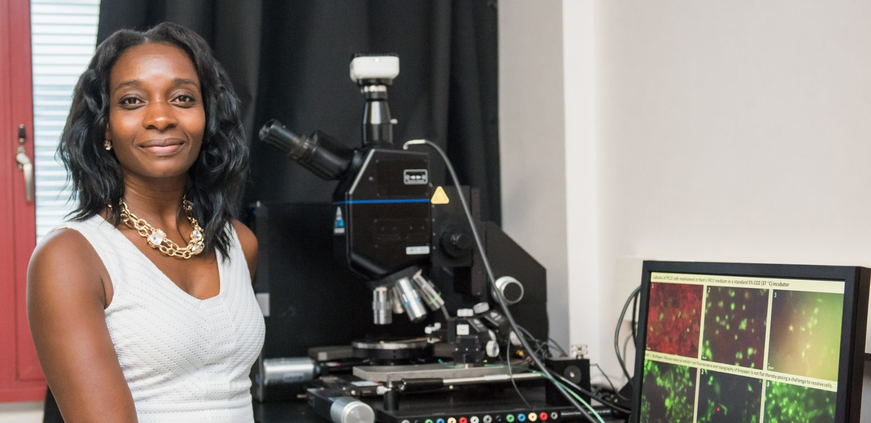
Find a mentor
Look at the department web pages. In some departments faculty post the projects for which they need undergraduate assistants. Identify projects you would like to work on or faculty you would like to work with, even if undergraduate research positions are not specifically mentioned
Speak with your academic advisor and your current professors
Talk with your peers or teaching assistants about which faculty members are good mentors
Find out who mentored earlier undergraduate researchers in your area by reading research abstracts linked from ur.umbc.edu/urcad/archive/
Look beyond the UMBC campus. Artists throughout the area may accept apprentices. Researchers at other area institutions often need students. For example, look at the faculty web pages at University of Maryland, Baltimore medical, dental, nursing and pharmacy schools

Slide 4
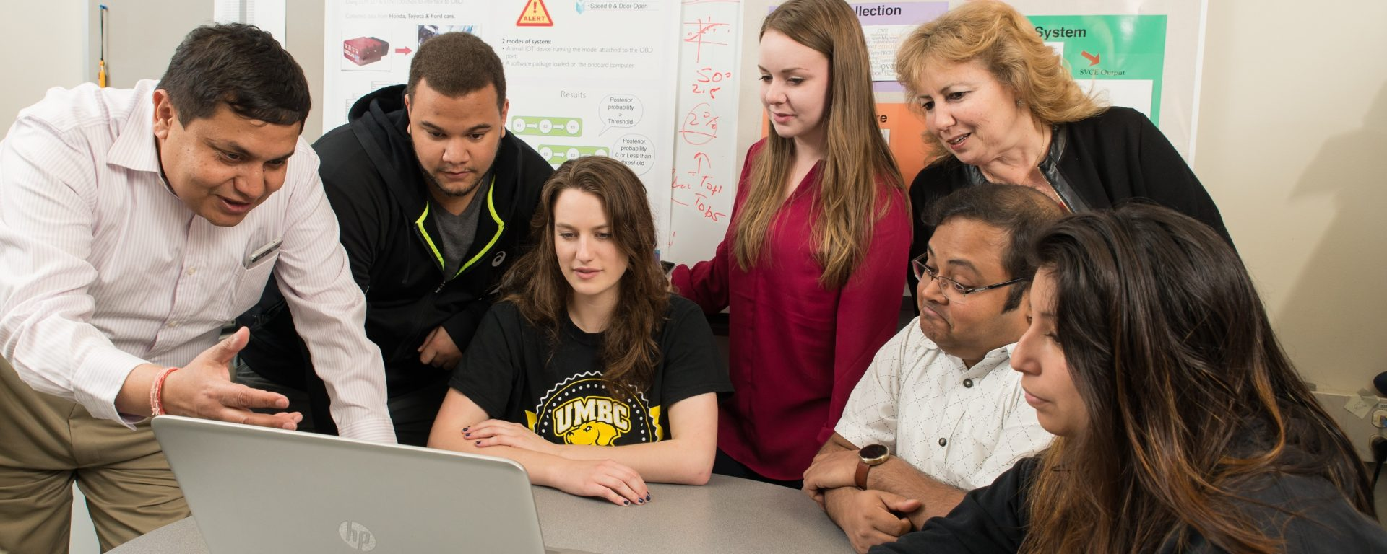
Find an opportunity
For a comprehensive list of research opportunities both on and off-campus, including summer opportunities, go to: ur.umbc.edu/summer-research/
You can search by your major, or go to the spreadsheet

Slide 5
Reach Out
Identify three to five potential mentors. Approach the faculty members after class or during office hours to request an appointment to discuss research
Be prepared to e-mail or bring in person your current transcript (unofficial) and a resume. Visit the Career Center for help in creating a strong resume
You may ask to join the faculty member’s ongoing work as an assistant, or request mentoring in a creative or research project of your own design. If you have a specific project in mind, a mentor can help you fine tune your plans and get started
Potential mentors may be approached at any time of year, but typically two to three months in advance of the time you would like to begin working
If you can offer large blocks of time during summer or winter break, this can be a good way to get started with an on-campus research or scholarly project. You can then receive necessary training in a short time and be ready to work more independently when classes start again
Many summer research application deadlines are in February. Look at the offerings through the fall. A successful application process usually starts in November

Slide 6
Once you start the research project…
Take the work seriously and make it a priority in your schedule. Be reliable
Keep in mind that your strongest letter of recommendation for graduate school or scholarship opportunities will come from your research mentor. Nurture the relationship
Discuss with your mentor whether academic credit is appropriate for your work. (PRAC)
Begin to work on your proposal for an Undergraduate Research Award. ur.umbc.edu/ura/
If you are already involved with research, plan to participate in Undergraduate Research and Creative Achievement Day (URCAD) on April 25 ur.umbc.edu/urcad/
Submit your research results for publication in the UMBC Review ur.umbc.edu/umbc-review
If you are a top-tier student, consider applying for a prestigious scholarship ur.umbc.edu/ncs

Slide 7
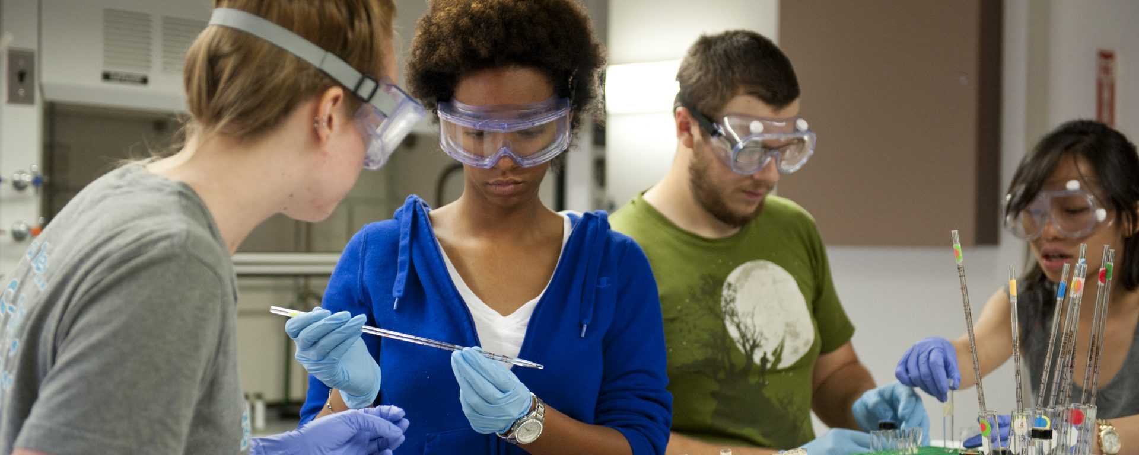
For more assistance
Dr. April Householder aprilh@umbc.edu
Enjoy the work!

