Slide 1
Collaborating on a Cloud Platform:
A Cloud Primer for CFO’s
How research and education institutions worked together to create a sustainable path to cloud technologies and achieve efficiencies through aggregation, collaboration, adoption and delivery
Monday, July 20, 2015
Notes:
Submitted

Slide 2
Today’s session will be interactive, please join us at the following link:
https://pulse.bing.com/app/Cloud4HigherEd/N15
Additional materials regarding todays session and higher education community collaboration for cloud adoption can be found at:
http://bettercloudforhighered.internet2.edu/

Slide 3
To what extent is your institution pursuing cloud services?
We are taking a wait-and-see attitude
We are planning, and piloting one or two initial services
We are, or are becoming, significantly invested in cloud services
Cloud has become the norm, not the exception, for delivering campus IT services
What are cloud services?

Slide 4
What aspect do you think offers the best potential benefit in adoption of Cloud Services?
Better User Experience
Speed of Deployment
Better Functionality
Consistent Functionality Lower Operating Costs
Who said its better than our current approach?

Slide 5
What is your biggest concern about your campus adopting Cloud Services?
Security
Cost (product and deployment)
Data Management (where’s the data?)
Accepting “as is” / Meeting business needs
All of the Above

Slide 6
What level do you think your primary cloud services strategy should target?
Individual Choice
Departments Choice
Campus Wide Standardization
System Wide Standardization
Intergalactic Wide or no Strategy

Slide 7
LYNNE C. SCHAEFER
Vice President, Finance & Administration
JOANNE DESTEFANO
Vice President for Finance and CFO
DR. ALAN D. ROBERTSON SR.
Vice President for Business & Finance/CFO
JACK SUESS
Vice President of Information Technology & Chief Information Officer
TED DODDS
CIO and VP for Information Technologies
CLIFFORD RUSSELL JR. Chief Information Officer
Moderator: SHELTON WAGGENER Senior Vice President, Internet2

Slide 8
How can information technology – and the CIO – improve work life for a CFO?
Providing better management information for decision making
Helping reduce the time & spend processing transactions (focus on analysis)
Helping improve business processes & “back office”
All of the above – and then some

Slide 9
What is the most difficult hurdle in buying cloud services?
Can’t make changes, have to accept as-is
Operating Expense vs. Capital Expense
Its harder to purchase than legacy tech
Legal agreements require more review time
All technology is the same – just fancy new name

Slide 10
What is most difficult hurdle in deployment of cloud services?
Can’t customize, have to accept as-is
Project planning and governance
Connecting a cloud system to a campus setting
Expectation Setting (“Its easy”)
All technology is the same – just fancy new name

Slide 11
LYNNE C. SCHAEFER
Vice President, Finance & Administration
JOANNE DESTEFANO
Vice President for Finance and CFO
DR. ALAN D. ROBERTSON SR.
Vice President for Business & Finance/CFO
JACK SUESS
Vice President of Information Technology & Chief Information Officer
TED DODDS
CIO and VP for Information Technologies
CLIFFORD RUSSELL JR. Chief Information Officer
Moderator: SHELTON WAGGENER Senior Vice President, Internet2

Slide 12
Shaping the Cloud NACUBO/EDUCAUSE/Internet2 Whitepaper
“One of the fundamental changes that higher education is beginning to understand is that institutions are competing as an alliance that moves the whole industry forward. One of our greatest leadership opportunities is to not simply think about optimizing our local campuses but the entire industry.”
— Brad Wheeler, CIO, Indiana University
https://internet2.app.box.com/Higher-Ed-Cloud-Paper-2010

Slide 13
How many are working actively with other campuses on your cloud deployments
Yes, have an active program in place
No, hard enough working with our departments!
Not yet but would consider it

Slide 15
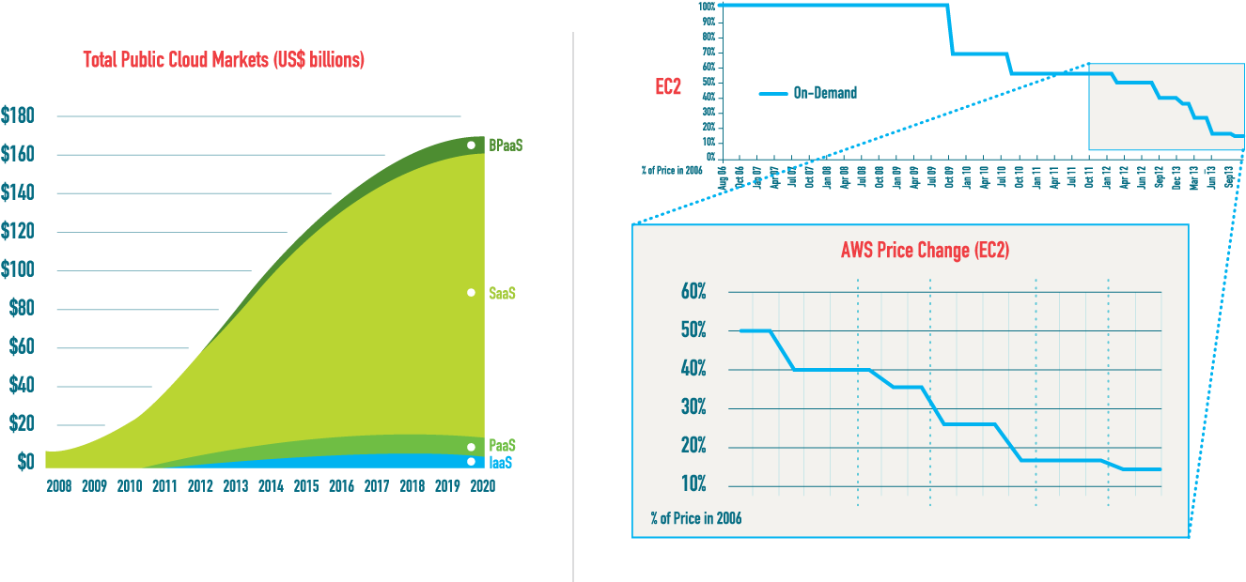
By 2020 SaaS will account for $133 billion of the $160 billion industry, while IaaS will make up
$5 billion, PaaS $12 billion and BPaaS $10 billion.
32% Year Over Year Growth With Near Quarterly Price Reductions in IaaS and PaaS

Slide 16
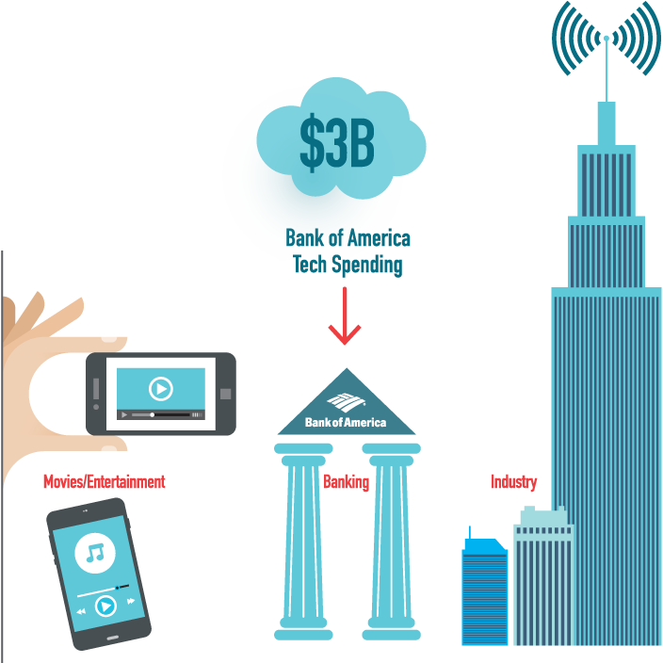
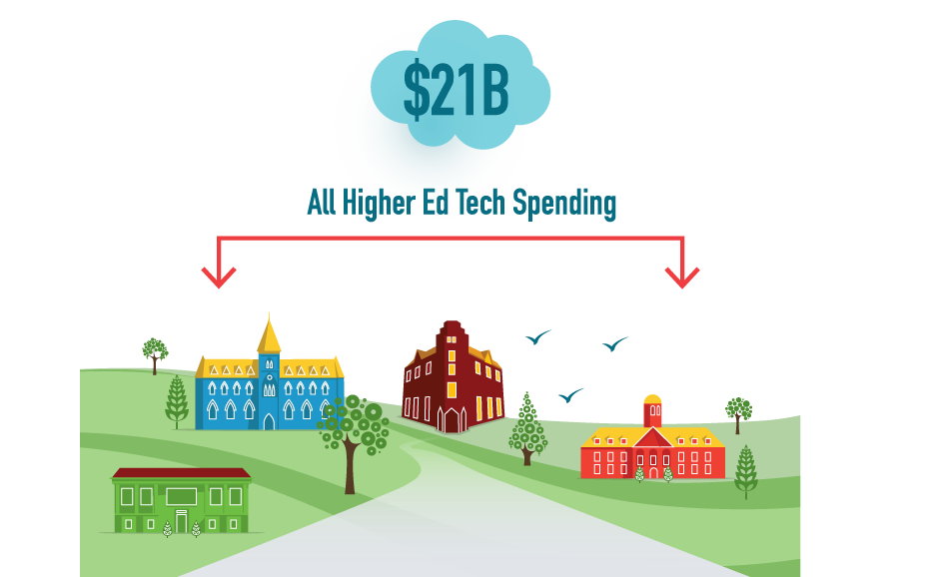
Setting an Aligned Direction
How does a community with just a few percent of spending, help set the direction for a growing industry?

Slide 17
How Do You Find The Best Services?

Slide 18
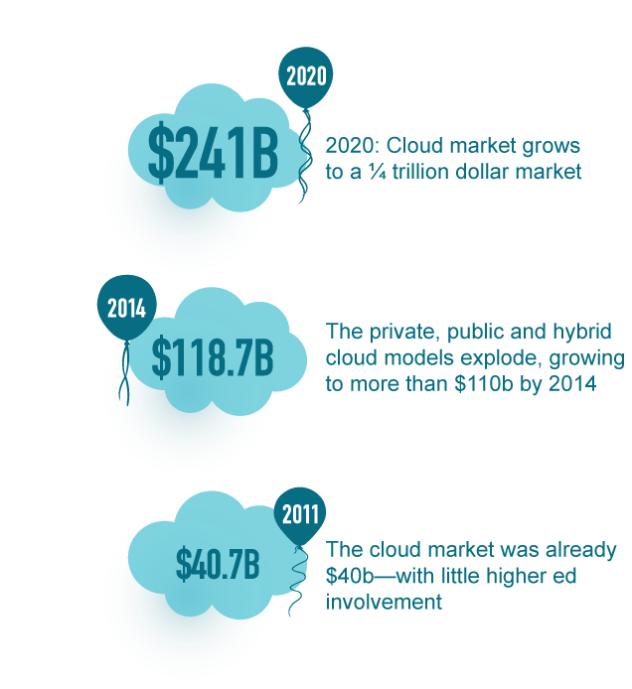
The Growth of Cloud Computing is Astounding
To Leverage Community Capabilities
To Influence the “Cloud Industry”
To Benefit National Scale Research & Education
Notes:
July 16 12:15 Eastern

Slide 19
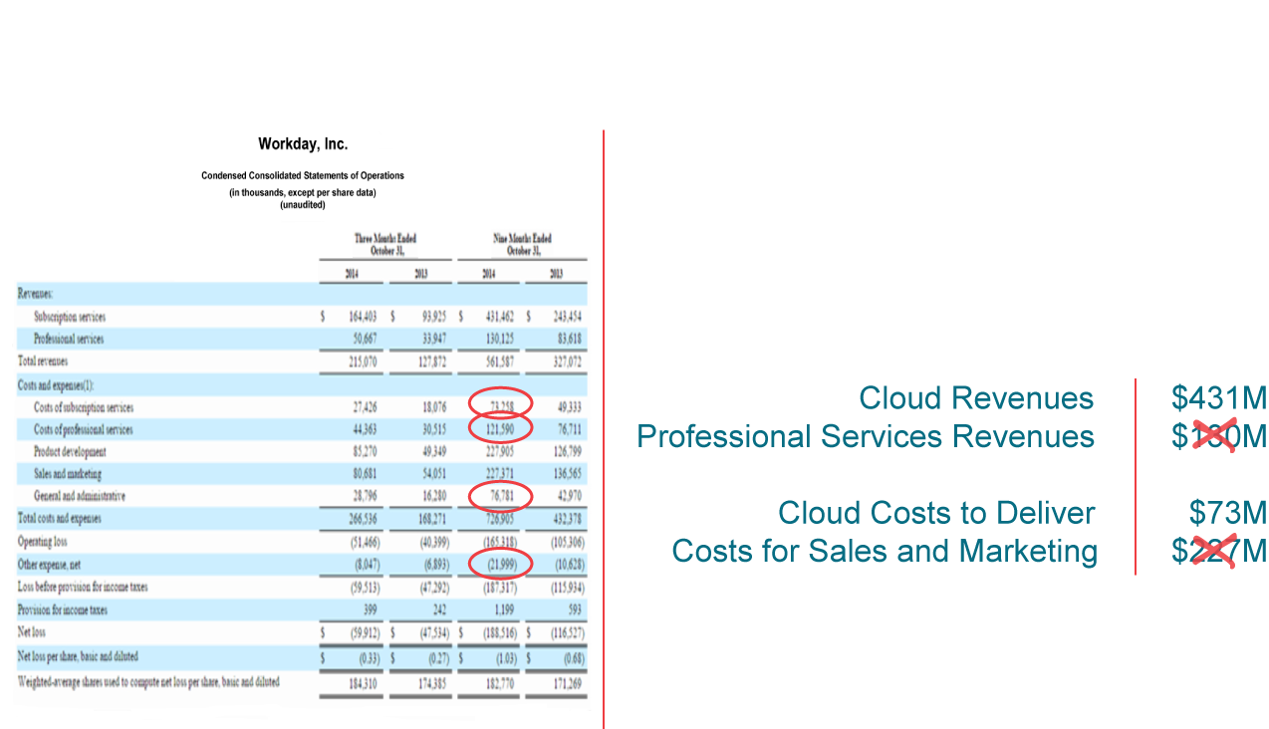
Our Mutual Opportunity Example: Workday 10-K, 9 months, October 2014

Slide 20
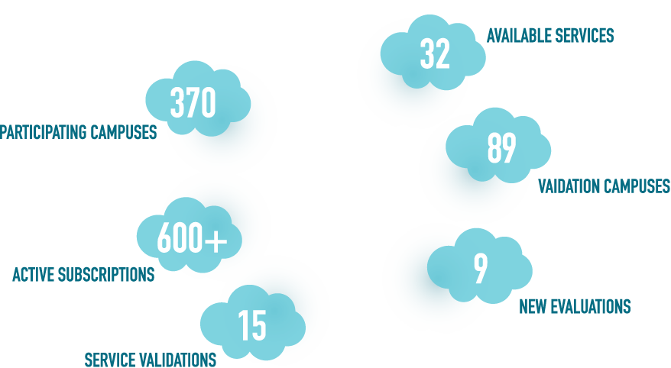
In 1210 Days You Have Built…
For the CIO’s: Each of you have been involved in service validation efforts.
What is your opinion on the process?

Slide 21
Our Strength is in Our Numbers
What is it about the NET+ principles that you feel are important for higher education and chief business officers to embrace?

Slide 22
Striking the Right Balance

Slide 23
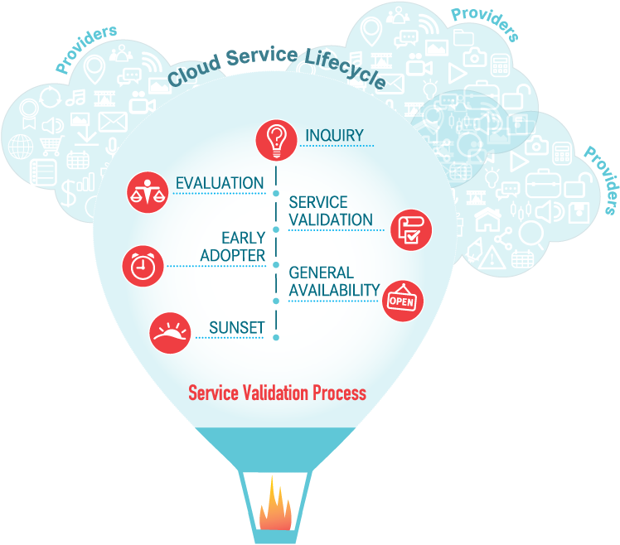
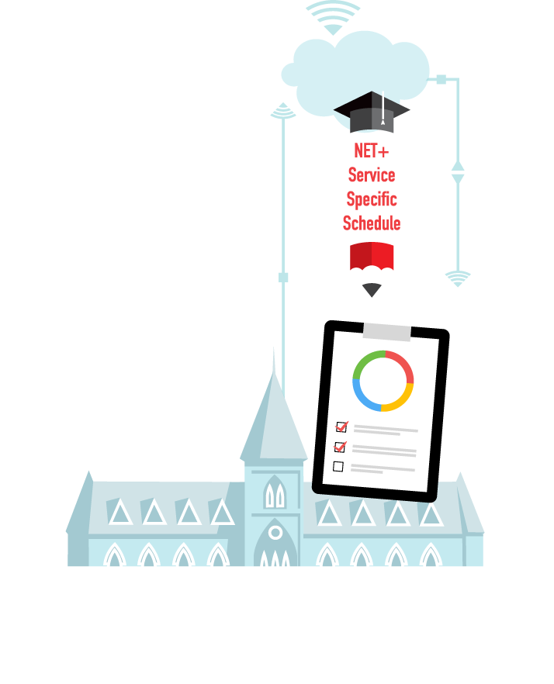
The New Streamlined Contract Model

Slide 24
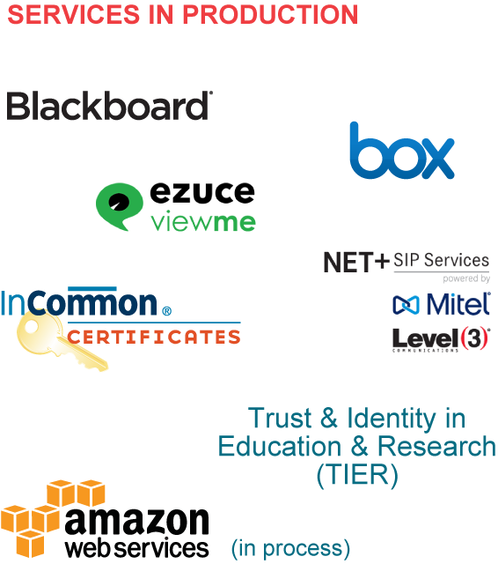
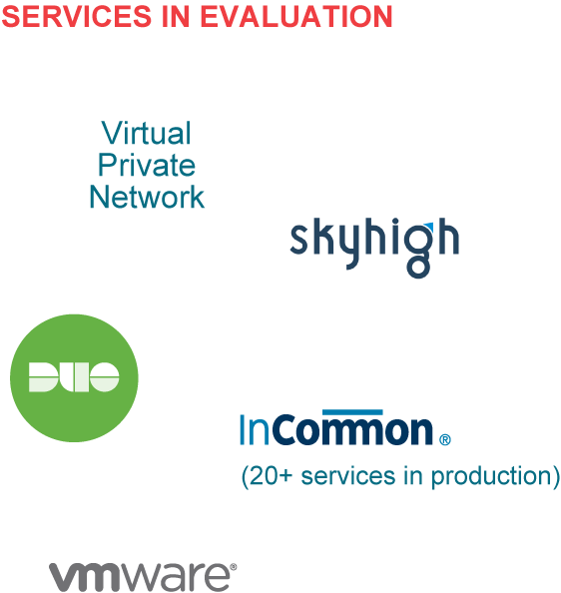
UMBC NET+ Services
SERVICES IN PRODUCTION
SERVICES IN EVALUATION

Slide 25
Cornell University NET+ Services
SERVICES IN PRODUCTION
SERVICES IN EVALUATION

Slide 26
Morehouse College NET+ Services

Slide 27
In 1210 days you have built a growing ecosystem of NET+ Services and Providers 35 tailored cloud services, now available—50+ in development!

Slide 28
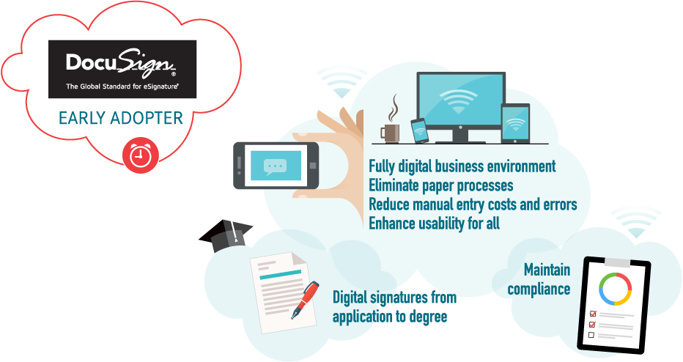
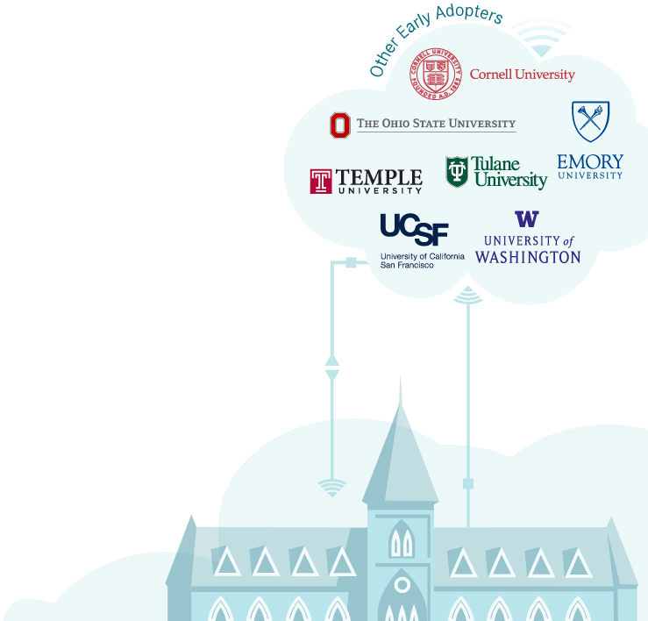
NET+ DocuSign—Powered By Community

Slide 29
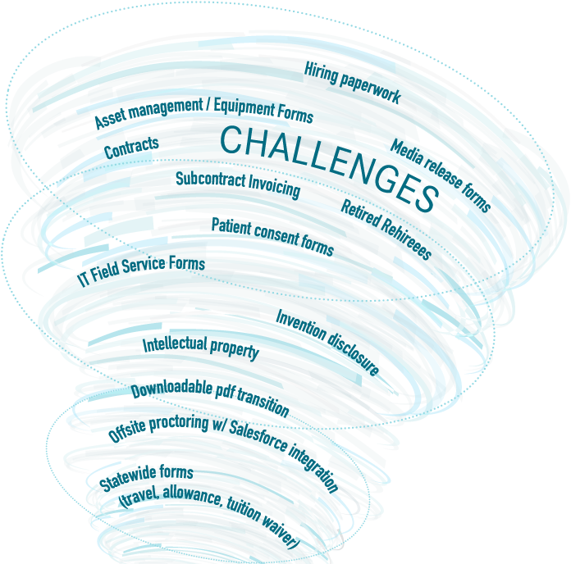
How is Higher Education Already Advancing with DocuSign?
2,500 documents prepared and sent in 15 minutes
982 documents signed within 1 hour of sending
2,961 documents signed within 24 hours of sending
$23.08 savings per hire in staff time
40% staff time Savings
Per-interaction and overall cycle time savings
Integration with HRS and other IT systems
It services form batch delivery
Campus-wide just in time document provisioning
Success with non-native english speakers
Document imaging library integrations
Embeddable powerforms
Esign Testing agreements

Slide 30
THANK YOU! More information about cloud services designed and vetted by the higher education community is available at: http://bettercloudforhighered.internet2.edu/

Slide 31
LYNNE C. SCHAEFER
Vice President, Finance & Administration
JOANNE DESTEFANO
Vice President for Finance and CFO
DR. ALAN D. ROBERTSON SR.
Vice President for Business & Finance/CFO
JACK SUESS
Vice President of Information Technology & Chief Information Officer
TED DODDS
CIO and VP for Information Technologies
CLIFFORD RUSSELL JR. Chief Information Officer
Moderator: SHELTON WAGGENER Senior Vice President, Internet2

