Slide 1
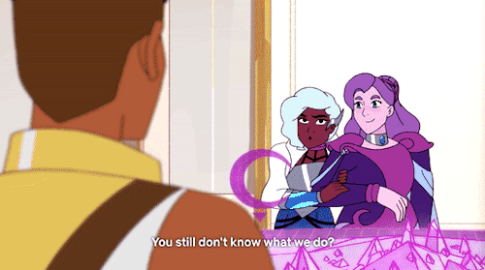
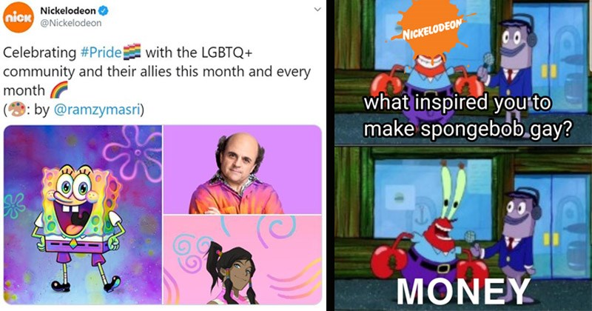
LGBTQ+ STUDENT UNION
General Body Meeting - October 14, 2020

Slide 2
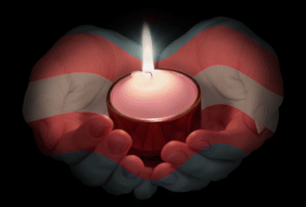
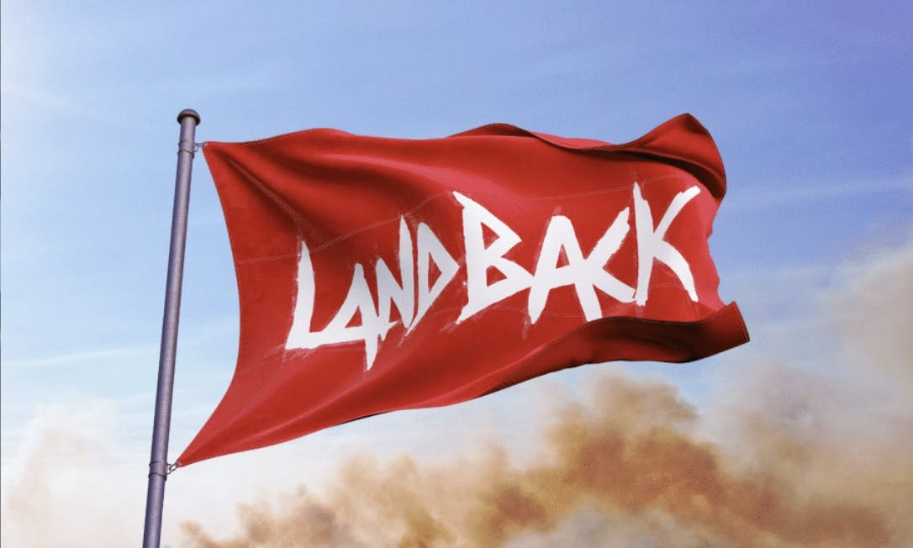
REMEMBRANCE & LAND RECOGNITION
“Fatal Violence Against the Transgender and Gender Non-Conforming Community in 2020”
“Murders of Transgender People in 2020 Surpasses Total for Last Year in Just Seven Months”
UMBC Women’s Center’s Land Recognition Statement: “UMBC was established upon the land of the Piscataway and Susquehannock peoples. Susquehannocks ceded this land and, over time, citizens of many more Indigenous nations have come to reside in this region.
For those residing in the area: this is not our land; we occupy it. Colonialism has long undergirded systemic violence faced by Black, Indigenous, and other communities of color.
We humbly offer our respects to all past, present, and future indigenous people connected to this place.”
Notes:
Jordan

Slide 3
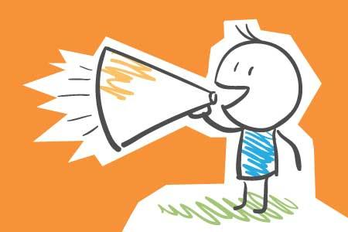
ANNOUNCEMENTS
Our Next Meetings (Subject to change):
Edu & Advocacy - Mon 10/19 @ 4pm
Trans Tuesday - Tues 10/27 @ 4pm
General Body - Wed 10/21 @ 4pm - 530pm**
^^Please fill out any forthcoming polls to let us know your availability; we are considering meeting changes. Also, be sure to fill out the upcoming survey about a potential weekly social hour!
**As we work on changes, we’ve decided to lengthen GBMs to allow extra space for sharing event/ planning ideas/updates and for some extra vibing!
Other LGBTQ-related Meetings & Events:
Spectrum
Between Women
QPOC - GBM
Brave Space Forum: Gender in a Pandemic
WILL+ What’s Your Leadership Style?
WILL+Social Hour
Other Events:
PAWTalks: Janel Martinez, “Ain’t I Latina?”
We Believe You discussion group
[Free]dom Fridays: The Yellow Power Movement
Sex in the Dark
Confronting Your Biggest Bully (You) [for
adult returning women and non-binary students]
Follow us @umbclgbtq on IG & Twitter ● Join our e-mail listerv ● Join our Discord
Notes:
Jordan

Slide 4
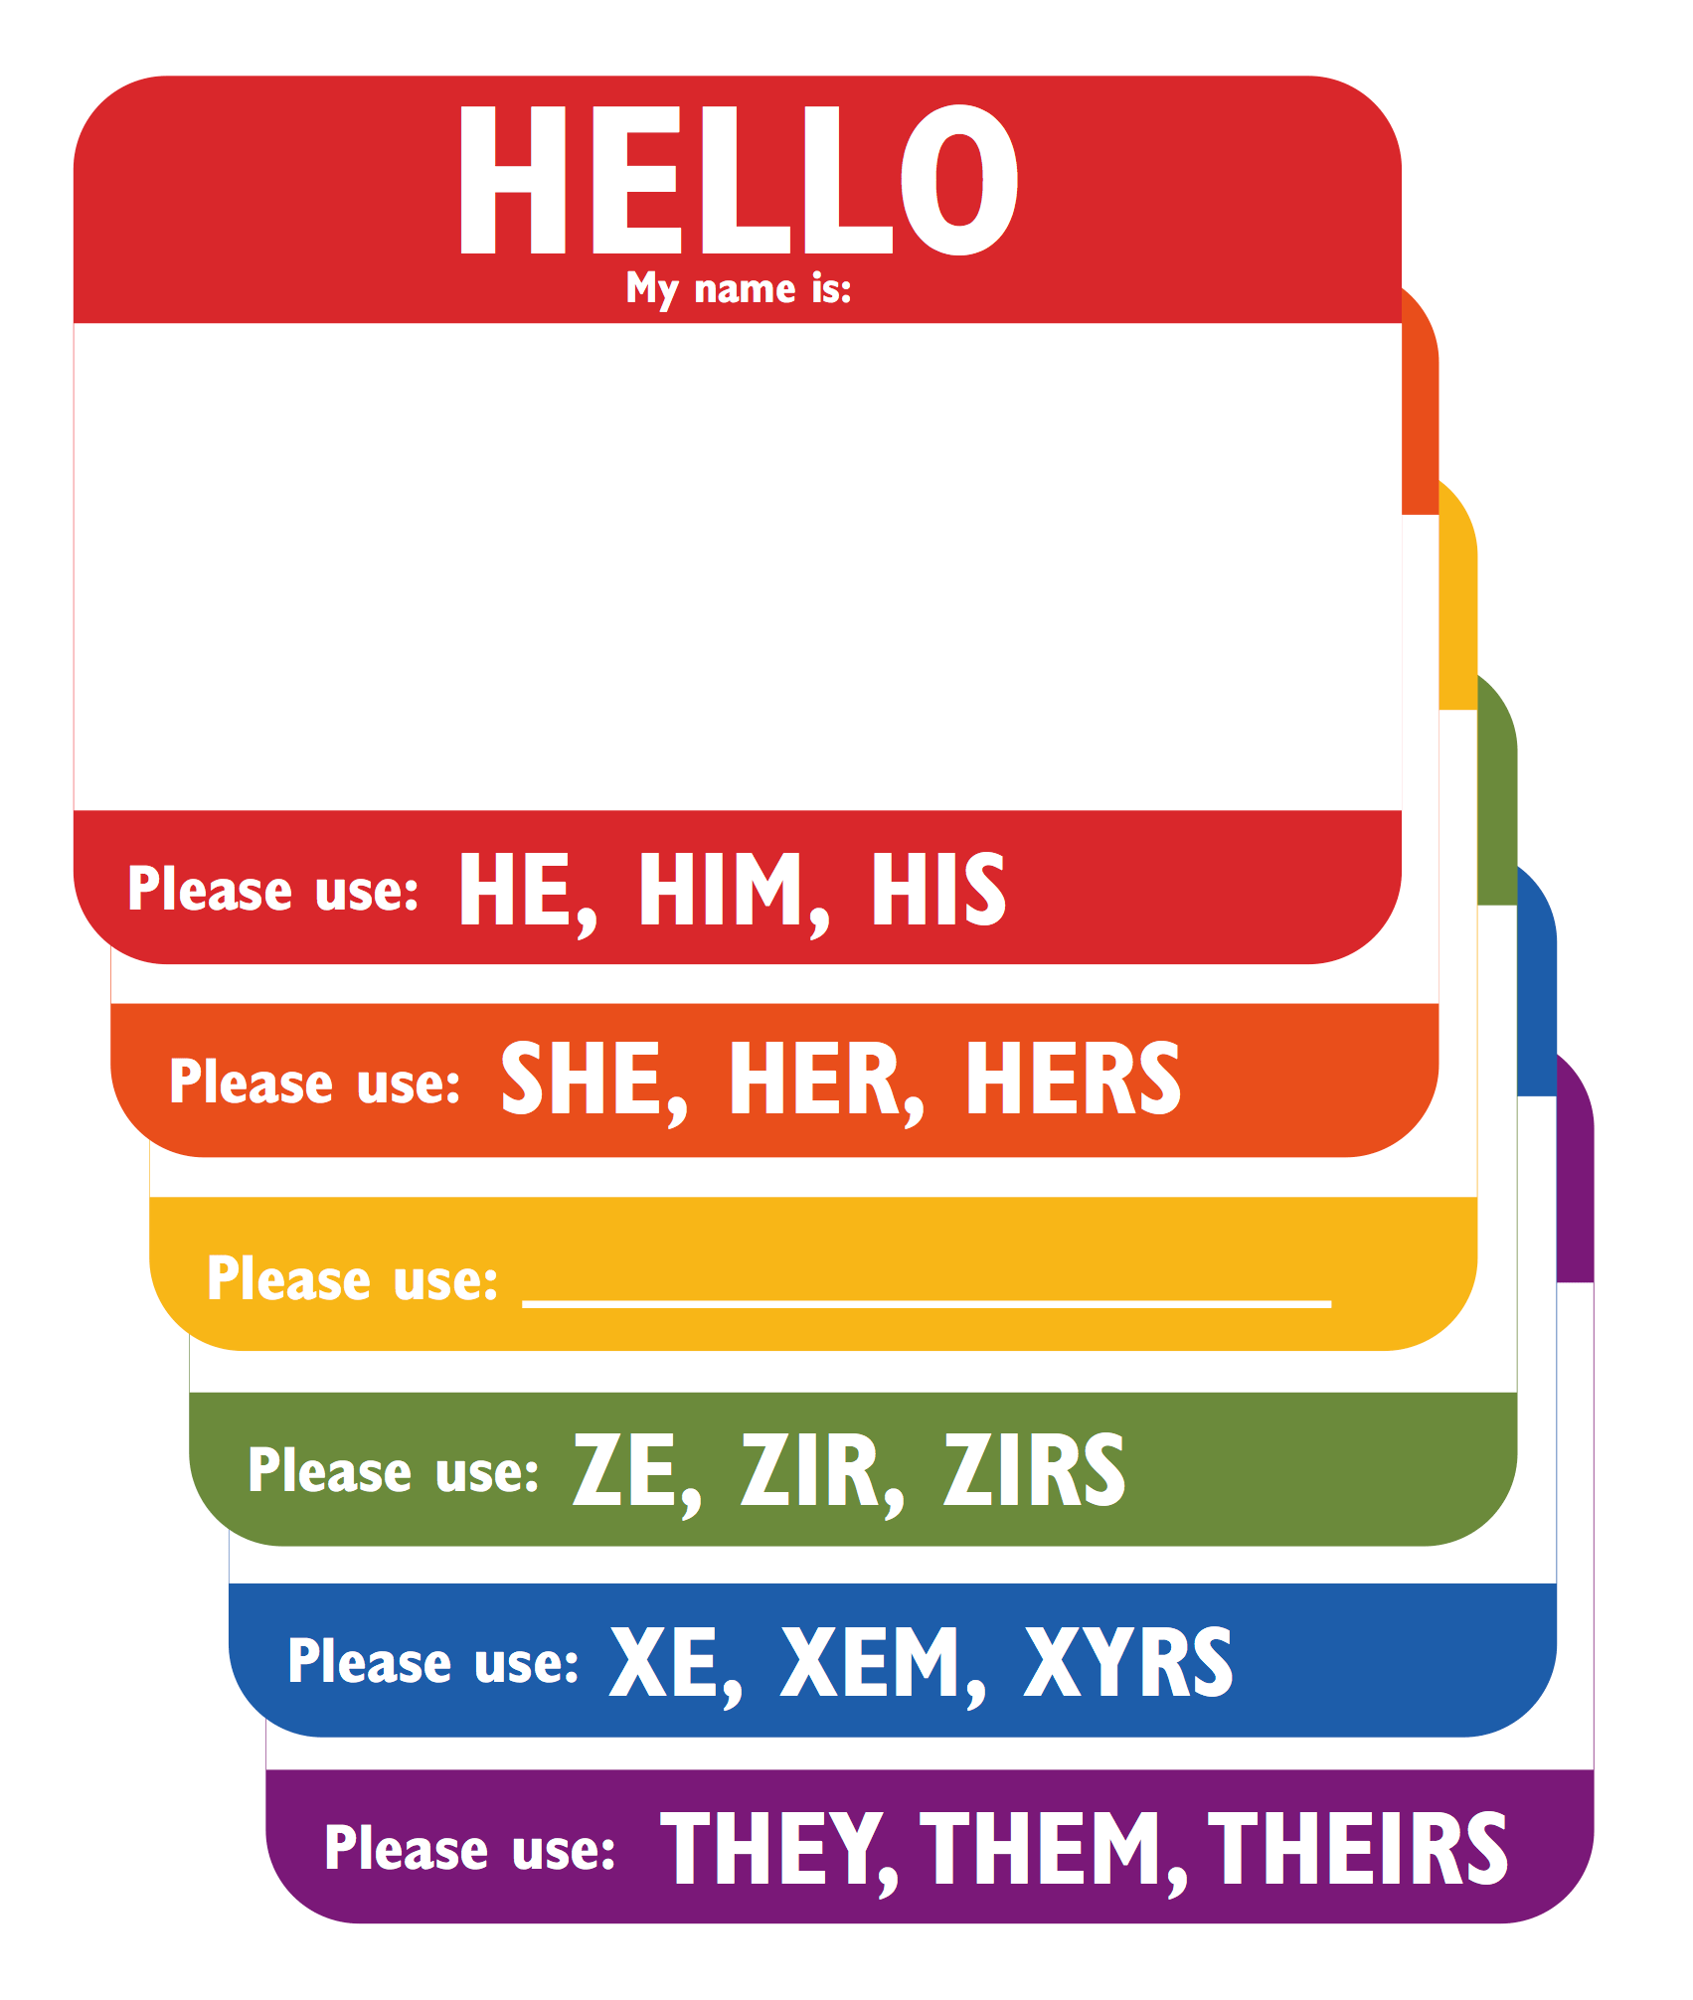
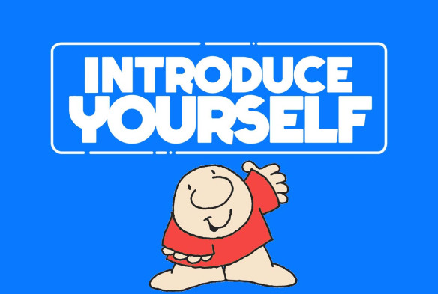
INTRODUCTIONS
Name (if you want)
Pronouns (if you want)
Major & Year (if you want)
Do you remember the first time you “saw yourself” in a media representation, or have you seen yourself? (if you want)
Notes:
Piper

Slide 5

DISCUSSION RULES
Ouch-Oops: If you’re “ouched”, apologize (or “oops”) and allow other person to let you know what you said that was hurtful. Actively listen, and if there’s need for specific repair/acknowledgement, do so.
  (Remember, we want this space to be a Brave Space, so we want to create room to call people in and build understanding, not just to call people out.)
Snaps or Jazz Hands: %% or emojis in the chat or jazz hands to echo someone else’s point or agree
Name & Pronoun Rules: If you screw up, apologize; restate sentence with correct name/pronouns; and don’t bring it back up.
Move up-Move Back: If you tend to speak a lot, try to pass the mic. If you often are more quiet or hesitant to share, try to step in if you want.
Notes:
Piper

Slide 6
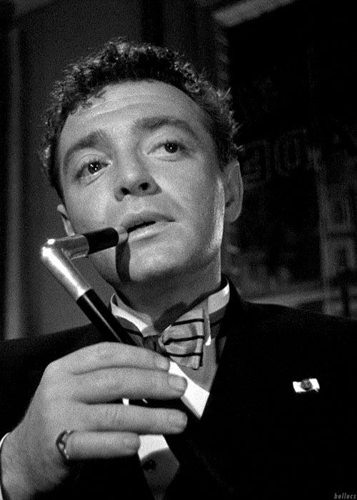
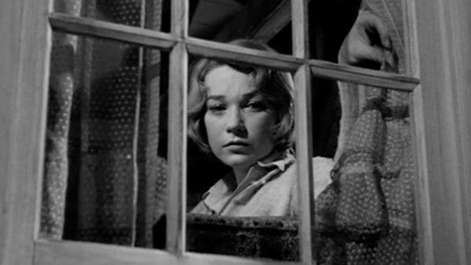
BRIEF HISTORY: LGBTQ+
REPRESENTATION in TV & FILM
The Hays Code & Queer Coding
Pre-Code, no film rating system like today - public concern about themes arose
SCOTUS Case 1915; ruling of Mutual Film Corporation vs. Industrial Commission of Ohio stated because film “may be used for evil…we cannot regard the [censorship of movies] as beyond the power of government”
Hollywood kept releasing film with “immorality”; U.S. citizens more vocal.
In 1933, Hollywood production companies self-imposed the Hays Code.
Enforced from about 1934-1965
Mandated what wasn’t allowed in film - prohibited positive explicit representation of deviance from hetero- or cisnormative gender and sexuality
Queer coding used during era to continue representing queer narratives in film.
Queer coding is accomplished by presenting characters with certain mannerisms, costuming, or speech patterns to evoke subconscious ideas of “queerness.”
Aftermath & Effects
See for more info: “The Evolution Of Queerbaiting: From Queercoding to Queercatching”
Leads to harmful tropes (e.g. “Bury your gays) and exaggerated stereotypes (e.g. the self-hating gay or the Pansy)
Turns queer representation into a money-making scheme (as in “queercatching”)
Notes:
Jordan

Slide 7
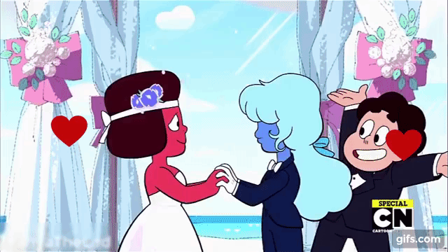
Q&A: LGBTQ+
REPRESENTATION in TV & FILM
What are some of your favorite LGBTQ+ characters in TV or film? Why?
(If we spend the whole time gushing about our faves, that’s fine by us! We
wanted this week’s meeting to bring some positive feels!)
How much has that media taught you about your own community(ies)?
Does “accurate” representation of LGBTQ+ characters matter? Why or why not? Is more of this kind of representation enough?
Do you think that quality representation in TV and films ultimately improves LGBTQ+ people’s lived experiences? Why or why not?
What can be done to make “better” representation? What would “better” mean to you?
Notes:
Piper

Slide 8

THANKS FOR COMING!
See you next time, and good luck with Midterms!

