Slide 1
UMBC Campus Resources

Slide 2
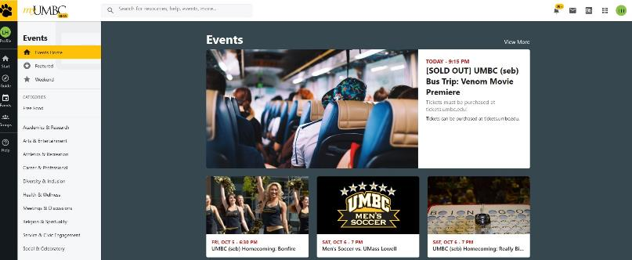
myUMBC Events Calendar
http://my.umbc.edu/events

Slide 3
University Health Services
Where: Erikson Hall
Monday – Friday, 8:30am – 5pm
(410) 455-2542
After hours care: (410)455-5555
https://player.vimeo.com/video/71349692

Slide 4
Counseling Center
Student Development & Success Center
410-455-2472
Monday-Friday 8:30am-5:00pm
http://counseling.umbc.edu/

Slide 5
Interfaith Center
The Interfaith Center "Student Success & Development Center", the yellow one-story building between Chesapeake and Susquehanna Halls. Walk up the right wheelchair ramp and go in the door on the right side of the building.
The Interfaith Center (IFC) is dedicated to creating, fostering, and supporting interfaith collaboration at UMBC. The IFC provides space for students, staff and faculty from all religious and spiritual backgrounds to meet, worship, discuss, and celebrate their individual and collective faiths and belief systems.
https://campuslife.umbc.edu/diversity-and-inclusion/interfaith-center/

Slide 6
Student Government Association
http://sga.umbc.edu

Slide 7
Student Events Board (seb)
http://seb.umbc.edu

Slide 8
Student Organizations Fraternities & Sororities
https://campuslife.umbc.edu/student-organizations/list-of-student-organizations/

Slide 9
The Retriever Weekly (TRW)
http://retrieverweekly.umbc.edu

Slide 10
Queer Student Lounge
Location : University Center, Rm. 201
Phone : 410-455-6370
E-mail : lgbtq@umbc.edu
9 AM – 5 PM, Monday – Friday
https://campuslife.umbc.edu/diversity-and-inclusion/lgbtq-resources/

Slide 11
Leadership Education from Student Life
STRiVE
LeadingOrgs Retreat
First Year Council (FYC)
https://campuslife.umbc.edu/leadership/leadership-development/

Slide 12
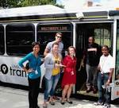
UMBC Transit Bus Schedule & Apps
http://www.umbc.edu/transit/

Slide 13
Women’s Center
http://womenscenter.umbc.edu/

Slide 14
Residential Life
http://www.umbc.edu/reslife/

Slide 15
Career Center & UMBCworks
Math/Psychology 201
Email: careers@umbc.edu
http://careers.umbc.edu/umbcworks/

Slide 16
The Shriver Center
Mission:
The Shriver Center at UMBC promotes the integration of civic engagement, teaching, learning, and discovery on campus, regionally, and nationally so that each advances the others for the benefit of society.
https://shrivercenter.umbc.edu/

Slide 17
The RAC’s Intermural Sports
Fall 2018 IMLeagues
Outdoor Soccer
Flag Football
Indoor Soccer
5v5 Basketball
E-Sports
Fall 2018 One Day Events/Tournaments
3K Monster Dash
5K Turkey Trot
BIG 3 Basketball ( 2 Day event)
Volleyball
GLOW Dodgeball
https://recreation.umbc.edu/

Slide 18
Pre-Professional Advising
http://advising.umbc.edu/

Slide 19
Registrar
Mission : “Our mission is to provide the UMBC community with high quality services related to academic programs, registration, records, and graduation…”
Location: Sherman Hall, B-Wing 2nd Floor
Office Hours : Monday – Friday, 8:30am-4:30pm
https://registrar.umbc.edu/

Slide 20
Financial Aid
Location : Library Poolside
Office Hours : Monday – Friday, 8:30am-4:30pm
Contact for Financial Aid : 410-455-2387
How to best locate/contact your Financial Aid Counselor:
https://financialaid.umbc.edu/contact/

Slide 21
Cyber Scholars
https://scholarships.umbc.edu/cyber/

Slide 22
Sherman STEM Teacher Education Scholars
https://scholarships.umbc.edu/sherman-stem/

Slide 23
Learning Resource Center
Location : Sherman Hall, Room 345
Services :
Tutorial Centers
The Placement Testing Program
The First Year Innovation Program
Supplemental Instruction
The International Teaching Assistants Program (ITAP)
https://lrc.umbc.edu/

Slide 24
The Writing Center
Location : First floor of library
Offers both Appointment Tutoring AND Walk-In Tutoring
Help with : Writing Assignments, Resumes, Application Essays etc…
https://lrc.umbc.edu/tutor/writing-center/

Slide 25
Student Judicial Program
Code of Conduct
Student Discipline
Hearing Guidelines
Parking Appeals
http://www.umbc.edu/sjp/

Slide 26
Voices Against Violence Website & Staff
Location : University Health Services, Erickson Hall
Phone : 410-455-3748
Email : vav@umbc.edu
Title IX Coordinator : Stephanie Lazarus
Email : slazar@umbc.edu

Slide 27
Green Dot Program
What does this organization/movement do?
http://rvap.umbc.edu/greendot/

Slide 28
Know Your UMBC Resources: We’re here to help you!!

