Slide 1
Mechanical Engineering at UMBC: Opportunity and Scholarship Dr. Liang Zhu Professor of Mechanical Engineering Director, ME S-STEM Scholarship Program

Slide 2
What is Mechanical Engineering?
A Profession that combines physics, math, & engineering.
Mechanical Engineering is one of the broadest branches of the engineering profession
Research, design and manufacture all kinds of mechanical things
Tools
Engines
Machines
Other devices

Slide 3
What do Mechanical Engineers do?
Design “smart” toys for kids
Develop cars that are more fuel efficient
Produce hypoallergenic air conditioning for hospital operating rooms
Create prosthetic hands that allow a person to write and type
Build aerospace vehicles to trek across planets and moons, collecting samples
Design hyperthermia treatment protocols for cancer patients
Develop cooling devices for head injury patients

Slide 4
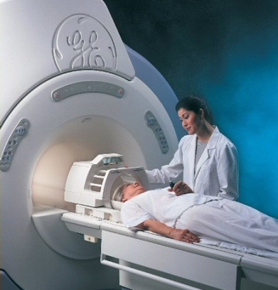
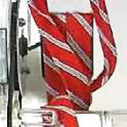
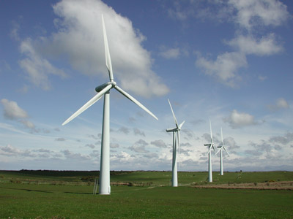
Mechanical Engineers Help to Improve Our World!

Slide 5
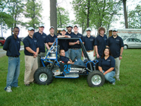
Undergraduate Activities
Society of Automotive Engineers
SAE
Mini Baja Car

Slide 6
Mechanical Engineering at UMBC
129 credit program
Electives offered in:
Biomechanics
Aerospace
Robotics
Mechatronics
Undergraduate Research Project
ABET accredited

Slide 7
Your High School Preparation
Basic Math (algebra, geometry, trig.)
Calculus
Chemistry
Physics
English
Computer Applications

Slide 8
Freshman Year Curriculum
FALL
ENES 101 - Intro Engineering Science 3 MATH 151 - Calculus I 4 CHEM 101 - Chemistry I 4 ENGL 100 - English Composition 3 GEP 3 Total: 17
SPRING
ENME 110 - Statics 3 MATH 152 - Calculus II 4 PHYS 121 - Physics I 4 CHEM 102 - Chemistry II 3 CHEM 102L - Chemistry Lab 2 Total: 16

Slide 9
Sophomore Year Curriculum
FALL ENME 220 - Mechanics of Materials 3 MATH 251 - Multi Variable Calculus 4 PHYS 122 - Physics II 4 STAT 355 - Prob and Stat for Engineers 4 GEP 3
Total: 18
SPRING ENME 217 - Engr. Thermodynamics 3 ENME 204 - Intro to Design w/CAD 3 ENME 221 - Dynamics 3
MATH 225 - Differential Equations 3 GEP 3 Total: 15

Slide 10
Junior Year Curriculum
FALL ENME 301 - Engineering Materials 3 ENME 303 - Topics Engineering Math 3 ENME 320 - Fluid Mechanics 3 ENEE 302 - Principles Electrical Engr 4 ENGL 393 - Technical Writing 3 Total: 16
SPRING ENME 304 - Machine Design 3 ENME 321 - Transfer Processes 3 ENME 332L - Solids Materials Lab 3 ENME 360 - Vibrations 3 GEP 3 Total: 15

Slide 11
Senior Year Curriculum
FALL ENME 403 - Automatic Controls 3 ENME 432L - Fluid/Energy Lab 2 ENME 4XX - Tech/Design Elective 3 S/DE - Science/Design Elective 3 GEP 6 Total: 17
SPRING ENME 444 - Systems Design 3 ENME 482L - Vibrations/Control Lab 2 ENME 4XX - Tech/Design Elective 3 GEP 7 Total: 15

Slide 12
Technical Electives
ENME 409 – Mechanics of Deformable Solids
ENME 412 – Mechanical Design For Manufacturing
ENME 422 – Heat Transfer in Biological Systems
ENME 423 – HVAC Design
ENME 460 – Kinematics and Mechanism Design
ENME 471 – Computer Aided Finite Element Based Design
ENME 472 – Materials and Processes for MEMS
ENME 489A – Digital and Analog Electronics
ENME 489B – Biomechanics
ENME 489C – Elements of Aerospace Engineering
ENME 489D – Computational Fluid Dynamics
ENME 489M – Space Technology and Design

Slide 13
Freshman Scholarship Opportunities at UMBC
Mechanical Engineering S-STEM Scholarship Program
Up to $7,500 per year (see the fliers)
Undergraduate Research Award
$2500 per year
Freshman Merit Awards
$500 per year to Full Tuition + Room & Board
Meyerhoff Scholarships
4-year scholarship: Full Tuition + Room & Board
ASME Freshman Scholarship
$3,000 for the freshman year
CWIT Scholarships
4-year scholarship: Full Tuition

Slide 14
Other Scholarship Opportunities at UMBC
Alvarez Scholarship
Junior or senior in engineering that demonstrates scholarship, leadership and service $5,000
Goldwater Scholarship
Outstanding sophomore and junior students involved in research

Slide 15
And even more …
Danaher Scholarship
Internship and $10,000 scholarship for sophomore or junior in Mechanical Engineering
Mercedes-Benz
Endowed scholarship to an outstanding contributor to the Mini-Baja team
ASME
Scholarships for ASME student members ranging from $1,000-$10,000
ASHRAE
Students studying heating, refrigeration and air conditioning, ~$2,000

Slide 16
Research Experience and Internships for Mechanical Engineers
Undergraduate Research Experience in the Department
UMBC is a research intensive university, ME has 15 faculty, 4 million annual external funding in biomedical engineering with clinical applications, nanotechnology, renewable energy, kinetics and vibration, materials and mechanics, engineering education, etc.
Internships with Industry
Northrop Grumman, Black & Decker, Eaton Fluid Sciences
The Shriver Center at UMBC

Slide 17
BS/MS Program
Obtain a Masters degree early in academic career
Complete MS in one additional year
Conduct research
Gain valuable hands on experience
Emphasis
Design, Manufacturing and Systems
Biomechanical Engineering
Mechanics and Materials Engineering

Slide 18
Mechanical Engineering Opportunities & Wages
Outlook
New opportunities in IT, bio and nanotechnology
Growth in business and engineering services firms
Average starting salaries
BS $58,610
MS $66,390
PhD $85,160
(Data from engineersalary.com)

Slide 19
ME S-STEM Scholarship Program
The ME S-STEM Scholarship Program” is an NSF funded four year scholarship program starting in 2010. We got the renewal from NSF in 2014 to continue the program for the next four years.
The S-STEM program will provide scholarships and educational opportunities to 16-24 economically disadvantaged and academically talented undergraduate students in the ME program at UMBC.
Scholarship amount is based on financial need (indicated in the FASFA form) and academic performance, with an average amount of $7500 per year per student.
Application deadline is May 15, 2016 for high school seniors.

Slide 20
What do we do?
Mentoring
One-to-one mentoring by faculty in the department with regular interaction.
Community Building
August retreat
Participate in various academic activities on campus
A designated room for the ME S-STEM Scholarship Program
Incorporating Research into Education
Bioengineering seminar series
One-semester or one summer research experience for the S-STEM scholars
Financing students’ participating in research conferences
Enhancing collaborations with Community Colleges
Visiting community colleges
Sending scholars back to their community colleges to describe the program
Establishing regular contacts and intense interaction with community college faculty and staff members

Slide 21
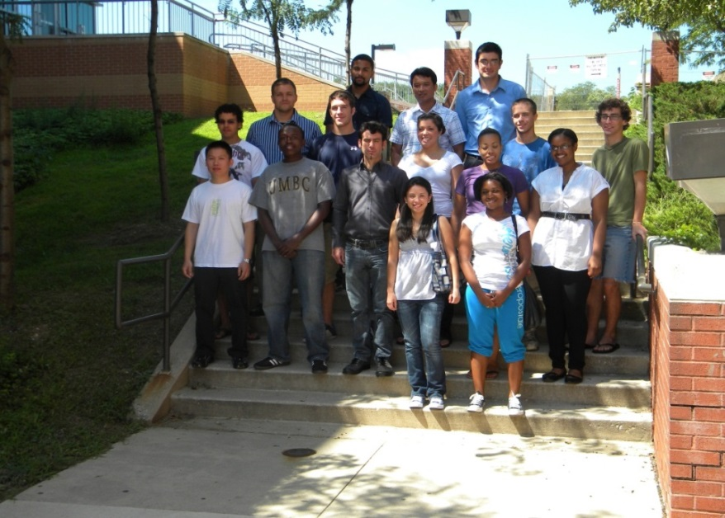
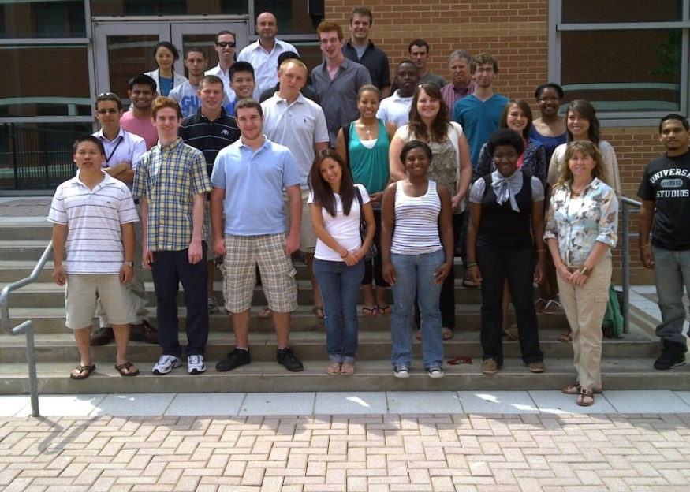
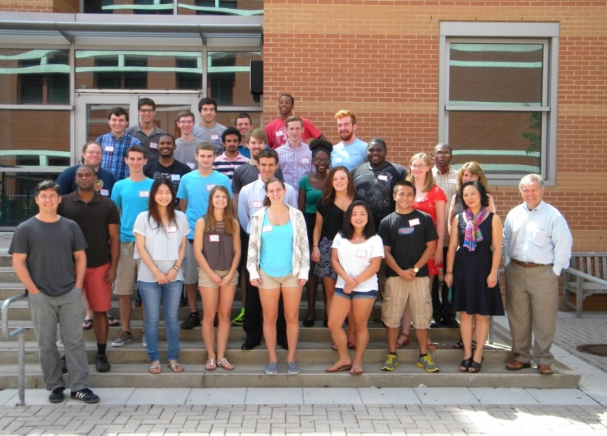
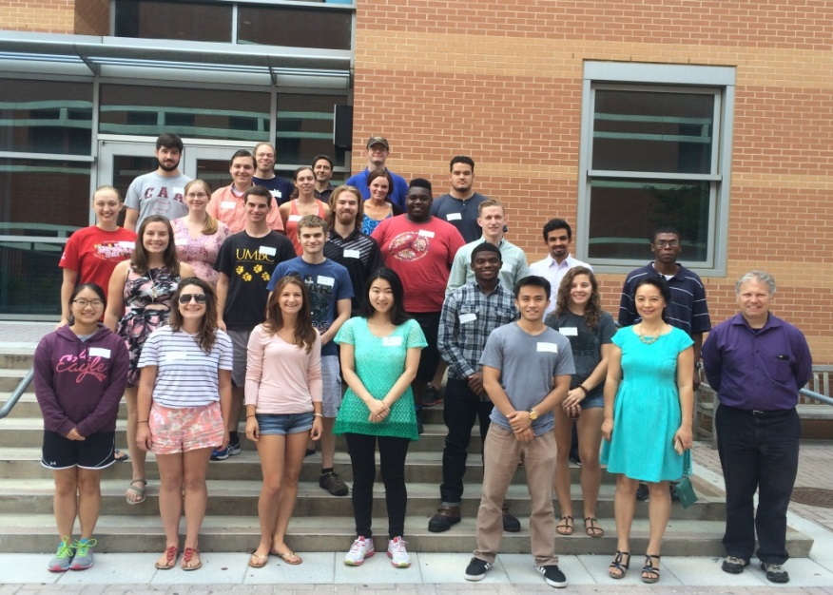
Our Scholars

Slide 22
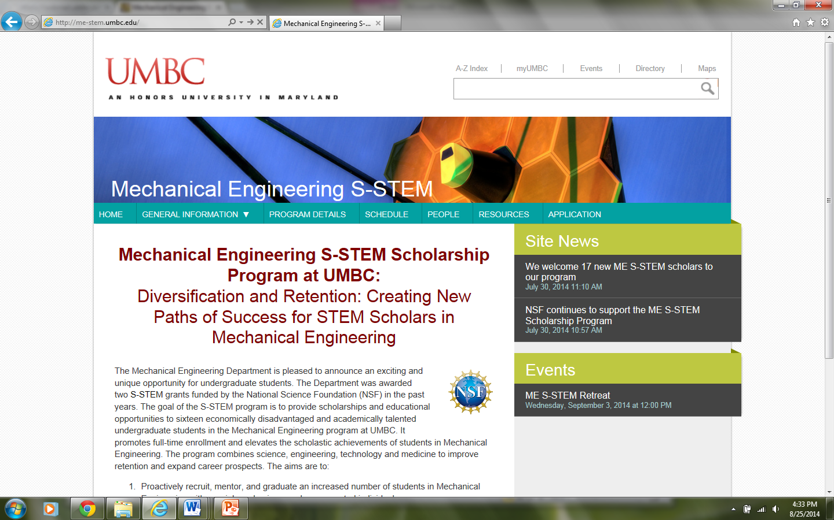
Our Website me-stem.umbc.edu

Slide 23
Research in Dr. Zhu’s Lab
Current cancer treatment options include: chemotherapy, radiation therepy, and surgery.
None of these methods have been able to consistently kill or remove all cancerous tissue at the original site, therefore, leading to tumor recurrence and/or metastasis.
The cancer treatment we are focusing on is using magnetic nanoparticles to generate heat to kill cancer cells.

Slide 24
Magnetic Nanoparticles
Iron oxides magnetite Fe₃O₄ and
maghemite γ-Fe₂O₃
Biocompatible
Coated for minimizing agglomeration.
Generation of heat when subject to an
alternating magnetic field
10 nm

Slide 25
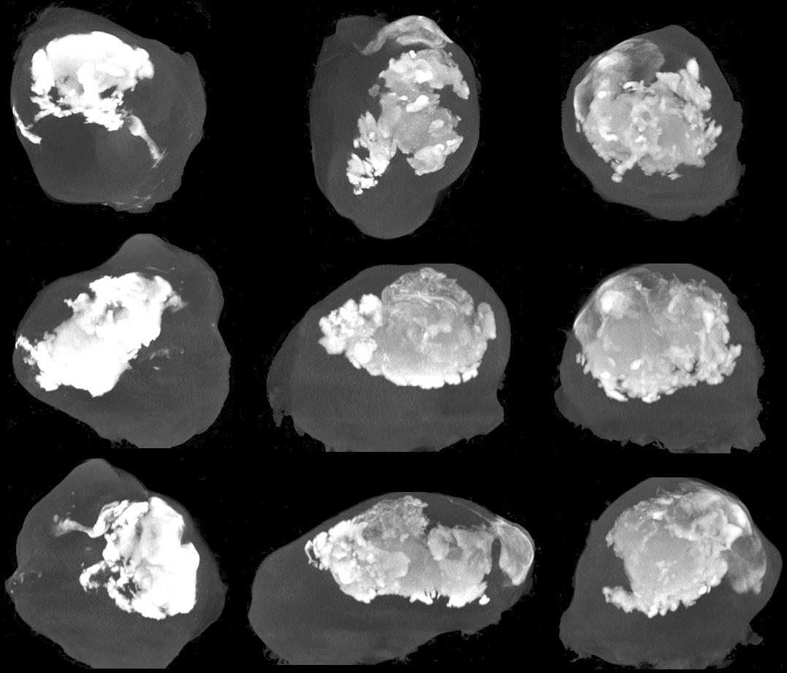
Nanoparticle Distribution in Tumors Using MicroCT
Nanoparticle region
Tumor region

Slide 26
Generation of Tumor and Mouse Models

Slide 27
Temperature Distribution in Tumors

Slide 28
Damaged Tumor Region

Slide 29
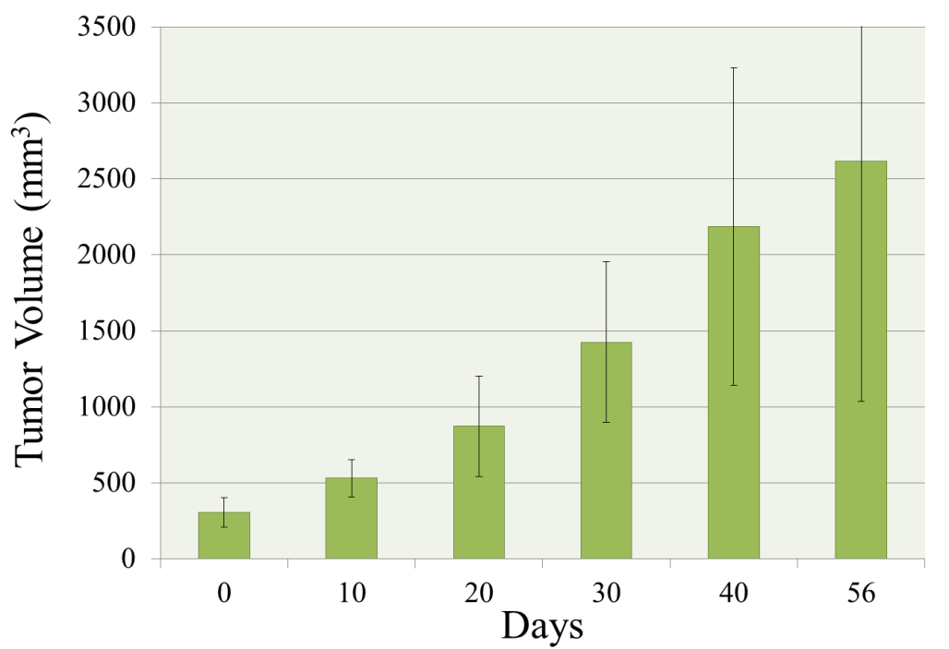
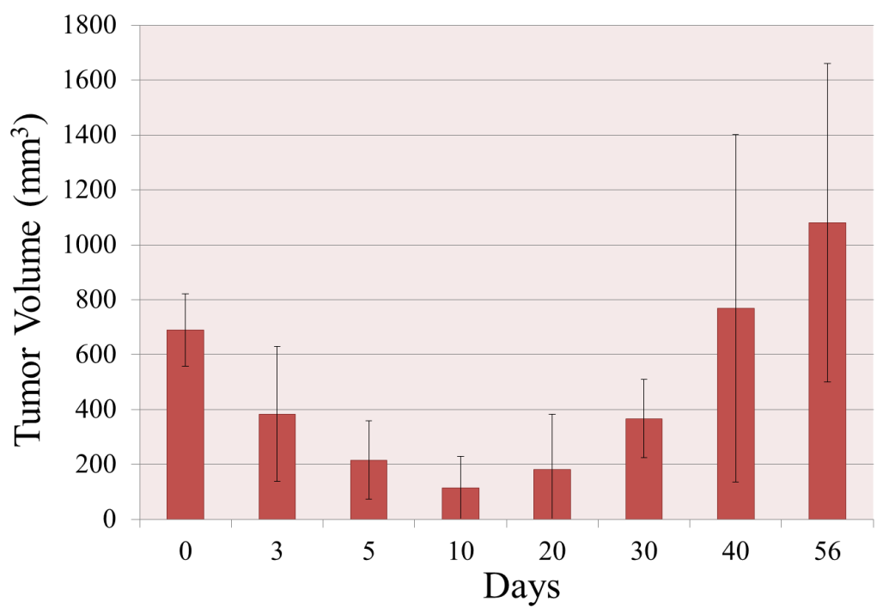
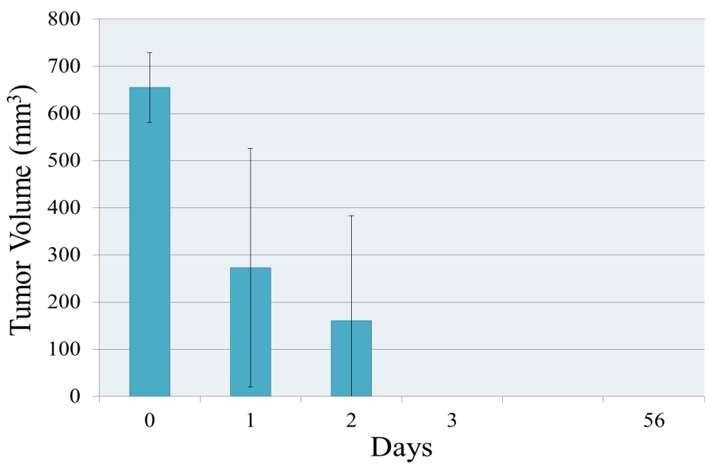
Does the designed protocol work?
No heating
Insufficient heating
Heating according to design
It works!

