Slide 1
FERPA Training
PROPOSAL:
To leverage training resources available to UMBC through CITI (currently utilized by Sponsored Programs) to provide and require FERPA training to all faculty and staff who are granted access to student data through Peoplesoft or REX

Slide 2
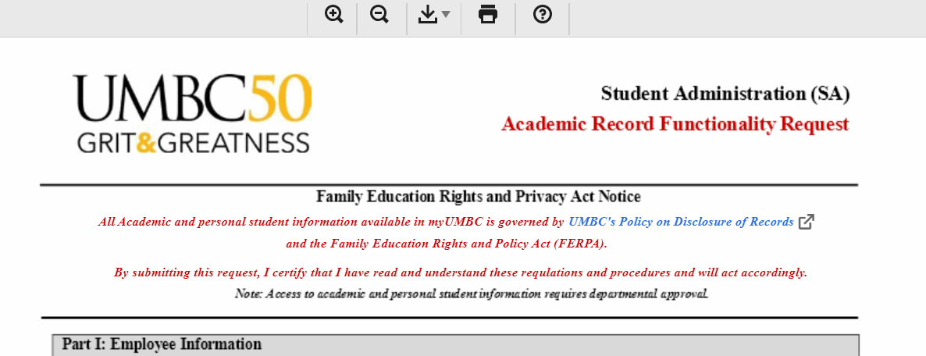
FERPA Training
Current Process:
The SA access request form notes that the requestor has read and understands UMBC’s Privacy and the Release of Education Records info at https://registrar.umbc.edu/services/records/privacy-and-the-release-of-education-records/.

Slide 3
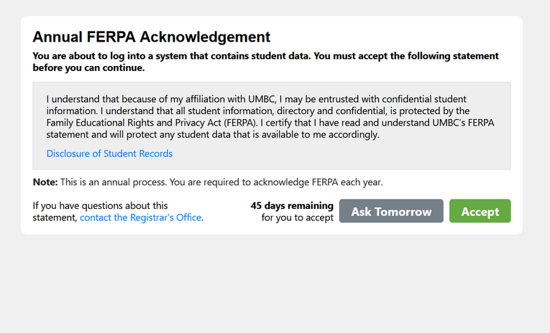
FERPA Training
Current Process:
Once access is granted, users are prompted annually to acknowledge this again.

Slide 4
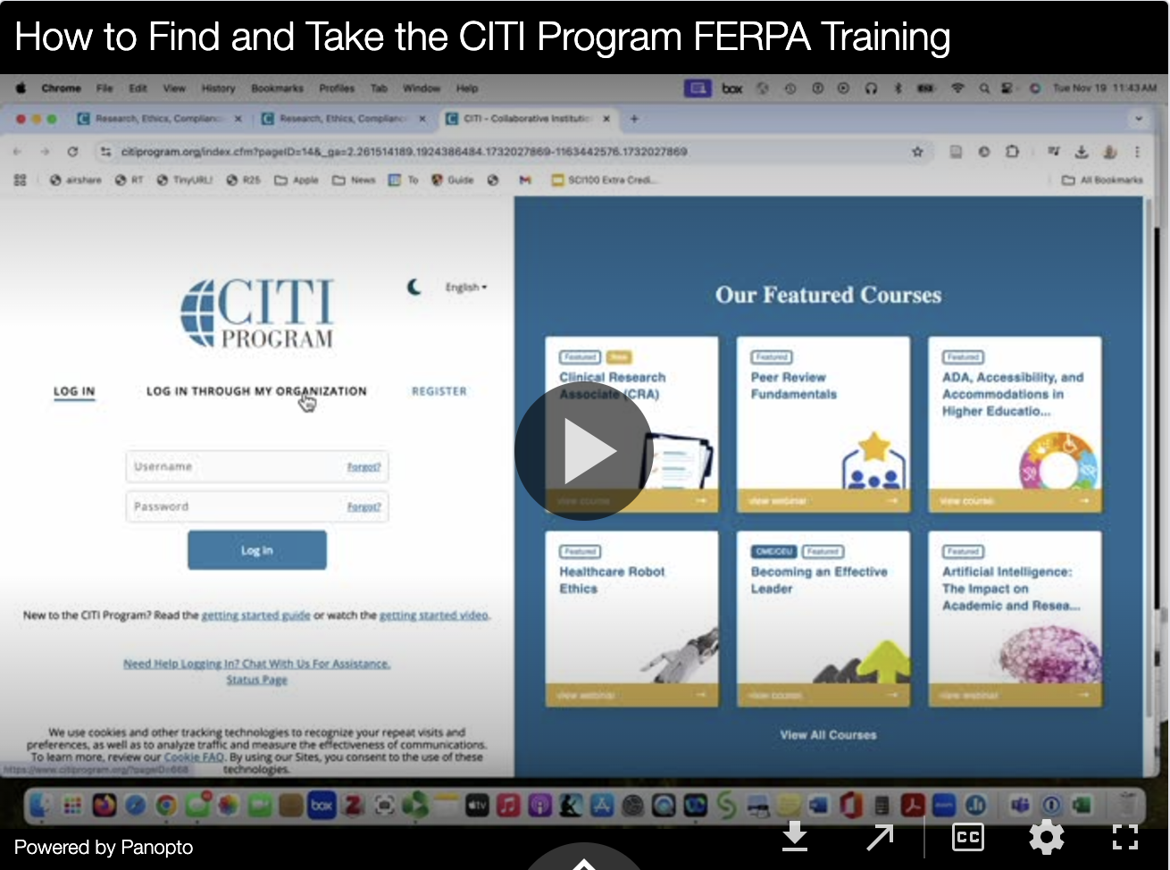
FERPA Training
New Process for First-Time Access Requests
The SA access request docusign currently requires signature of requestor and department chair/director. That will not change.
An FAQ has been created for how to find and take the FERPA Training offered by the Collaborative Institutional Training Initiative (CITI). Note: CITI also powers UMBC’s IRB training.
Requestors will be required to complete, download and attach the completion certificate to their request form.

Slide 5
FERPA Training
Process for Current System Users
We will announce the new training and invite/encourage them to complete it as soon as possible. However, we will not require completion until the user’s annual acknowledgement period rolls around (varies by user based on date access was first granted).
At that time, they will need to complete the training and upload the certificate along with clicking the acknowledgement in order to retain access.

Slide 6
FERPA Training
General Information Regarding the Training
Average time for completion of Basic Module (the required portion): 20-30 minutes.
The training also allows interested users to pursue more detailed information such as case studies and complete additional more job-specific modules (Instructors, Administrators)
Provides info regarding PII (Personally identifying information, Directory Information, Defining legitimate educational interest for access or disclosure of information, and helps users understand the consequences of FERPA violations.
Training Link: https://umbc.atlassian.net/wiki/x/AgAgLQ

Slide 7
FERPA Training
Additional Benefits
allows us to verify training rather than rely on acknowledgements of reading required information
system is user-friendly and training is comparable to Basic AACRAO FERPA training
allows interested users to dive deeper into FERPA at any time

