Slide 1

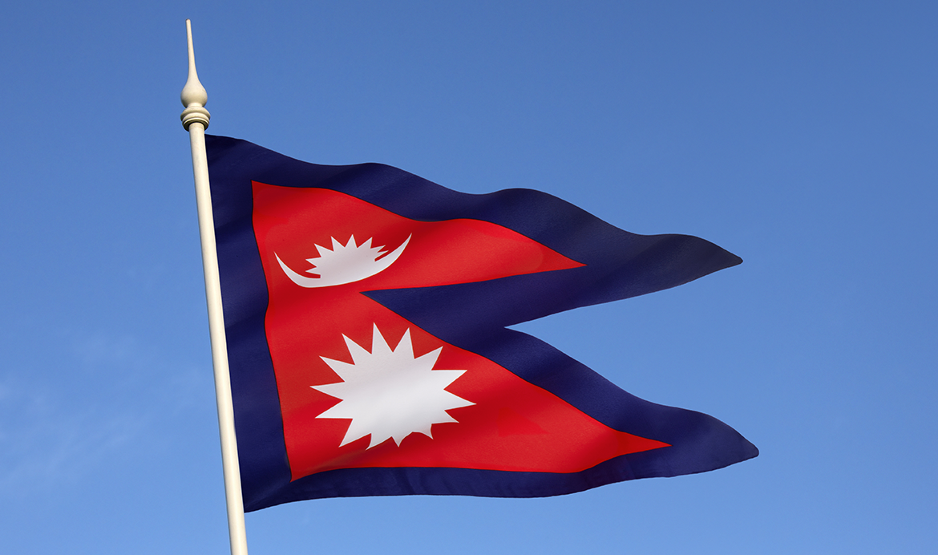
Nepali Student Association (NSA)
End of Semester Review
Fall 2018

Slide 2
September-December
^{Fall 2018}
Weekly meeting
First meeting- September 17th
Last meeting- December 10th
Change in meeting policy
Plan for nsa members meeting for spring 2019.

Slide 3
Media availability
Active myumbc PAGE. (thanks to Anusha)
Active facebook page. (thanks to June and jyotsna)
Active viber group. (thanks to all the members)
Active nsa official email. (thanks to sangita)

Slide 4
Nsa t-shirt
Printed 30 t-shirts using sga funds.
Policy for t-shirt distribution.
Total recipients 9 umbc students.

Slide 5
Spring 2019 plans
Spring involvement fest (February).
Nepali cultural night (April 5th, 2019).
Ticketed event
NSA logo
Flier
On stage display
Song and dance
Google form for event coordinator (by the end of December)

Slide 6
Thank you!!
All the members and board members.

