Slide 1
Outdoor Recreation
Club

Slide 2
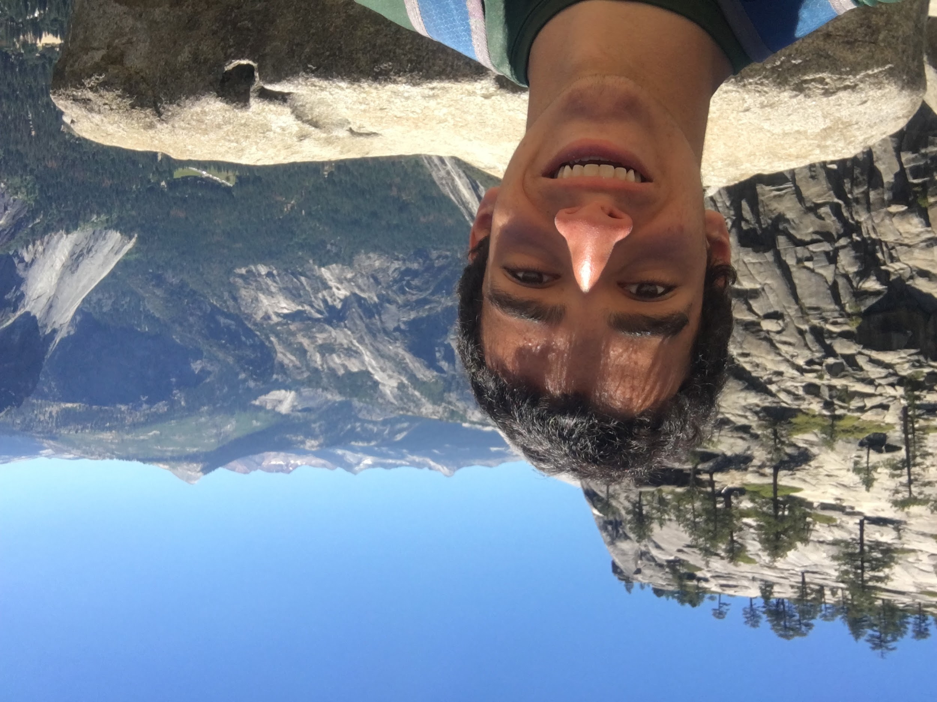
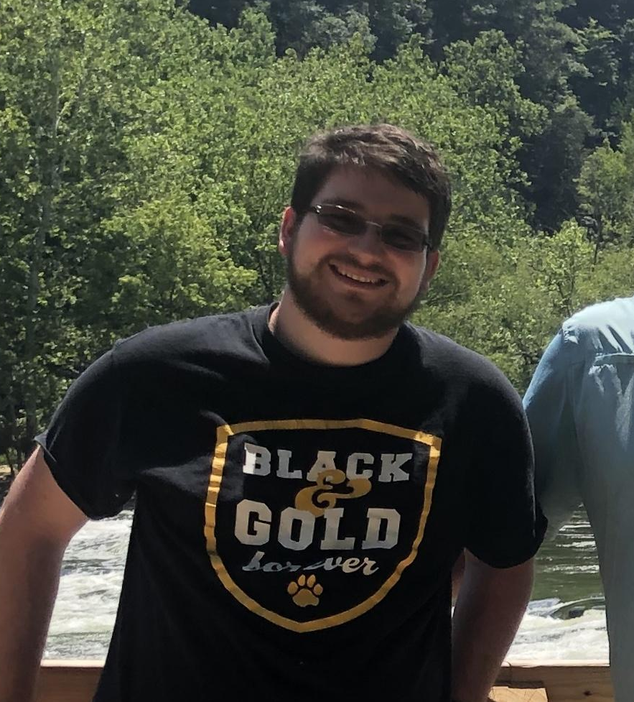
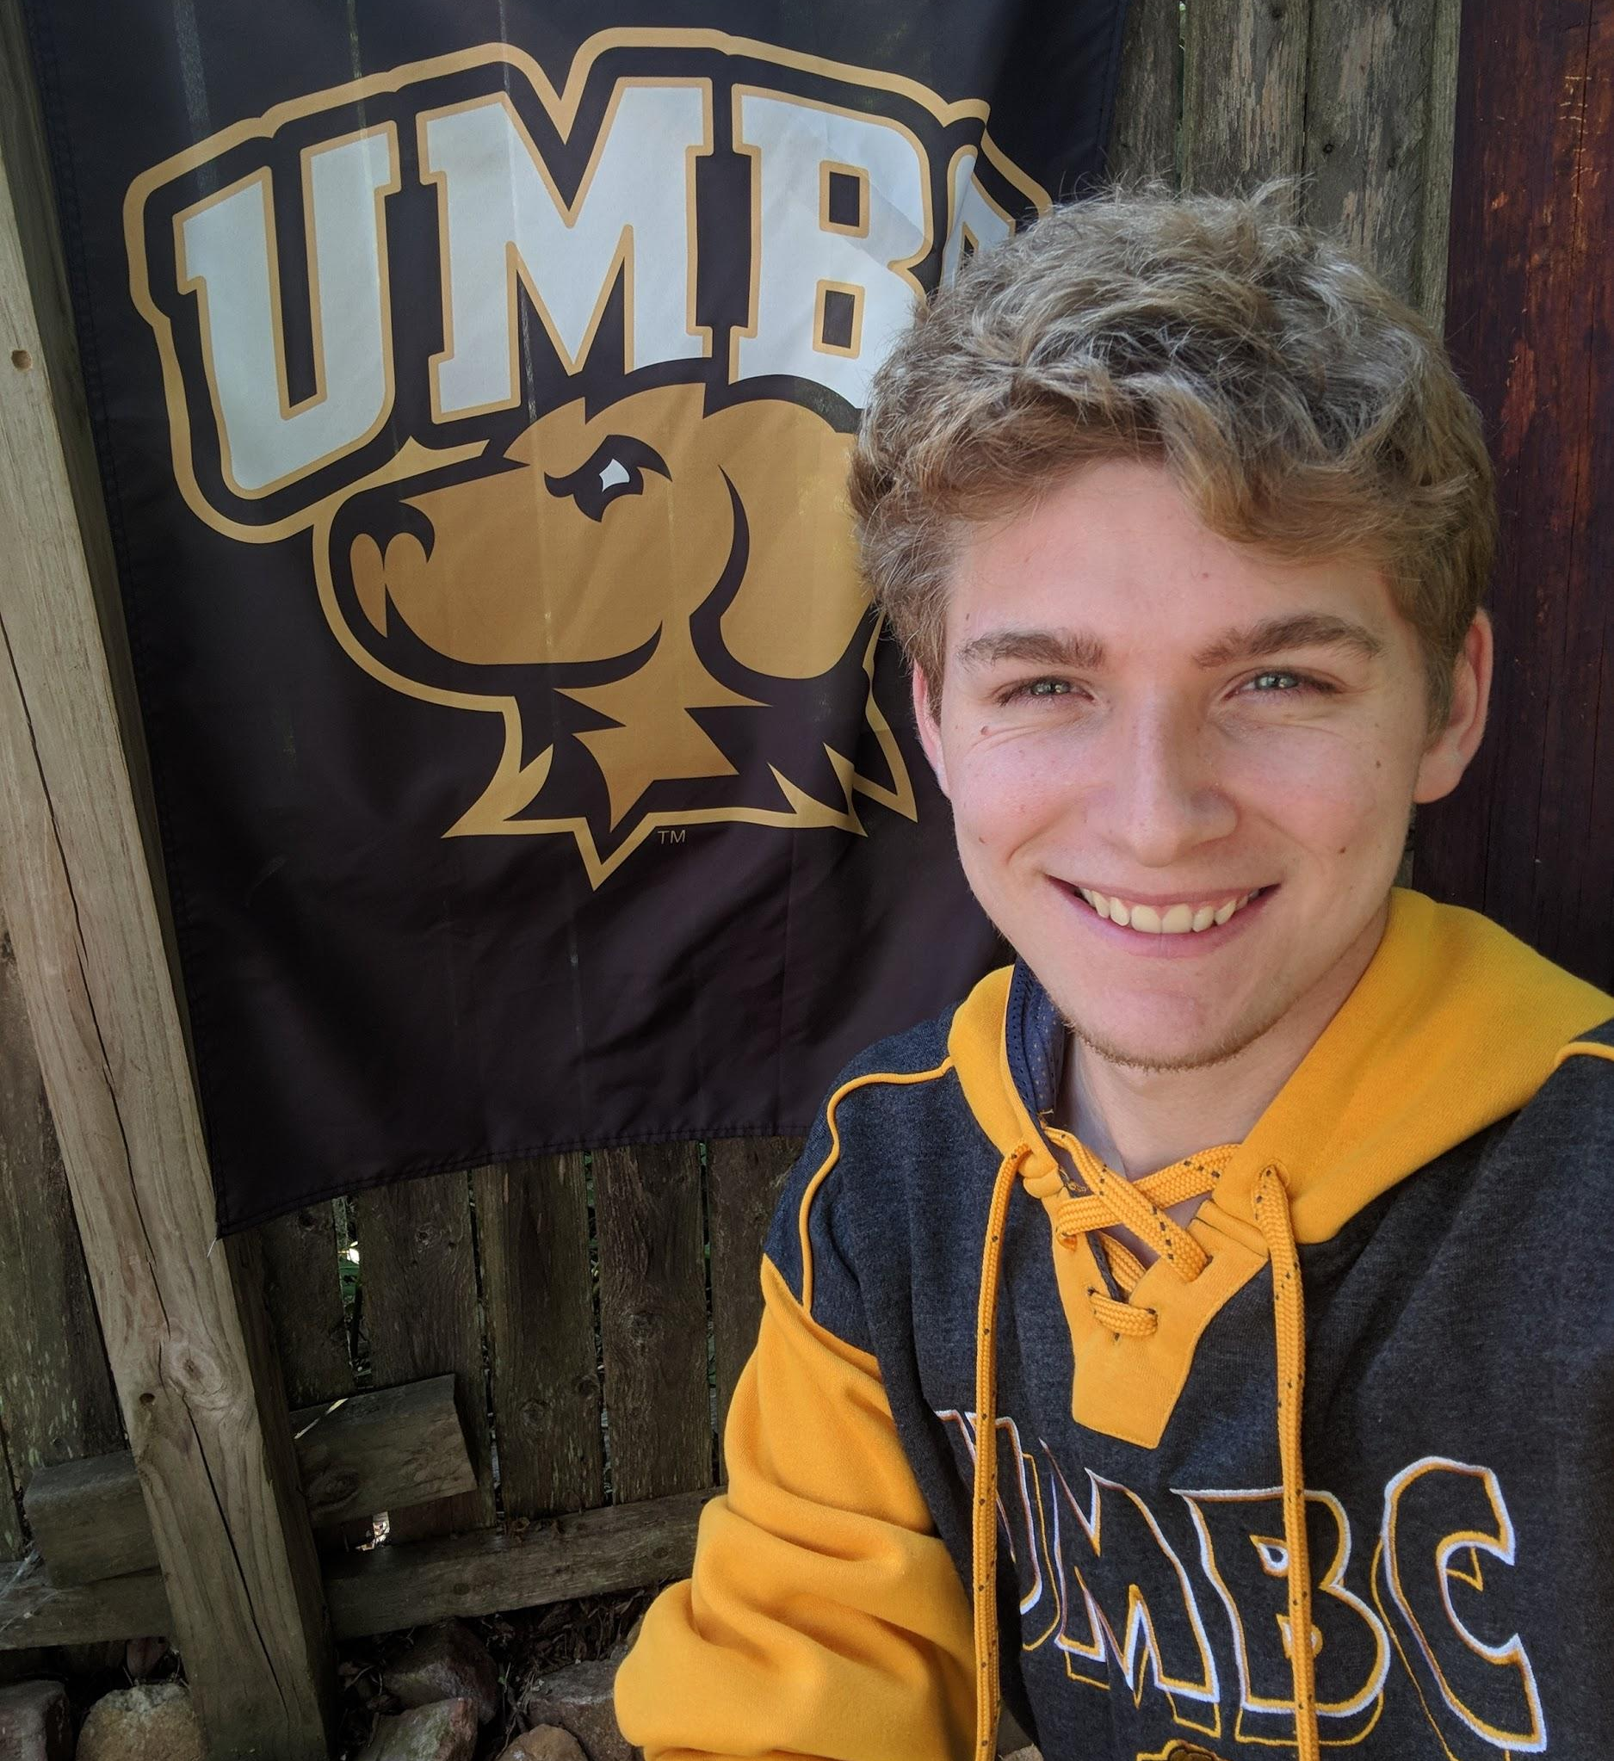
Who We Are
Insert group picture from the hiking trip here
Some of our Members:
President: Tobias Coombs
Vice President: Stephen Vaudreuil
Connect with Us!
Email: outdoorsumbc@gmail.com
myUMBC: Outdoor Recreation Club
Instagram: umbcoutdoorclub
Secretary: Angelica Mansfield
Treasurer: Caleb Flesher

Slide 3
What We Do
HIKING
FISHING
ARCHERY
BICYCLING
CAMPING
General Outdoor Recreation
While some of these activities require you have your own equipment, you do not need any fancy gear for hiking (or archery). Anyone can join us for these!

Slide 4
Patapsco State Park Hike
March 7th, 2020

Slide 5
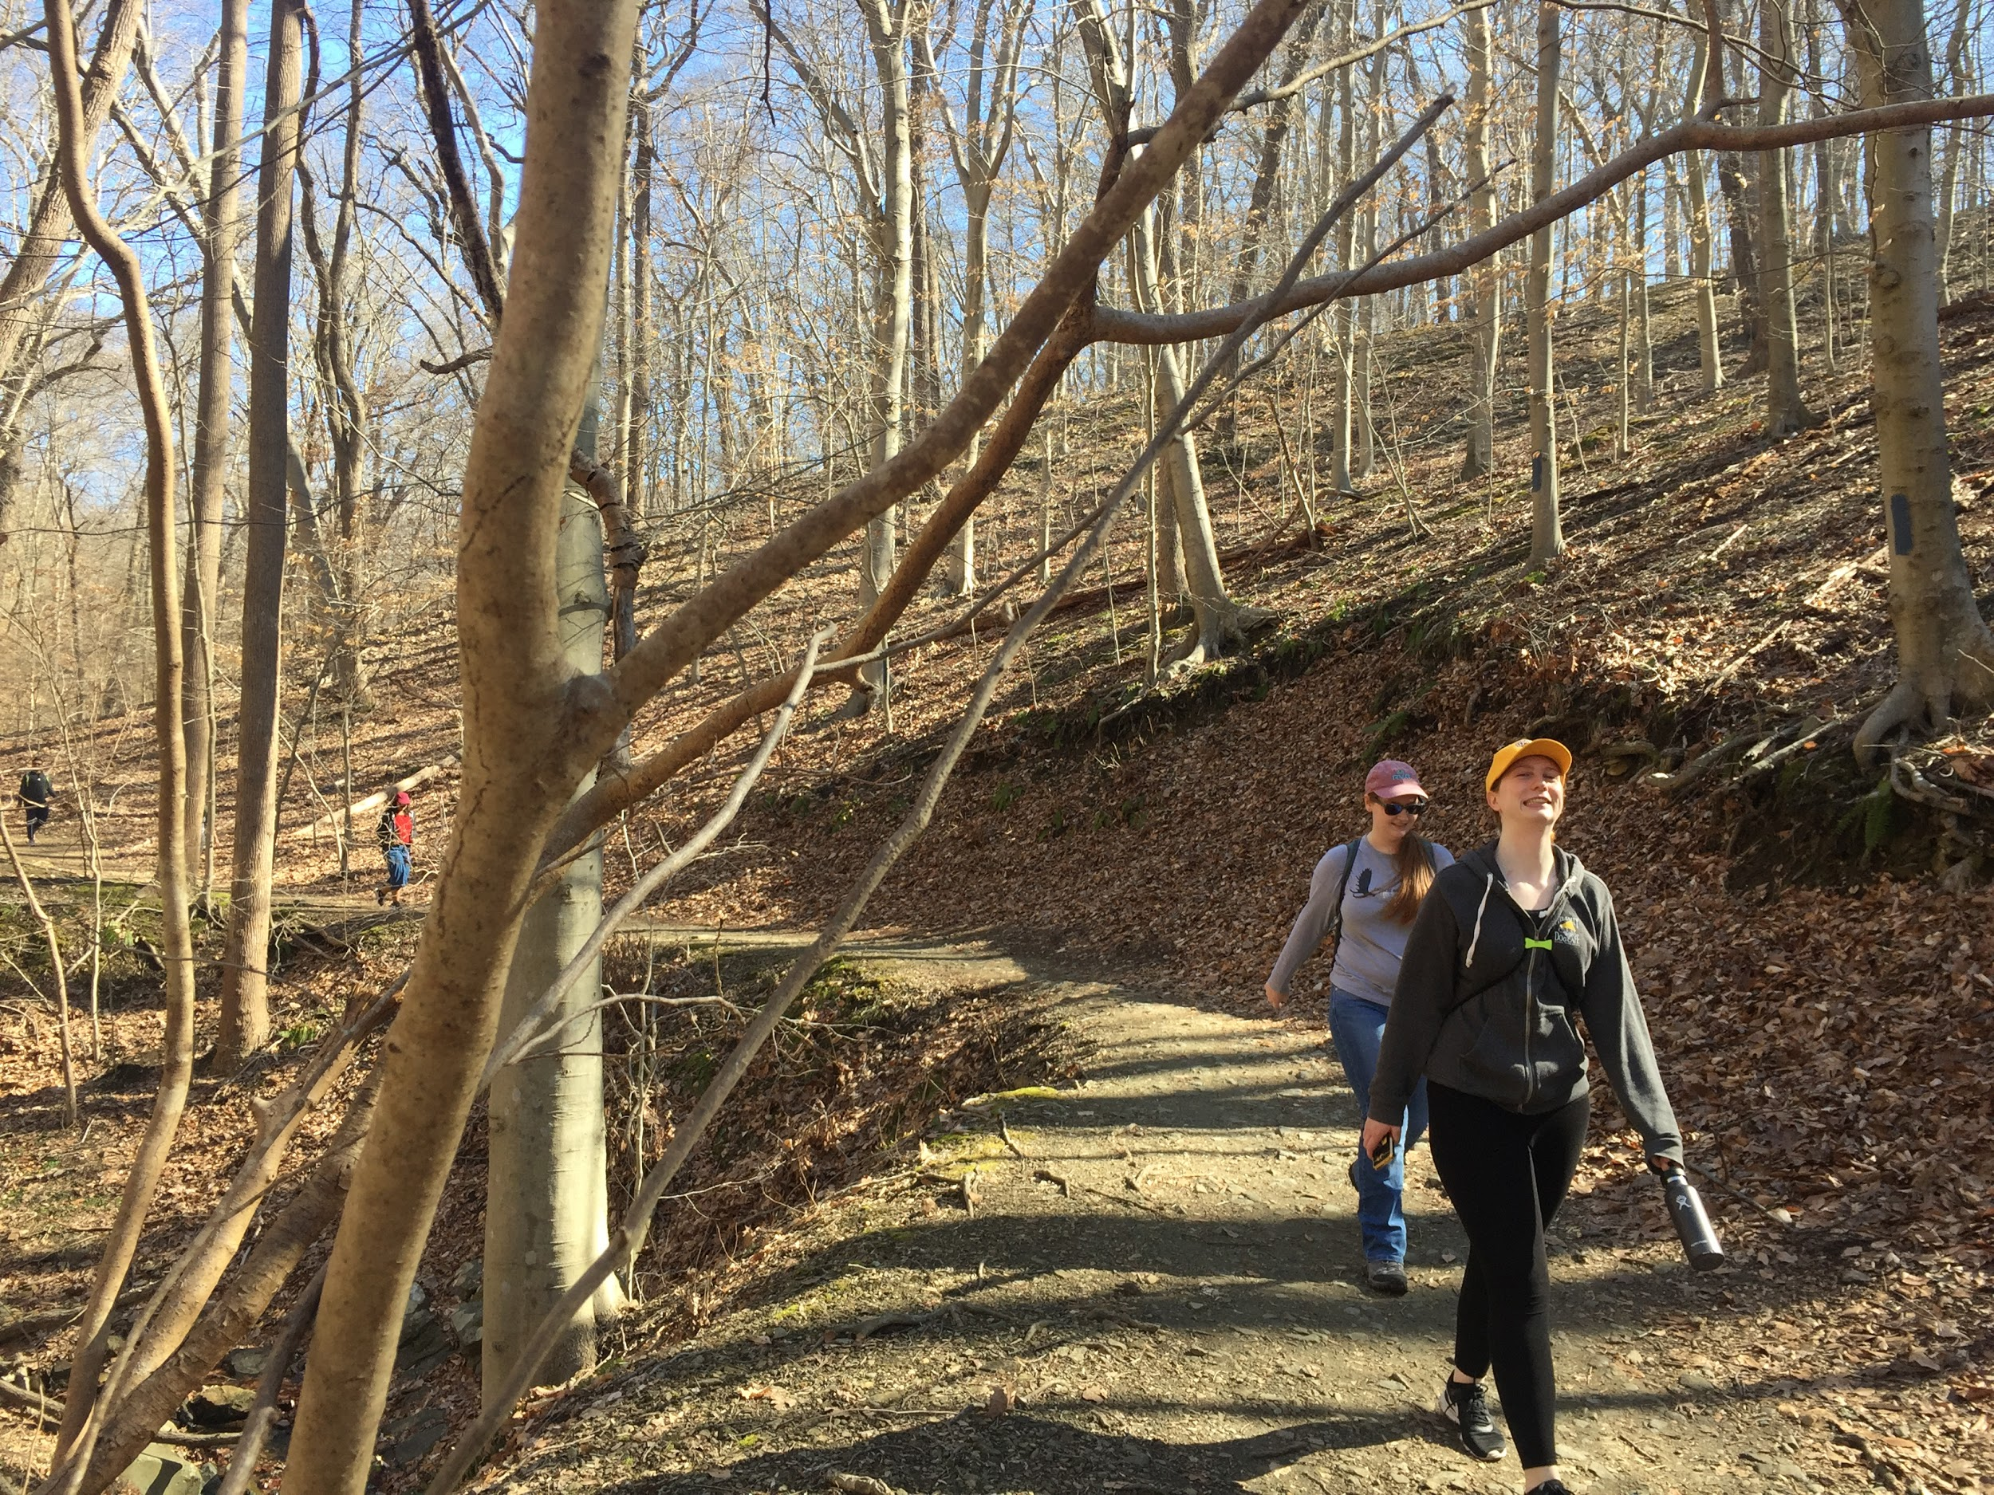
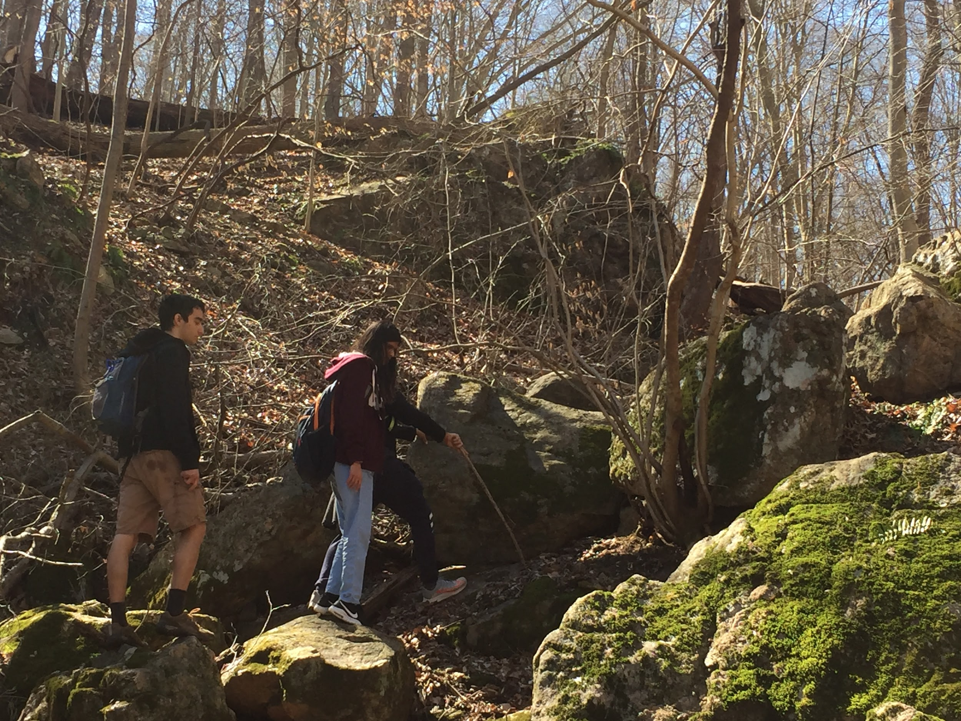
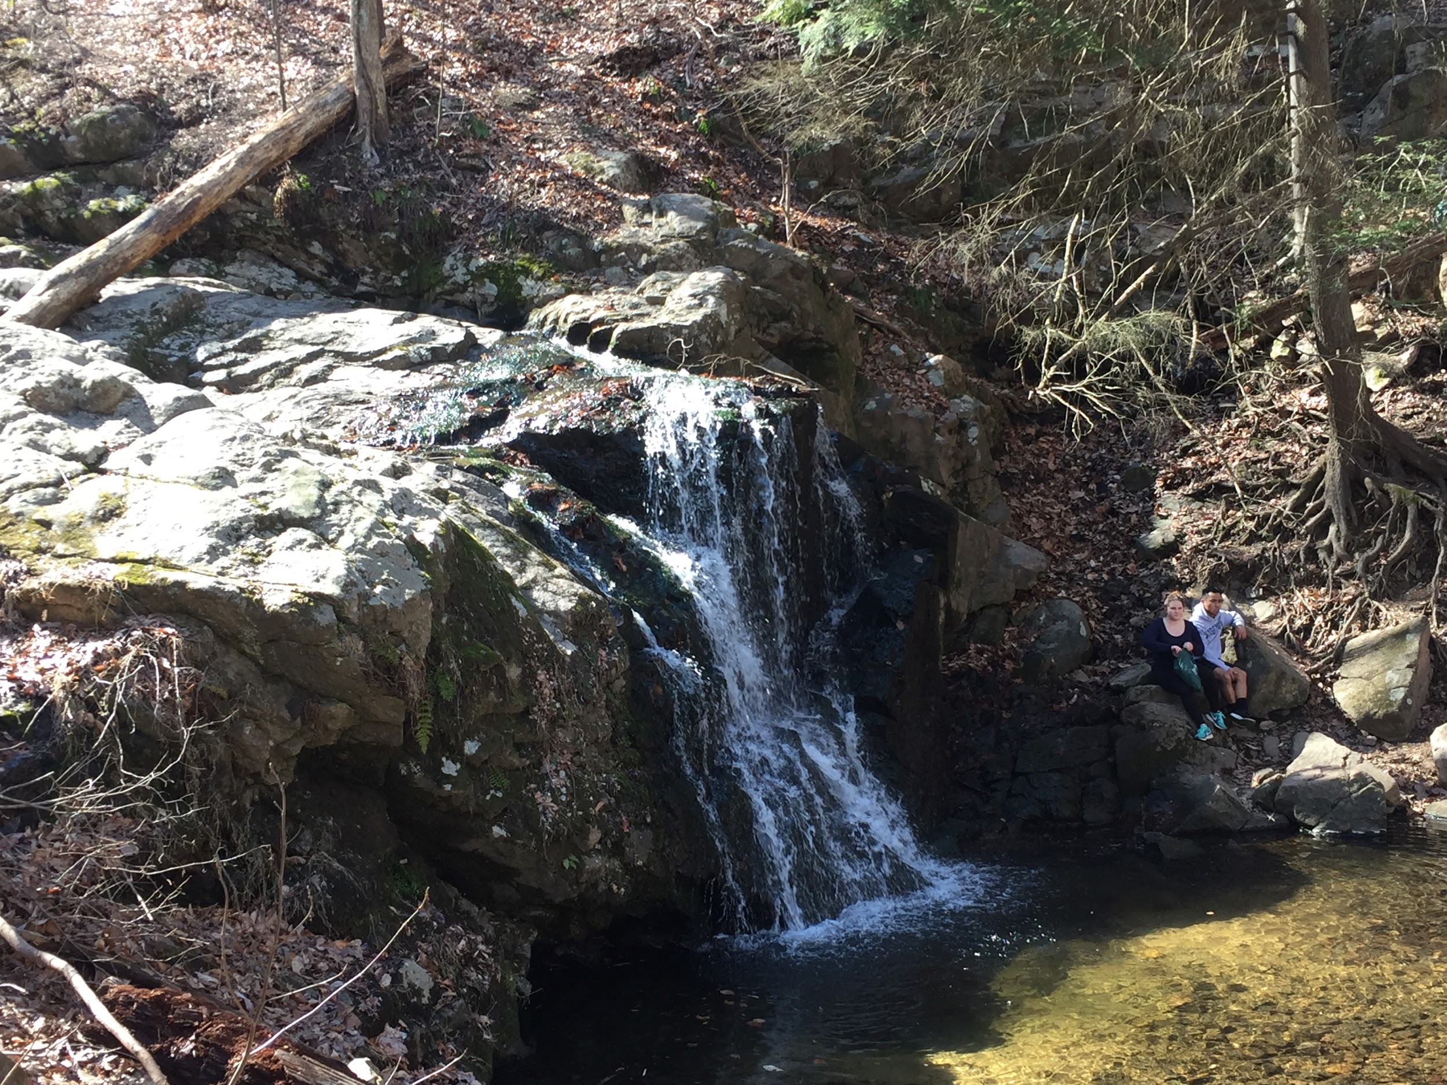

Slide 6
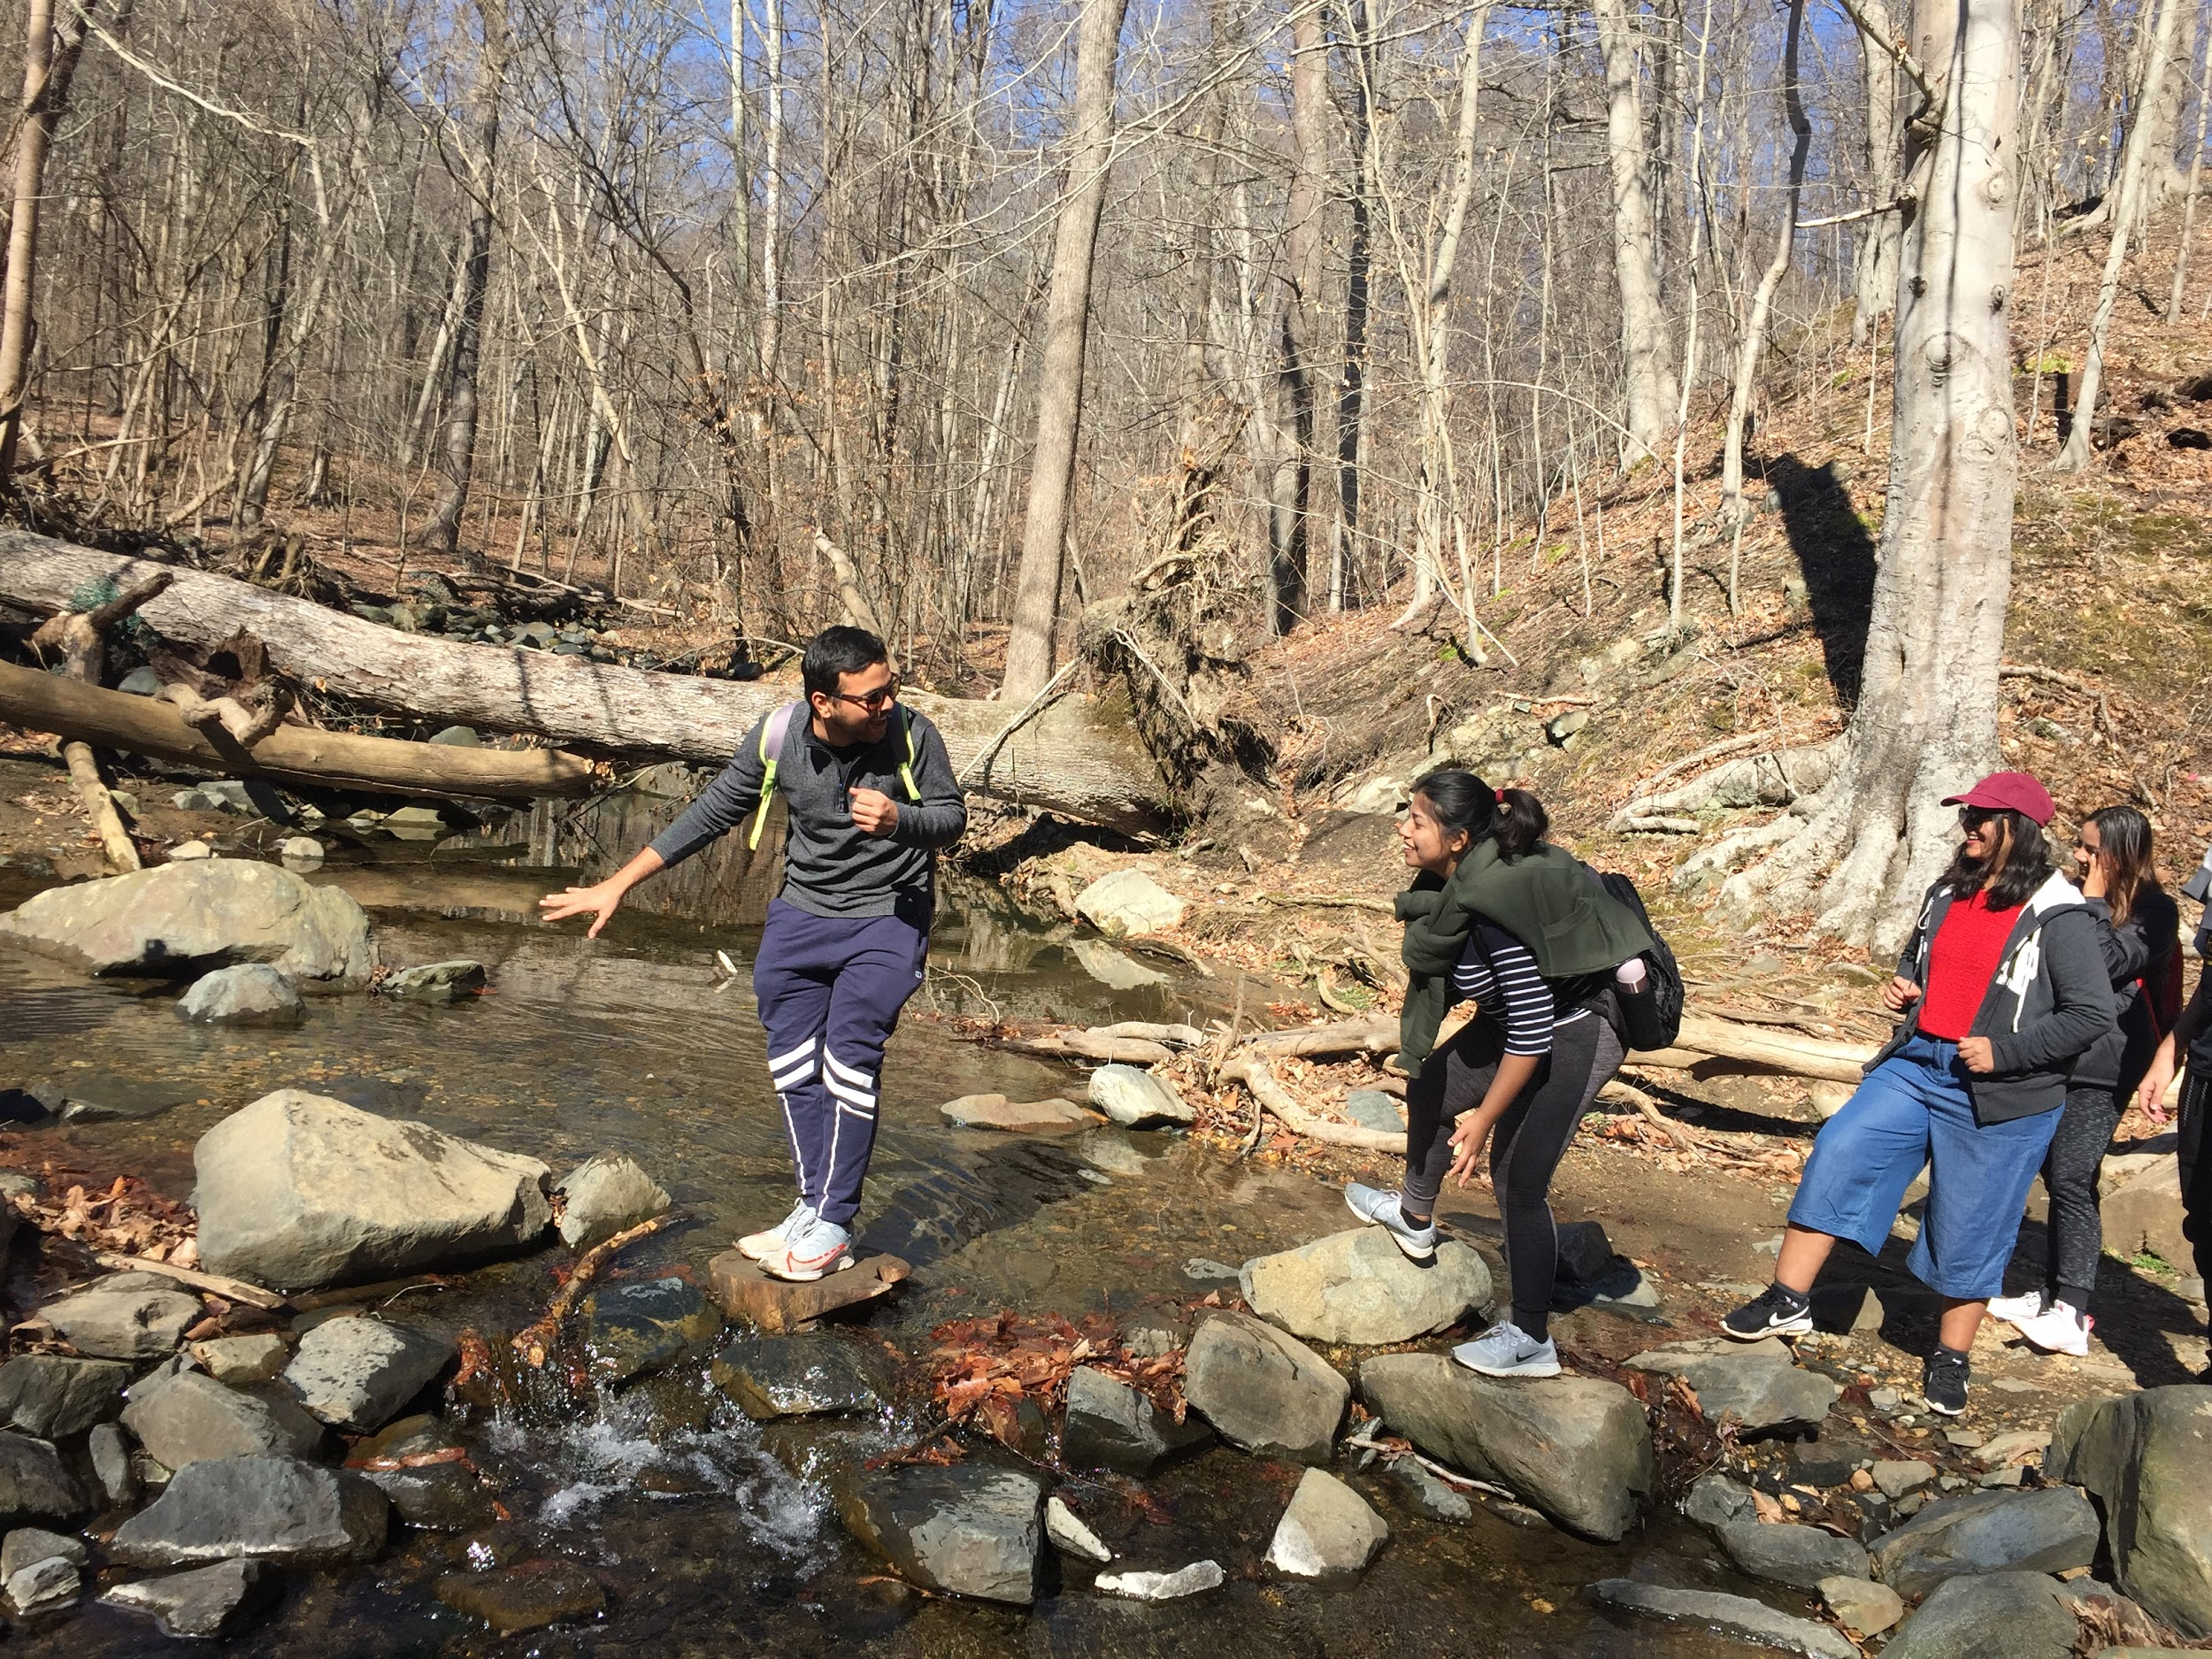
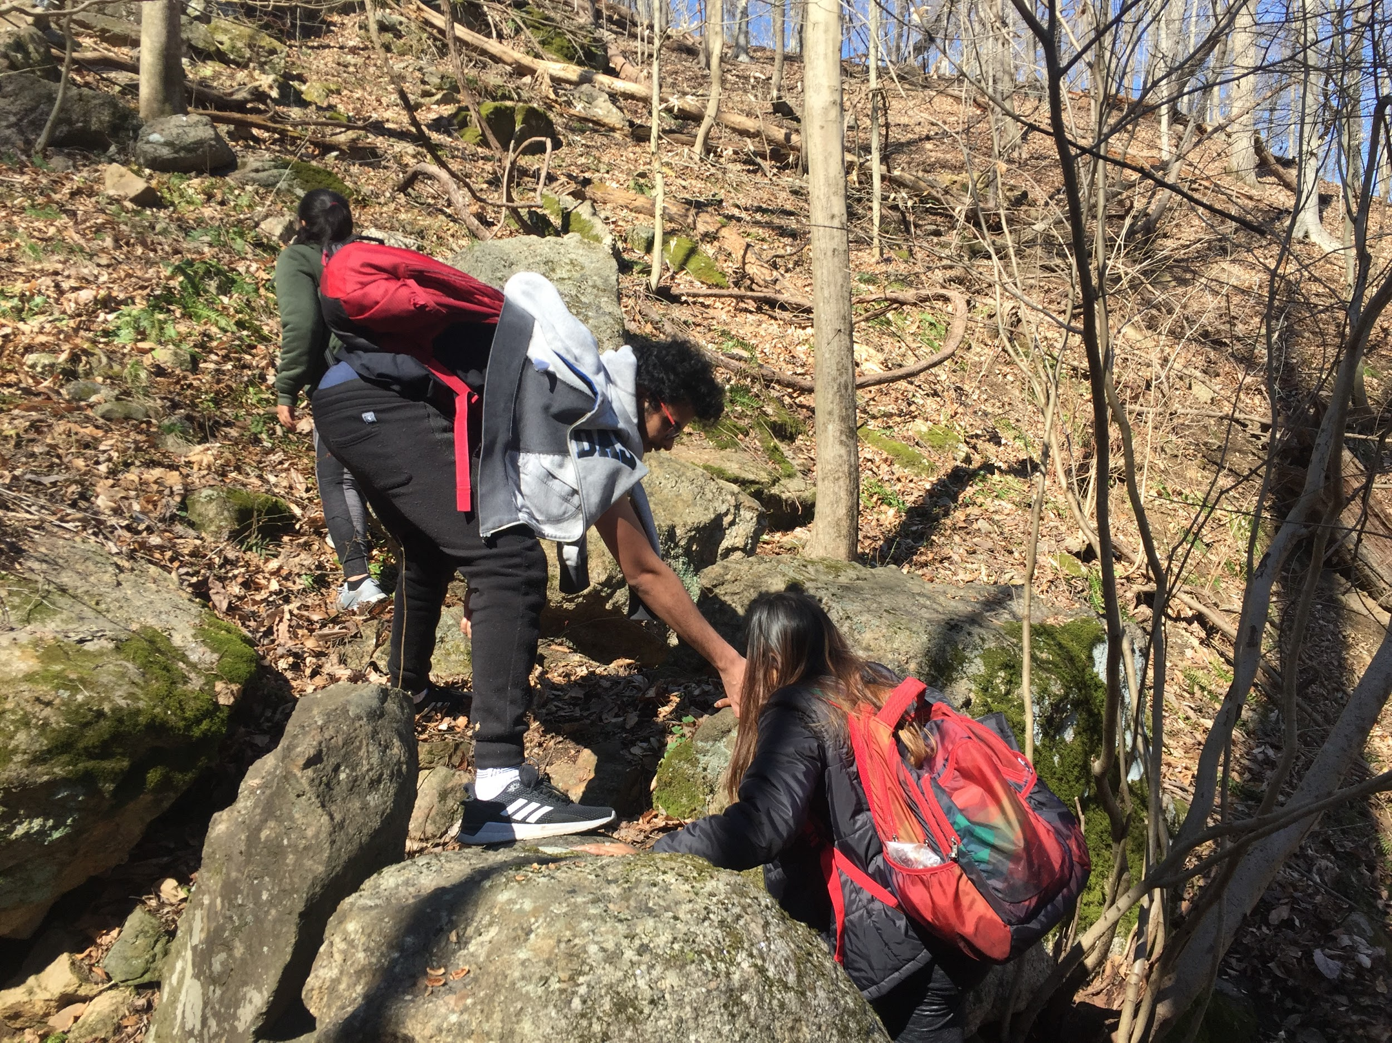

Slide 7
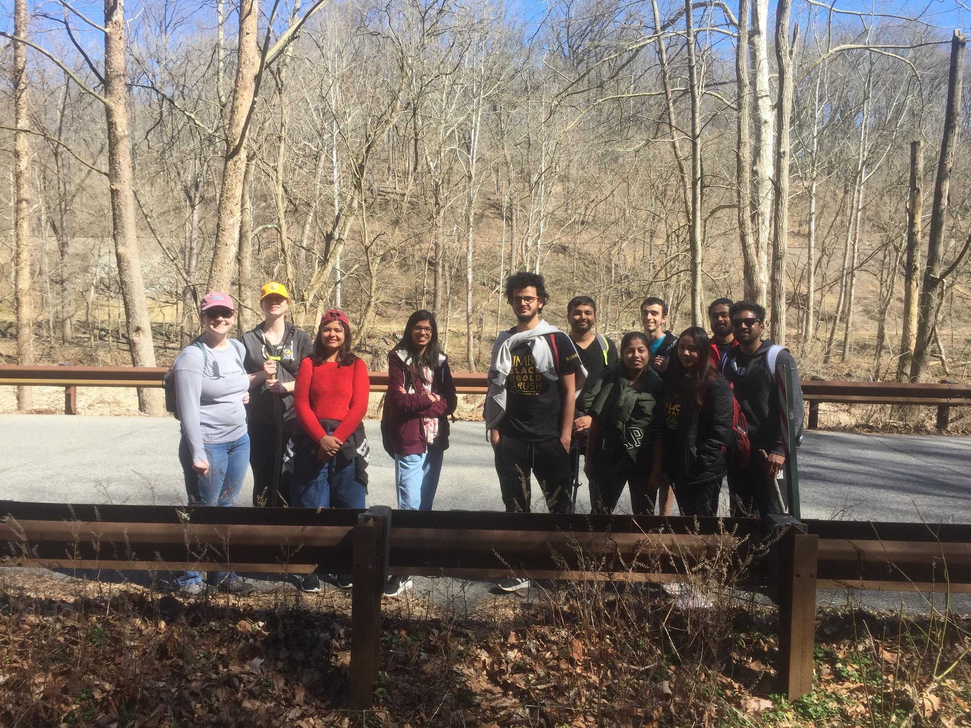

Slide 8
Unfortunately, due to COVID-19 Restrictions, Outdoor Recreation Club (ORC) will be unable to hold any of its events until students orgs are once again able to have in-person meetings. ORC will resume its events as soon as these restrictions are lifted. In the meantime, we will be recommending different trails for students to explore in Maryland!

