Slide 1

The Honor Society of
Phi Kappa Phi
Awards Information and Leadership Workshop

Slide 2
Awards
Chapter 22 UM-UMBC:
Shirley C. Sorensen Undergraduate Academic Excellence Award
Fellowship (National and Chapter Level)
Undergraduate Research Awards
National Office:
Study Abroad
Love of Learning
Dissertation Fellowship
Literacy Grants

Slide 3
Shirley C. Sorensen Undergraduate Academic Excellence Award
One $1,000 award
Awarded to undergraduate PKP members on the basis of academic excellence as demonstrated by outstanding grades, academic honors and recognition, and activities in the University or in the Community
Applications submitted directly to Chapter 22 UM-UMBC by March 1, 2021

Slide 4
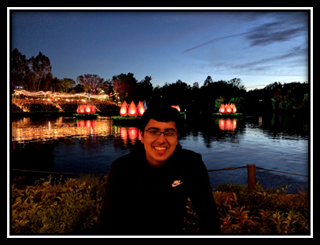
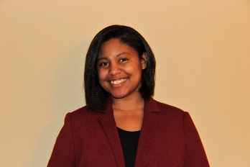
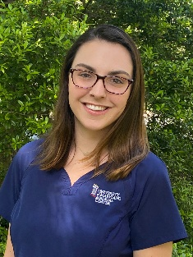
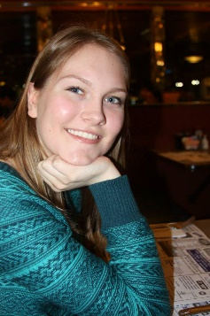
2020 Sorensen Award Winner(s)
2020 Sorensen Award Special Recognition
Christine Vaaler
Ana Pieszala
Karan Luthria
Briscoe Turner

Slide 5
Marilyn Demorest
Love of Learning Award
Two $500 awards
Awarded to graduate members on the basis of academic excellence as demonstrated by outstanding grades, academic honors and recognition, and activities in the University or in the Community as well as an essay explaining what the PKP Motto means to them.
Applications submitted directly to Chapter 22 UM-UMBC by March 1, 2021

Slide 6
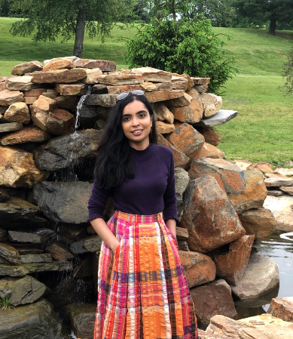
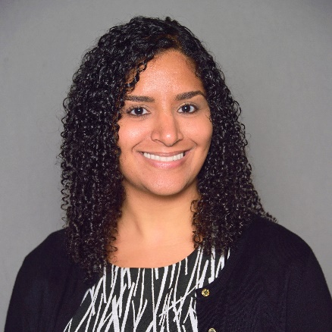
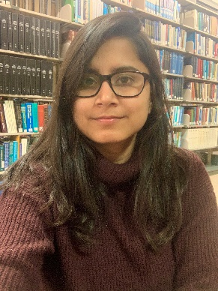
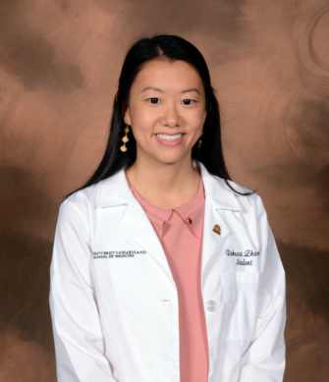
2020 Demorest Award Winner(s)
2020 Demorest Award
Fariha Khalid
Melissa Metry
2020 Demorest Award Special Recognition
Neha Agarwala
Rebecca Zhang

Slide 7
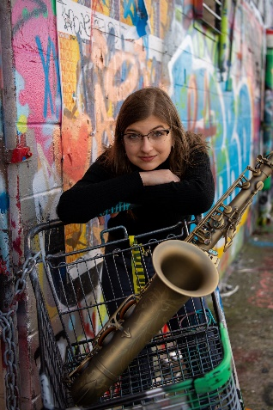
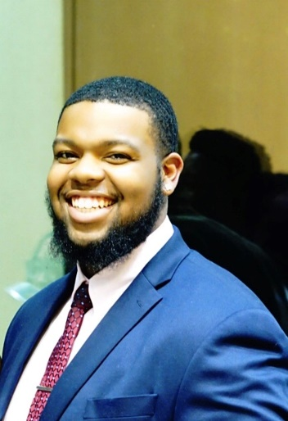
Undergraduate Research Award
(PKP membership not required)
No application deadline – Students are automatically reviewed through the URCAD Application Process
One $500 award to an “unaffiliated” (not a member of a scholars or honors program) URCAD student from CNMS/COEIT/INDS
One $500 award to an “unaffiliated” URCAD student from CAHSS/SOWK/Erickson
Students accepted to URCAD will be reviewed for the PKP Chapter 22 Undergraduate Research Award by the URCAD Committee, who then make recommendations to PKP Executive Committee
The URCAD Committee will review the undergraduate students on the basis of:
  Strength of the mentor support statement
  Strength of the 200 word research abstract
  Most innovative research
Awards presented at spring initiation ceremony.
Awards will also be recognized at the URCAD event in April 2021
2019 winners, Leah Prescott and Darin Gilchrist

Slide 8

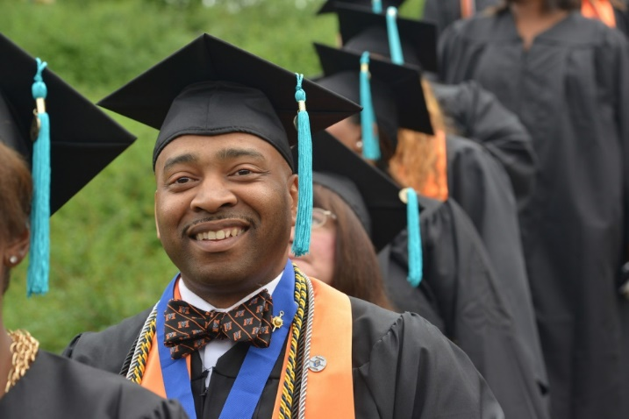
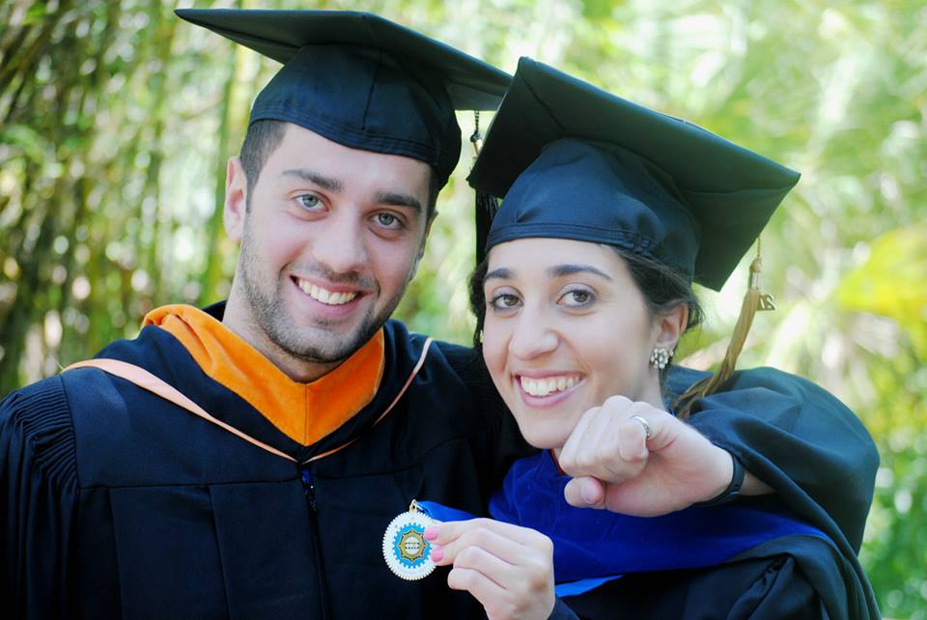
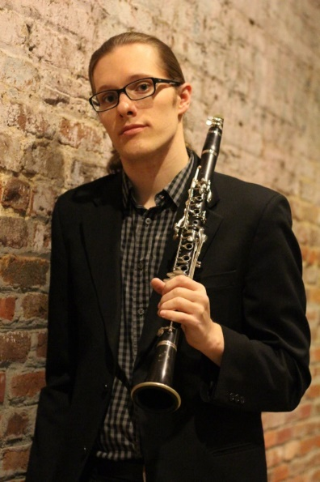
Fellowship
Notes:
Moving on to my personal pet project … our Fellowship Program!
It is my personal goal to increase chapter participation in the Fellowship program this next year! In 2014, we had 171 chapters submit nominees to the national competition. We have over 300 active chapters, and my goal next year is to have over 300 Fellowship nominees!
It may be ambitious, but with your help, we can do it!

Slide 9
Fellowship
National Level:
  Two Fellowships $35,000 each
  Six Fellowships at $20,000 each
  Fifty Fellowships at $8,500 each
Awarded to PKP members entering first year of graduate or professional study (must have completed less than 10 graduate hours)
Applications (download from phikappaphi.org) must be submitted directly to Chapter 22 UM-UMBC by March 1, 2021
One nomination submitted by chapter to the National Office April 30, 2021
The chapter’s nominee will receive a $1000 award regardless of standing in the national competition

Slide 10
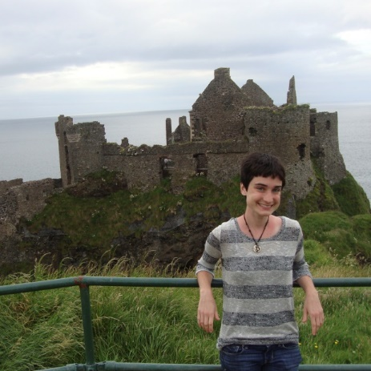
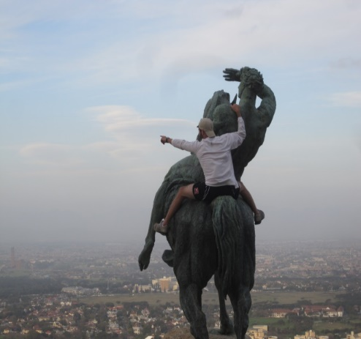
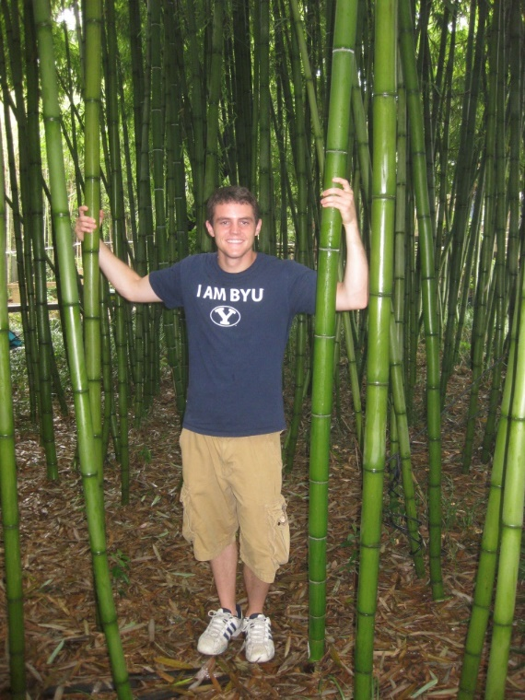
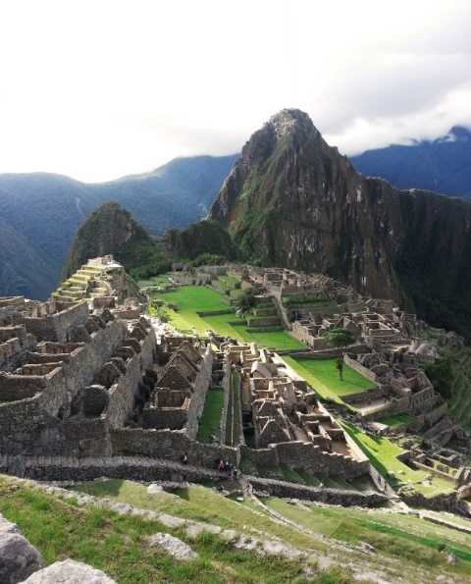
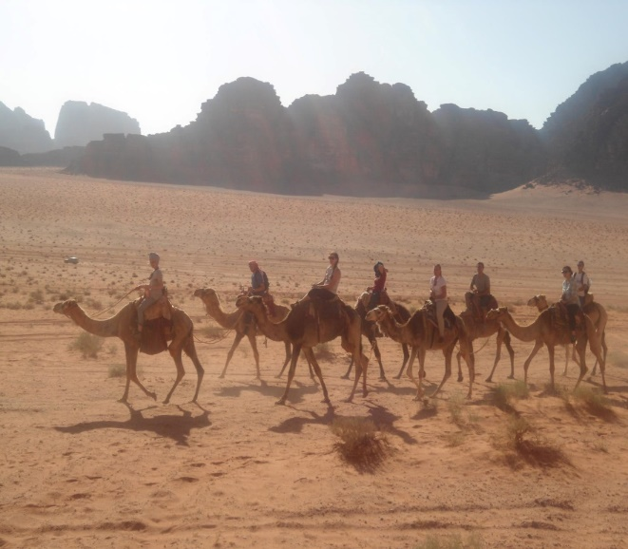
Study Abroad Grants
Notes:
Okay, first up is our Study Abroad Grant program… I just absolutely love these pictures that my winners send in. I get to take min-vacations in my office by flipping through their pictures and reading their final reports. We are helping to fund life experiences for these kids and I think that is just so cool!

Slide 11
Study Abroad
Study abroad grants are currently on hiatus due to the COVID19 Pandemic
Seventy-five $1,000 grants
Only award open to non-members!
Must have a GPA of at least 3.75
Applications and other materials submitted through phikappaphi.org (via online portal)
You can go to PhiKappaPhi.org/grants-awards and sign up for a notification when award re-opens.

Slide 12
Love of Learning
Two hundred awards at $500 each
Awarded to PKP members who have completed their baccalaureate degree by the application deadline (must not be a Fellowship recipient)
Funding designed to support graduate/professional studies, doctoral dissertations, continuing education, career development, travel related to teaching/studies
Submit application and other materials through phikappaphi.org (via online portal) by June 30, 2021

Slide 13






Dissertation Fellowships
Notes:
Okay, first up is our Study Abroad Grant program… I just absolutely love these pictures that my winners send in. I get to take min-vacations in my office by flipping through their pictures and reading their final reports. We are helping to fund life experiences for these kids and I think that is just so cool!

Slide 14
Dissertation Fellowship
Ten dissertation fellowships at $10,000 each
Awarded to PKP members who are doctoral candidates completing dissertations
Applications and materials submitted through phikappaphi.org (via online portal) by November 30, 2020

Slide 15
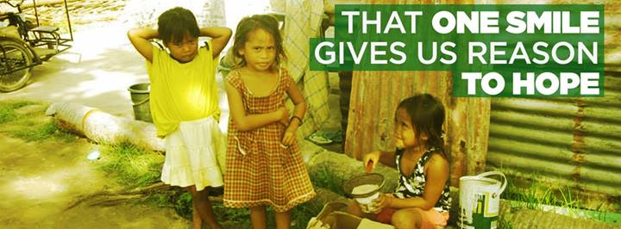

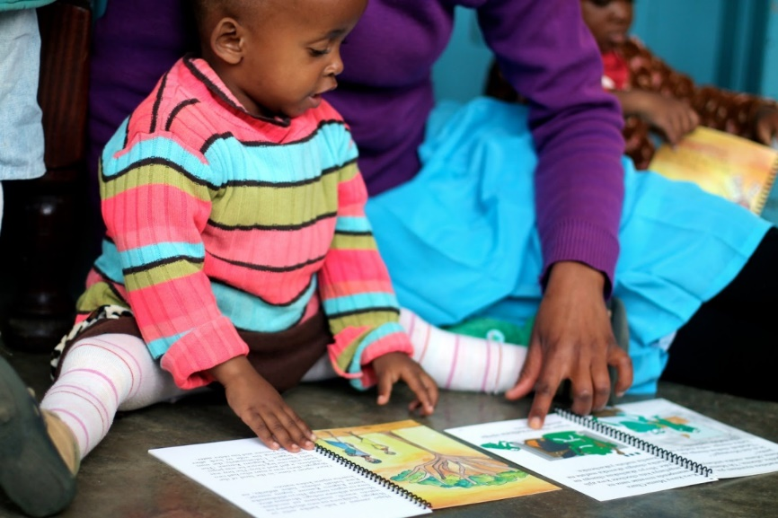
Literacy Grants
Notes:
On to one of my personal favorites… the Literacy Grant Program. This is may absolute favorite program... The projects that apply are incredible... I'll be honest that I don't read every application for content… lol, shhhh don't tell the boss... Haha... No really, There's no way I could personally read each application. The conference call is where the magic happens as we dive into the projects.
Scores matter but they aren't the final call. That’s when I get to hear committee members go to bat for their favorites and the conversation is pretty impressive.
Our mission includes “engaging the community of scholars in service to others”… and our members and chapters have been able to do amazing things with these funds!

Slide 16
Literacy Grants
Grants up to $2,500 are available to champion literacy initiatives
Open to campus chapters and active individual members
Proposals may be for new projects or for support for existing projects
Target groups may include preschool to adults
Duration of the project may be short-term, one-time activity, or a longer ongoing series of activities
Applications and materials submitted through phikappaphi.org (via online portal) by April 1, 2021
Application portal opens December 15, 2020

Slide 17
Literacy Project

Slide 18


A gift of $25 sends one book per month to one child for one year
A gift of $125 sends one book per month to one child from birth to age five
Early Head Start

Slide 19
Summary
One of the greatest benefits to being a Phi Kappa Phi member is having access to so many awards and resources
Take advantage of the opportunity!
and
Check the National website
https://www.phikappaphi.org/grants-awards#.X7bOuWhKiUk
for updates on application timelines

Slide 20
Thank you!
Sign-up to volunteer and get involved!
Email phikappaphi@umbc.edu for more information.
Join the myUMBC Group Page for updates!
Join us on Facebook!

