Slide 1

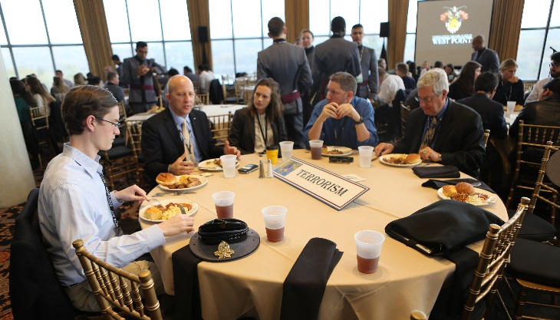


What is SCUSA?
Reflections on SCUSA 71 (2019)
The 72nd Annual
Student Conference on U.S. Affairs
West Point, New York
03 – 06 November 2021
The United States Military Academy at West Point hosts SCUSA every fall. It is the oldest and largest conference of its type and is attended by approximately 200 undergraduate students from over 125 colleges and universities worldwide. Despite the COVID-19 pandemic causing the 2020 SCUSA to be cancelled and limiting the size of the conference this year, USMA will still uphold the conference’s rich storied tradition in 2021. The experiences of SCUSA inspire many delegates to pursue a career in public service. This four-day conference provides a foundation for strong civil-military relationships among future leaders in the military and public policy.
Challenging Existing Approaches/Developing New Ideas
Throughout the conference, the student delegates will discuss and debate the impact of past and current events on the national strategy of the United States and work to formulate sound policy recommendations for the United States Government.
New to 2021 – Virtual Pilot Program
Due to the ongoing public health emergency, we are piloting a virtual option for the conference in conjunction with the in-person experience. The virtual option will still provide the rigor and expertise of the in-person experience through live-streaming panels and video communications with your table.
Unique Interaction with America’s Military
While attending SCUSA, delegates will get a unique glimpse into the daily life of the United States Corps of Cadets, future officers in the U.S. Army. Delegates interact with cadets on their roundtables and with West Point’s staff and faculty throughout the conference. They will work together with cadets, forging lasting bonds of friendship and draw upon the incredible skills within each cohort.
  Mentorship Beyond the Classroom
  SCUSA draws experts from academia and public service to facilitate roundtable discussions and guide delegates in developing a series of policy recommendations for their table region or topic.
  Past Distinguished Guest Speakers:
  Secretary Henry Kissinger
  Secretary Madeleine Albright
  Ambassador (later President) George H.W. Bush
“SCUSA was an incredibly enlightening and powerful experience for us both. The SCUSA conference was one of the most intellectually stimulating experiences of our lives. The opportunity to collaborate and engage with some of the brightest and most well-traveled individuals introduced us to a passionate community of motivated change-makers.”
- Liza Patterson & Jackson Price, Skidmore College
“SCUSA was truly incredible. I have attended other conferences and was so impressed at the entire programming vision that the cadets at West Point had designed. SCUSA is unique in that it splits delegates into different groups…and [with] two of the foremost experts in the field to sit down and discuss what informs policy on this issue.”
- Sam Collins, Tufts University
"SCUSA provided an environment for me to meet diverse people to discuss topics with other cadets and students as well as explore staffing and planning a large-scale event. It was an incredible opportunity to learn and expand my knowledge on both national and international conflicts and solutions.“
- Lillian Brown, SCUSA 72 Commander
Disruptive Technology and American Influence in the Coming Decade
General Questions:
westpoint.scusa.info@gmail.com
Transportation Questions:
scusa.transpo@gmail.com
Contact the Executive Secretary:
Major Jared Stefani
253-219-7081
Jared.Stefani@westpoint.edu
The USMA Class of ’71
The George and Carol Olmsted Foundation
Notes:
https://www.marist.edu/liberalarts/polsci/news/scusa.html
http://www.olmstedfoundation.org/news/olmsted-scholars-serve-as-table-co-chairs-at-scusa-68
https://www.maxwell.syr.edu/uploadedFiles/ir/undergrad/Extracurricular/Student_Conferences/SCUSA%2068%20Reflection%20-%20Emilie%20Scardilla.pdf

Slide 2
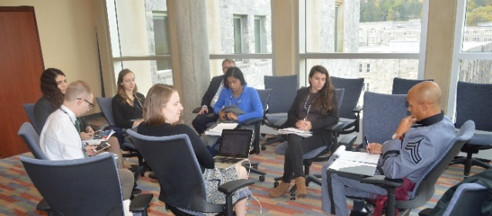



SCUSA 72 Roundtable Topics
How does SCUSA work?
Important Questions
In-Person Modality
The U.S. and the Political Economy of Innovation
Social Media & the Weaponization of Information
Public Health and the Biomedical Revolution
Artificial Intelligence and Automation
21st Century Vulnerabilities: Critical Infrastructure, Supply Chains, and Cyber Security
Climate Change
China & East Asia
Space: The Final Frontier
Virtual Pilot Program
Inequality in an Era of Disruptive Technology
Trade, Globalization, and Economic Statecraft
Russia
Key Conference Events
November 3
Arrival, registration, welcome, and opening senior panel discussion of the conference theme.
November 4
Roundtable sessions and keynote address.
November 5
Roundtable sessions, weapons and equipment interactive display, working roundtable dinner.
November 6
Closing presentation of policy recommendations. Delegate departure.
Preparing for SCUSA
Prior to the SCUSA conference, delegates should prepare to discuss their roundtable topic as it relates to the conference theme.
SCUSA 72’s theme is
“Disruptive Technology and American Influence in the Coming Decade.”
As we enter a new decade, America faces opportunities and challenges generated by major technological innovations. Advances in disruptive technologies — such as automation, artificial intelligence, robotics, and machine learning — promise to increase our ability to connect with others while addressing important threats to well-being such as disease and poverty. However, these technologies can also have negative consequences for privacy, civil liberties, prosperity, equality, and national security. Large-scale breaches into stores of personal data and the displacement of millions of workers are now common. Disruptive technologies will also accelerate changes in trade and security relationships among major powers in the international system. One of the great challenges for the United States is to find effective policy responses to this rapidly evolving environment. Policymakers face a critical question: How should the United States advance its interests and values in an era of turbulent technological change?
Q: How do I attend SCUSA?
A: Contact your academic advisor at your college or university to discuss your interest in SCUSA.
Q: What is the registration fee & payment due?
A: The registration fee is $150. Payment can be made by credit card. SCUSA points of contact will receive a link for the registration/payment site in September. All payments must be made by October 22.
Q: How do I get to West Point?
A: Students pay for their own air or rail transportation. The SCUSA cadet staff will arrange ground transportation for delegates arriving at Newark, LaGuardia, and Stewart Airports, as well as Garrison Train Station. Delegates may also drive to West Point.
Q: Where will I stay?
A: Delegates will be housed in The Thayer Hotel on West Point. Cadets will stay in their barracks.
Q: What if I am 27 years old or older during the conference?
A: Students who are 27 years old during the conference will not be accepted due to legal restrictions preventing us from housing students who are 27 or older on campus. No exceptions will be made for any reason.
Q: How do I prepare for SCUSA?
A: Delegates will be informed of their roundtable assignments after registering for the conference. Delegates should read the theme and roundtable papers provided on the SCUSA website and come prepared to discuss the key issues in their policy or regional area.
Q: What is the dress code?
A: Delegates should bring business casual wear for daytime use and casual dinners. Weather in New York is breezy and cool in mid-fall; we recommend that you bring a warm winter coat and an umbrella.
Q: Can I change my conference modality (virtual/in-person)?
A: Due to the limited number of slots for in-person SCUSA 72, we are unable to change your table once selected.
SCUSA Sites
SCUSA Website
https://westpoint.edu/academics/academic-departments/social-sciences/conferences/student-conference-on-us-affairs
https://twitter.com/scusawp
https://www.facebook.com/groups/SCUSAwp
​
​
https://www.instagram.com/scusa_wp/?hl=en

