Slide 1
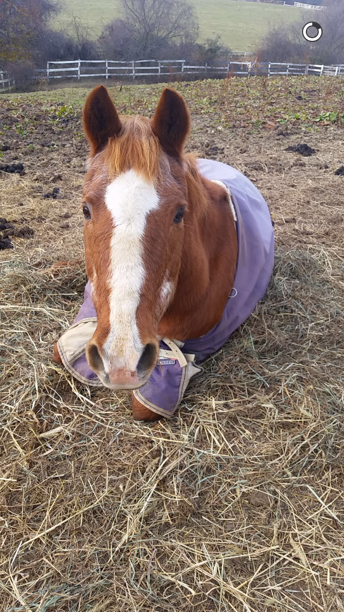
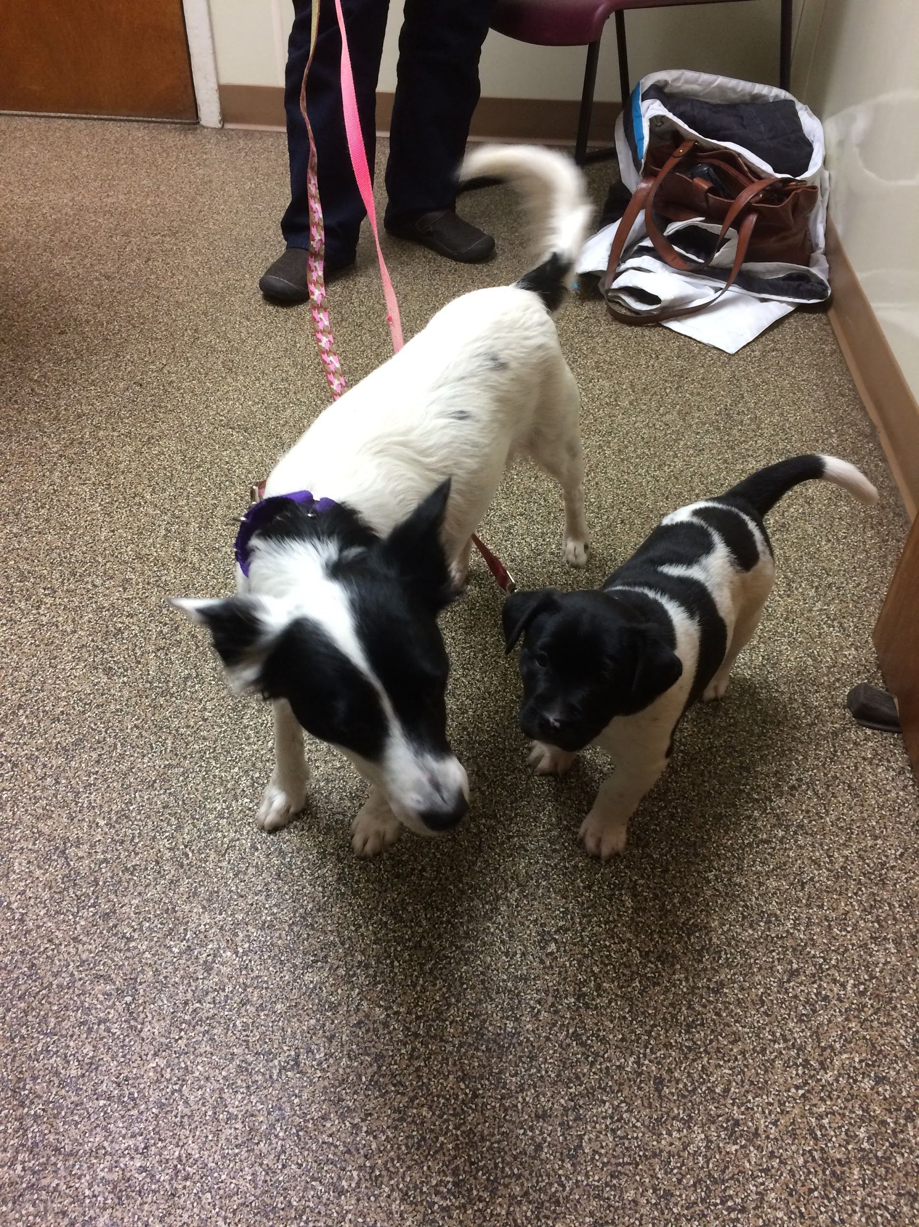
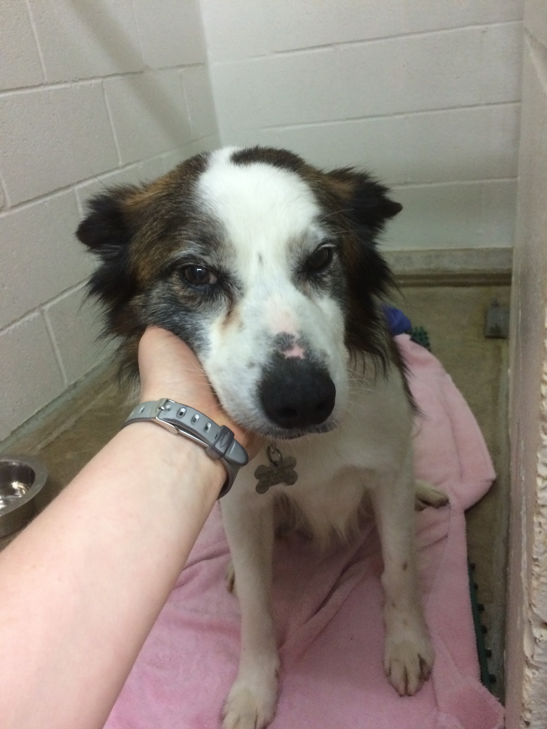
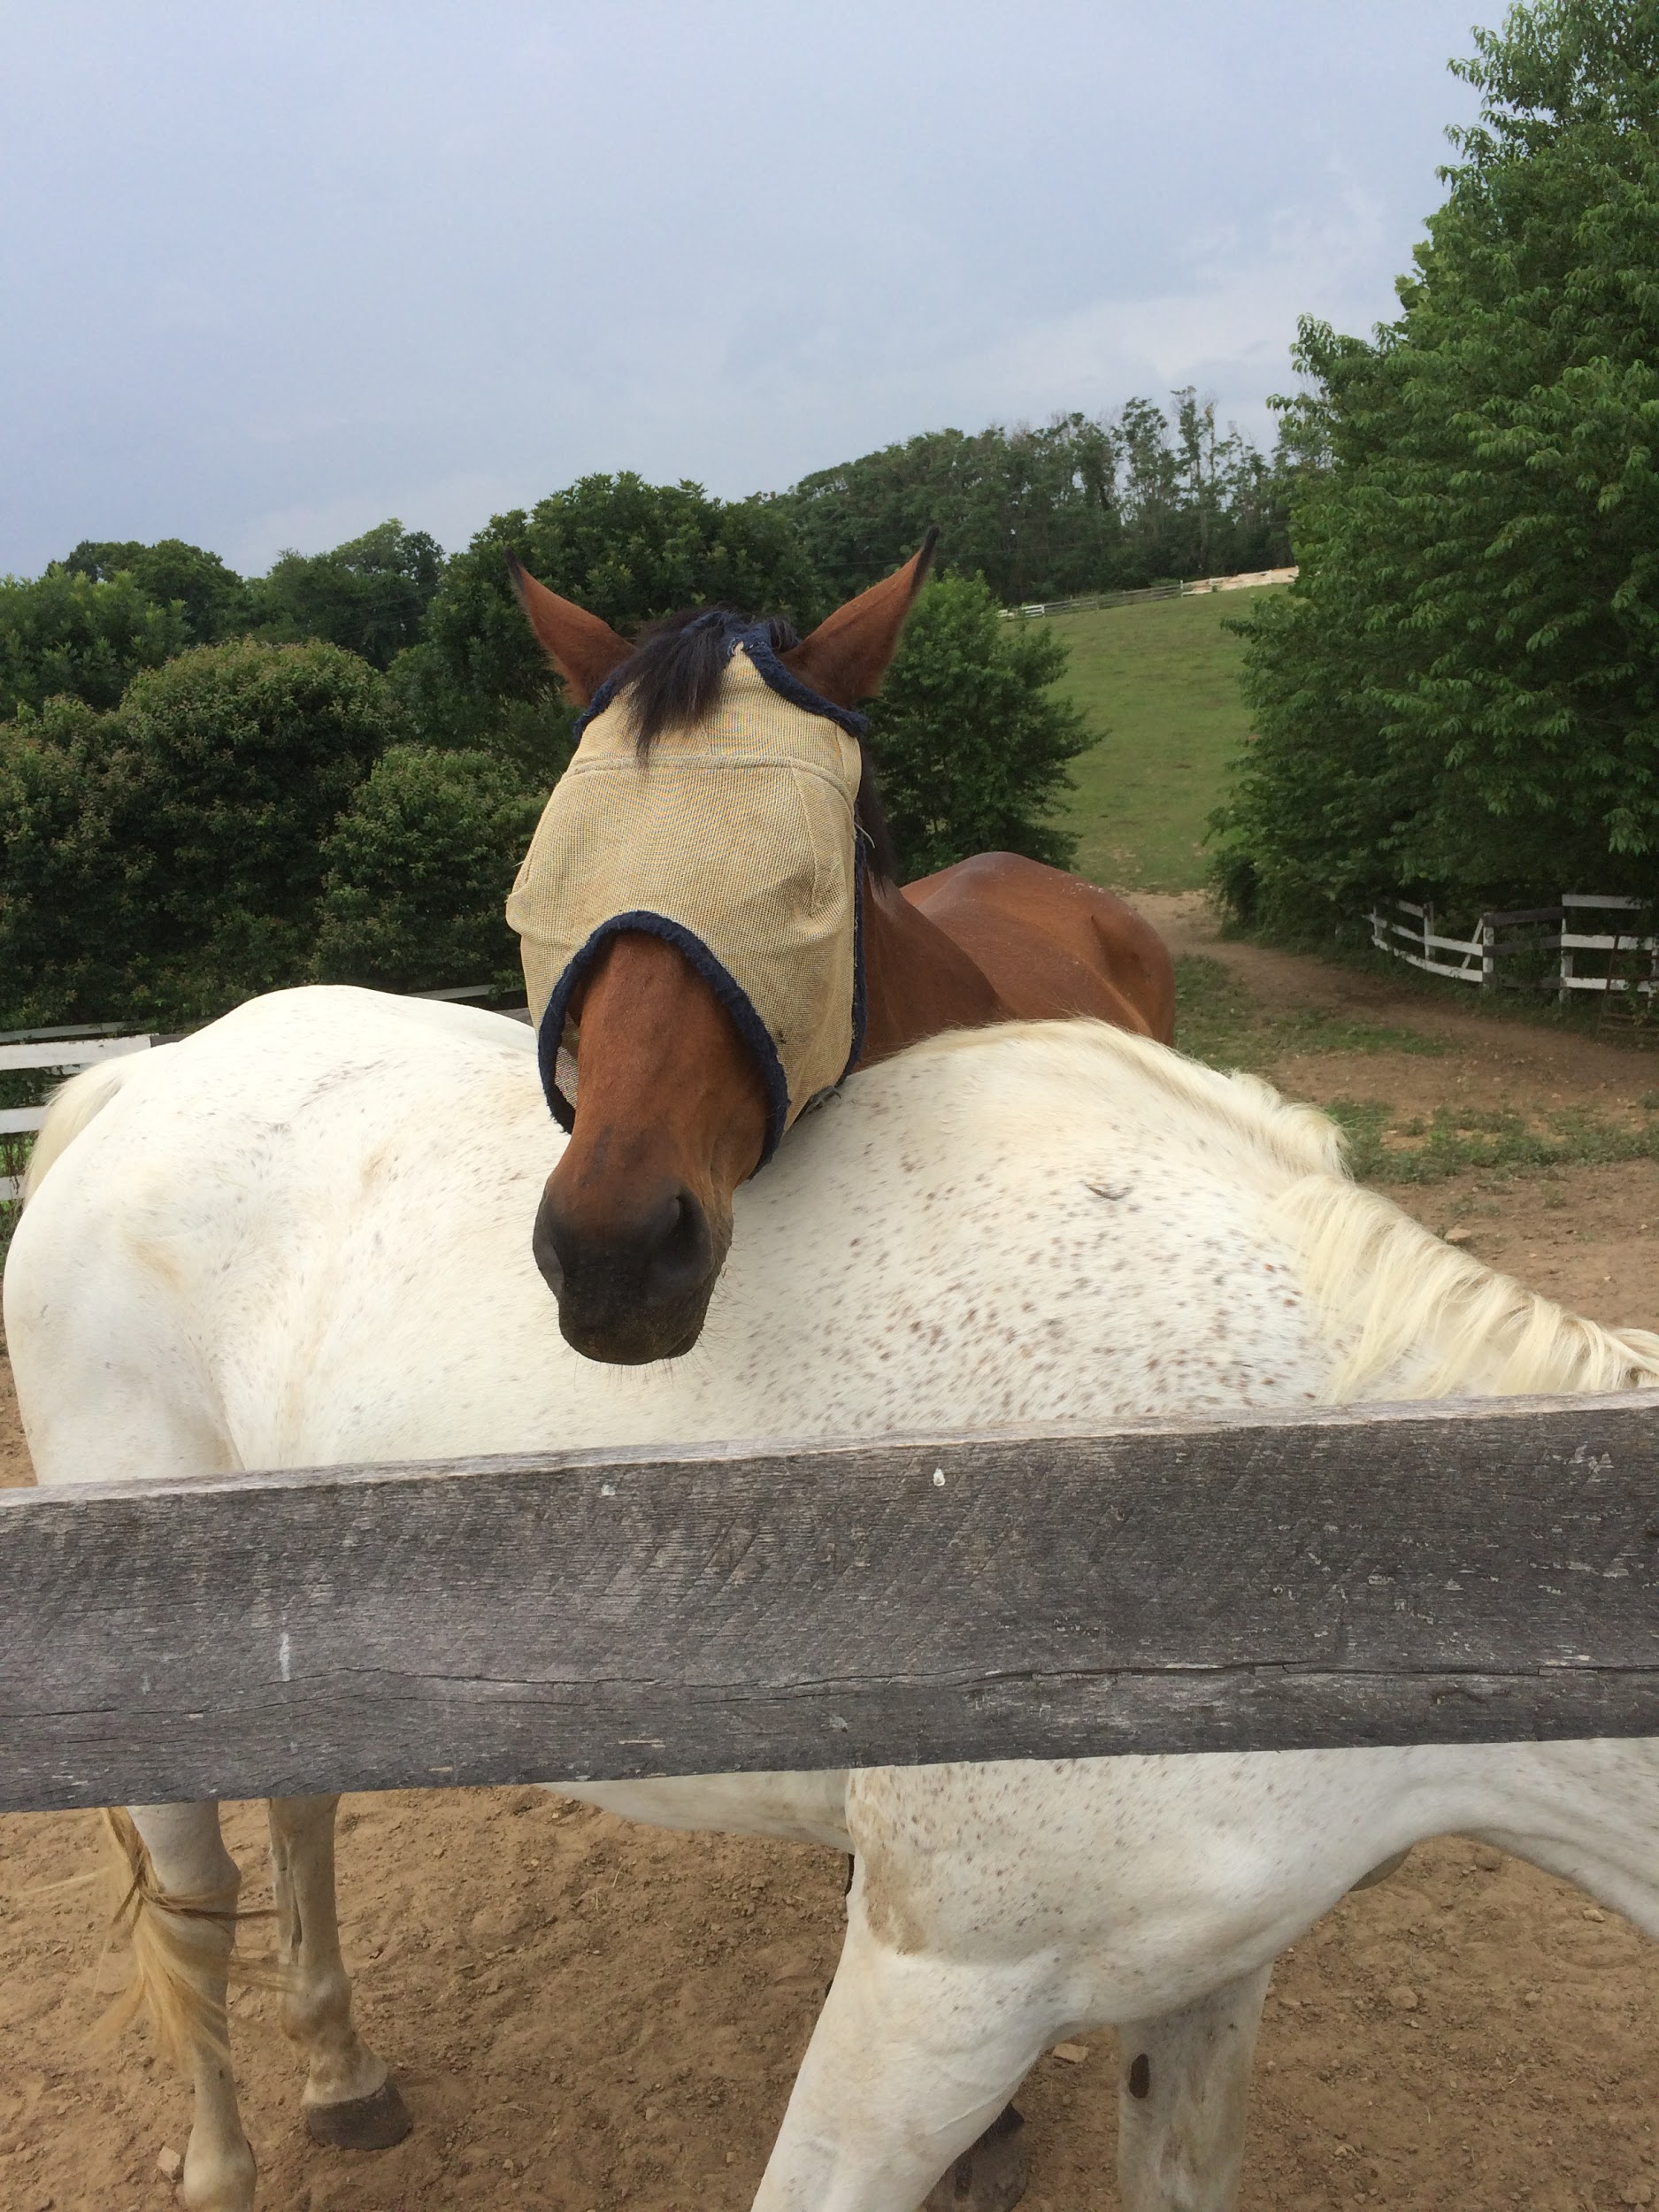
Pre-Veterinary Society GBM
9/25/19

Slide 2
Different Career Paths in Veterinary Medicine

Slide 3
Emergency Medicine
Take care of patients when they can’t reach their regular veterinarian.
Education:
DVM.
3 years in a residency program.
Can become a Diplomat of the American College of Veterinary Emergency and Critical Care (DACVECC).
Salary:
Entrance Salary: $35,000, starting residency salary (2018).
Range Once Established: $71,500-$132,000 (June 2019).
Notes:
http://doctorly.org/how-to-become-an-emergency-veterinarian/
https://www.ziprecruiter.com/Salaries/Emergency-Veterinarian-Salary
https://www.aavmc.org/public-data/2018-resident-salaries
https://bluepearlvet.com/hospital/new-castle-de/

Slide 4
Emergency Medicine Cont.
Worklife:
Rigorous; put in more work than other specialists.
Expected to work late evenings, weekends, and holidays.
Long work hours (ex- 1 week on, 1 week off).
Career Development:
Become owner of a practice.
Receive higher salary, but also more work in running a clinic.
Become an educator.
May require further PhD education.
Notes:
http://doctorly.org/how-to-become-an-emergency-veterinarian/
http://www.veterinarytechnicianinfo.com/emergency-critical-care-veterinary-technician/

Slide 5
Shelter Medicine
Help animals who need it most (community cats, abuse/neglect cases).
LOTS of spays and neuters, but also disease management.
Only started to gain traction in the 90’s with help from Maddie’s Fund.
Education:
DVM; Masters in Public Health may be useful as well.
Depending on the school, can do a track in shelter medicine focusing in epidemiology, animal forensics, etc..
Can get further training after vet school in residency and certification programs.
Notes:
https://vet.tufts.edu/shelter-medicine-at-cummings-school/about/what-is-shelter-medicine/
https://www.public-health.uiowa.edu/about-mph/
https://www.vet.cornell.edu/research/faculty/holly-putnam-dvm

Slide 6
Shelter Medicine Cont.
Salary:
$60,000-$75,000 (2011).
Worklife:
Lots of work to do, but very rewarding to see animals find their forever homes.
Career Development:
Can go into teaching; may need a PhD for this.
Certification courses to learn more (Maddie’s Professional Certificate in Shelter Medicine and others).
Notes:
https://www.sheltervet.org/assets/PDFs/VIN-ASV%20survey-final-th.pdf
https://sheltermedicine.vetmed.ufl.edu/education/on-campus-certificate/

Slide 7
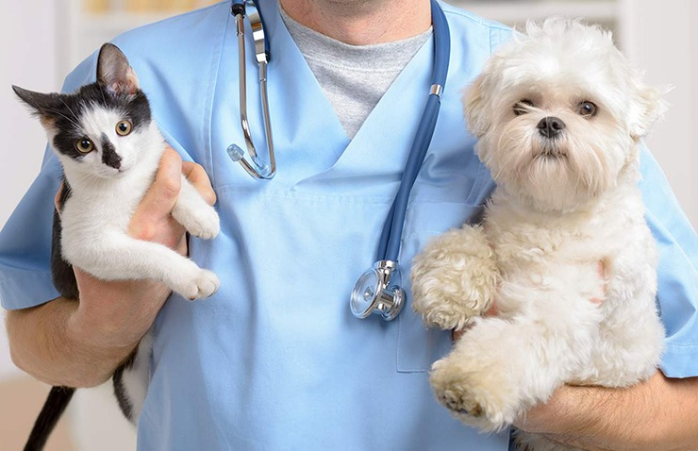
General Small Animal Practice
Treat companion animals in a clinic setting handling appointments, surgeries, and occasionally emergencies.
Appointments include: annual wellness exams, vaccinations, evaluating and treating wounds, diagnostic testing, neonate care, and MUCH MORE.
Must stay up-to-date with new research and can go to continuing education conferences
Entrance salary - $71,462

Slide 8
Small Animal cont.
NAVLE, The North American Veterinary Licensing Exam - the only required exam to legally practice in US (other states may need more licensing)
Internships - not mandatory, but strengthens new skills. Beneficial if not going straight into practice; can lead to residency
Specialities - additional education available for those interested in board-certified specialty

Slide 9
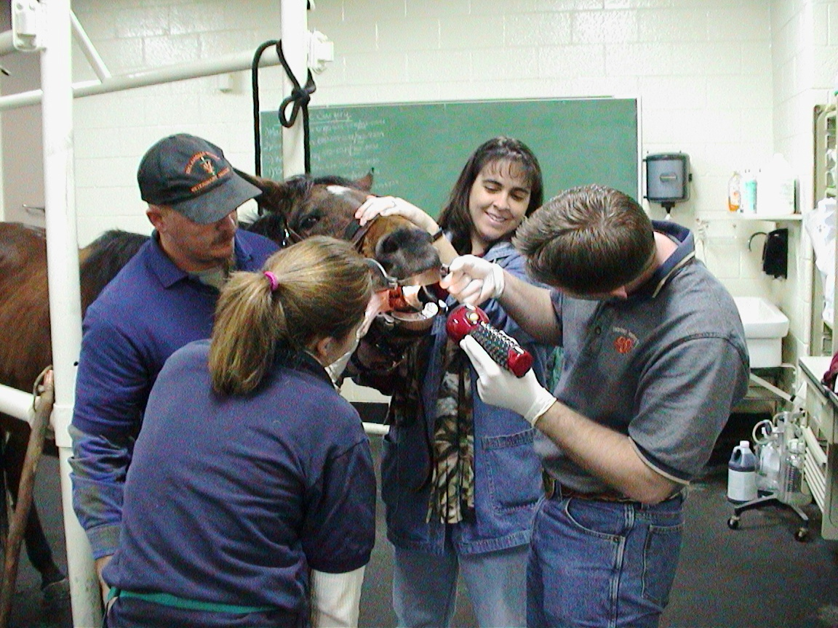
Veterinary Educators - Clinical Instructor
Instruct in the clinical setting
Interact with students as an educator
Required education and experience:
Doctorate in Vet Medicine; PhD not necessary, but preferred
2-3 years of private/public practice experience
Entrance salary: $92,125

Slide 10
Clinical Instructor- Career Advancement
01
Assistant Clinician
Hospital Full-Time
Lecture Part-Time
02
Clinical Instructor
Hospital Full-Time
Lecture Part-Time with Preference
03
Hospital or Department Head
Highest Quality of Education
Manage Faculty
Develop Resources
04
Be a DVM
Budget and Authority
Hire a sufficient amount of staff
Encourage a Diverse, Non-discriminatory Environment
Dean

Slide 11
Job Availability, Security, & Advancement
High availability - vet students steadily increasing; jobs competitive
Security differs - varying approaches to tenured vs. non-tenured professors
VA-MD College of Veterinary Medicine - no tenure for faculty or staff
Cornell University and University of FL - tenure only for faculty
Advancement with relative mobility, but very linear
Determine what you do based on interest

Slide 12
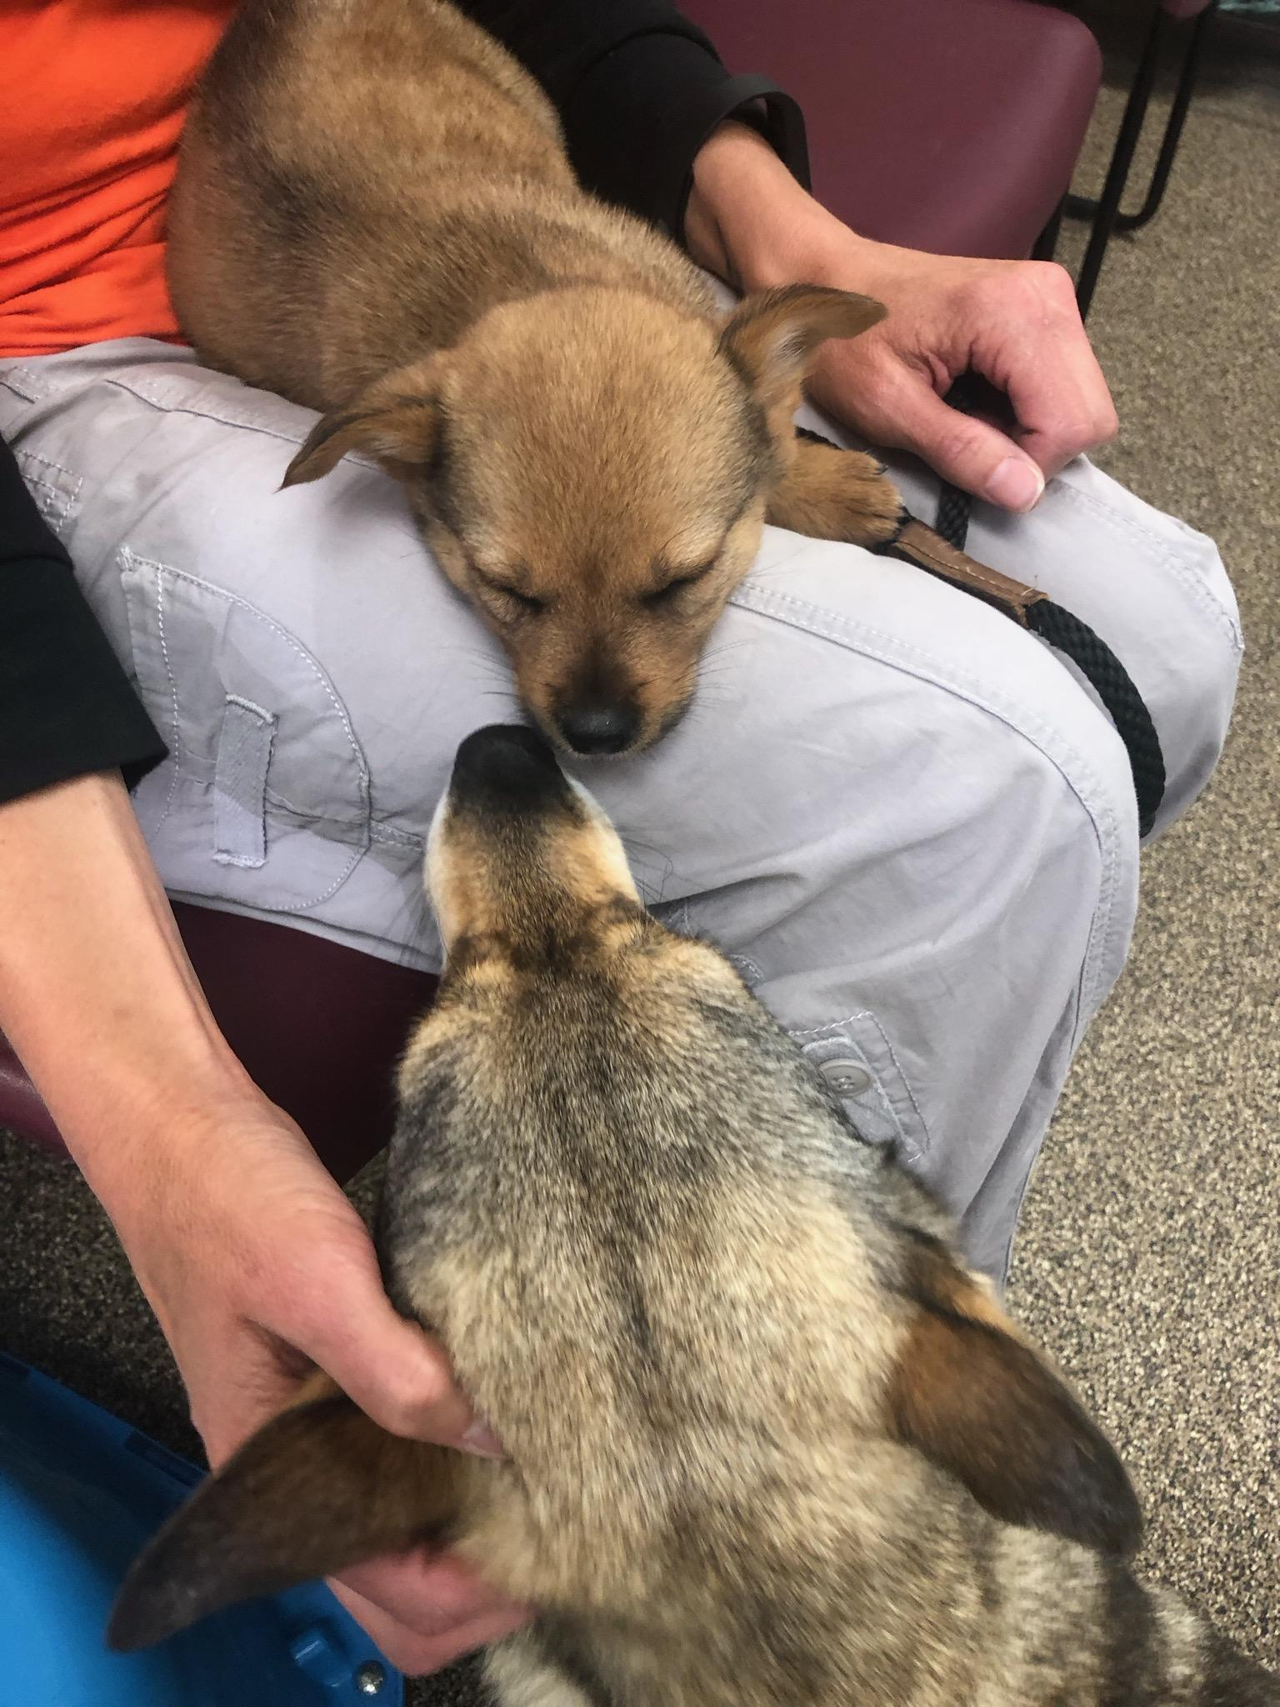
Veterinary Technician
Assist veterinarians
Monitor vital signs
Obtain blood, stool, and other samples
Test blood, stool, and other samples
Take x-rays
Prepare animals for surgery
Perform dental procedures
Emergency first aid
Restrain animals during exams
Administer anesthesia
Administer medications and vaccines, and treatments prescribed by a veterinarian

Slide 13
Veterinary Technician Continued...
Education: Aspiring veterinary technicians earn an associate’s degree from a two-year veterinary technology program that has received accreditation from the American Veterinary Medicine Association (AVMA) Committee on Veterinary Technician Education and Activities (CVTEA). A list of accredited programs in the United States and Canada on the AVMA website: Veterinary Technology Programs Accredited by the AVMA CVTEA.
Certification: Licensing requirements for veterinary technicians vary by state. The American Association of Veterinary State Boards (AAVSB) administers the Veterinary Technician National Examination, which typically is required. AAVSB maintains contact information for licensing boards in the U.S. and Canada on its website.
Training and experience: Formal training typically includes laboratory and clinical work with live animals. It’s also a good idea to volunteer at a veterinarian's office or an animal shelter to gain experience.
Notes:
https://www.thebalancecareers.com/what-is-a-veterinary-technician-526080

Slide 14
Veterinary Technician Salary
Veterinary technicians working in research tend to earn more money those working in offices serving family pets.
Median Annual Salary: $33,400 ($16.05/hour)
Top 10% Annual Salary: $49,350 ($23.72/hour)
Bottom 10% Annual Salary: $22,880 ($11.00/hour)
Veterinary Technicians can work in a variety of environments, including small animal, large animal, mixed animal, small exotic animals, zoo medicine, wildlife rehabilitation, and aquatics medicine.

Slide 15
Research Veterinarian
“Research veterinarians are often called in to solve both animal and human health problems, such as West Nile Virus, Mad Cow Disease and a host of other critical illnesses that affect huge populations of animals and people. Sometimes they work in a lab and use animals for research purposes (a highly controversial subject according to some), but even when they are working with animals, their primary goal is always first and foremost to maintain the safety and health of said animals.”
Notes:
https://www.jobmonkey.com/animaljobs/research-veterinarians/

Slide 16
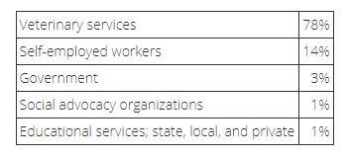
Research Veterinarian Requirements and Salary (Government)
DVM and PhD required in most cases
Salary: $99,420 to $144,735
Notes:
https://www.salary.com/research/salary/benchmark/research-veterinarian-salary
https://collegegrad.com/careers/veterinarians

Slide 17
Research (PhD) That Can Involve Animals (Including Insects)
https://burnslab.umbc.edu/
https://news.umbc.edu/umbcs-sarah-stellwagen-first-in-world-to-sequence-genes-for-spider-glue/
https://biology.umbc.edu/directory/faculty/bieberich/
https://www.mendelsonlab.net/
https://userpages.umbc.edu/~blohr/
https://omlandlab.umbc.edu/
https://biology.umbc.edu/directory/faculty/person/ST65604/
https://biology.umbc.edu/directory/faculty/brewster/brewster-lab/
https://biology.umbc.edu/legates-lab/
https://leipslab.umbc.edu/
https://linlab.umbc.edu/
http://lobolab.umbc.edu/research/
https://biology.umbc.edu/directory/faculty/person/RX81928/
https://biology.umbc.edu/padmanabhan-lab/
https://biology.umbc.edu/directory/faculty/person/RA08807/
https://starzlab.umbc.edu/
https://biology.umbc.edu/vonhoff-lab/
https://biology.umbc.edu/directory/faculty/

Slide 18
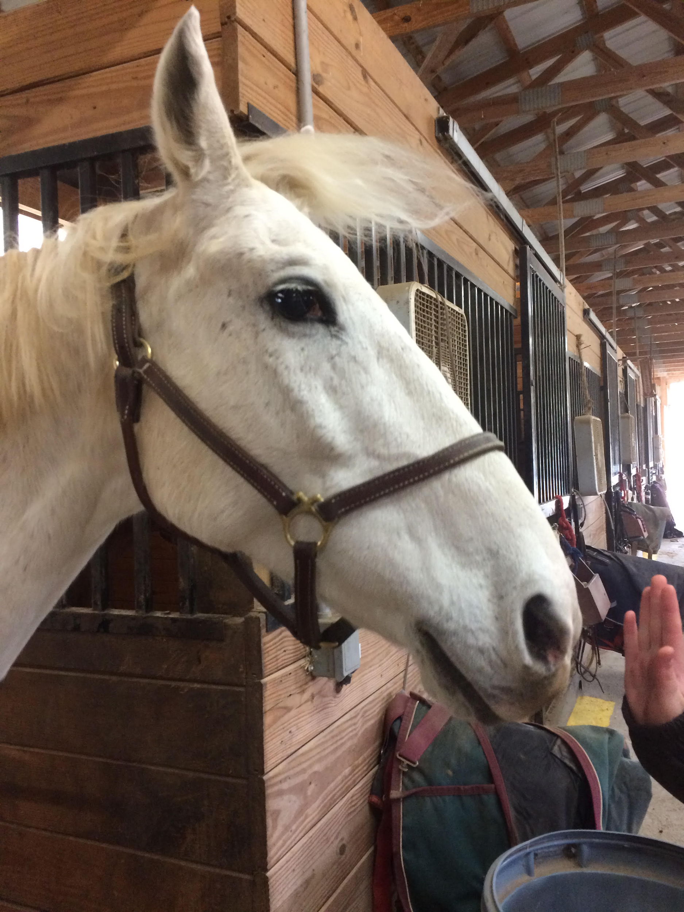
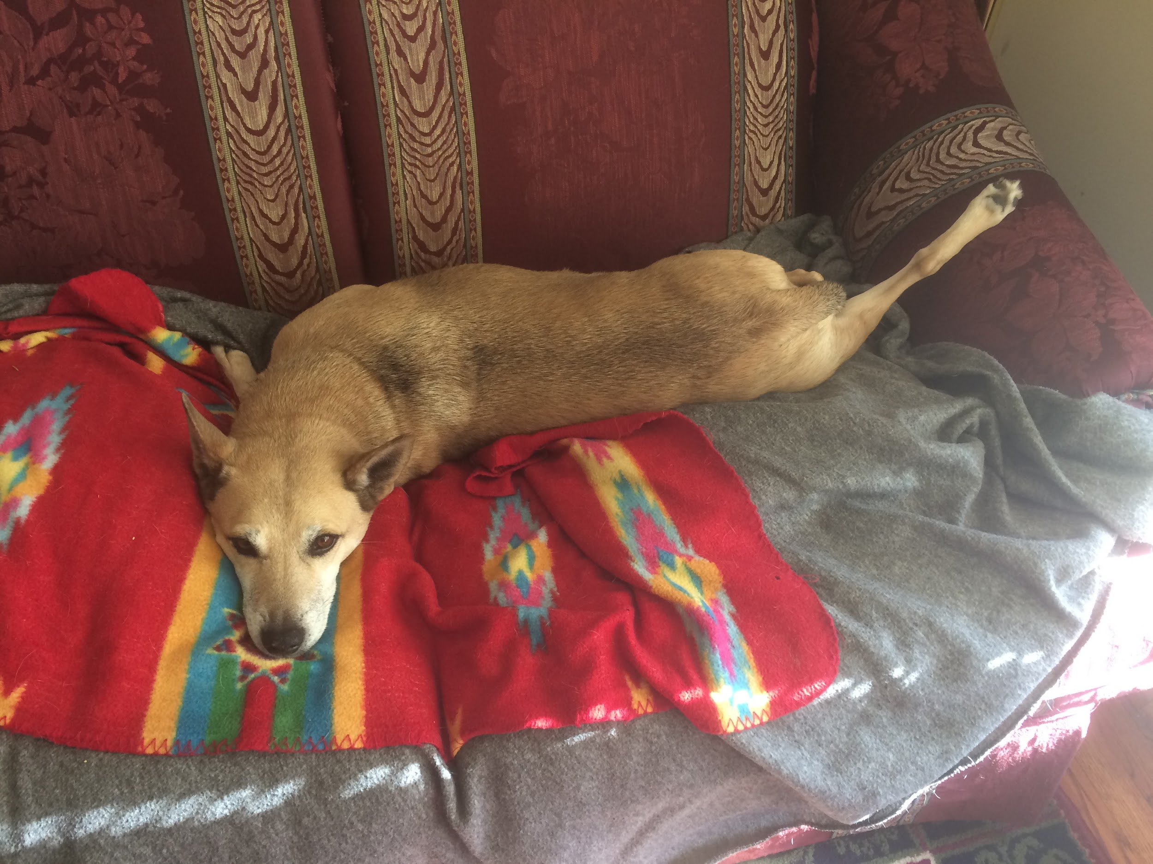
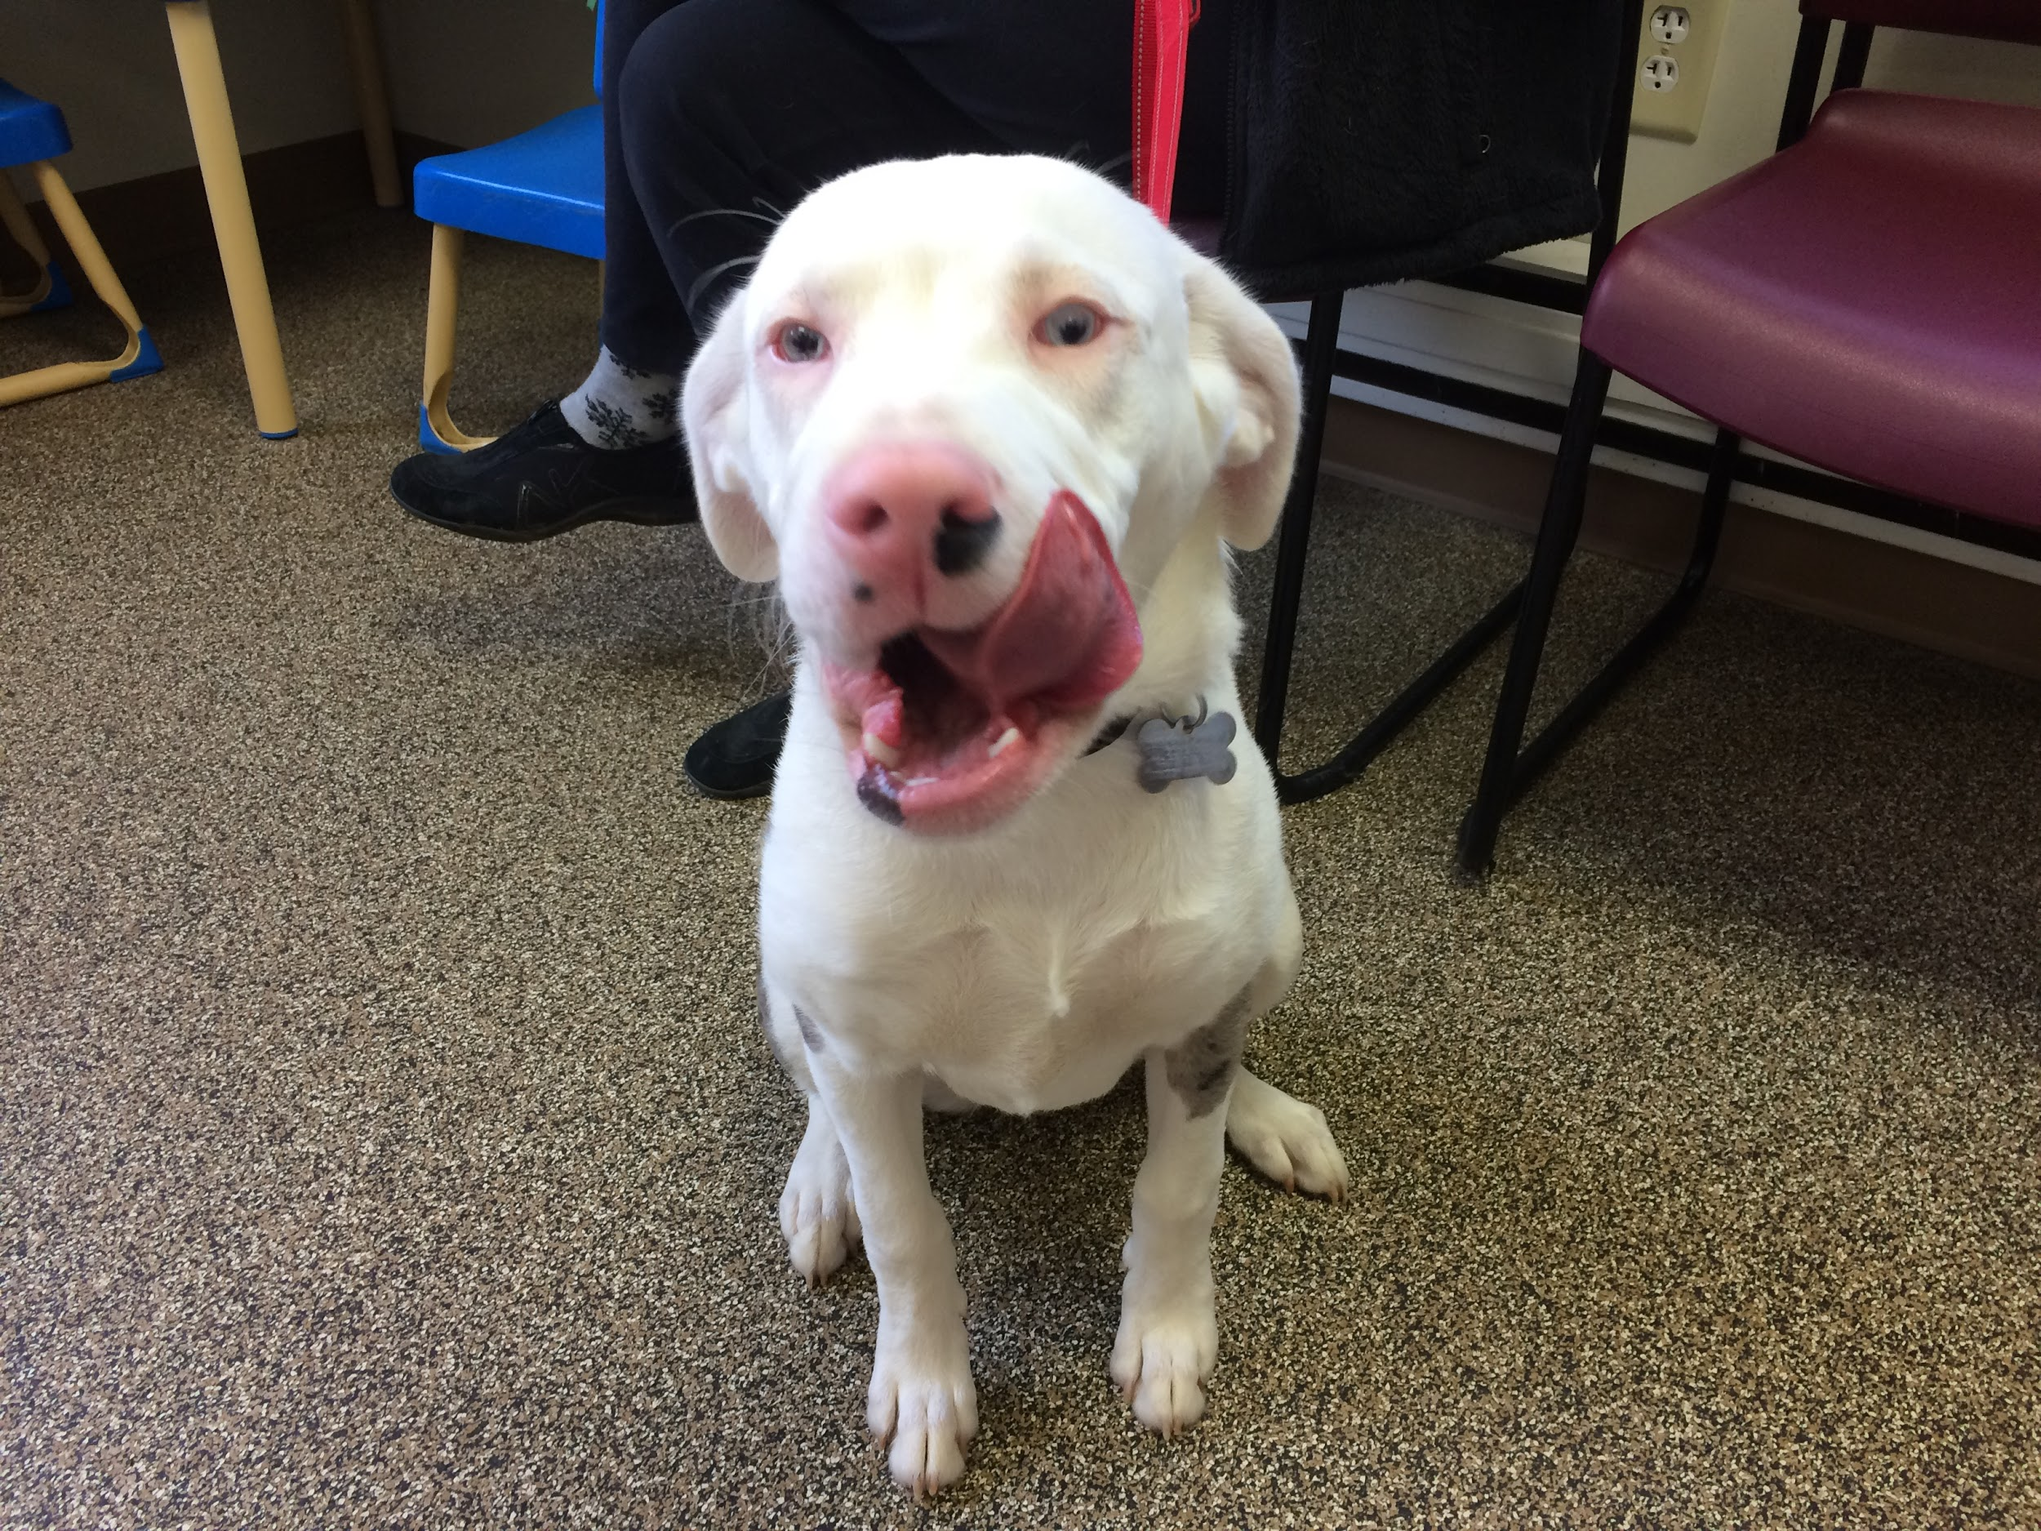
Thank you for attending!
Check out the Career Fair in the RAC (11:30am to 3:30pm)

