Slide 1
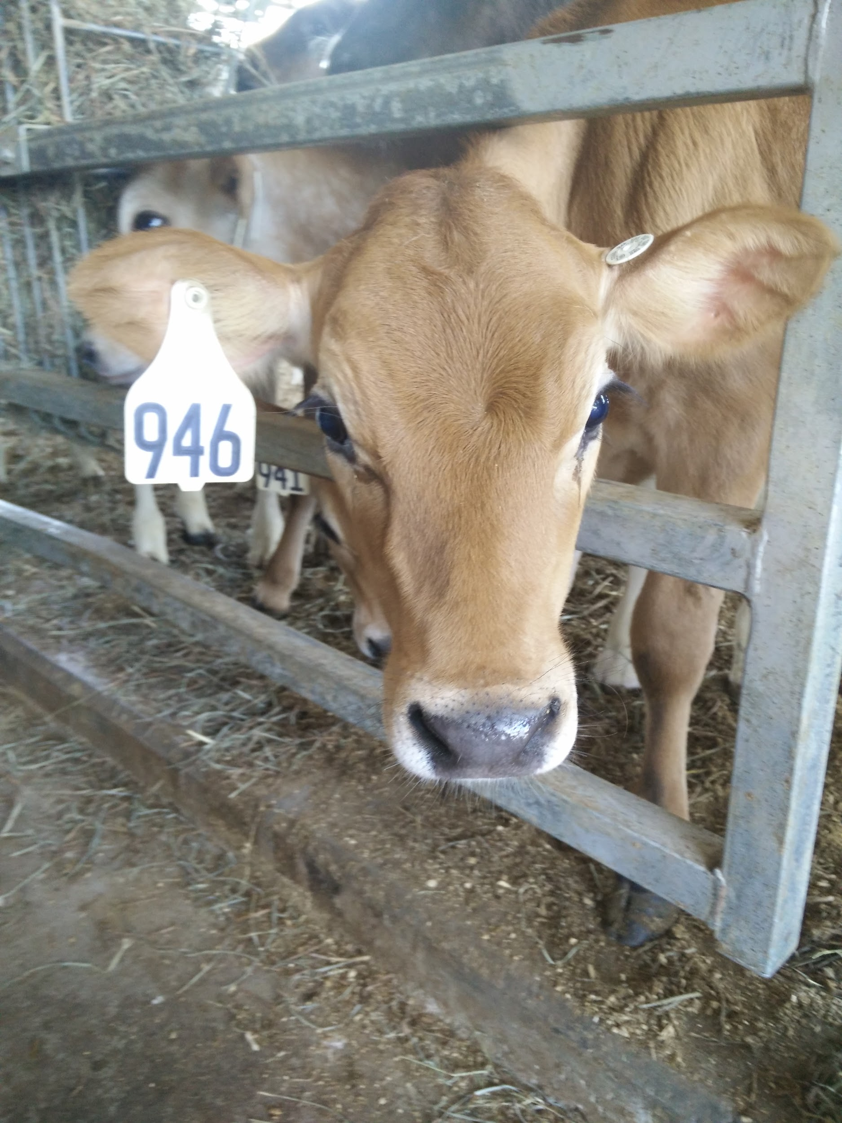
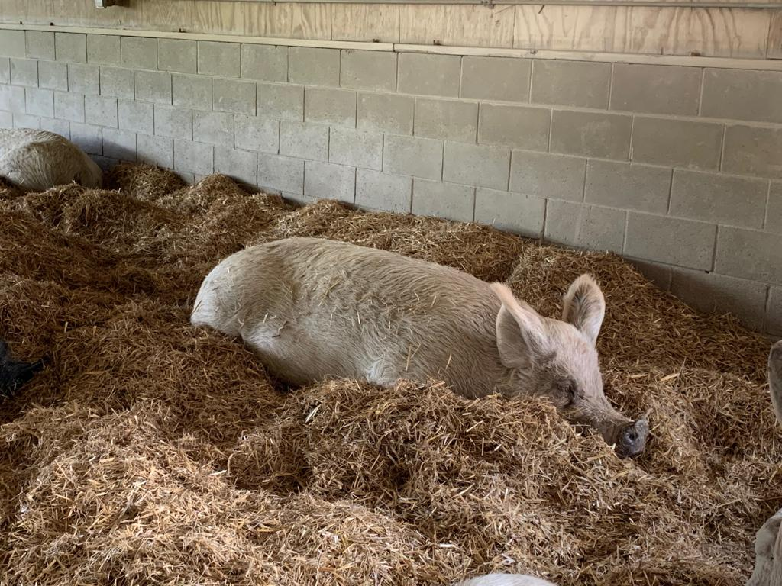
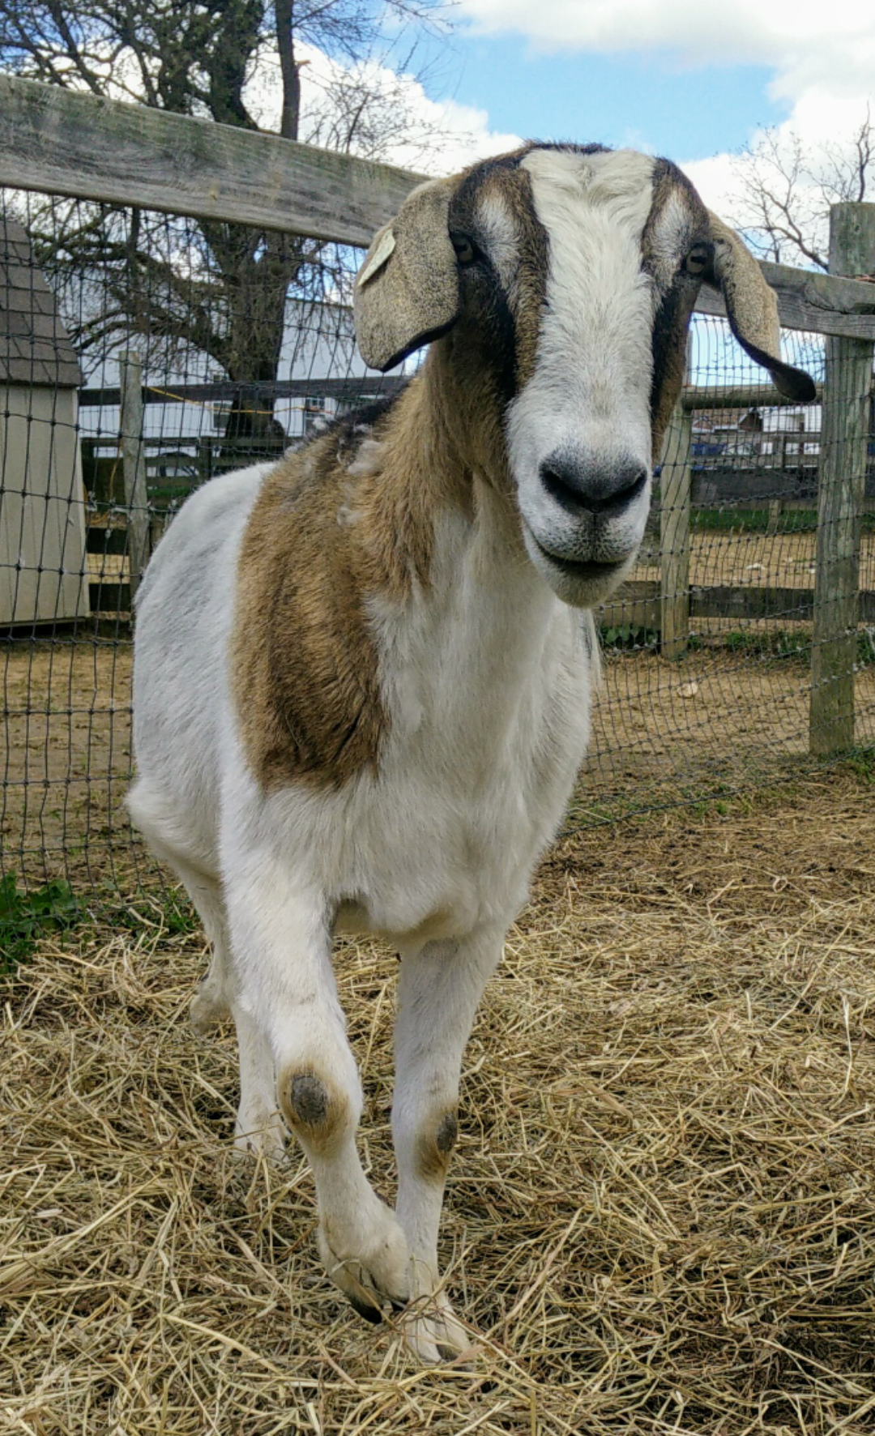
Pre-Veterinary Society GBM
10/9/19

Slide 2
General Announcements
T-shirts
Trip to Virginia/Maryland College of Veterinary Medicine
Upcoming events:
Zoo
Speakers

Slide 3
Demi
Get your resume ready!
Visit local veterinary offices.
Walk in dressed presentably (business casual)
Have resume in hand
Ask for volunteer/work opportunities
Smile 😊
Be persistent

Slide 4
Arushi
Volunteer at BARCS (Baltimore, MD):
Summer after freshman year.
Part of Shriver Center’s Prac 096 course.
Was in their TNR and surgery departments.
Started cleaning, but progressed to more veterinary related tasks.
Shadow at a Veterinary Hospital (Columbia, MD):
Saw x-rays, surgeries, appointments.
Got the chance to ask a lot of questions.
Tips:
Journal every day.
Ask questions.

Slide 5
Jenni
Do not be afraid to email/call vet offices
Start with your own pet’s veterinarian
When shadowing,
Learn, but do not be in the way (you want to be invited back)
Do not be afraid to ask questions (when vets aren’t busy)
Offer to help out when they seem to need it
Most important: Be persistent (as Demi said) and be positive/polite

