Slide 1
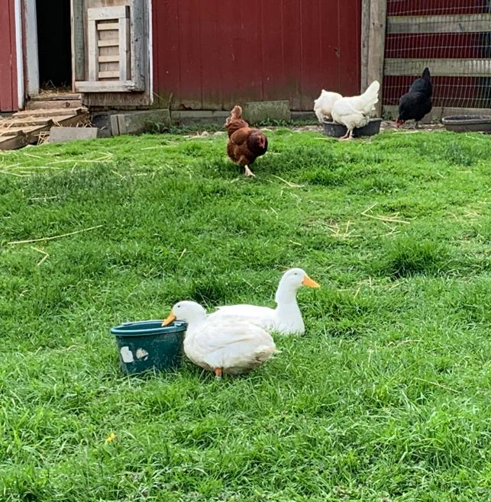
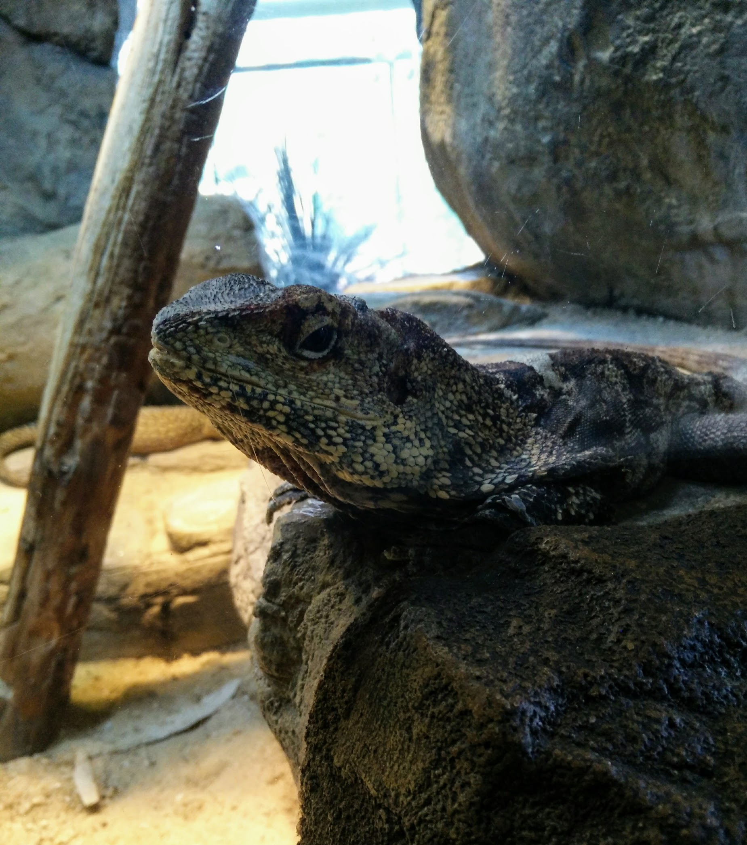
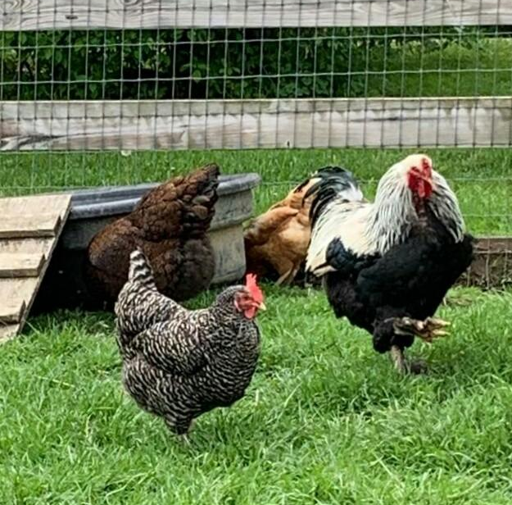
Pre-Veterinary Society GBM:
Animal Experiences
10/23/19

Slide 2
General Announcements
T-shirts
Trip to Virginia/Maryland College of Veterinary Medicine
Upcoming events:
Speakers
Gentle Giants
Notes:
Drivers to VT- Savannah, me, maybe grace- 1 spot left if you know anyone that wants to come- may post about it later
Dr. Holland- made a poll on myUMBC- please answer by Sunday
Sent email to people going to VT, please answer by friday, or I’m taking you off the list for going

Slide 3
Equestrian Club- Volunteer with Gentle Giants
Saturday, November 16th 12-3pm
https://www.gentlegiantsdrafthorserescue.org
17250 Old Frederick Road, Mount Airy Maryland 21771
About 30 mins away

Slide 4
Courses Pertaining to Pre-Vet
BIOL 305 (3) and 305L (2) - Comparative Animal Physiology & Lab
Description:Functional features of whole organisms and their component organs and organ systems will be studied. Emphasis will be on ways in which diverse organisms at various phylogenetic levels perform similar functions. Examples of topics include osmoregulation, gas exchange, control systems, sensors, effectors, brain and behavior.
Prerequisites: You must have completed BIOL 303 In addition, you must be concurrently enrolled PHYS 112 or 122 or have completed those courses in a previous semester with a C or better.
Frequency: BIOL 305 - Spring. BIOL 305L - Spring & Summer

Slide 5
Courses Pertaining to Pre-Vet
BIOL 480 - Animal Behavior (4)
Description:This course explores the general themes and important questions in animal behavior. We cover subjects that examine how and why animals interact with each other and with their environment. Topics include: the genetics of behavior, behavioral development, learning, animal communication, habitat selection, foraging, sexual selection, and mating systems, among others. This is a quantitative course; a familiarity with basic statistics and mathematics is assumed. This course is Writing Intensive.
Prerequisites:You must complete BIOL 142 and BIOL 302 and BIOL 303 and ENGL 100 or equivalent with a C or better.
Frequency: Fall (Occasionally Spring & Summer)
Meets Writing Intensive requirement

Slide 6
Courses Pertaining to Pre-Vet
BIOL 457 - Physiology of Marine and Estuarine Animals (4)
Description: A study of the physiological specializations demanded by marine/estuarine environments, including physiological mechanisms for coping with stresses imposed by extremes of temperature, salinity, aerial exposure and low oxygen concentrations; sensory physiology, including visual, chemical and mechanical modalities; exogenous and endogenous rhythms related to tidal or diel cycles; and bioluminescence. The course includes one or more trips to field laboratories.
Prerequisites: You must have completed BIOL 302 and BIOL 303 and [BIOL 305 or BIOL 307] with a grade of "C" or better
Frequency: Spring (Every other year - Being taught Spring 2020, won’t be taught again till Spring 2022!)

Slide 7
Now… Animal Experiences!

Slide 8
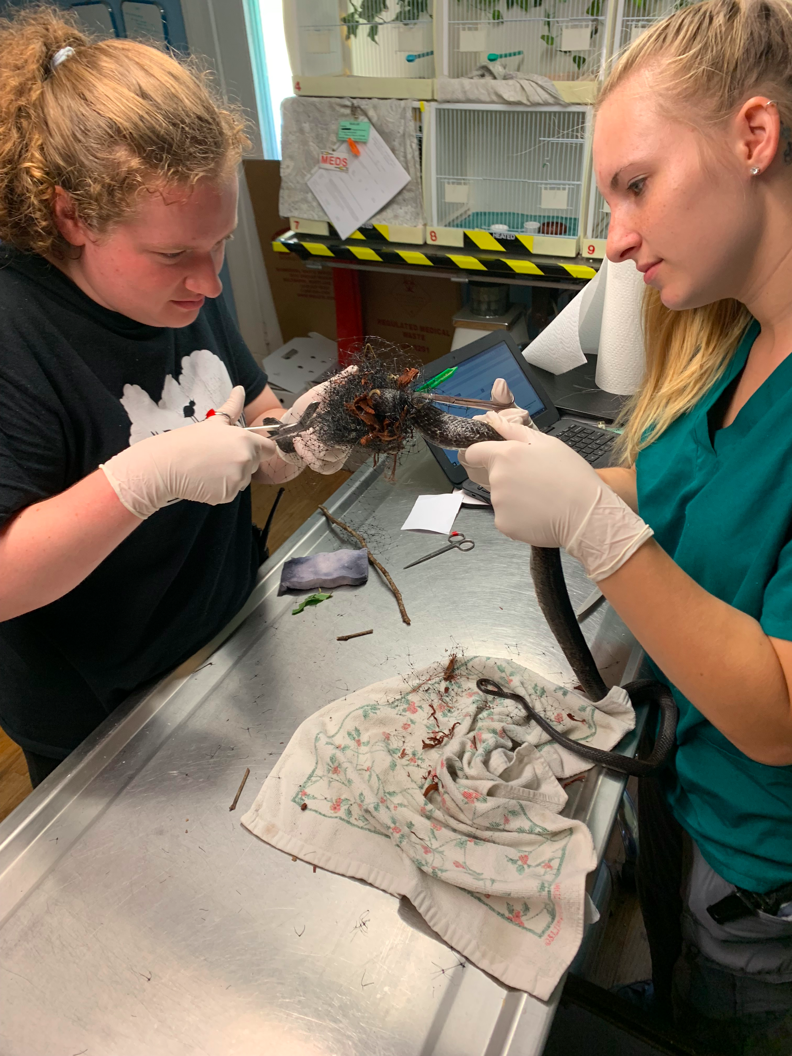
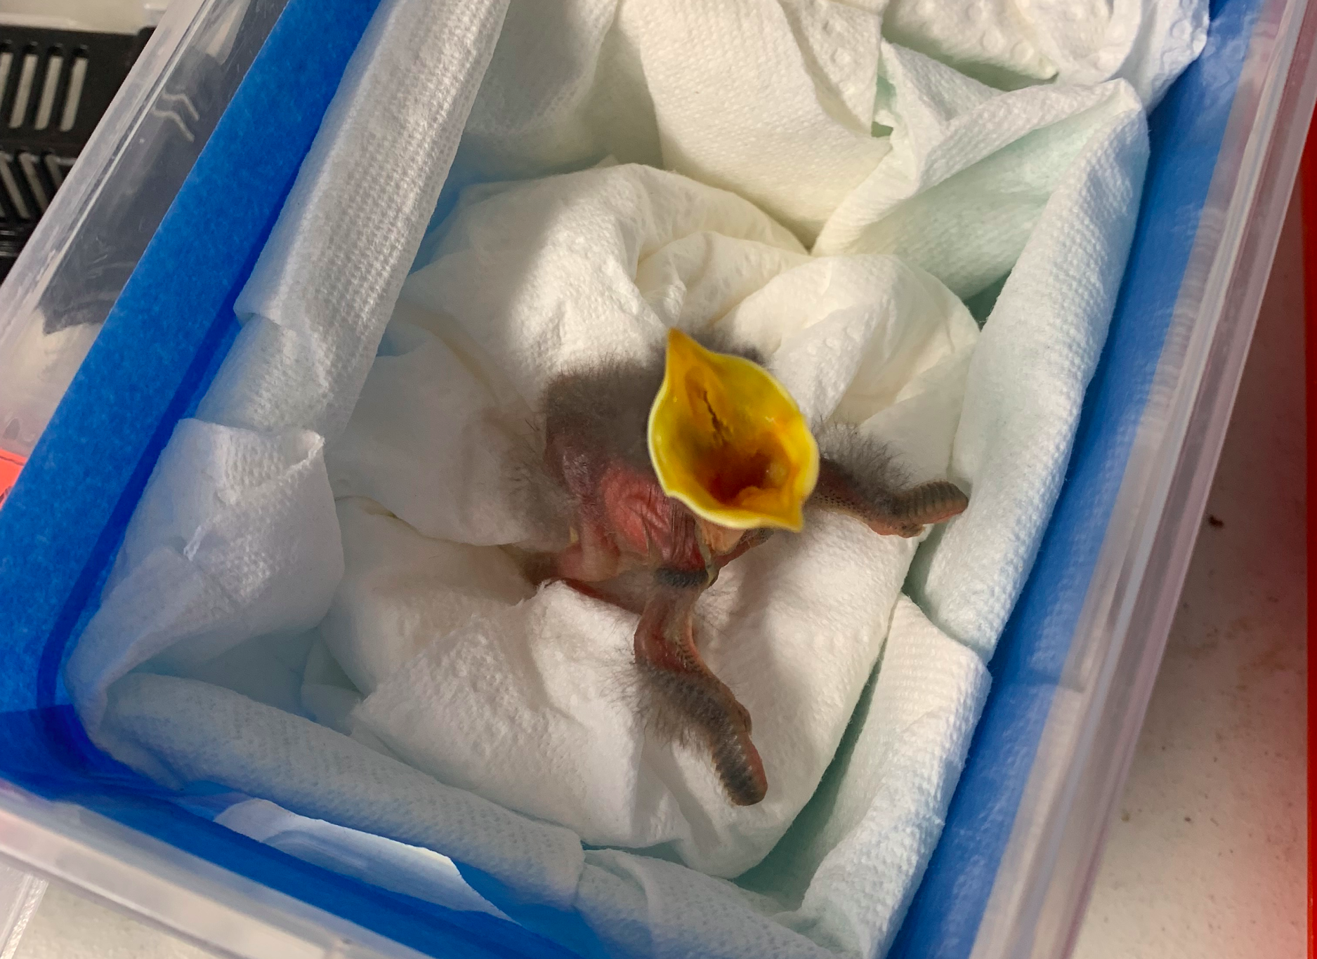
Second Chance Wildlife Center
The mission of Second Chance is to provide compassionate, rehabilitative care to orphaned, ill, and injured wild animals, and to advise our community on helping animals.
Opportunities: Volunteering and Internship (10 week)
Website: www.scwc.org

Slide 9
BARCS
Horseback Riding
Cat socializing, dog walking, TNR, etc.
Help animals in need and learn more about shelters.
Also through Shriver Center (PRAC 096), transportation provided.
UMBC Shriver Contact: Kasey Venn, kasven1@umbc.edu.
Website: https://barcs.org/.
I used to horseback ride as a kid; my barn let me volunteer there.
Equestrian Club has volunteering opportunities at Patapsco Horse Center:
https://docs.google.com/forms/d/e/1FAIpQLScG8e0k0q-v7bqIGjaU7oclsu5CCttXlcEnDB1pjiwiVjO4oQ/viewform
Notes:
https://www.google.com/imgres?imgurl=https%3A%2F%2Fbarcs.org%2Fstatic%2Fimg%2Fbarcs-logo-blue.png&imgrefurl=https%3A%2F%2Fbarcs.org%2F&docid=7UP82W5u4OeeEM&tbnid=IIzD7eZotm2yZM%3A&vet=10ahUKEwiIvJXmibDlAhXmw1kKHWLFAx8QMwhDKAAwAA..i&w=600&h=283&bih=657&biw=1366&q=barcs&ved=0ahUKEwiIvJXmibDlAhXmw1kKHWLFAx8QMwhDKAAwAA&iact=mrc&uact=8

Slide 10
Horse and Small Animal Experience
Therapeutic and Recreational Riding Center (TRRC)
https://www.trrcmd.org/
Patapsco Horse Center
Is also a therapeutic riding center, but only certain times of the year
Let Jenni know if you want to volunteer
Small Miracles Cat and Dog Rescue
http://www.smallmiraclesrescue.org/
Canine Humane Network
http://caninehumane.org/
K9 Lifesavers
https://www.k-9lifesavers.org/

Slide 11
More Animal Experiences...
Days End Horse Rescue
Aquarium
Maryland Zoo
Whispering Rise Farm and Animal Sanctuary (Pigs)
Poplar Spring Animal Sanctuary
Little Longears Miniature Donkey Rescue

Slide 12
Volunteer Experience
Shriver Center
Service clubs and sororities on campus
My favorite places
Hillcrest School
Little Sisters of the Poor
Happy Helpers for the Homeless
Howard County Library

Slide 13
Another UMBC Volunteer Opportunity...
Become a UMBC Math Coach and work with a small group of students for two hours each week on key concepts in math at Lakeland Elementary/Middle School, located just 12 minutes from campus in Baltimore. Teachers at the school design mini-lessons and activities for you to facilitate with your small group each week.
The program is supported by Sherman Scholars and is entering the 6th semester with Lakeland. In part because of our efforts, Lakeland math scores have increased 15% points over the past three years. And, elementary schoolers (grades 3-5) at Lakeland now exceed their peers statewide in math. Read The Sun's coverage on the Math Coach Program and read on how this helped students at Lakeland grow in math achievement.
Be a part of something special -- register today to volunteer as a UMBC Math Coach. Want to learn more? Email Lead Coach Mickayla Bacorn (mbacorn1@umbc.edu) or stop by the Sherman Office (Sherman Hall 214).

