Slide 1
Pre-Veterinary Society GBM
11/6/19

Slide 2
Announcements
T-shirts!
Trip to VA-MD CVM: January 24th- waiting for more details
Gentle Giants Volunteer Event- moved to November 17th 12-3pm
Veterinarian Visit event: November 19th 2:30-4pm in Commons 329
Christmas family (see next slide for details)

Slide 3
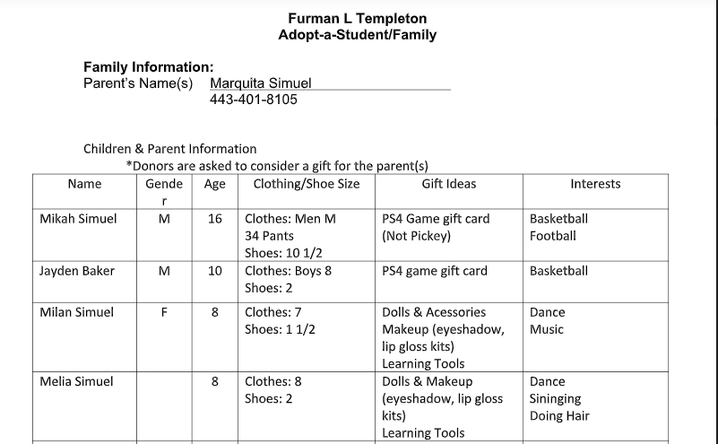
Christmas Family

Slide 4




Research Experience
Notes:
https://www.google.com/imgres?imgurl=https%3A%2F%2Fwww.aiip.org%2Fresources%2FPictures%2FAIIP%2520Website%2520Icons%2FAIIP%2520Research%2520Icon.png&imgrefurl=https%3A%2F%2Fwww.aiip.org%2Fresearch-specialists&docid=wFdVF4qmAREf9M&tbnid=geG4g1PuVJg_FM%3A&vet=10ahUKEwiR7fOzkMzlAhUFU98KHUafC4cQMwh7KAEwAQ..i&w=800&h=800&bih=657&biw=1366&q=research&ved=0ahUKEwiR7fOzkMzlAhUFU98KHUafC4cQMwh7KAEwAQ&iact=mrc&uact=8
https://www.google.com/imgres?imgurl=https%3A%2F%2Fwww1.chester.ac.uk%2Fsites%2Fdefault%2Ffiles%2Fstyles%2Fhero_mobile%2Fpublic%2F041019-1020_Research%2520Festival%25202020%2520Portal%2520Banner.jpg%3Fitok%3DJDR-nIMq&imgrefurl=https%3A%2F%2Fwww1.chester.ac.uk%2Fresearch%2Fresearch-festival&docid=NwSs3wSm3aBD3M&tbnid=N-t1uoGsiFpKpM%3A&vet=10ahUKEwiR7fOzkMzlAhUFU98KHUafC4cQMwh-KAQwBA..i&w=800&h=450&bih=657&biw=1366&q=research&ved=0ahUKEwiR7fOzkMzlAhUFU98KHUafC4cQMwh-KAQwBA&iact=mrc&uact=8
https://www.google.com/imgres?imgurl=https%3A%2F%2Fcdn.business2community.com%2Fwp-content%2Fuploads%2F2015%2F07%2Fmarketing_research.jpg-900x359.jpg&imgrefurl=https%3A%2F%2Fwww.business2community.com%2Finbound-marketing%2Fthe-5-step-marketing-research-process-01269959&docid=hWAoMfg918iDpM&tbnid=AcmqVdJ3tV7NtM%3A&vet=10ahUKEwiR7fOzkMzlAhUFU98KHUafC4cQMwiDASgJMAk..i&w=900&h=359&bih=657&biw=1366&q=research&ved=0ahUKEwiR7fOzkMzlAhUFU98KHUafC4cQMwiDASgJMAk&iact=mrc&uact=8
https://www.google.com/imgres?imgurl=https%3A%2F%2Felearningindustry.com%2Fwp-content%2Fuploads%2F2015%2F11%2F10-online-research-tools-every-online-learner-know.jpg&imgrefurl=https%3A%2F%2Felearningindustry.com%2F10-online-research-tools-every-online-learner-know&docid=tRvtPjc6FId6mM&tbnid=GGj0InveE2qF_M%3A&vet=10ahUKEwiR7fOzkMzlAhUFU98KHUafC4cQMwh_KAUwBQ..i&w=1920&h=1440&bih=657&biw=1366&q=research&ved=0ahUKEwiR7fOzkMzlAhUFU98KHUafC4cQMwh_KAUwBQ&iact=mrc&uact=8

Slide 5

Gaining Research Opportunities at UMBC
Decide what field you’re interested in and the type of research
Read professors’ papers
Email expressing interest
  They will hopefully ask to meet with to discuss
Apply to summer programs
Be professional, polite, and engaged!

Slide 6
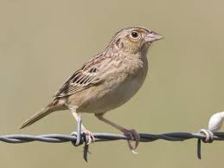
Arushi: Lohr Lab
Study birdsong in the Grasshopper Sparrows.
  Ground dwelling birds found throughout North & Central America & the Caribbean.
  Song is a learned behavior; not innate like a call.
    Varies regionally.
  2 main types of song: Warble & Buzz (hence the name).
  Try to quantify these sounds & learn it like a language.
Animal Care & Research
  Care for Grasshopper Sparrow colony on UMBC campus.
  Fieldwork to see birds in the wild.
  Bioacoustic analysis of birdsong via SIGNAL & Syrinx programs.
Hope to present at URCAD & apply for URA next semester.
  URCAD is an undergrad research symposium where we can present our research.
  URA gives undergrads money to support their research project.
  USM LSAMP offers funding, training, & mentorship to undergrads.
  BioCOM Lab Tours.
Notes:
https://www.google.com/imgres?imgurl=https%3A%2F%2Fwww.allaboutbirds.org%2Fguide%2Fassets%2Fphoto%2F39344721-480px.jpg&imgrefurl=https%3A%2F%2Fwww.allaboutbirds.org%2Fguide%2FGrasshopper_Sparrow%2Fid&docid=5bdowJxiyYTZkM&tbnid=d6vSNnKB23oNZM%3A&vet=10ahUKEwiblrSyj8zlAhXITN8KHZYFA3oQMwhqKAAwAA..i&w=480&h=360&bih=657&biw=1366&q=grasshopper%20sparrow&ved=0ahUKEwiblrSyj8zlAhXITN8KHZYFA3oQMwhqKAAwAA&iact=mrc&uact=8

Slide 7
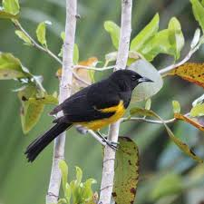
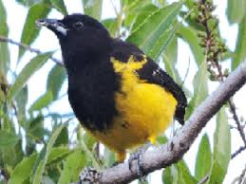
Omland Lab IRES Opportunity
Application for next summer due February 1st.
Travel to Bahamas and research endangered Bahama Orioles.
  Travel and living expenses covered; stipend as well.
Notes:
https://www.google.com/imgres?imgurl=https%3A%2F%2Flookaside.fbsbx.com%2Flookaside%2Fcrawler%2Fmedia%2F%3Fmedia_id%3D469742143125457&imgrefurl=https%3A%2F%2Fwww.facebook.com%2FOmlandLab%2Fposts%2F&docid=JxutpnhalqNlRM&tbnid=QHlX3Sjpxsf4iM%3A&vet=10ahUKEwiyioCZ4MzlAhVjpVkKHcq9DFAQMwhlKBYwFg..i&w=640&h=640&bih=657&biw=1366&q=omland%20ires%20umbc&ved=0ahUKEwiyioCZ4MzlAhVjpVkKHcq9DFAQMwhlKBYwFg&iact=mrc&uact=8
https://encrypted-tbn0.gstatic.com/images?q=tbn:ANd9GcRNHMGtp_NTL4Os5IHYRHS4yj8A1SM0BloHbogE3xqajLswMb7eSg&s

Slide 8
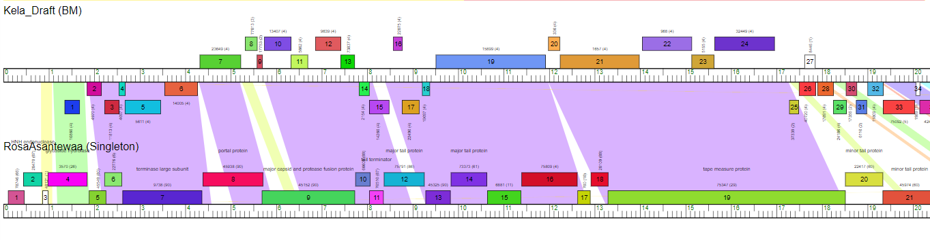
Jenni: Phage Hunters
Did not take 302L in the Fall
Took 316L in the Spring (second, computational part of 302L in the Fall) with Dr. Caruso and Dr. Erill
Annotated phages when they came back from being sequenced
RosaAsantewaa and Kela

Slide 9
Jenni: FDA Center for Veterinary Medicine
Found it through networking
Valuable veterinary research experience
Can’t really say all that much about the content because it is a study that will affect a lot of people and it has not finished/been published yet

Slide 10
Thank you!

