Slide 1
All
About
$$$
Pre-Vet
Society
Meeting!

Slide 2
Schedule
Volunteering Event
Research Opportunity
Elections!
Applying to Vet School
Comparing Cost for Different Vet Programs
Taking Out Loans
Paying Back Loans
Comparing Salaries for Different Positions

Slide 3
Volunteering at Days End Farm with UMBC Equestrian Club!
Last semester many of you voiced a strong interest in volunteering and helping animals!
We will be doing a volunteer event in collaboration with the UMBC Equestrian Club at Days End on Saturday, 4/29 from 9am-12pm. The address to the farm is 1372 Woodbine Rd, Woodbine, MD 21797.
There will also be liability/waiver forms to be filled out before the day of. Those will be sent out after this form has been filled out. This form must be filled out by 4/21.
https://docs.google.com/forms/d/e/1FAIpQLSfsYKdsyBh5FjmKF0j4ZY1-FWsbxn4xWszZaA3kaAksxxNLRQ/viewform?usp=pp_url

Slide 4
Research Opportunity On Campus!
Message from Dr. Lohr Lab:
Hi Pre-Vet group! Hope your semester has been going well. It's Rebecca Hill again, from the Lohr Lab. I'm a PhD student studying the development of song in birds by recording them in our lab at UMBC. I'll be needing some help with caring for the birds this June, and we've had great success recruiting students from the pre-vet group in the past. We provide BIOL 499 credit for this bird care - we normally have you come in for ~3 hours / week for 1 credit for the summer, and for each semester you work with us. This involves arriving at the lab before noon 2-3 days a week to refresh food and water, as well as do a few other maintenance tasks. I also need lots of help finishing my data analysis, and could use lots of research assistants as well! Unlike bird care, research projects can be completed at any time of day/day of the week, and can fit much more flexibly in your schedule. This would involve an additional credit or two (we're also happy to take you on if you'd just like the bird care experience/credit). If this sounds interesting to you, please email me at rebecc8@umbc.edu and we can set up an interview to discuss the position further and so I can get to know you better!

Slide 5
Elections
Thank you for everyone who has submitted an interest form! <3
Please submit an election form if you wish to run for a position for next school year, even if you submitted an interest form!
For elections, we ask you to provide a reason why you think you should be elected, list relevant experiences and your plans to improve the club (if running for multiple positions just write a general election pitch).
I can read your speech to everyone if you do not want to as well.
Each position is held for one school year.
After speeches, everyone will vote! There will also be transition training that we will provide you before the end of the 2023 spring semester.
Election Form: https://docs.google.com/forms/d/e/1FAIpQLSeS6IICteU8rhk4iHcqs2f11Bn5Dourj7PhW7zNHOppK1olAw/viewform?usp=pp_url

Slide 6
E-board Positions
President: Oversee and assist all committees below and club events, Developing and managing projects, Leads both general body and executive board meetings; attend UMBC student org training sessions, Ensures that all requirements for renewal of the club are being met, Serving as the organization’s official representative for communicating with SGA and UMBC staff, Manage club socials (Instagram account, groupme, discord, and myUMBC page)
Vice-President: Assuming the role of President in the event of the President’s absence or incapacity, Assists the President in all duties, Acts as a bridge of communication between every position, Assist treasurer in managing fundraising and managing the organization’s funds while ensuring compliance with all financial rules and guidelines, Attend officer meetings and UMBC student org training sessions
Election Form: https://docs.google.com/forms/d/e/1FAIpQLSeS6IICteU8rhk4iHcqs2f11Bn5Dourj7PhW7zNHOppK1olAw/viewform?usp=pp_url

Slide 7
E-board Positions
Secretary: Send out bi-weekly emails to remind people about upcoming meetings, Manage member recruitment/retention, Exploring and sharing the history of the organization, Attend officer meetings and UMBC student org training sessions
Treasurer: Managing fundraising, Managing the organization’s funds and ensuring compliance with all financial rules and guidelines, Attend officer meetings and UMBC student org training sessions (especially treasurer training), Help apply for funding, such as SOAR.
Events Manager: Manage member recruitment/retention, Exploring and sharing the history of the organization, Plan service/volunteer events or Pre-Vet club related trips, Create social events for club members, Attend officer meetings and UMBC student org training sessions, Develop graphics for events, including elections, involvement fest, and volunteering events
Election Form: https://docs.google.com/forms/d/e/1FAIpQLSeS6IICteU8rhk4iHcqs2f11Bn5Dourj7PhW7zNHOppK1olAw/viewform?usp=pp_url

Slide 8
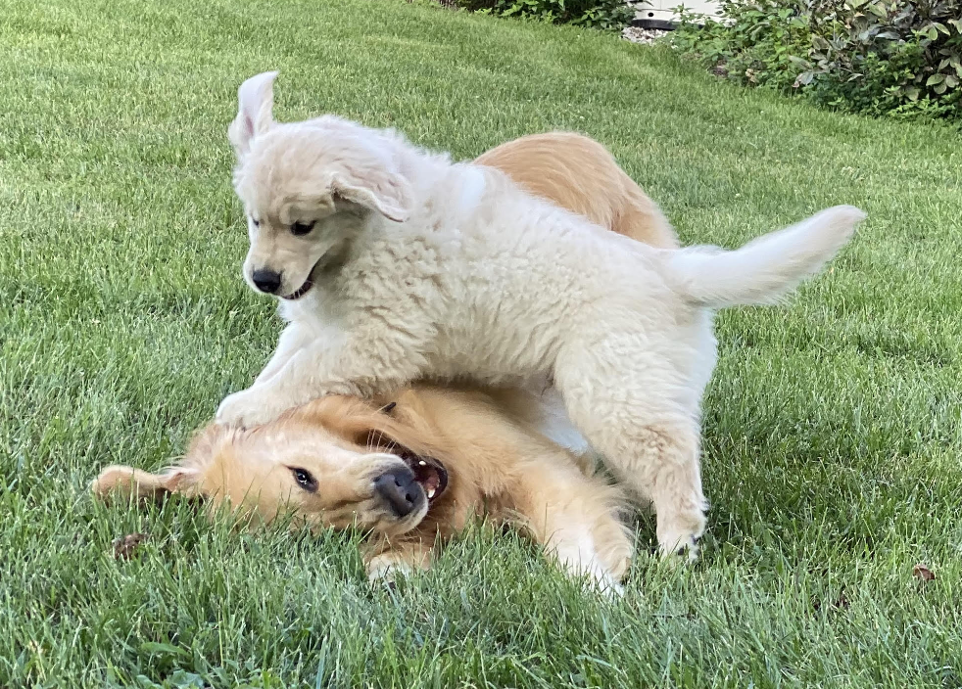
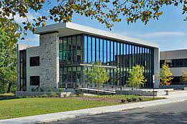
Applying to Multiple Vet Schools
Sadly, applying to multiple schools can get very expensive. VMCAS charges $220 for the first program you apply to and $115 for each additional program. And on top of that schools have a supplemental application fee.
When choosing which schools to apply to keep in mind how far the school is from home and if that matters to you.
Keep in mind out of state tuition costs and whether or a school allows you to apply for residency and receive in state tuition.
List of North American veterinarian schools that allow you to apply for residency: North Carolina, Ohio, Missouri, Illinois, UC Davis, and Washington
Maryland’s Instate Tuition School: Virginia-Maryland College of Veterinary Medicine
Notes:
E

Slide 9
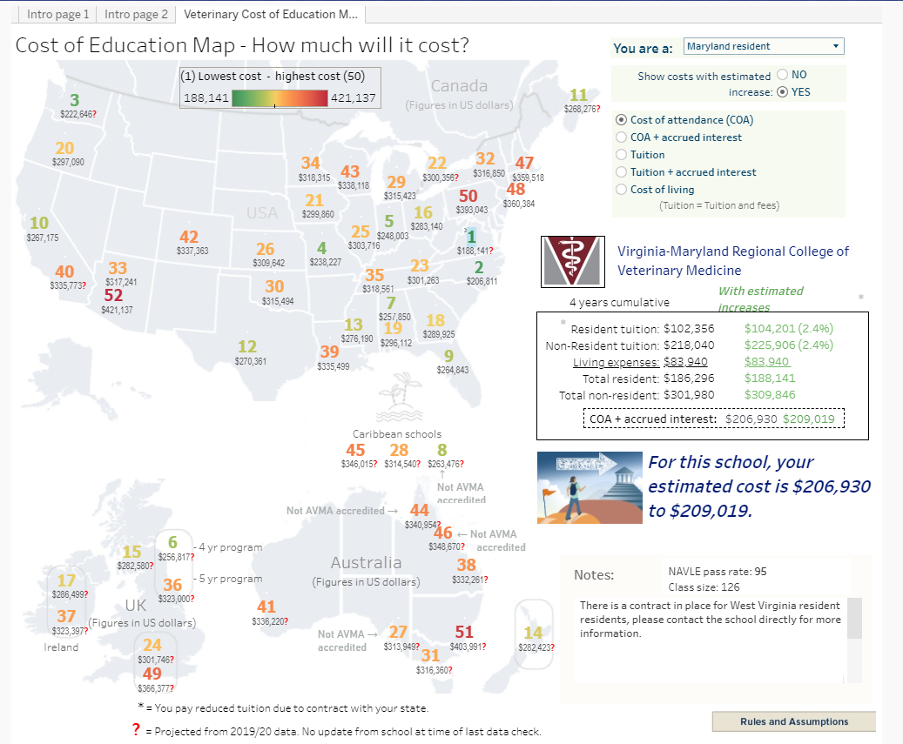
Comparing Costs for each Veterinary Program
https://www.aavmc.org/becoming-a-veterinarian/funding-your-degree/cost-comparison-tool/
Provides summary regarding each schools cost, scholarship, and debt information.
https://www.vin.com/studentdebtcenter/default.aspx?pid=14352&id=7728661
Provides ranking information for each school based off of tuition and cost of living.

Slide 10
Loans
https://www.aavmc.org/becoming-a-veterinarian/funding-your-degree/
General information about possible payment options.
https://myvetlife.avma.org/current-student/your-financial-health/loan-repayment-strategies
Videos about loan information.
Health Professions Student Loan (Subsidized) - Financial need based. Based off FAFSA and requires parental information. Fixed interest of 5% during repayment only and allows 1 year grace period.
Federal Direct Unsubsidized Stafford Loans - Allows up to $40,500 per year. Interest accrues from date money is disbursed. Allows 6 month grace period.
Federal Direct Grad PLUS Loans- Only if unsubsidized is maxed and requires separate application. Approval is based on credit history review. Fixed interest and starts after disbursement. 6 month grace period.

Slide 11
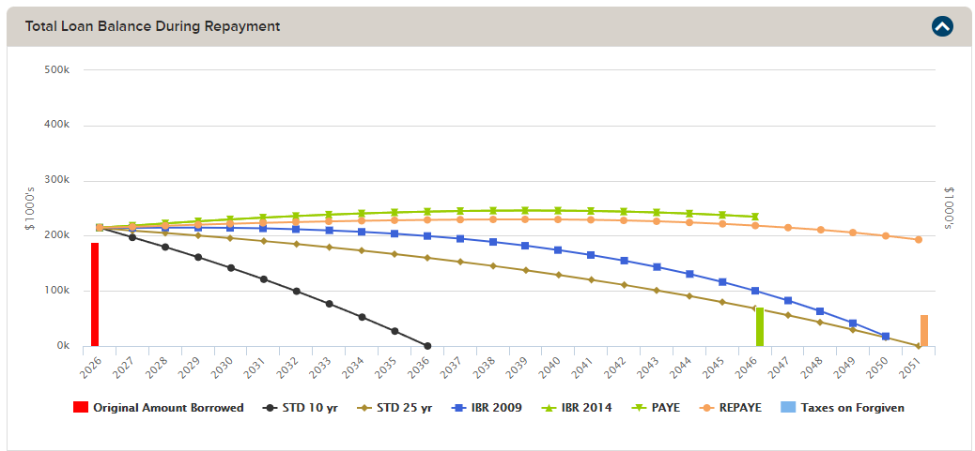
Loan Repayment
Loan and repayment plan simulation based off of debt accrued and payment plan chosen: https://www.vin.com/studentdebtcenter/default.aspx?pid=14352&id=8202658

Slide 12
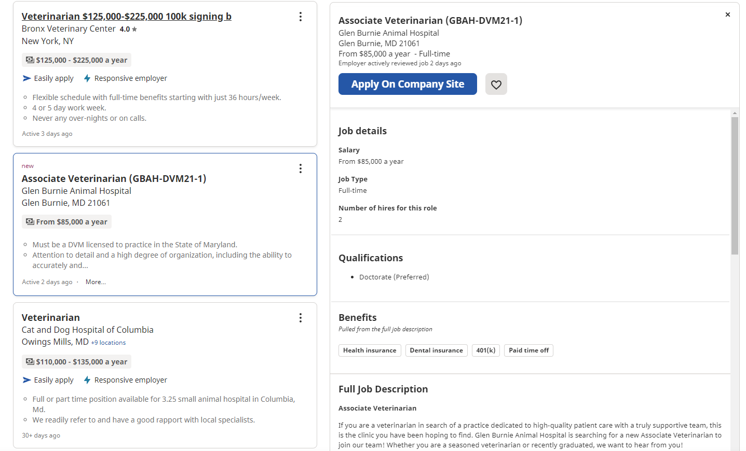
Salary Comparison
General Practice Veterinarian - Information can vary based off of job location, experience, type of practice, etc: https://money.usnews.com/careers/best-jobs/veterinarian/salary
Lists emergency and some of the higher paid specialist salaries:https://emergencyvetsusa.com/er-veterinarian-salary/
Best way to find out about salaries: search job finding websites and look for jobs you would be interested in to see up to date salaries.

Slide 13
Questions?

