Slide 1
3D Printing
Presented By Mathew Ridge

Slide 2
What is 3D Printing?
The process of forming a physical object from a 3D digital model.

Slide 3
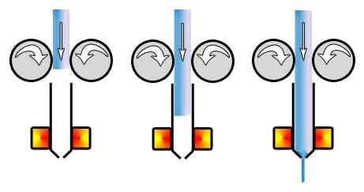
How is This Done?
Extrusion of a heated substance that quickly cools as it is released.

Slide 4
Well How Does It Make Something 3D?
Once the printer has completed the first layer, it will move the printing bed down and then ‘draw’ the next layer on top.

Slide 5
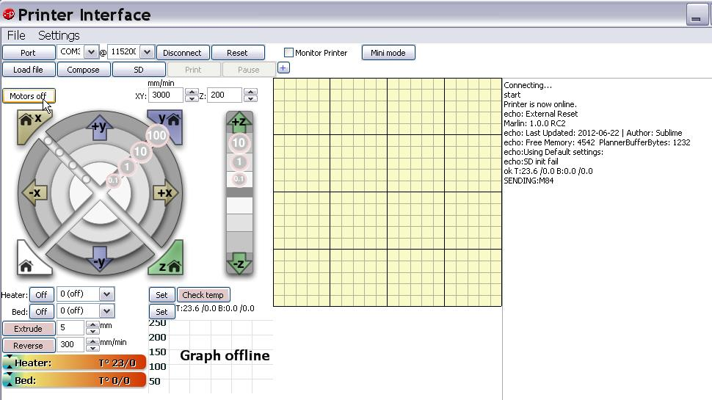
How do We Control the Printer
Though some sort of software, The most commonly used I have found is called pronterface.

Slide 6
How do We Control the Printer
Set Temperatures
Select Files
Select Slicing Settings
Start Prints
Monitor Progress

Slide 7
What Type of File do we Use?
The files that we design for use in 3D printing are called STL or Standard Template Library.
Though the files that the printer reads are different. They are called g-code

Slide 8
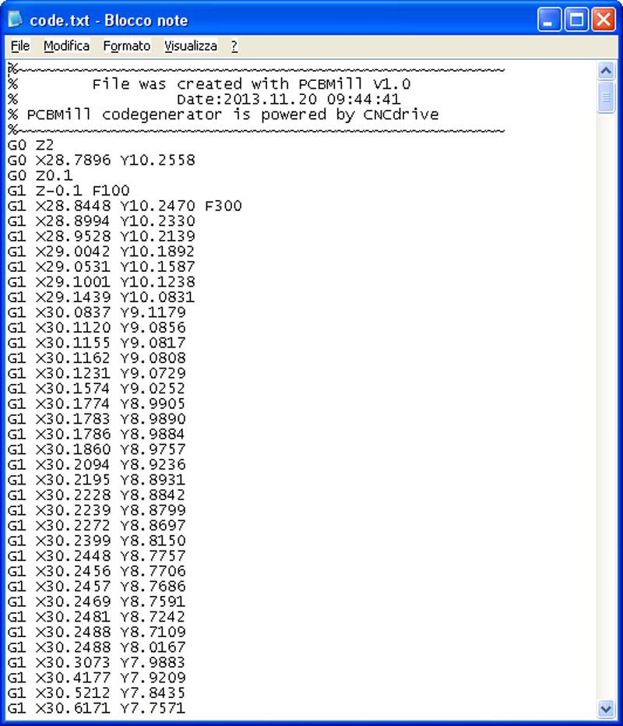
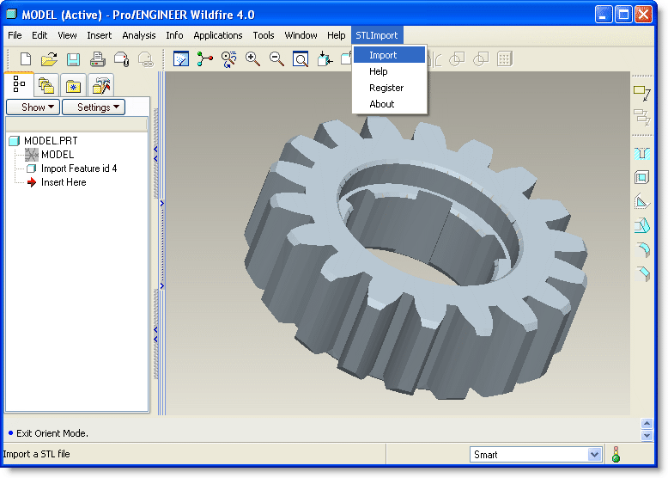
The Difference
STL
G-CODE

Slide 9
What Programs Make STL Files
Free
3dtin
Sketchup
OpenSCAD
Wings3D
Blender
Pov-ray
Art of Illusion
FreeCAD
HeeksCAD
TinkerCAD
Not-Free($)
Rhino
Autodesk
Autocad, Inventor
SolidWorks
Cheetah3D
bonzai3D

Slide 10
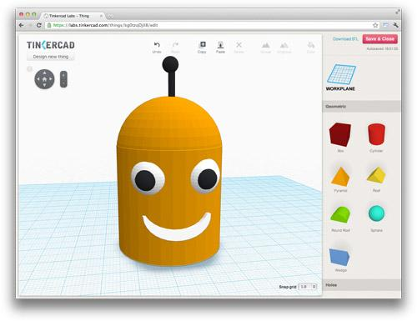
What Do I Use?
The program that I now consistently use is Tinkercad. It is very good for beginners and is very robust with practice

Slide 11
Let’s Check out Tinkercad

