Slide 1
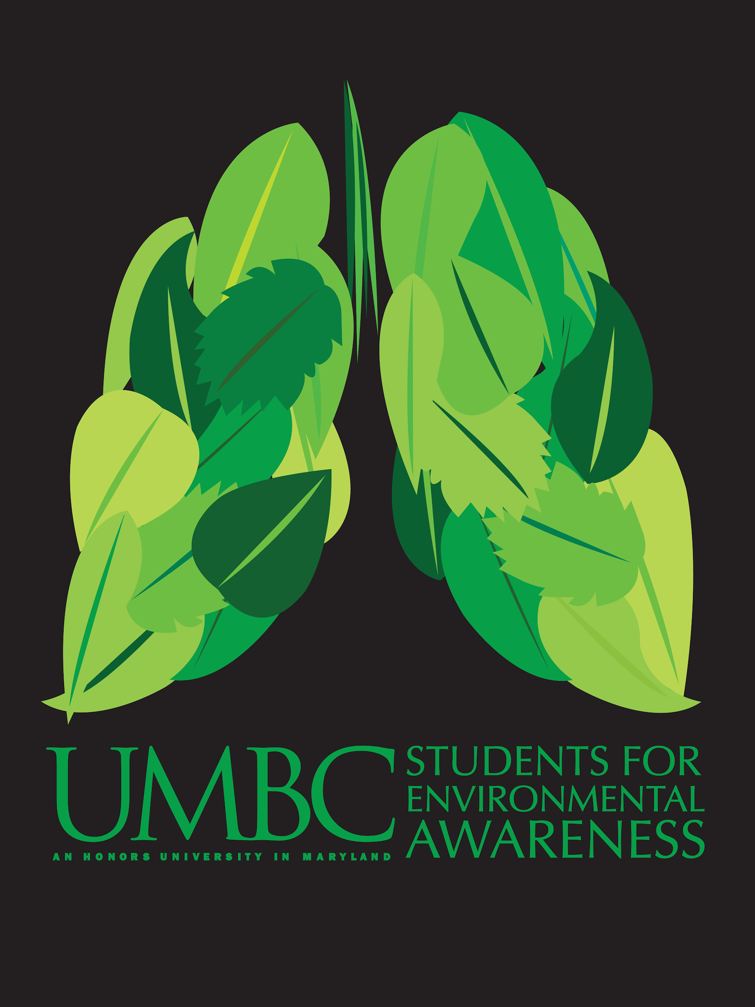
Welcome to SEA!

Slide 2
WHO WE ARE
Description
“[SEA] has been established for the purpose of providing an opportunity for the entire UMBC community to participate in a variety of environmental activities.” (our constitution)
“We are SEA, a group of environmentally conscious students whose goal is to make UMBC an enjoyable and sustainable place to live and learn. We love to see new people discover their passion for helping the environment, so please stop by.” (myUMBC)
2019-2020 Officers:
President: Reda Munir
Vice President: May Bennett
Treasurer: Ally Melton
Secretary: Kylie Barrett

Slide 3
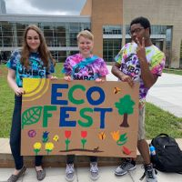
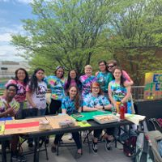
WHO WE ARE
NAME
MAJOR
YEAR
NEW OR RETURNING MEMBER
ICEBREAKER

Slide 4
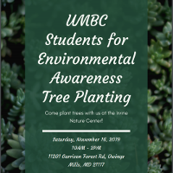
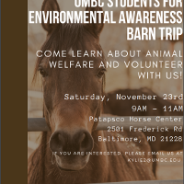
THINGS WE DO
Weekly Meetings surrounding a topic
HarvestFest and EcoFest
Retriever Treasure
Eco Coalition & Ambassadors
Fundraisers
Panera
Volunteering
Cleanups, etc.
Team-building
Field trips, activities, etc.

Slide 5
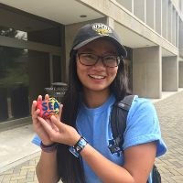
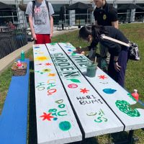
CAMPUS RESOURCES
Student Orgs
Environmental
Environmental Task Force
Greenpeace
The Garden
Food Donations
Food Recovery Network
Retriever Essentials
Advocacy
YDSA - Young Democratic Socialists of America
GES COM - promote the academic interests, social interests and unity among students, faculty, and staff within the Geography & Environmental Systems Dept.
SGA ECO - Environmental Collaboration of Organizations

Slide 6
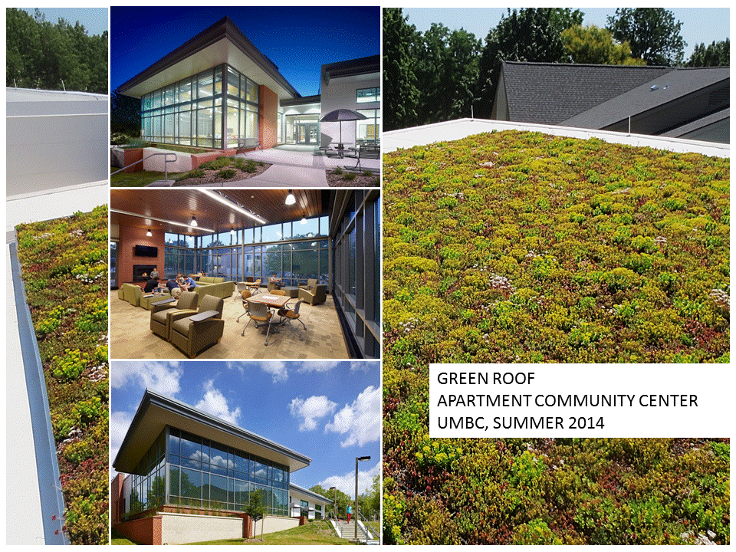
CAMPUS RESOURCES
Campus Transportation
UMBC Transit
ZipCar
Bike Share
Casual Carpooling
Natural Resources
Green Roofs
Composting (Commons)
Green Buildings (Green Building Tour)
Pig Pen Pond
CERA Trail
Sustainability Matters
Climate Action Plan

Slide 7
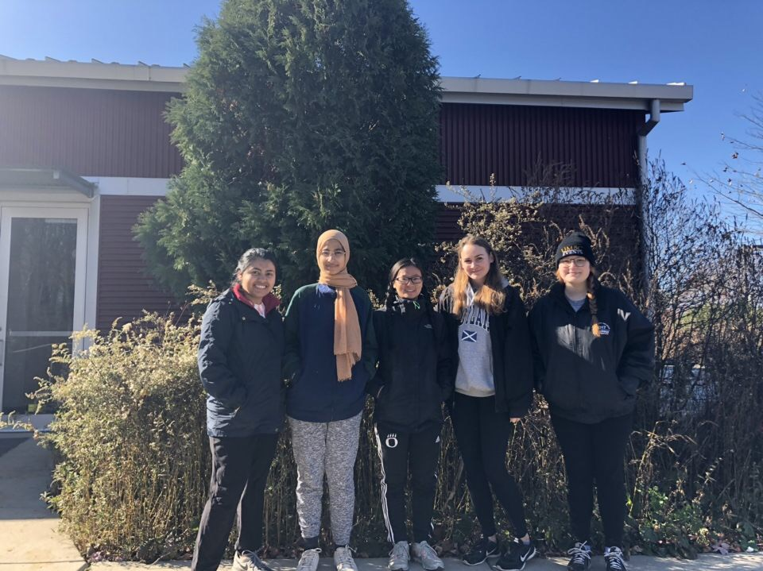
SPRING 2020 PROJECTS
EcoFest
GreenFest
Irvine Nature Center (or similar tree planting event)
Nature Hikes
Zero Waste Challenge
DIY projects
Retriever Treasure
What do you want to do this semester?

Slide 8
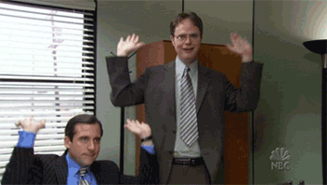
RAFFLE
Thank you for coming!

