Slide 1
Human Resources
BPI Updates

Slide 2
DocuSign Update
hr.umbc.edu

Slide 3
DocuSign Update
hr.umbc.edu

Slide 4
PageUp - Timeline
PageUp Project Kick-Off September 7, 2016
Configuration of System September – February 2017
User Testing March - April 2017
Go LIVE – Phase 1 – Nonexempt Staff May 1, 2017
Go LIVE – Phase 2 – Exempt Staff June 1, 2017
Training for campus users April – August 2017
hr.umbc.edu
Notes:
Here is a time line of the project.
We are currently in user testing. We had a user testing sessions with a few HR Hiring Liaisons from various areas on March 17th. We found some glitches with security and are currently working with PageUp to resolve.
We plan to Go Live with nonexempt recruitment on May 1, 2017. This means any new recruitments. Any positions in which the search is in progress will continue using the paper manual process.
Our target date for exempt recruitment to go live is June 1st.

Slide 5
PageUp - Roles
Recruitment & Hiring Roles
Search Committee Chair & Search Committee Members
Approvers
Hiring Manager
HR Hiring Liaison
hr.umbc.edu
Notes:
There are 4 basic roles in PageUp
Search Committee Chairs and Members will automatically have access when their names are entered on the Personnel Requisition
Approvers will have access when their name is typed into the approver field
Hiring Managers are individuals that directly supervise staff. They will automatically have access for any of their positions
HR Hiring Liaisons – are individuals that coordinate hiring functions for his/her dept. We have worked with the various divisions and have assigned each area at least one Liaison.

Slide 6
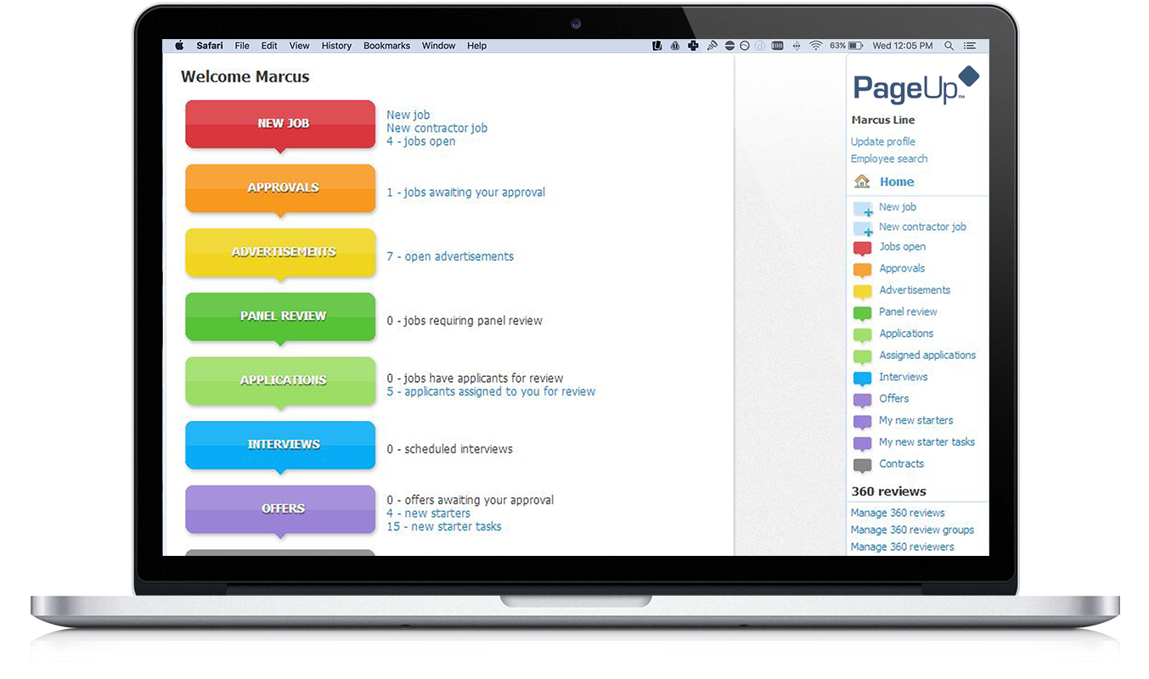
PageUp - Dashboard
hr.umbc.edu
Notes:
Internal users will access PageUp via single sign on meaning they will not have to manage a new user id log on and password.
Applicants will create an account within PageUp to apply to UMBC jobs
Once a user logs in this will be the home screen view. PageUp calls this the Dashboard. It shows all the statuses of recruitment and what is open and pending.

Slide 7
PageUp – Recruitment Process
Position already establish and Hiring Exception approval obtained
Complete Requisition in PageUp
Route for approvals to begin search (same signatures as required currently)
HR will review and edit job posting if needed
HR will post the ad on the HR website, HERC & Highered jobs
Applicants will apply on-line (both nonexempt and exempt)
Hiring Department/Search Committee view applications in PageUp
hr.umbc.edu
Notes:
The recruitment and hiring process steps will essentially be the same but in an automated and streamlined system which allows for quicker processing times.
Everything will now be done through PageUP including the Personnel Requisition and all approvals.
All candidates will complete on-line applications through PageUP to apply for positions.

Slide 8
PageUp – Next Steps
Nonexempt Positions Go Live – May 1, 2017
Exempt Positions Go Live – June 1, 2017
Departments that will be hiring in May and June should sign up for training preferably right before or after their hiring exception is approved.
Department not hiring immediately should attend training during the summer.
Additional training will be offered in the fall.
Training guides, videos and additional resources will be on the website.
hr.umbc.edu
Notes:
We are in the process of scheduling training sessions.
Departments that will be hiring for positions in May & June should ideally sign up for training first. We recommend you sign up near the time of the hiring exception approval so the information will be fresh in your mind when it comes time to using PageUp.
Training will be offered throughout the summer and fall.

