Slide 1
WR Grace
Candice Theodossiou
Greg Ford
Rachel Katzenberger
www.grace.com

Slide 2
Safety Contact
Unsafe walking habits can lead to injury
Grace Safety Rules:
NO cellphone use while walking
Use handrails at all times
Use designated safe walkways

Slide 3
Society of Women Engineers - UMBC
Company overview
Grace Internship Program
Manufacturing Leadership Program
Career Overview
Candice Theodossiou
Rachel Katzenberger – 1st year MLP
Q&A

Slide 4
A Global Leader
Built on talent, technology, and trust, Grace is a leading global supplier of specialty chemicals.
Our two industry-leading business segments —Catalysts Technologies and Materials Technologies—provide innovative products, technologies, and services that enhance the products and processes of our customers around the world.
Global Public Company
3,900 employees in 30 countries
Customers in 70 countries
New York Stock Exchange (GRA)
Holding more than 800 active U.S. patents
25 acquisitions since 2003
Headquarters: Columbia, Maryland USA
Founded in 1854

Slide 5
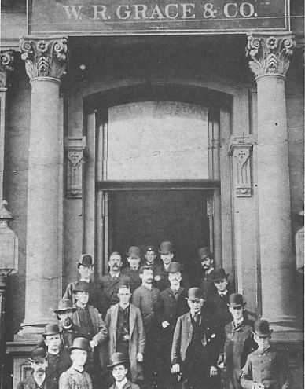
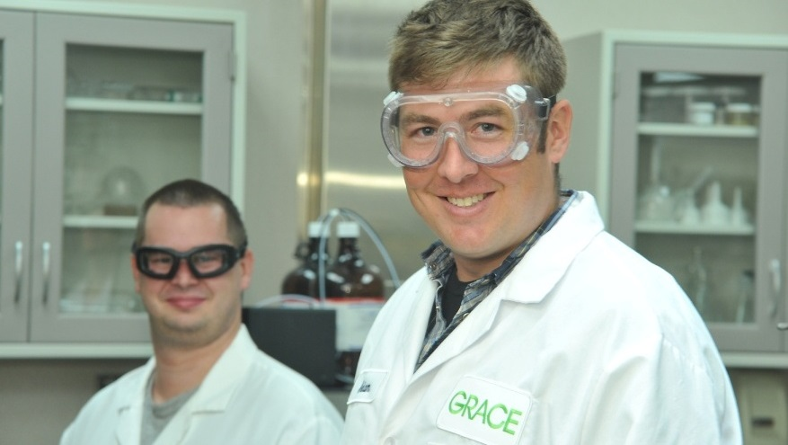
Earning Trust
187 Years of History... and Focused on the Future
1832 William T. Davison founds Davison, Kettlewell & Co. in Baltimore, MD
1854 William Russell Grace founds W. R. Grace & Co. in Peru
1865 W. R. Grace & Co. relocates from Peru to New York City
1890 Grace inaugurates steamship service between New York and South America
1923 Davison Chemical Co. begins selling silica gel
1941 Davison Chemical Co. ships the first synthetic fluid cracking catalyst from Curtis Bay (Baltimore), MD
1953 Grace lists on the NYSE with ticker symbol GRA
1954 Grace acquires Davison Chemical Company and Dewey & Almy Chemical Company
1972 Grace builds its first European manufacturing facility in Worms, Germany
1987 Grace becomes the first wholly foreign-owned company to do business in The People's Republic of China
1999 Grace relocates corporate headquarters to Columbia, MD
Optimizing and Selectively Strengthening Our Specialty Chemicals Portfolio
2000 – Acquires DuPont Colloidal Silica Business
2001 – Acquires Akzo-PQ Precipitated Silica Business
2010 – Acquires Synthetech for Single-Site Catalysts and Fine Chemicals
2013 – Acquires Dow’s UNIPOL® Polypropylene Process Technology Licensing and Catalysts Business
2016 – Spins Off Construction Products and Packaging Businesses
2016 – Acquires BASF Polyolefin Catalysts Business
2016 – Opens Process Innovation Center in Curtis Bay, MD
2016 – Expands Corporate Facilities and Pilot Plant in Columbia, MD
2016 – Expands Albany, OR Facility for Single-Site Catalysts and Fine Chemicals
2018 – Acquired Albemarle Polyolefin Catalysts Business

Slide 6
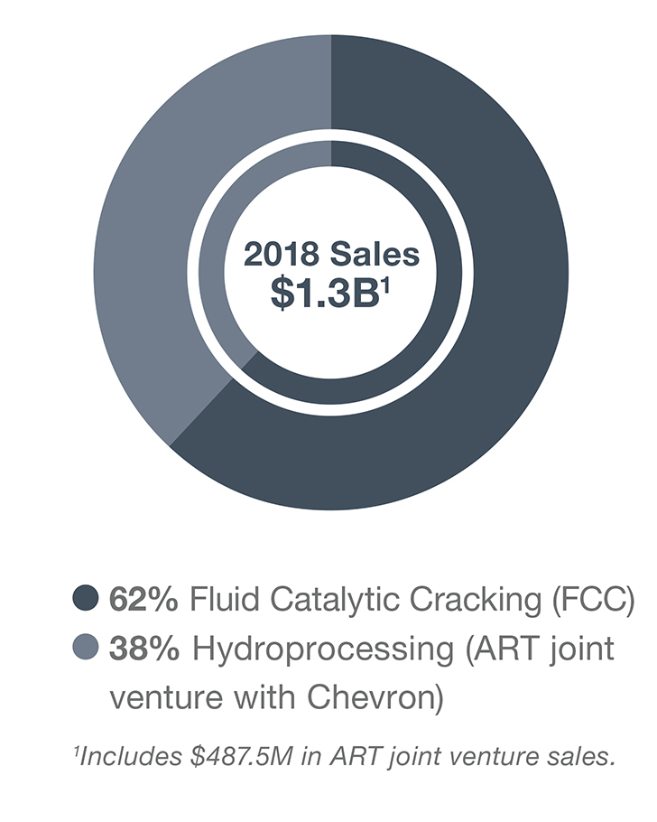
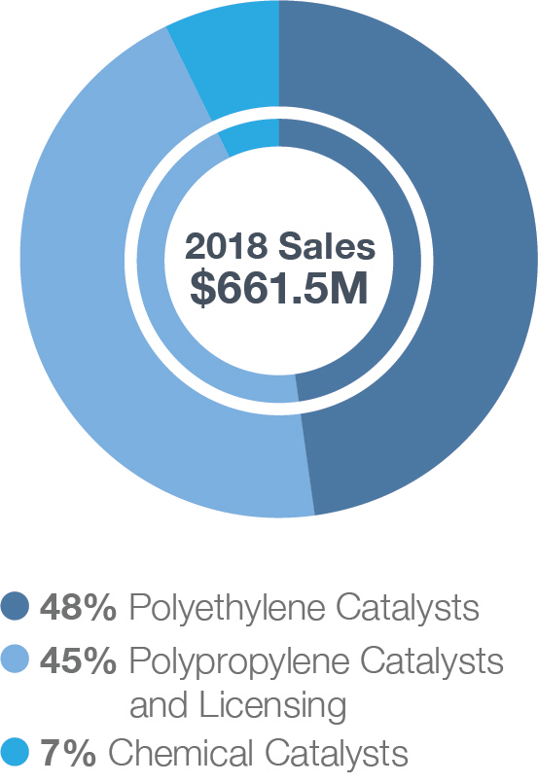
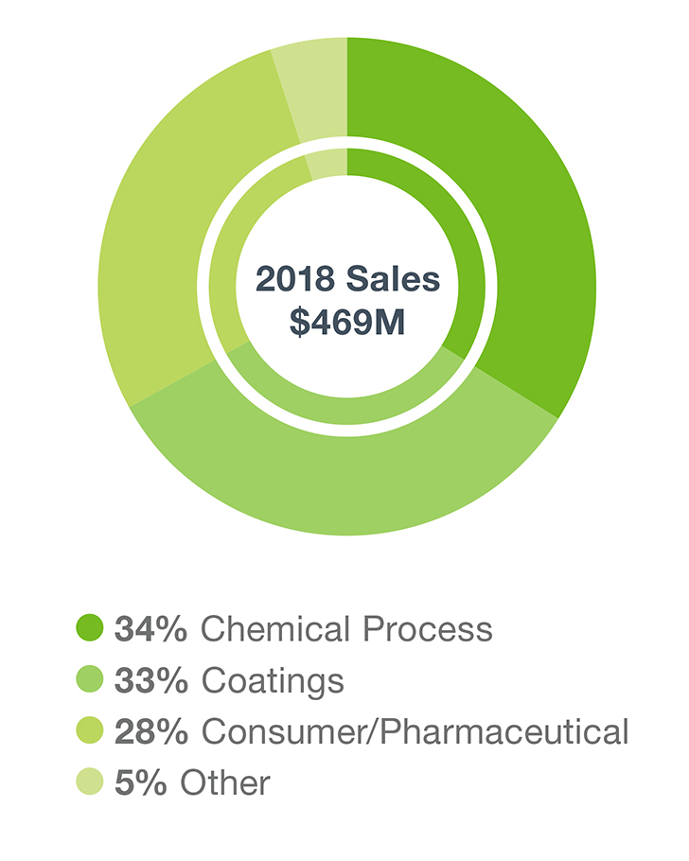
Strong Market Positions and Financial Performance
A $2 Billion Technology Leader
Refining Technologies
Specialty Catalysts
Materials Technologies
~$2B
2018 Sales^{2, 3}
~$5B
Market Cap¹
80% of Sales in segments where we are #1 or #2
#1
FCC Catalysts
Hydroprocessing
Hydrocracking
Polyolefin catalysts
Independent polypropylene process technology licensing
Specialty silica gel
~ 72%
Sales Outside the U.S.
¹ Based on FY2018
² Catalysts Technologies includes unconsolidated ART joint venture; FCC = Fluid Catalytic Cracking, SC = Specialty Catalysts, ART = Advanced Refining Technologies; FCC and ART together constitute the Refining Technologies operating segment
³ As of 7/27/18

Slide 7
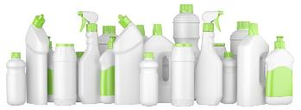
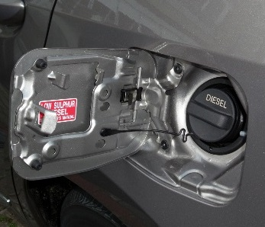
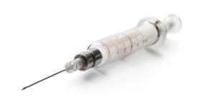
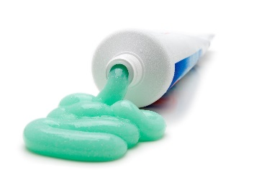
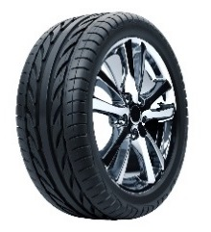
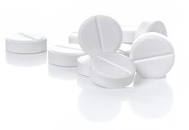
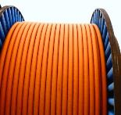
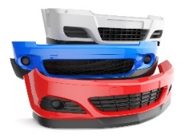
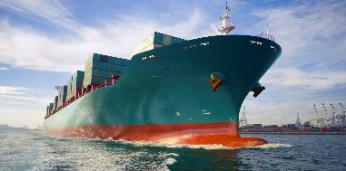
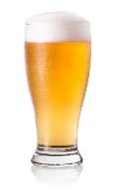
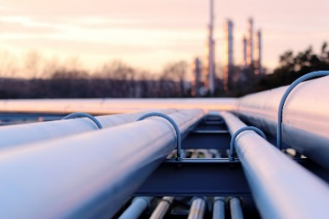
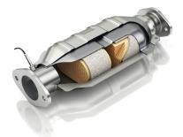
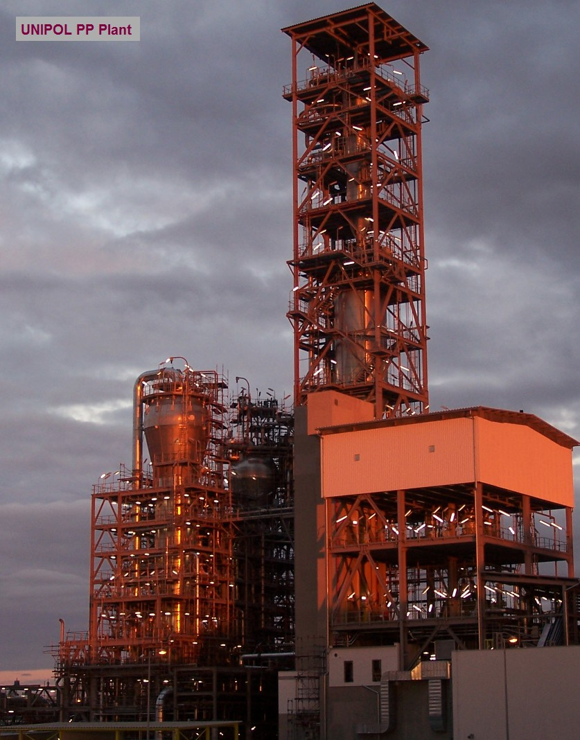
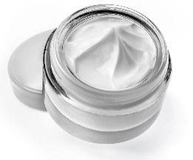
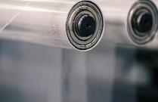
Our Businesses
Catalysts Technologies |  |  |  | Materials Technologies
Petrochemical and Chemical |  | Refining |  | Coatings, Consumer/Pharma and Chemical Process
Specialty Catalysts | FCC Catalysts |  | Hydroprocessing Catalysts (ART) | Silica-based and Silica-Alumina-based Materials

Slide 8
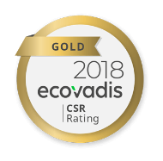
Safety and Sustainability are Top Priorities
Across the supply chain, Grace is transparent and trustworthy, assuring customers, employees, and investors that Grace is committed to safety, security, and sustainability.
Audited and certified by the American Chemistry Council, the industry’s Corporate Social Responsibility gold standard.*
Safety
Operating all facilities in a safe, healthy, environmentally sound, and secure manner
In compliance with local, state, and federal regulations
Extending the ACC’s Responsible Care commitment to our global facilities
Manufacturing productivity tools drive reductions in variability and reduce raw material inputs
Below-average injury rates – millions of working hours without incident
Sustainability
Reducing our impact through:
Increased recycling
Energy savings
Waste reduction
LEED-certified headquarters
2019 Ecovadis Gold Rating for Corporate Social Responsibility
Attentive to customers’ CSR goals
In top 5% of all global suppliers assessed on a variety of CSR standards
Sustainable practices across the supply chain
Recognized for fair labor and business practices
High scores in environment and labor practices
*Audited and certified member of the American Chemistry Council’s Responsible Care® Initiative. Signatory of the Global Responsible Care Charter.

Slide 9
Our Global Presence
Manufacturing
R&D and Technical Service
19 facilities in 8 countries
11 facilities in 7 countries
1 in development
Headquarters Columbia, MD
Manufacturing and R&D centers

Slide 10
Grace Internship Program
MISSION
The goal of the Internship Program is to create a strong pipeline of talented candidates for future full time career opportunities, as well as provide Grace with skilled students that will accomplish meaningful work.
PROGRAM DETAILS
Duration 11-12 weeks
Summer Break: May – August
Projects located at various sites within the US
2019: Maryland (3 sites), Texas (near Houston), Louisiana (Baton Rouge), Illinois (Chicago)
Candidates selected based on cumulative GPA, degree/focus, competencies needed for the specific job as well as leadership skills/game changers
INTERNSHIP HIGHLIGHTS
Orientation/Lab Tours
Career Panel
Meet n’ Munch over lunch with MLPs, GWN
Social Activity (i.e. Pirate ship and dinner in 2019, TBA 2020)
The Highlight: End-of-year presentations to Senior Leadership, Group presentations, Gallery walk & picnic
Apply @ Grace https://jobs.grace.com/
© 2019 W. R. Grace & Co.

Slide 11
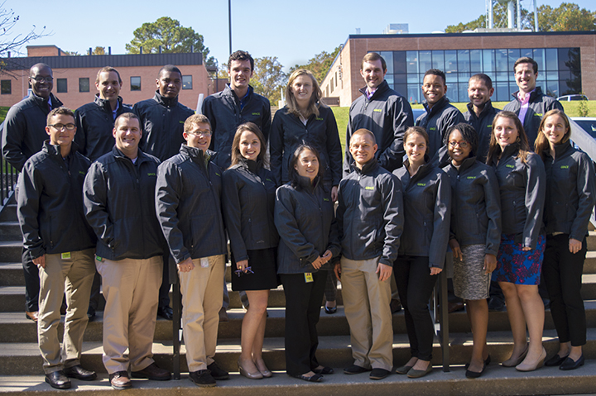
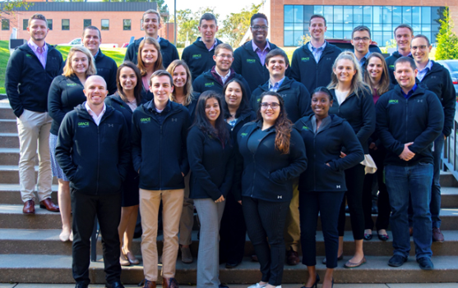
Manufacturing Leadership Program
Grace’s Manufacturing Leadership Program recruits engineers that have demonstrated technical excellence and strong leadership experience.
GPA requirement is 3.0 to be considered
Flexibility on assignments / locations
Each MLP completes three, one (1) year assignments. Examples of assignment areas:
Manufacturing, Quality, Productivity, Strategic Sourcing, Environmental Health and Safety, Process Technology.
Locations: Maryland, Illinois, Indiana, Tennessee, Oregon, Texas, and Louisiana.
Currently there are 21 Active MLPs throughout Grace’s US sites.
Placement into key roles at the successful completion of the program.
MLP Conference – Fall 2016
MLP Conference – Fall 2018

Slide 12
Our University Partners
University
Partners
4
© 2016 W. R. Grace & Co.

Slide 13
What do we look for in a candidate?
Utilize your summer break to do something!
Internship in your field
Summer job (Mall, Camp Counselor, Local store)
Research
Volunteering
Missions trips
Leadership skills
Athletic leader
Student Organization Leader
Academic/Group Leader
Church leader
Teaching Assistant
Resident Assistant
Grace looks for well rounded candidates

Slide 14
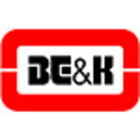
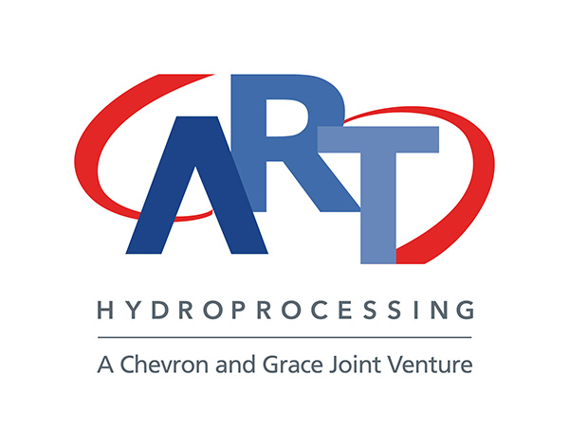
Candice Theodossiou – Business Quality Manager
University of Delaware ‘07: Chemical Engineering
School Involvement
Internships
Current Job
Chemical Engineering
Manufacturing Leadership Program (Rotations)
Production Engineer (NJ)
Production Engineer (MD)
Black Belt (MD)
Permanent Roles
Production Engineer
Quality Engineer (Corporate)
Quality Manager (Corporate)
Vice President
Treasurer
Notes:
UMBC Wlax: 4 years varsity women’s lacrosse, defense
UMBC SAAC: Involvement in the student athletic body (Public Relations Representative)
UMBC SGA: Involvement in the entire UMBC student body (Director of Athletic Relations)
Naval Research Lab: First internship @ Center for Corrosion Science and Engineering, basic research in corrosion, full-time 2 summers breaks and 1 winter break
Fiberight: Second internship, part-time fall and spring semester of senior year, start up, advanced recycling, construction of the first plant was being done while I was interning
Grace:

Slide 15
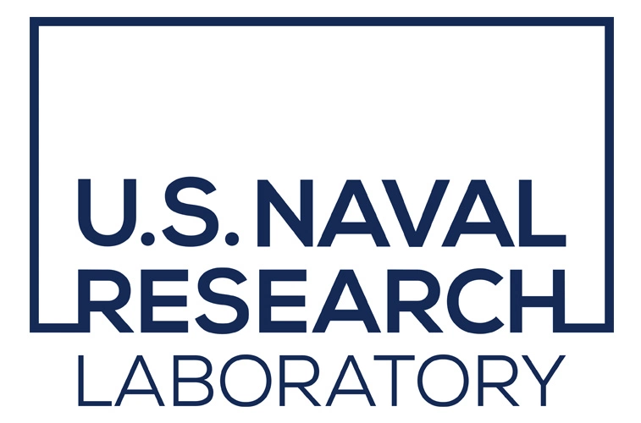
Rachel Katzenberger – 1st Year MLP @ Corporate HQ
UMBC ‘19: Chemical Engineering B.S. & Biological Sciences B.A.
School Involvement
Internships
Current Job
Manufacturing Leadership Program
1st Rotation: Materials Technologies, Productivity Engineer
Monthly Operating Reviews
TeamGuru Data Integrity
Capacity Model
PHLI
2nd & 3rd Rotation: TBD
Notes:
UMBC Wlax: 4 years varsity women’s lacrosse, defense
UMBC SAAC: Involvement in the student athletic body (Public Relations Representative)
UMBC SGA: Involvement in the entire UMBC student body (Director of Athletic Relations)
Naval Research Lab: First internship @ Center for Corrosion Science and Engineering, basic research in corrosion, full-time 2 summers breaks and 1 winter break
Fiberight: Second internship, part-time fall and spring semester of senior year, start up, advanced recycling, construction of the first plant was being done while I was interning
Grace:

Slide 16
Thank you.
www.grace.com
Careers @ Grace
https://jobs.grace.com/

Slide 17
Disclaimer
Statement Regarding Safe Harbor For Forward-Looking Statements
This presentation contains forward-looking statements, that is, information related to future, not past, events. Such statements generally include the words “believes,” “plans,” “intends,” “targets,” “will,” “expects,” “suggests,” “anticipates,” “outlook,” “continues,” or similar expressions. Forward-looking statements include, without limitation, expected financial positions; results of operations; cash flows; financing plans; business strategy; operating plans; capital and other expenditures; competitive positions; growth opportunities for existing products; benefits from new technology and cost reduction initiatives, plans and objectives; and markets for securities. For these statements, Grace claims the protections of the safe harbor for forward-looking statements contained in Section 27A of the Securities Act and Section 21E of the Exchange Act. Like other businesses, Grace is subject to risks and uncertainties that could cause its actual results to differ materially from its projections or that could cause other forward-looking statements to prove incorrect. Factors that could cause actual results to differ materially from those contained in the forward-looking statements include, without limitation: risks related to foreign operations, especially in emerging regions; the cost and availability of raw materials and energy; the effectiveness of its research and development and growth investments; acquisitions and divestitures of assets and gains and losses from dispositions; developments affecting Grace’s outstanding indebtedness; developments affecting Grace's funded and unfunded pension obligations; its legal and environmental proceedings; uncertainties related to Grace’s ability to realize the anticipated benefits of the separation transaction; the inability to establish or maintain certain business relationships and relationships with customers and suppliers or the inability to retain key personnel; costs of compliance with environmental regulation; and those additional factors set forth in Grace's most recent Annual Report on Form 10-K, quarterly report on Form 10-Q and current reports on Form 8-K, which have been filed with the Securities and Exchange Commission and are readily available on the Internet at www.sec.gov. Reported results should not be considered as an indication of future performance. Readers are cautioned not to place undue reliance on Grace's projections and forward-looking statements, which speak only as the date thereof. Grace undertakes no obligation to publicly release any revision to the projections and forward-looking statements contained in this announcement, or to update them to reflect events or circumstances occurring after the date of this presentation.
Non-GAAP Financial Terms
In this presentation, Grace presents financial information in accordance with U.S. generally accepted accounting principles (U.S. GAAP), as well as the non-GAAP financial information described in the Appendix. Grace believes that this non-GAAP financial information provides useful supplemental information about the performance of its businesses, improves period-to-period comparability and provides clarity on the information management uses to evaluate the performance of its businesses. In the Appendix, Grace has provided reconciliations of these non-GAAP financial measures to the most directly comparable financial measure calculated and presented in accordance with U.S. GAAP. These non-GAAP financial measures should not be considered as a substitute for financial measures calculated in accordance with U.S. GAAP, and the financial results calculated in accordance with U.S. GAAP and reconciliations from those results should be evaluated carefully.
Trademarks
GRACE®, ACHIEVE®, MIDAS® GOLD, MAGNAPORE®, CONSISTA®, SmART Catalyst System® (Stylized), SYLOID®, SYLOBLOC®, LUDOX®, SYLOBEAD®, CBA®, ADVA®, HEA2®, DCI®, are trademarks, registered in the United States and/or other countries, of W. R. Grace & Co.-Conn.
TALENT | TECHNOLOGY | TRUST™ is a trademark of W. R. Grace & Co.-Conn.
UNIPOL® is a trademark of The Dow Chemical Company or an affiliated company of Dow. W. R. Grace & Co.-Conn. and/or its affiliates are licensed to use the UNIPOL trademark in the area of polypropylene.
SIX SIGMA® is a trademark, registered in the United States and/or other countries, of Motorola, Inc.
This trademark list has been compiled using available published information as of the publication date of this presentation and may not accurately reflect current trademark ownership or status. © Copyright 2019 W. R. Grace & Co.-Conn. All rights reserved.

