Slide 1
Women Empowering Women
Ceil Paul, VP Clarity Innovations

Slide 2
Facing Doubt
Guidance counselors wanted me to get a degree in Home Economics or Teaching
Get my coffee, aren’t you the Secretary? My response: Get your own damn coffee
Not invited to key meetings as the only female
Believe in yourself – Don’t be your own enemy

Slide 3
Declining Numbers
Women make up less than 25% of the STEM (science-technology-engineering-mathematics) workforce in the United States.
Data from the US National Science Foundation shows that between 2006-2014, the number of women graduating with a degree in computer science actually declined.
Some roots causes: lack of encouragement, active discouragement, lack of role models, negative peer pressure, and harassment.
https://www.weforum.org/agenda/2017/11/women-in-tech-engineering-ellen-stofan/

Slide 5
Into Engineering
Although Anan’s quote is about economic development, the same is true for engineering
Diversity leads to more innovation
STEM is growing fast, so there are more and good paying jobs
Research has shown that women want to make a difference in the world. For example, the American Association of University Women conducted a study which found that women place a higher value on careers that involve helping and working with other people.
Emphasize the collaborative and problem-solving nature of STEM
Provide role models and start skills early
Encourage other Women around you that Problem solving in STEM is rewarding
https://www.weforum.org/agenda/2017/11/women-in-tech-engineering-ellen-stofan/

Slide 6
Still Fighting

Slide 7
Know your worth
Ask for the raise or promotion - Have No Fear
Seek out women who can mentor you
Offer to help other women not hurt them
STOP APOLOGIZING - know you are valuable
Believe in yourself, and others will also
Take credit for what you have done

Slide 8
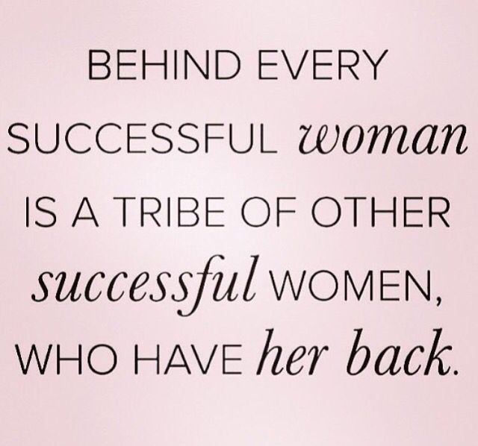

Slide 9
Progress and hope
There are companies who are committed to equality, not just in name but in practice.
Women in leadership roles
Women in all kinds of roles
Women solely responsible for actions that impact the company
Women’s opinion’s respected
Women who other Women to be successful

Slide 10
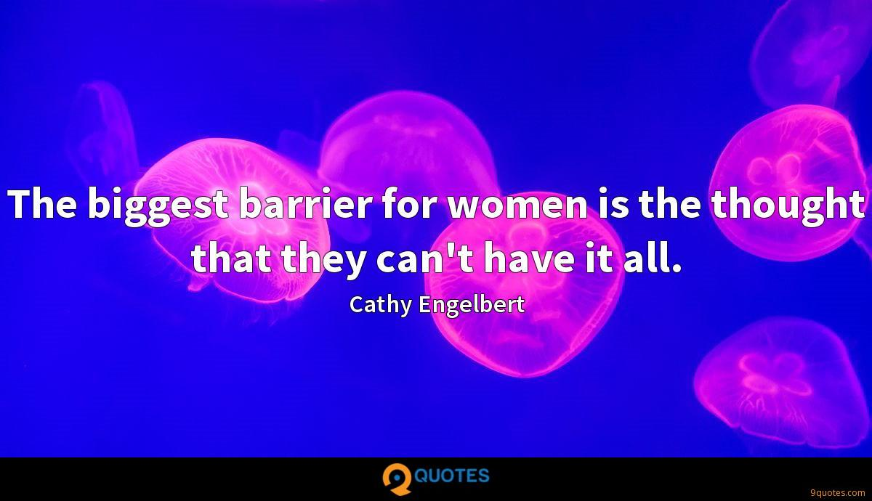

Slide 11
Clarity Innovations
Clarity is a Service-Disabled Veteran Owned Company founded by Two Servicemen and a Software Developer from NSA.
We primarily do Software Engineering, Dev Ops, Systems Engineering and Administration at NSA, JSOC, Airforce and Commercial Applications.
We hold true to our core values of Honesty, Integrity, and Transparency.
Our employees are the best in the business and we put them first.
We strive to make sure our engineers are doing work that is interesting to them, and will move them across different portfolios until they find work that will make them happy
Hold true to Caring about our people, and have a 97% retention rate
We are equal opportunity employers who employee all people with equitable pay.
We hire and train interns to grow with us
We develop teams to bring great solutions to real world problems.

