Slide 1
What is “Good” English?
Thursday, February 15, 2018 | 5:30 - 7 p.m.
Commons: 329

Slide 2


Who’s Here?
Becca Mann
The Mosaic: Center for Culture and Diversity
Foreign-Born and International Student Outreach Intern
Jon Inscoe
Research Assistant, PhD Student, UMBC
May F. Chung
Research Assistant, PhD Candidate, UMBC
Writing Coordinator, National Defense University

Slide 3
Language is the most representative symbol of history and culture, reflecting where people come from, how they have developed, and their establishment of past and current identity. Its symbolic significance resonates in the voices of ordinary speakers in everyday conversation. Voices reflect the diversity of its people, who came to this region from different places, under varied conditions, and established diverse communities and identities based on the natural resources of the land and waterways.

Slide 4
What is a Dialect?
Grammar
Pronunciation
Vocabulary
Dialect
“A neutral label to refer to any variety of a language that is shared by a group of people” (Wolfram & Schilling Estes 1998, p.2).

Slide 5
Dialect Origins
Puritans in early 1600s from East Anglia (Eastern United Kingdom and Northern Ireland) settled in Massachusetts
Absence of “r” in words such as far= “fah” and Carter = “Catah”
Dutch colony in New York (New Amsterdam): “t’s” become “d’s”
Jewish immigrants (Yiddish language) in 19th century
Ex: “these, those, that” becomes “deese, dose, dat”
Ex: “schmuck”, “kluz”, “What’s up?” and “get lost”
Notes:
Puritans = religious dissenters fleeing oppression from Charles I

Slide 6
Dialect Origins
Royalists in 1640s from the south/southwest England, settled in Virginia brought their south England drawl: “Ain’t” and “axed”
Black English: slaves from West African tribes and whites couldn’t communicate so form a mixture called Pidgin or Creole
Aspects from West African Senegal and Bantu languages- loss of “to be” in sentences
Ex: He workin’ versus He be workin’
(Western Washington University- Linguistics Department)
Notes:
Royalists- people who were supporters of the king when the civil war was overthrowing the monarchy

Slide 7
Dialect Origins
1700’s people from North Britain and Northern Ireland settled in Appalachian Mountains- "Scots-Irish" with Gaelic language
Double negatives: “not nobody”
Retention of preposition: “I'm a talking to you”.
5. 1675-1725 Quakers from North England and Wales to Delaware
Valley.
Pronunciation of a back rounded [Å]: same for “caught” and “cot”
Pronunciation of an “e” sound in “bad” and “sack”
(Western Washington University- Linguistics Department)

Slide 8
What about American English Dialects Today?

Slide 9
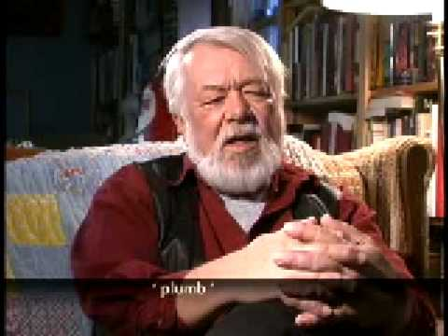
Dialects Today- Appalachian
Southern English
(Mountain Talk)
cot/caught
don/dawn
water/wooder
mary/merry/marry/murray
https://www.youtube.com/watch?v=eXghKHHzlXQ
Notes:
Until 1:00

Slide 10
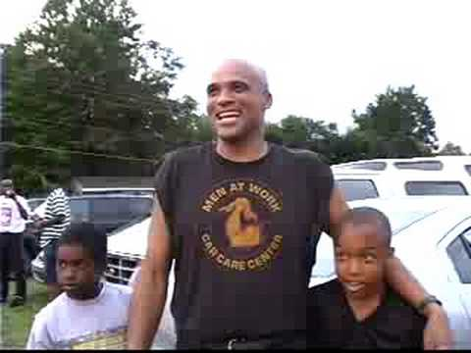
Dialects Today: African American English
Use of “be” for an action that occurs habitually (not once or in a permanent state)
Examples:
“Sometimes, my ears be itching”
“James always be coming to school”
https://www.youtube.com/watch?v=RTt07IVDeww
Notes:
Video 0:35 to 2:47
Specifically in the South

Slide 11
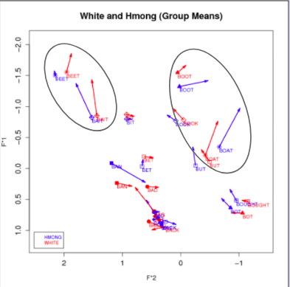
Dialects Today: Asian English
Asian Americans are an understudied ethnic minority in the United States
Problematizing Asian English and embracing Asian Englishes

Slide 12
There is a single, standard dialect of English which is “correct” and which everyone should strive to speak.
MYTH
All dialects and languages are valid.
People who make judgments based on your language may be making judgments about your culture, race, ethnic heritage, sex, social group, etc.
REALITY

Slide 13
“Standard” English
What it is:
A socially constructed dialect
Historically associated with upper class and the wealth/power/prestige
The national dialect that generally appears in print and for official purposes
Taught in schools and students are expected to use it in their essays.
What it is not:
Statistically the most frequently occurring form of English (the “most heard”)
Encountered across the whole social spectrum, though not necessarily in equivalent use by all members of all classes.
Imposed upon those who use it
Produced by conscious design, it evolved over time
(“What Is 'Standard English'?" RELC Journal)
Notes:
Not imposed (no corporal punishment for those who don’t use it, monitored by the government not the product of linguistic planning

Slide 14
Dialects are ill-formed derivatives of Standard English
MYTH
Dialects are highly patterned, intricate and systematic varieties of a language
REALITY

Slide 15
How do people experience different English dialects?
Notes:
Have audience discuss with people around them about their experiences with different dialects and how non-standard english dialects could be affected negatively.

Slide 16
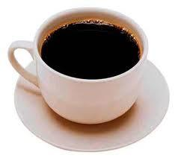
How do you pronounce this word?
Coffee

Slide 17
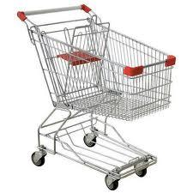
What is this object called?

Slide 18
What do you call it when it rains while the sun is shining?
sunshower (34.29%)
the devil is beating his wife (6.43%)
monkey's wedding (0.16%)
pineapple rain (0.03%)
liquid sun (0.74%)
other (3.02%)
I have no term or expression for this (55.15%)

Slide 19
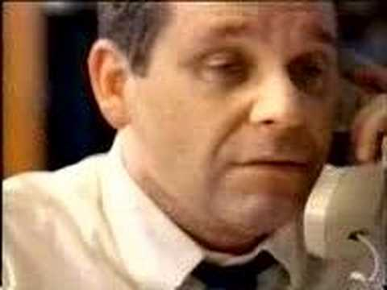
Superiority of “Standard” English
Discrimination based on language variation is “so commonly accepted, so widely perceived as appropriate, that it must be seen as the last back door to discrimination. And the door stands wide open”
https://www.youtube.com/watch?v=c_3mSW8XUZI

Slide 20
Why is this important?
“Because language is so closely tied to identity, if a student feels that his or her dialect is not valued by majority culture or is taught that it should not be used in certain settings he or she will likely “feel pressure and anxiety” to change this part of his or her identity and face difficulties in reconciling maintenance of cultural heritage and adoption of characteristics associated with mainstream success“
(Hudley and Mallinson, 2011)

Slide 21
Qualitative interviews with 26 participants at NC State on how language affects their performance in the classroom.
“I guess it was the first week of classes freshman year. I had an English professor and I said ‘yes sir’ to him and he called me- I don’t know if I can say the whole thing. I mean, he called me a ‘kiss-ass’ for saying ‘yes-sir’. I was like, ‘I’m sorry, that’s the way I was raised’ and he was like, ‘Well, that’s unfortunate.’ I didn’t know what to do. I mean it just took me off guard. I was like, ‘OK, soo...’ So I had to stay in there as a night class so I got out of there at like 9:30, and I called home. I was like, ‘I don’t know what just happened, but…”
(Dunstan, 2013)

Slide 22
Why does language matter in the classroom?
The language students bring with them to class influences performance
Instructor expectations of students (Charity Hudley & Mallinson 2010)
Stereotype threat (Steele 2007; Clark, Eno & Guadagno 2010)
Delpit (1995) Codes of Power
Culture of power, rules for participation: “linguistic forms, communicative strategies, and presentation of self; that is, ways of talking, ways of writing, ways of dressing, ways of interacting” (p. 25)

Slide 23
7 Privileges of Standardized English Speakers
The newspapers, magazines, books, and other media they encounter at school will be in the type of English they are already familiar with
They will not be mocked or teased for how they pronounce words
They will not be thought of as being less intelligent because of how they talk
Standardized test instructions and materials will be written in the English they are already familiar with
Most of their educators will communicate with them in the type of English the students are already familiar with
The way they talk will not be the subject of jokes or belittling in mainstream TV shows or movies
Their pronunciation, intonation, and sentence structure will not interfere with their ability to be assessed accurately, to interact with authority figures, or later in life, to obtain housing and be hired for a job.

Slide 24
Ebonics
1973: term “ebonics” by psychologist Dr. Robert Williams, new term for “Black English”
1996: Oakland School Board Resolution
Goal: increase literacy win black populations
Issues: Black students equated with ESOL students
Impact: Funding for schools, difference between “language” and “dialect”
Notes:
Ask audience about their opinion/viewpoint on the Oakland School Board Resolution

Slide 25
Ebonics Controversy
Largely based on misconceptions about linguistic jargon; for instance, “genetic”
“[Scholarly] studies have also demonstrated that African language systems are genetically-based and not a dialect of English.”
“‘Black students are genetically predisposed to speaking an inferior style of English.’ What would happen if a white conservative said that?” (Rush Limbaugh, On Ebonics, The Rush Limbaugh Show, Dec 22, 1996)
Media, politicians, and others helped instigate a moral panic around Ebonics that still persists

Slide 26
Ebonics Controversy (con’t)
The Oakland resolution was more conservative than is given credit. One motivator for the resolution and one caveat are often forgotten:
Funding: administrators knew there was funding available to teach children with a non-English home language
Standard English would still be encouraged; Oakland would incorporate Ebonics to better teach Standard English

Slide 27
How to empower ESOL students and dialect variation
Embrace the Native Language
Redefine Student Error
Teacher education programs to include linguistic knowledge and practical application
Emphasize your role as commenter (a face for the faceless audience, use of “we” & “us”)
Focus on appropriateness of language
“Errors” are systematic, so don’t even call them “errors” (e.g., miscues)
Academic writing is no one’s mother tongue, this isn’t natural for anyone
Notes:
Take audience suggestions about how they can support dialects and ESOL students

Slide 28
Reflection
Introduce Yourselves: Name, Pronouns, Year, Major Include your background, if comfortable doing so
Answer the question: Where did you grow up and how did this affect the way you speak today? What stood out to you during this event?

Slide 29
Questions?
Thank You!

